Slide 1
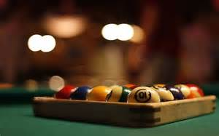
Pool

Slide 2

Paper

