Slide 1
CS1501 Recitation #6: 2/10/17
These slides are available online:
https://github.com/kc13/CS1501
Agenda for today:
Grader info:
Ameya Daphalapurkar, abd51@pitt.edu
Review of LZW compression

Slide 2
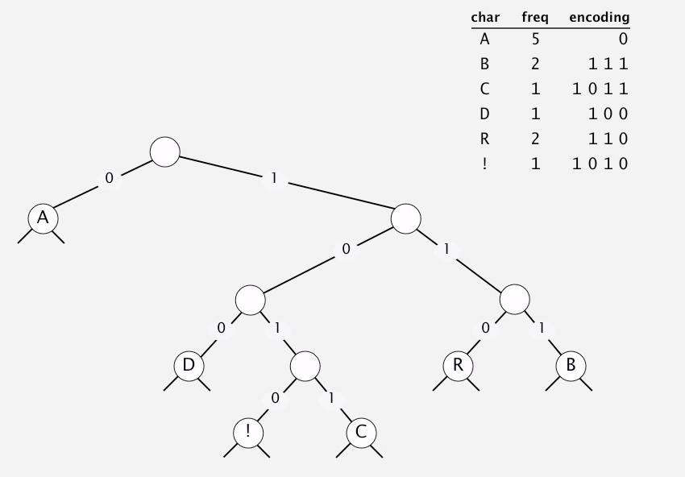
Huffman vs. LZW (Lempel-Ziv-Welch) method
Huffman
Uses variable length codewords to encode fixed length inputs (1 codeword per character).
The symbol table (i.e., the trie), must be available for expanding the compressed file.
Image credit: http://algs4.cs.princeton.edu/lectures/55DemoHuffman.mov

Slide 3
Huffman vs. LZW (Lempel-Ziv-Welch) method
LZW
Huffman
Uses fixed length codewords to encode variable length inputs.
Uses variable length codewords to encode fixed length inputs (1 codeword per character).
The symbol table can be reconstructed during expansion.
The symbol table (i.e., the trie), must be available for expanding the compressed file.

Slide 4
LZW compression
The general approach:
Example:
cascara
Initialize the codebook with the set of characters
e.g., codeword size of 12 bits
0-255 for the set of ASCII characters
Scan the string from left to right:
While !EOF:
Find longest substring (denoted ‘s’) that matches an existing codebook entry.
Print the corresponding codeword
Scan one character ahead to get the ‘lookahead character’, c
Form a new codebook key, ‘s + c’, that will map on to the first available codeword value

Slide 5
LZW compression
Codebook (limited view of initialized ASCII portion, to save space)
cascara
String pattern | codeword (in decimal)
c | 99
a | 97
r | 114
s | 115
99
97
115
256
114
97
ca
256
as
257
sc
258
car
259
ra
260

Slide 6
LZW expansion
The general approach:
Example:
99 97 115 256
114 97
Initialize the codebook with the set of characters
Same as compression, except codewords become the symbol table keys
Scan the string from left to right:
Get the first ASCII character (99 = ‘c’), assign to variable ‘x’, print to file
While !EOF:
Read in the next available codeword, find the string associated with it, assign to variable ‘y’
The lookahead character, ‘c’, is the first character in the string associated with y
Add ‘x+c’ to first available position in codebook
Update ‘x’: x = y

Slide 7
LZW expansion
Codebook (limited view of initialized ASCII portion, to save space)
Example:
999711525611497
codeword | String pattern
99 | c
97 | a
114 | r
115 | s
256 | ca
c
x = ‘c’
y = ‘a’
c = ‘a’
x + c = ‘ca’

Slide 8
LZW expansion
Codebook (limited view of initialized ASCII portion, to save space)
Example:
999711525611497
codeword | String pattern
99 | c
97 | a
114 | r
115 | s
256 | ca
257 | as
ca
x = ‘a’
y = ‘s’
c = ‘s’
x + c = ‘as’

Slide 9
LZW expansion
Codebook (limited view of initialized ASCII portion, to save space)
Example:
999711525611497
codeword | String pattern
99 | c
97 | a
114 | r
115 | s
256 | ca
257 | as
258 | sc
cas
x = ‘s’
y = ‘ca’
c = ‘c’
x + c = ‘sc’

Slide 10
LZW expansion
Codebook (limited view of initialized ASCII portion, to save space)
Example:
999711525611497
codeword | String pattern
99 | c
97 | a
114 | r
115 | s
256 | ca
257 | as
258 | sc
259 | car
casca
x = ‘ca’
y = ‘r’
c = ‘r’
x + c = ‘car’

Slide 11
LZW expansion
Codebook (limited view of initialized ASCII portion, to save space)
Example:
999711525611497
codeword | String pattern
99 | c
97 | a
114 | r
115 | s
256 | ca
257 | as
258 | sc
259 | car
260 | ra
cascar
x = ‘r’
y = ‘a’
c = ‘a’
x + c = ‘ra’

Slide 12
LZW expansion
Codebook (limited view of initialized ASCII portion, to save space)
Example:
999711525611497
codeword | String pattern
99 | c
97 | a
114 | r
115 | s
256 | ca
257 | as
258 | sc
259 | car
260 | ra
cascara
x = ‘a’

Slide 13
LZW expansion
The general approach modified:
Special case:
‘zzz’
= 122 256
Initialize the codebook with the set of characters
Same as compression, except codewords become the symbol table keys
Scan the string from left to right:
Get the first ASCII character (99 = ‘c’), assign to variable ‘x’, print to file
Not available in codebook when we need to read it
While !EOF:
Read in the next available codeword, find the string associated with it, assign to variable ‘y’
If the next codeword maps to an empty entry in codebook, then y = ‘x’ + x.charAt(0), otherwise:
The lookahead character, ‘c’, is the first character in y
Add ‘x+c’ to first available position in codebook
Update ‘x’: x = y

Slide 14
Example exercise:
Text to compress = abababbabaabbabbaabba
Assume the letters in the text are limited to {a, b}
In practice, the alphabet may be the 256 character ASCII set.
The characters in the alphabet are assigned code numbers beginning at 0
The initial code book is:
code
0
1
key
a
b
Exercise credit: Slides from Amin Shobani

