Slide 1
CS1501 Recitation 3/3/17
These slides are available online:
https://github.com/kc13/CS1501
Agenda for today:
→ Review of Priority Queues
Slide credits: Some images and content for these slides were adapted from the following:
http://algs4.cs.princeton.edu/lectures/24PriorityQueues.pdf
https://www.youtube.com/watch?v=C8dsmIflDyI
http://people.cs.pitt.edu/~nlf4/cs1501/slides/pqs.pdf

Slide 2
Priority Queues: Why are they useful?
PQ’s are useful whenever an algorithm needs to:
(1) Maintain a collection of items and their values (here, called “keys”)
Character frequencies
Edge weights
(2) Retrieve (and possibly remove) the item the current collection that has the smallest key.
Assuming a min PQ
(3) Insert new items
Both insertions and removals may require adjustment of the PQ.

Slide 3
Priority Queues: What data structure do we use?
Binary Heaps:
Adopt the form of a binary tree
Nodes hold keys

Slide 4
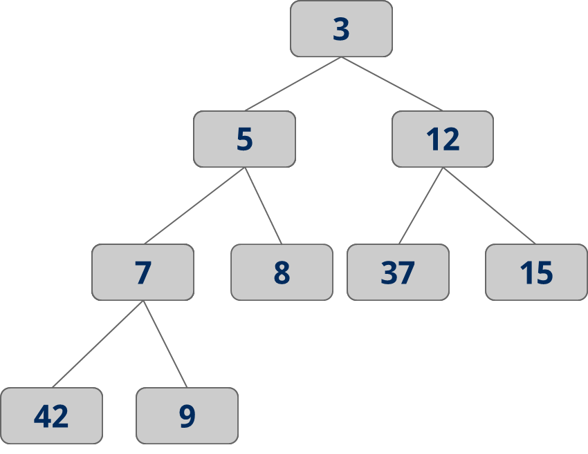
Binary Heaps: How are they different from BSTs?
Ordering properties:
Min value is at root
For each parent (i.e., non-leaf) node:
-- key(node.children) >
key(node)
No claims made about relationship of left and right child!

Slide 5
Binary Heaps: How do we insert new entries?
Must maintain heap ordering:
Add new node to first available leaf
While key(new-node) < key(new-node.parent):
→ Exchange child and parent nodes
Textbook code calls this process “swim”

Slide 6
Binary Heaps: Insertion example
Assume we start with this heap…
10
12
15

Slide 7
Binary Heaps: Insertion example
Assume we start with this heap…
10
Add a ‘3’
12
15
3

Slide 8
Binary Heaps: Insertion example
Assume we start with this heap…
10
Add a ‘3’
12
15
3 < 12:
exchange
3

Slide 9
Binary Heaps: Insertion example
Assume we start with this heap…
10
Add a ‘3’
3
15
3 < 12:
exchange
12

Slide 10
Binary Heaps: Insertion example
Assume we start with this heap…
10
Add a ‘3’
3
15
3 < 10:
exchange
12

Slide 11
Binary Heaps: Insertion example
Assume we start with this heap…
3
Add a ‘3’
10
15
3 < 10:
exchange
12

Slide 12
Binary Heaps: How do we remove the root (min key)?
Must maintain heap ordering:
Replace root with last leaf
While key(node) > key(node.children):
→ Exchange node with child with min key
Textbook code calls this process “sink”

Slide 13
Binary Heaps: Removal example
We want to remove the root:
3
10
15
12

Slide 14
Binary Heaps: Removal example
We want to remove the root:
3
Overwrite with 12
10
15
12

Slide 15
Binary Heaps: Removal example
We want to remove the root:
12
Overwrite with 12
10
15

Slide 16
Binary Heaps: Removal example
We want to remove the root:
12
Overwrite with 12
10
15
12 > 10 and 15:
Exchange with 10

Slide 17
Binary Heaps: Removal example
We want to remove the root:
10
Overwrite with 12
12
15
12 > 10 and 15:
Exchange with 10

Slide 18
Binary Heaps: How do we avoid overhead of linked lists?
→ Use an array representation.
7
5
3
3
42
5
7
5
37
15
12
3
5
42
9
7
8
15
37
12
15
9
42
9
3

Slide 19
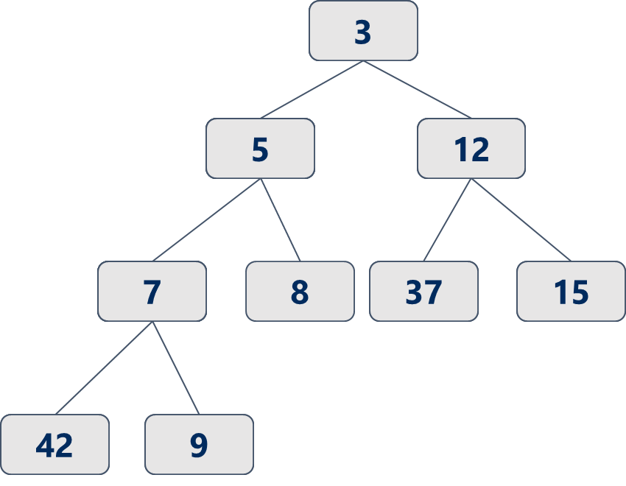
Binary Heaps: How can we represent them as arrays?
Note differences between textbook and lecture slides:
Lecture slides start indexing at 0, textbook starts at 1.
These slides will use the textbook’s approach.
A
0
1
2
3
4
5
6
7
8
9

Slide 20
Binary Heaps: How can we represent them as arrays?
Textbook approach: Put root value into A[1]
Continue filling in entries (go L→ R in row before descending to the next level)
A
3
5
12
7
8
37
15
42
9
0
1
2
3
4
5
6
7
8
9

Slide 21
Array representation: Formulas to find parents/children
Textbook formulas:
Lecture approach will differ!
Parent of key in A[k] →
k/2
(integer divison)
Example:
A[7] = 15
Parent is A[3] = 12
A
3
5
12
7
8
37
15
42
9
0
1
2
3
4
5
6
7
8
9

Slide 22
Array representation: Formulas to find parents/children
Textbook formulas:
Children of key in A[k] →
2k and 2k+1
Example: A[4] = 7
Left = A[8] = 42
Right = A[9] = 9
A
3
5
12
7
8
37
15
42
9
0
1
2
3
4
5
6
7
8
9

Slide 23
IndexMinPQ.java: Some good things to know
There are three important data structures: “pq”, “qp”, “Keys”
The pq data structure is not analogous to A (below).
A
3
5
12
7
8
37
15
42
9
0
1
2
3
4
5
6
7
8
9

Slide 24
IndexMinPQ.java: Some good things to know
There are three important data structures: “pq”, “qp”, “Keys”
Keys[]: A key’s position in this array is determined by an ID that was assigned by the user when the Key was added.
PQ: pq[j] says what is at position j in the heap, but does not store the key itself: It stores its ID. Must go to Keys[ID] to get actual key
QP: qp[ID] tells you the current heap position of the key with that ID

Slide 25
Exercise: Build a new min PQ by inserting the following elements:
17, 3, 9, 19, 16, 20, 14,1
Then, remove the min key (root) and adjust the heap.

