Slide 1
CS1501 Recitation 4/14/17
These slides are available online:
https://github.com/kc13/CS1501
Agenda for today:
→ Review of reduction to prove NP completeness

Slide 2
P vs. NP (from lecture slide 9)
P = The set of problems that can be solved by deterministic
algorithms in polynomial time
http://people.cs.pitt.edu/~nlf4/cs1501/slides/p_np.pdf

Slide 3
P vs. NP (from lecture slide 9)
P = The set of problems that can be solved by deterministic
algorithms in polynomial time
Known examples:
Very many of the problems addressed in this class (sorting, shortest path, substring search…)
→ Algorithms exist for which the largest term in the runtime complexity is raised to only a constant power (no exponential or factorial terms)
http://people.cs.pitt.edu/~nlf4/cs1501/slides/p_np.pdf

Slide 4
P vs. NP (from lecture slide 9)
NP = The set of problems that can be solved by non-deterministic algorithms in polynomial time
i.e., the solution from a non-deterministic algorithm can be verified in polynomial time
Known examples:
Very many of the problems addressed in this class (sorting, shortest path, substring search…) AND
- Many problems for which no known polynomial time solution exists (Traveling Salesman, Longest Path, Vertex Cover…)
http://people.cs.pitt.edu/~nlf4/cs1501/slides/p_np.pdf

Slide 5
The two possible realities: P ⊂ NP or P = NP
NP
NP, P
P
Millennium Prize: http://www.claymath.org/millennium-problems/p-vs-np-problem
http://people.cs.pitt.edu/~nlf4/cs1501/slides/p_np.pdf

Slide 6
NP Completeness
Recall the previous examples of problems with no known polynomial-time solution (TSP, longest path, vertex cover…).
Several of these problems have been formally related to each other, to form the category of NP Complete problems.
Implication: If a polynomial time solution is found for one NP-Complete problem, then a polynomial time solution exists for all other NP-Complete problems.

Slide 7
Reduction
Reduction is the process through which we demonstrate that a new problem should be included in the NP-Complete set.
Textbook definition:
“We say that a problem A reduces to another problem B if we can use an algorithm that solves B to develop an algorithm that solves A.”
A = a known NP complete problem
B = the new problem

Slide 8
Reduction
Reduction is the process through which we demonstrate that a new problem should be included in the NP-Complete set.
Textbook definition:
“We say that a problem A reduces to another problem B if we can use an algorithm that solves B to develop an algorithm that solves A.”
A = a known NP complete problem
B = the new problem

Slide 9

Reduction example: Clique problem
“A clique in an undirected graph G (V,E) is a subset V’ ⊆ V of vertices, each pair of which is connected by an edge in E. In other words, a clique is a complete subgraph of G.” ¹
¹ Cormen, T. H. (2009) Introduction to algorithms. MIT press.
Image credit: http://mathworld.wolfram.com/Clique.html

Slide 10
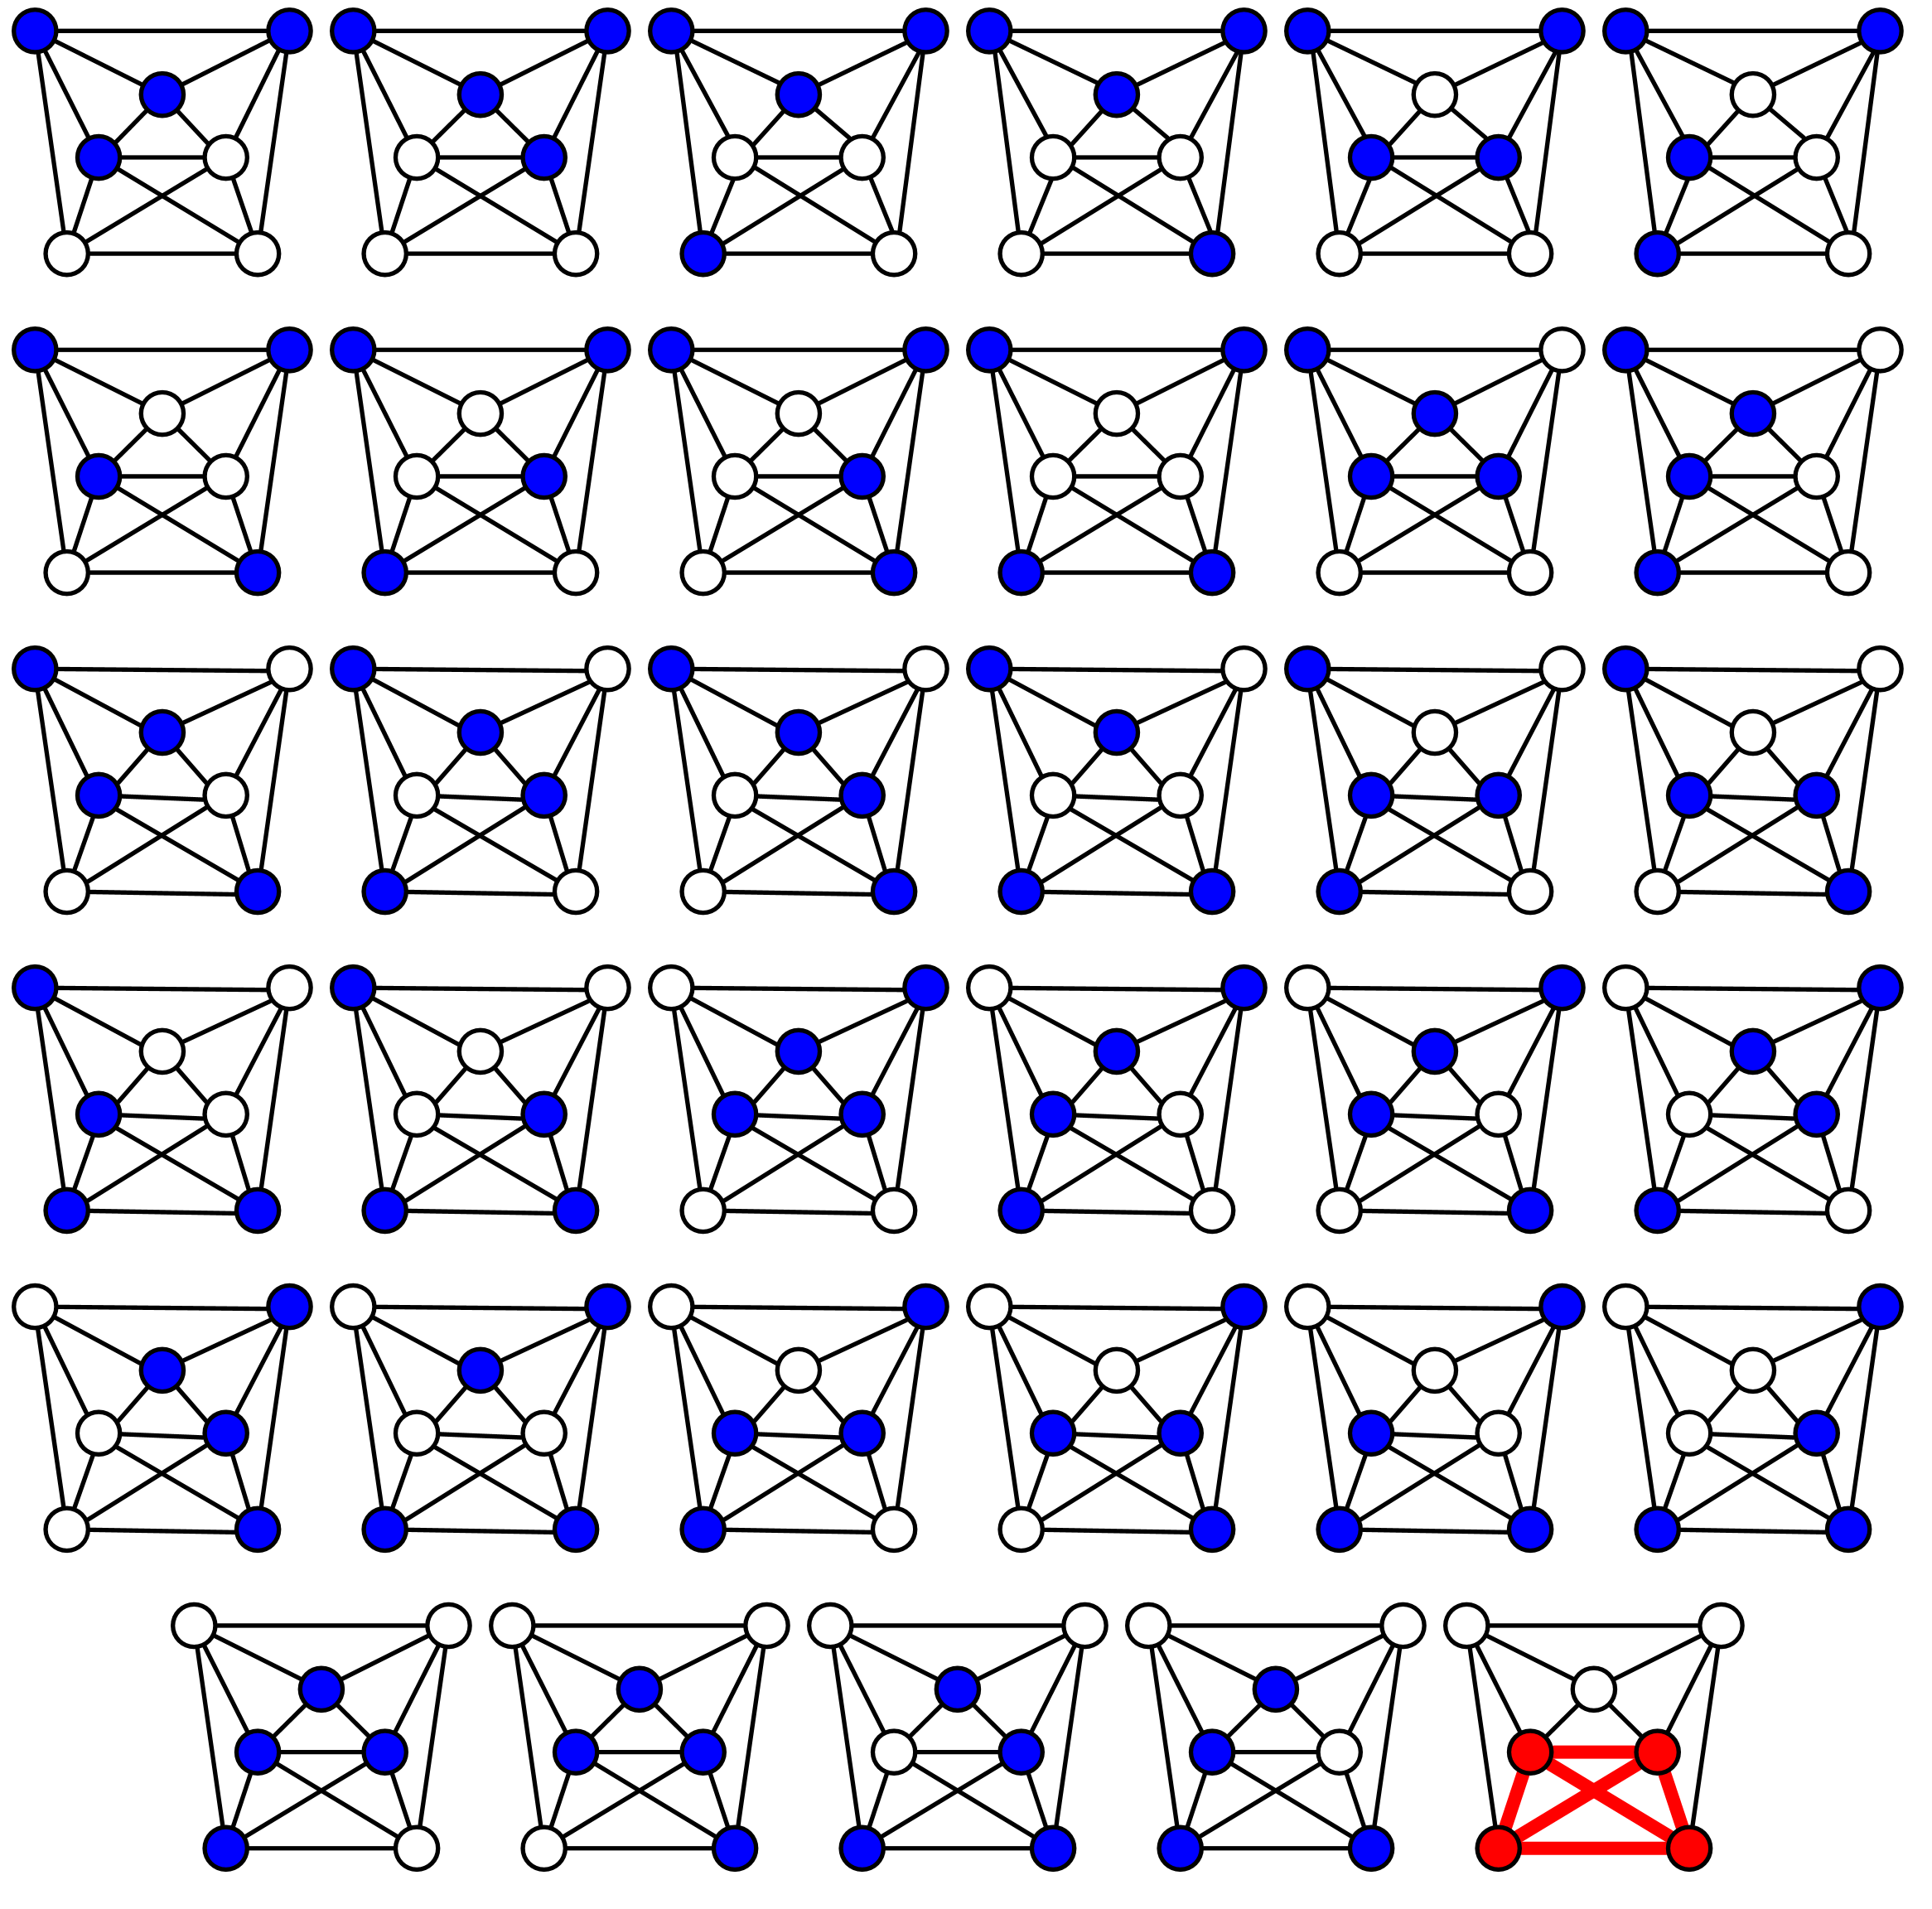
Reduction example: Clique problem
Clique problem: Does the graph G contain a clique of size k? (k = 4 in example)
No known polynomial time solution – Can we prove this to be NP-Complete?
We first need to identify an NP-Complete problem to reduce to the Clique problem.
Image credit: By Thore Husfeldt at English Wikipedia, CC BY-SA 3.0, https://commons.wikimedia.org/w/index.php?curid=31823619

Slide 11
NP-Complete problem: Boolean satisfiability (SAT)
Key elements of a SAT problem:
Satisfiability: Given an expression, does there exist a set of x_{i} assignments such that the expression evaluates to true (1)?
Boolean variables:
x₁, x₂, ….x_{n}
values = 0 or 1
Boolean connectives:
Logical terms to apply to 1-2 Boolean variables
e.g., AND (Ʌ), OR (V), NOT(¬)
Parentheses
e.g., x₁ Ʌ (x₂ V x₃)
Reference: Cormen, T. H. (2009) Introduction to algorithms. MIT press.

Slide 12
Subset of SAT: Problems in 3-CNF-SAT form
Example of 3-CNF (3-Conjunctive Normal Form):
Clauses must contain 3 “literals” (instance of a variable or its negation)
OR appears within clauses; AND between clauses
Reference: Cormen, T. H. (2009) Introduction to algorithms. MIT press.

Slide 13
How would we use a solver for the clique problem to solve a 3-CNF-SAT problem?
Example:
First, we need to convert the 3-CNF-SAT problem to a graph G.
Reference: Cormen, T. H. (2009) Introduction to algorithms. MIT press.

Slide 14
Step #1: Add a vertex for every literal (here, V = 9).
Label the vertices with both the literal itself and some indication of the # of the clause from which it originated
Step #2: For each possible pair of vertices v_{i} and v_{j}, add an edge between v_{i} and v_{j} if both of the following rules hold:
v_{i} and v_{j} originated from different clauses
v_{i} is not the negation of v_{j} (and vice versa)
Reference: Cormen, T. H. (2009) Introduction to algorithms. MIT press.

Slide 15
Exercise: Create the graph for this 3-CNF-SAT problem.
Step #1: Add a vertex for every literal (here, V = 9).
Label the vertices with both the literal itself and some indication of the # of the clause from which it originated
Step #2: For each possible pair of vertices v_{i} and v_{j}, add an edge between v_{i} and v_{j} if both of the following rules hold:
v_{i} and v_{j} originated from different clauses
v_{i} is not the negation of v_{j} (and vice versa)
Reference: Cormen, T. H. (2009) Introduction to algorithms. MIT press.

Slide 16
Solution:
Reference: Cormen, T. H. (2009) Introduction to algorithms. MIT press.

Slide 17
Cast as a clique problem: Does the graph contain a clique of size k, where k = # of clauses in the expression?
To demonstrate: The SAT problem is satisfiable if and only if there exists a clique of size k in the corresponding graph.
Satisfying assignment:
x₁ = ?, x₂= 0, x₃ = 1
Reference: Cormen, T. H. (2009) Introduction to algorithms. MIT press.

Slide 18
If there is a satisfying assignment, then a clique of size k exists.
Then each clause must include at least one literal that evaluates to “true” (1) for this input assignment.
This set of literals corresponds to vertices that form a clique.
-- each vertex is already connected with everything except the negated version of itself, and x and ¬x cannot be true at the same time
Satisfying assignment:
x₁ = ?, x₂= 0, x₃ = 1
Reference: Cormen, T. H. (2009) Introduction to algorithms. MIT press.

Slide 19
If a clique of size k exists, then the problem is satisifable.
The k vertices must be in different clauses, due to our graph rules.
Since there are no edges between x and ¬x, there is no contradiction in assuming that these three literals evaluate to true.
These k literals are sufficient to make the full expression satisfiable.
Reference: Cormen, T. H. (2009) Introduction to algorithms. MIT press.

