Slide 1
CS1501 Recitation #7: 11/1/19
These slides are available online:
https://github.com/kc13/CS1501
Agenda for today:
Review of lazy and eager Prim’s algorithm
Exercise
Code
References: https://www.coursera.org/lecture/algorithms-part2/prims-algorithm-HoHKu
http://people.cs.pitt.edu/~nlf4/cs1501/slides/weighted_graphs.pdf
http://mathworld.wolfram.com/SpanningTree.html
https://algs4.cs.princeton.edu/lectures/43DemoPrim.pdf

Slide 2
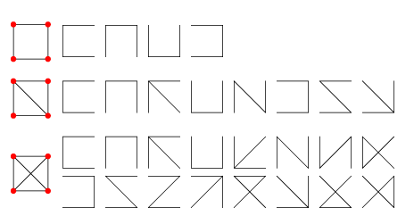
Why do we use Prim’s algorithm?
--> To compute the minimum spanning tree (MST) of a graph
--> What is a spanning tree?
For graphs with v verticies (v = 4 in the example):
Find v-1 edges such that:
All v vertices are connected
(connected = there exists a path between any arbitrary v_{i} ,v_{j})
The v-1 edges define an acyclic graph (acyclic = graph w no cycles; i.e., there is no simple path such that the first and last vertex are the same; simple path = no vertices repeated along the path)
For each graph in the first column, the valid spanning trees are shown to the right. If the graph edges are weighted, then we can ask which spanning tree carries the minimum cost.
Image and definition credit: Wolfram Mathword and lecture slides

Slide 3
What about BFS/DFS?
--> Both bread-first and depth-first search will return spanning trees -- the traversed path is acyclic and touches each vertex once
--> However, BFS/DFS don’t consider edge weights, and can’t guarantee minimal cost.
Image credit: Images from lecture slides

Slide 4
Prim’s: general concept
Start with an arbitrary vertex v₀
v₀ will form the start of the tree T
While there remain vertices not included in T:
Find the edge of lowest weight that connects T to a vertex that hasn’t yet been touched.
There are lazy and eager implementations of Prim’s that handle this process less or more efficiently.
Image credit: Images from lecture slides

Slide 5
Lazy Prim implementation: general concept
Start with an arbitrary vertex v₀
v₀ will form the start of the tree T
While there remain vertices not included in T:
Find the edge of lowest weight that connects T to a vertex that hasn’t yet been touched.
For each newly added v_{i}, add any edges between it and any other vertex v_{j} to a min PQ, if v_{j} is not yet in T
Then pop the min edge from the PQ:
While this min edge points to a v_{j} already in T:
Pop another edge
Once an edge to a v_{j} not in T is found, add it to T
Image credit: Images from lecture slides

Slide 6
Lazy Prim demonstration:
14
0
4
12
8
19
2
2
2
20
3
1
5
12
Note that the vertex labels are arbitrary (3 was accidentally skipped here, but this makes no difference for the MST – they would need to be adjusted to 0-4 in order to submit this to the textbook code)

Slide 7
Lazy Prim demonstration: starting at 0
14
0
4
12
8
19
2
2
2
20
3
1
5
12

Slide 8
Lazy Prim demonstration: starting at 0
Min PQ
0-2 | 12
0-4 | 14
0-1 | 19
14
0
4
12
8
19
2
2
2
20
3
1
5
12

Slide 9
Lazy Prim demonstration: remove min / add edge
Min PQ
0-4 | 14
0-1 | 19
14
0
4
12
8
19
2
2
2
20
3
1
5
12

Slide 10
Lazy Prim demonstration: add edges to PQ
14
Min PQ
2-5 | 3
2-4 | 8
0-4 | 14
0-1 | 19
2-1 | 20
0
4
12
8
19
2
2
2
20
3
1
5
12

Slide 11
Lazy Prim demonstration: remove min / add edge
14
Min PQ
2-4 | 8
0-4 | 14
0-1 | 19
2-1 | 20
0
4
12
8
19
2
2
2
20
3
1
5
12

Slide 12
Lazy Prim demonstration: add edges to PQ
14
Min PQ
5-4 | 2
2-4 | 8
5-1 | 12
0-4 | 14
0-1 | 19
2-1 | 20
0
4
12
8
19
2
2
2
20
3
1
5
12

Slide 13
Lazy Prim demonstration: remove min / add edge
14
Min PQ
2-4 | 8
5-1 | 12
0-4 | 14
0-1 | 19
2-1 | 20
0
4
12
8
19
2
2
2
20
3
1
5
12

Slide 14
Lazy Prim demonstration: no new edges to add (other edges of 4 touch vertices already in T)
14
Min PQ
2-4 | 8
5-1 | 12
0-4 | 14
0-1 | 19
2-1 | 20
0
4
12
8
19
2
2
2
20
3
1
5
12

Slide 15
Lazy Prim demonstration: remove min: vertices 2 and 4 already in T
14
Min PQ
5-1 | 12
0-4 | 14
0-1 | 19
2-1 | 20
0
4
12
8
19
2
2
2
20
3
1
5
12
Note: Eager Prim’s will help prevent this wasted work!

Slide 16
Lazy Prim demonstration: remove min / add edge
14
Min PQ
0-4 | 14
0-1 | 19
2-1 | 20
0
4
12
8
19
2
2
2
20
3
1
5
12

Slide 17
Lazy Prim demonstration: All vertices in T – MST is complete
14
Min PQ
0-4 | 14
0-1 | 19
2-1 | 20
0
4
12
8
19
2
2
2
20
3
1
5
12

Slide 18
Lazy Prim runtime/space requirements:

Slide 19
Eager Prim implementation: general concept
Start with an arbitrary vertex v₀
v₀ will form the start of the tree T
While there remain vertices not included in T:
Find the edge of lowest weight that connects T to a vertex that hasn’t yet been touched.
For each newly added v_{i} :
Consider each edge to a vertex not yet in T
For each such edge
Look up the other vertex v_{j} in an indexable PQ
If v_{j} is not in the PQ: add the edge
If v_{j} is in the PQ: replace existing edge if weight new edge < weight edge in PQ
Heap will be adjusted as needed
Pop the min edge to identify the next edge to add to T
Then pop the min from the PQ to find out the next v_{j} to add to T (and the edge used to connect to it)
Image credit: Images from lecture slides

Slide 20
Eager Prim demonstration:
14
0
4
12
8
19
2
2
2
20
3
1
5
12

Slide 21
Eager Prim demonstration: starting at 0
14
0
4
12
8
19
2
2
2
20
3
1
5
12

Slide 22
Eager Prim demonstration: update min cost edge for each new vertex not in T (so we can skip 0)
14
0
4
Indexable PQ
Key | Best edge | Weight
2 | 0-2 | 12
4 | 0-4 | 14
1 | 0-1 | 19
12
8
19
2
2
2
20
3
1
5
12

Slide 23
Eager Prim demonstration: remove min / add edge
14
0
4
Indexable PQ
Key | Best edge | Weight
4 | 0-4 | 14
1 | 0-1 | 19
12
8
19
2
2
2
20
3
1
5
12

Slide 24
Eager Prim demonstration: update min cost edge for each new vertex not in T
14
0
4
Indexable PQ
Key | Best edge | Weight
5 | 2-5 | 3
4 | 2-4 | 8
1 | 0-1 | 19
12
8
19
2
2
2
20
3
1
5
12

Slide 25
Eager Prim demonstration: remove min / add edge
14
0
4
Indexable PQ
Key | Best edge | Weight
4 | 2-4 | 8
1 | 0-1 | 19
12
8
19
2
2
2
20
3
1
5
12

Slide 26
Eager Prim demonstration: update min cost edge for each new vertex not in T
14
0
4
Indexable PQ
Key | Best edge | Weight
4 | 5-4 | 2
1 | 5-1 | 12
12
8
19
2
2
2
20
3
1
5
12

Slide 27
Eager Prim demonstration: remove min / add edge
14
0
4
Indexable PQ
Key | Best edge | Weight
1 | 5-1 | 12
12
8
19
2
2
2
20
3
1
5
12

Slide 28
Eager Prim demonstration: no new edges to add (other edges of 4 touch vertices already in T)
14
0
4
Indexable PQ
Key | Best edge | Weight
1 | 5-1 | 12
12
8
19
2
2
2
20
3
1
5
12

Slide 29
Eager Prim demonstration: remove min / add edge
14
0
4
Indexable PQ
Key | Best edge | Weight
12
8
19
2
2
2
20
3
1
5
12

Slide 30
Eager Prim demonstration: MST complete
14
0
4
12
8
19
2
2
2
20
3
1
5
12

Slide 31
Eager Prim runtime/space requirements:
Compare to:

Slide 32
Exercise: Demonstrate Eager Prim’s MST on the following graph, starting with vertex 0:
0
7
2
14
4
19
3
1
6
21
8
1
18
3
12
5

Slide 33
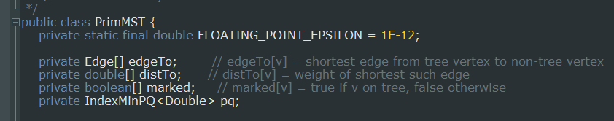
Code review (selected lines)

Slide 34
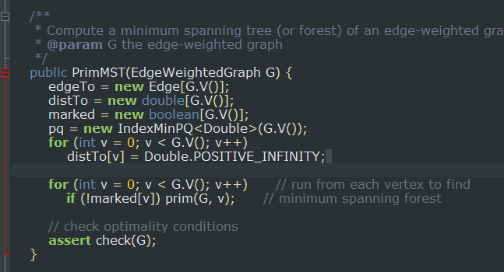
Code review (selected lines)

Slide 35
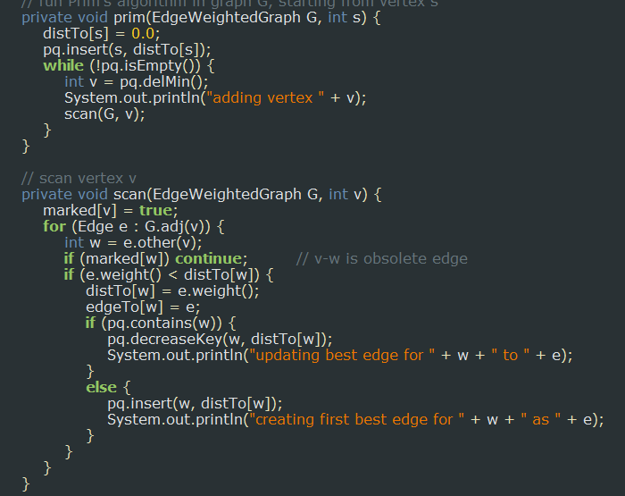
Code review (selected lines)

