Slide 1
CS1501 Recitation #1: 9/6/19
These slides are available online:
https://github.com/kc13/CS1501
Agenda for today:
Overview of the recitation
Demonstration of how to submit assignments on Github

Slide 2
Contact info
Email: kmc51@pitt.edu
Office: 6150 Sennott Square
Office hours: T 3-6 PM; F 12-3 PM
Note: Grading will be done by a different TA see course website for contact info)

Slide 3
Where to access recitation materials (optional):
Github repository:
https://github.com/kc13/CS1501
This repository will include recitation slides, and possibly other helpful material. It should be considered an optional resource.
It will not be used for homework submission!
Homework will be submitted through unique repositories that will be created for you prior to each assignment.

Slide 4
Questionnaire (also optional):
Google form:
https://forms.gle/rqaYcXzPCtfMCCmn9
Single, open ended question, where you can share your thoughts on what you might like to see in this recitation.
Responses to this form will be monitored for at least the next three weeks.

Slide 5
Attendance:
Not monitored, however –
There will be unannounced quizzes.
Lowest quiz grade will be dropped.

Slide 6
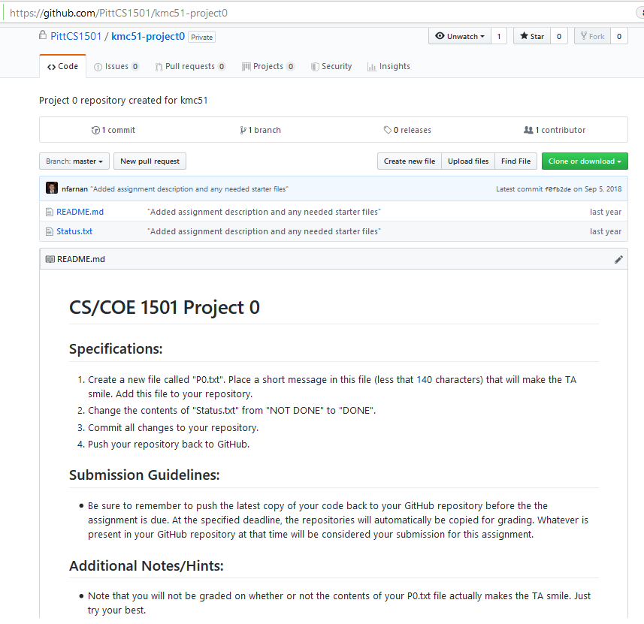
Homework submission through Github:
For practice, you will submit a “Project 0.”
This project will be made available to you in the near future.
Github will firsts send you an email to invite you to the CS1501 organization.

Slide 7
Homework submission through Github:
The project will require you to both modify an existing text file (Status.txt) and add a new one (P0.txt)
Today we will discuss how to accomplish this using git on the command line.
There are ways to accomplish the same process through the web and/or a GUI-based application (Github Desktop). Use of these alternatives is done at your own risk (you might experience problems).

Slide 8
What is git?
Version control system (for detailed info, see Prof. Farnan’s “git_crash_course” slides in the kc13/CS1501 repository).
Users can record changes to the files of a developing program in a local or remote repository.
You can use git to push the final version of your homework to the designated assignment repository.

Slide 9
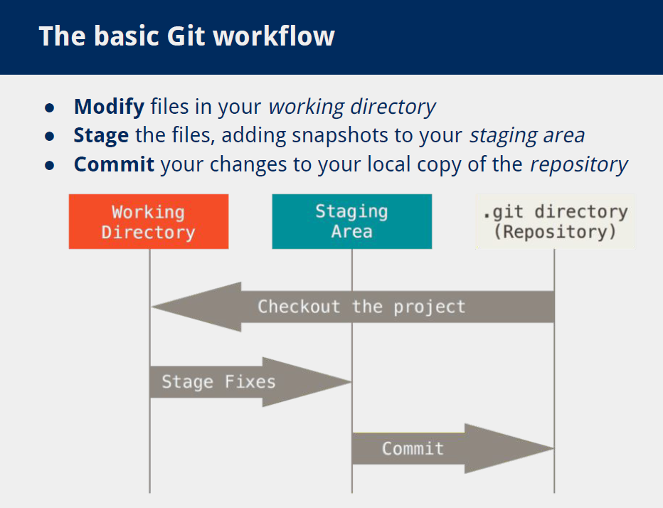
What is git? (from git_crash_course slides)
Commit to local repository (additional push command needed to upload to Github)

Slide 10
How can git be accessed?
These slides will explain how to set up git for a Windows machine.
Options for installing git on MacOS/Linux are described here:
https://git-scm.com/book/en/v2/Getting-Started-Installing-Git
(This is also the reference for the Windows instructions provided here.)

Slide 11
Git on Windows
Navigate to https://git-scm.com/download/win
The download should start automatically.
Run the installer that is downloaded.
For these slides, all the defaults were chosen in the installation options, with the exception of the choice of default text editor (nano instead of Vim)

Slide 12
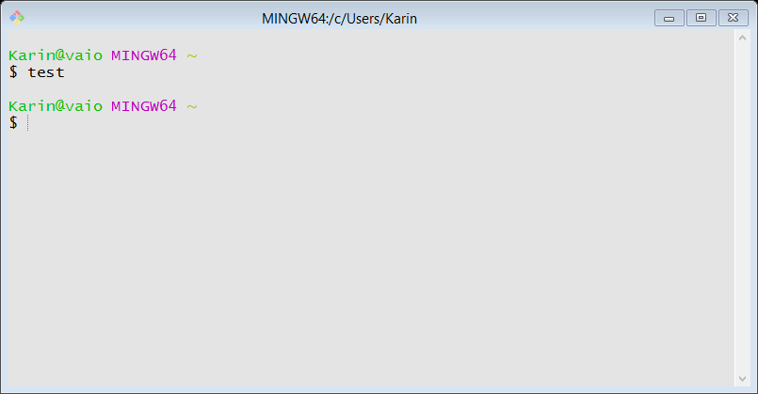
After installation
Search for the application “Git Bash”. Upon opening, you should see a shell that may look something like this (the color/font settings have been modified in this example):

Slide 13
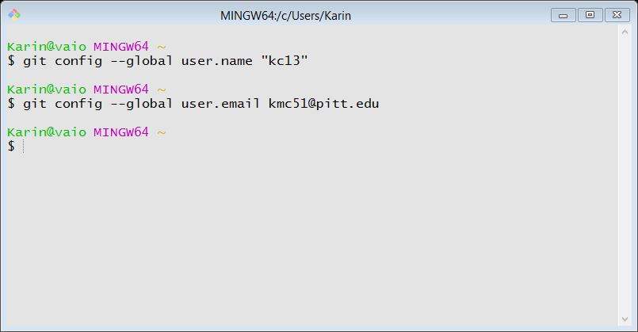
Do some basic configuration
“git config --list” can be used to view configuration settings

Slide 14
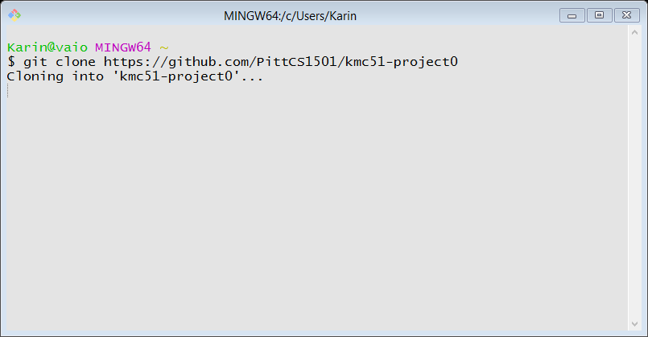
How do we complete Project 0?
First, clone the remote repository to your local workspace.
Command: git clone <full Github URL for repository>

Slide 15
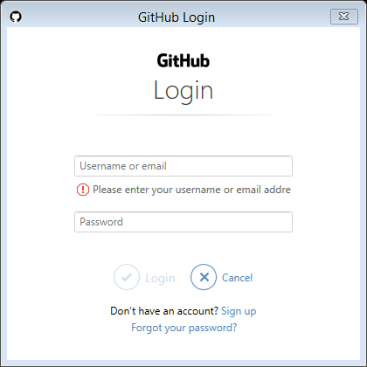
How do we complete Project 0?
This may pull up a prompt for your Github credentials:

Slide 16
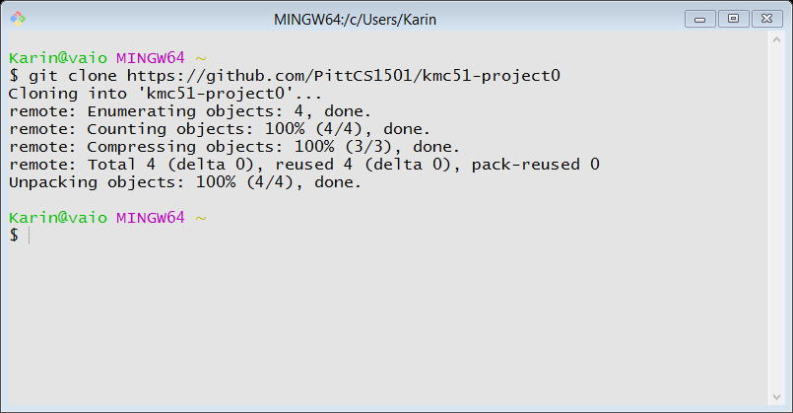
How do we complete Project 0?
After entering the Github username/password:

Slide 17
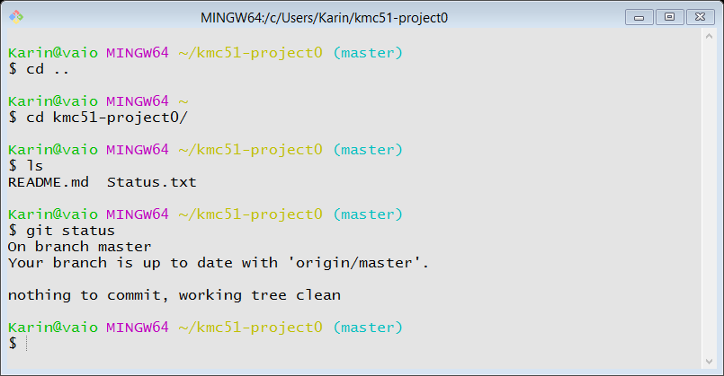
How do we complete Project 0?
Inspecting contents:

Slide 18
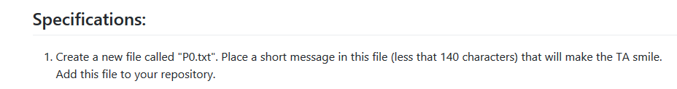
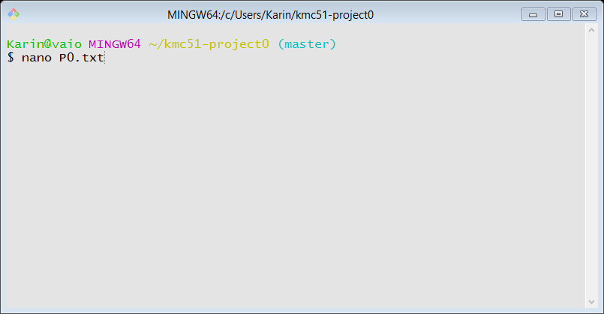
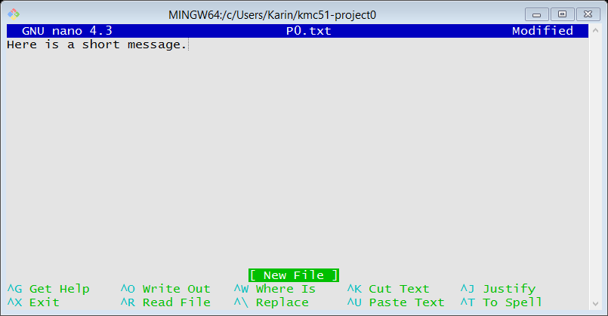
How do we complete Project 0?

Slide 19
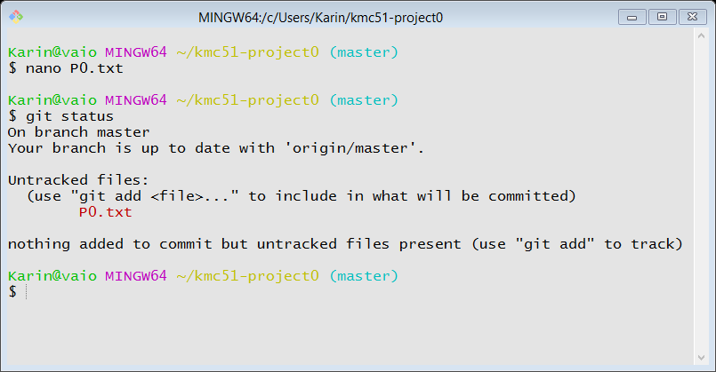
How do we complete Project 0?

Slide 20
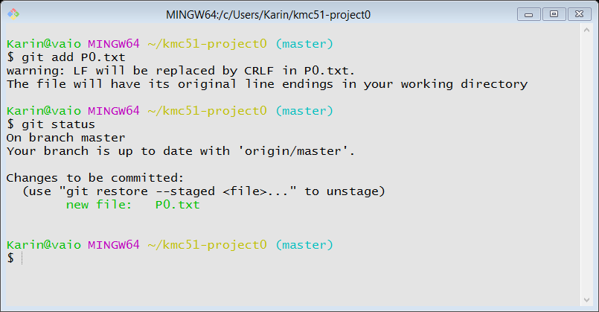
Complete step 1 of Project 0 (continued):
Add the completed P0.txt file to the “staging area.”
command: git add <filename>

Slide 21
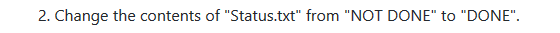
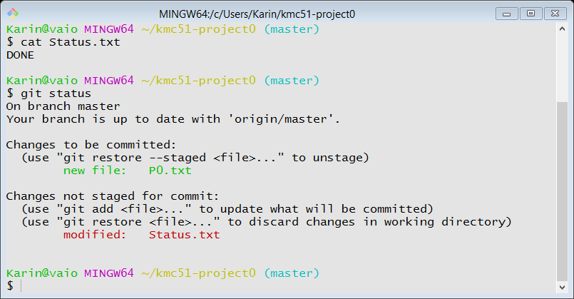
Complete step 2 of Project 0:
We need to use an add command to place our modifications in the staging area.

Slide 22
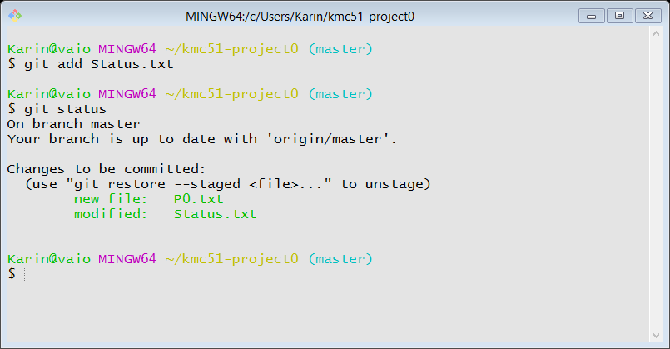
Complete step 2 of Project 0:

Slide 23
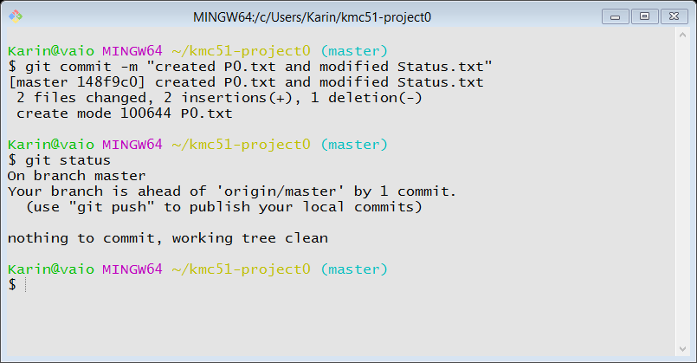
Complete step 3 of Project 0:
3. Commit all changes to your repository.
Command: git commit -m <descriptive message”>
This “commits” changes to your local repository.
The message is obligatory!
Commands “git status” and “git log” are helpful for keeping track of past additions/commits.

Slide 24
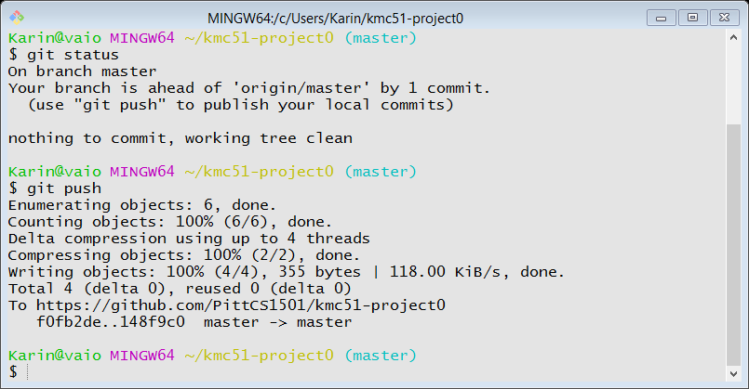
Complete step 4 of Project 0:
4. Push your repository back to GitHub.

Slide 25
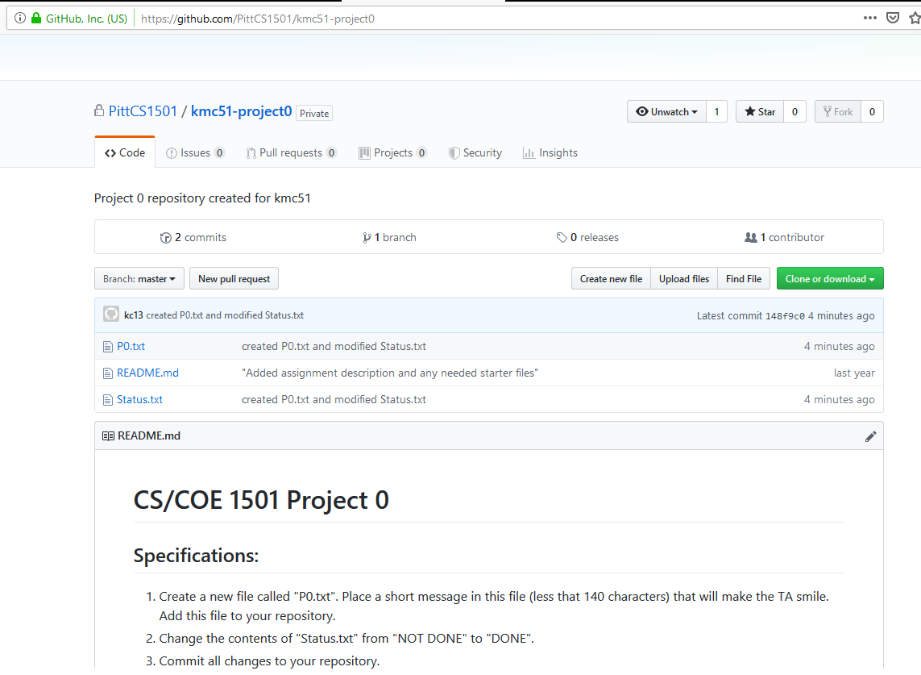
Confirm that the updates appear in the Github repository:

Slide 26
Final remarks on git/Github:
Your final project submission = contents of Github repository at the time of the deadline.
Leave plenty of advance time to push contents to the repository and confirm correct updating of the Github repository.
Expect to be invited to the PittCS1501 group and provided with your own project0 repository in the near future.

Slide 27
General remarks:
Try to start projects early!
Don’t assume that the first project will be the fastest/easiest.
The code examples given in the textbook can provide useful guidance.
The Coursera courses taught by the textbook author can also be informative (although they should not be considered a replacement for the lecture material, and may differ from this in some ways):
https://www.coursera.org/learn/algorithms-part1
https://www.coursera.org/learn/algorithms-part2

