Slide 1
CS1501 Recitation 10/25/19
These slides are available online:
https://github.com/kc13/CS1501
Agenda for today:
Quizzes are available
Review of Priority Queues:
Binary Heaps + Exercise
Indexable PQs
Slide credits: Some images and content for these slides were adapted from the following:
http://algs4.cs.princeton.edu/lectures/24PriorityQueues.pdf
https://www.youtube.com/watch?v=C8dsmIflDyI
http://people.cs.pitt.edu/~nlf4/cs1501/slides/pqs.pdf

Slide 2
Priority Queues: Why are they useful?
PQ’s are useful whenever an algorithm needs to:
Maintain a collection of “keys” and any associated information
Examples: Character frequencies, Edge weights
Keys can also be anything that can be transformed into comparable values (e.g., Strings/chars, not just numeric data)
(2) Retrieve (and possibly remove) the item the current collection that has the smallest key.
Assuming a min PQ
(3) Insert new items
Both insertions and removals may require adjustment of the PQ.

Slide 3
Priority Queues: What data structure do we use?
Binary Heaps:
Adopt the form of a binary tree
Nodes hold keys

Slide 4
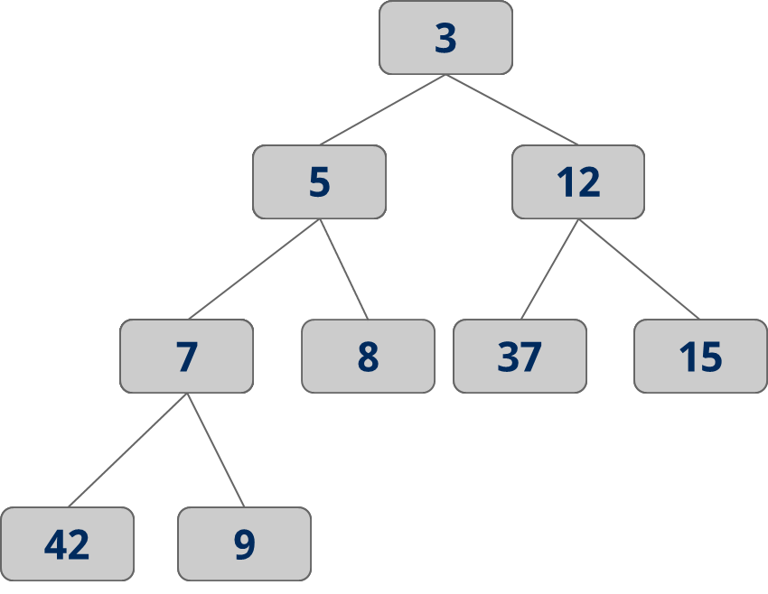
Binary Heaps: How are they different from BSTs?
Ordering properties:
Min value is at root
For each parent (i.e., non-leaf) node:
→ key(node.children) >
key(node)
No claims made about relationship of left and right child!

Slide 5
Binary Heaps: How do we insert new entries?
Must maintain heap ordering:
Add new node to first available leaf
While key(new-node) < key(new-node.parent):
→ Exchange child and parent nodes
Textbook code calls this process “swim”

Slide 6
Binary Heaps: Insertion example
Assume we start with this heap…
10
12
15
(Keys can be anything Comparable; here keys are numbers)

Slide 7
Binary Heaps: Insertion example
Assume we start with this heap…
10
Add a ‘3’
12
15
3

Slide 8
Binary Heaps: Insertion example
Assume we start with this heap…
10
Add a ‘3’
12
15
3 < 12:
exchange
3

Slide 9
Binary Heaps: Insertion example
Assume we start with this heap…
10
Add a ‘3’
3
15
3 < 12:
exchange
12

Slide 10
Binary Heaps: Insertion example
Assume we start with this heap…
10
Add a ‘3’
3
15
3 < 10:
exchange
12

Slide 11
Binary Heaps: Insertion example
Assume we start with this heap…
3
Add a ‘3’
10
15
3 < 10:
exchange
12

Slide 12
Binary Heaps: How do we remove the root (min key)?
Must maintain heap ordering:
Replace root with last leaf
While key(node) > key(node.children):
→ Exchange node with child with min key
Textbook code calls this process “sink”

Slide 13
Binary Heaps: Removal example
We want to remove the root:
3
10
15
12

Slide 14
Binary Heaps: Removal example
We want to remove the root:
3
Overwrite with 12
10
15
12

Slide 15
Binary Heaps: Removal example
We want to remove the root:
12
Overwrite with 12
10
15

Slide 16
Binary Heaps: Removal example
We want to remove the root:
12
Overwrite with 12
10
15
12 > 10:
Exchange with 10

Slide 17
Binary Heaps: Removal example
We want to remove the root:
10
Overwrite with 12
12
15
12 > 10:
Exchange with 10

Slide 18
Binary Heaps: How do we avoid overhead of linked lists?
→ Use an array representation.
7
5
3
3
42
5
7
5
37
15
12
3
5
42
9
7
8
15
37
12
15
9
42
9
3

Slide 19
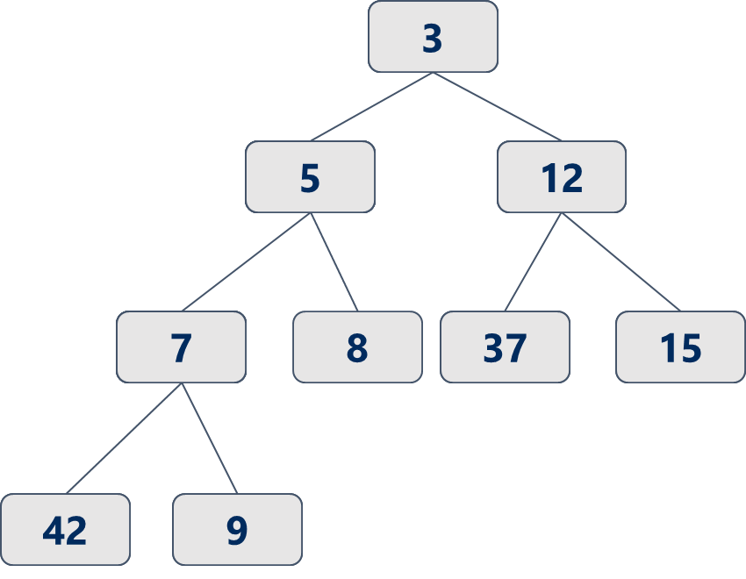
Binary Heaps: How can we represent them as arrays?
Note differences between textbook and lecture slides:
Lecture slides start indexing at 0, textbook starts at 1.
These slides will use the textbook’s approach.
A
0
1
2
3
4
5
6
7
8
9

Slide 20
Binary Heaps: How can we represent them as arrays?
Textbook approach: Put root value into A[1]
Continue filling in entries (go L→ R in row before descending to the next level)
A
3
5
12
7
8
37
15
42
9
0
1
2
3
4
5
6
7
8
9

Slide 21
Array representation: Formulas to find parents/children
Textbook formulas:
Lecture approach will differ!
Parent of key in A[k] →
k/2
(integer division)
Example:
A[7] = 15
Parent is A[3] = 12
A
3
5
12
7
8
37
15
42
9
0
1
2
3
4
5
6
7
8
9

Slide 22
Array representation: Formulas to find parents/children
Textbook formulas:
Children of key in A[k] →
2k and 2k+1
Example: A[4] = 7
Left = A[8] = 42
Right = A[9] = 9
A
3
5
12
7
8
37
15
42
9
0
1
2
3
4
5
6
7
8
9

Slide 23
Exercise: Build a new min PQ by inserting the following elements:
17, 3, 9, 19, 16, 20, 14,1
Then, remove the min key (root) and adjust the heap.

Slide 24
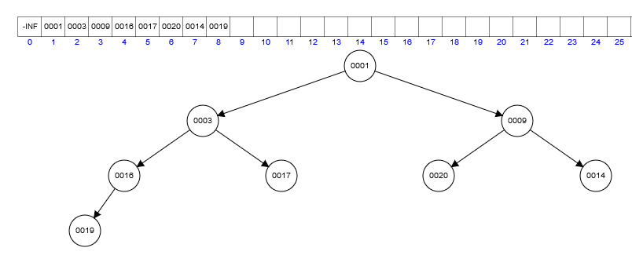
Exercise: Solution (initial heap)
To recreate: https://www.cs.usfca.edu/~galles/visualization/Heap.html

Slide 25
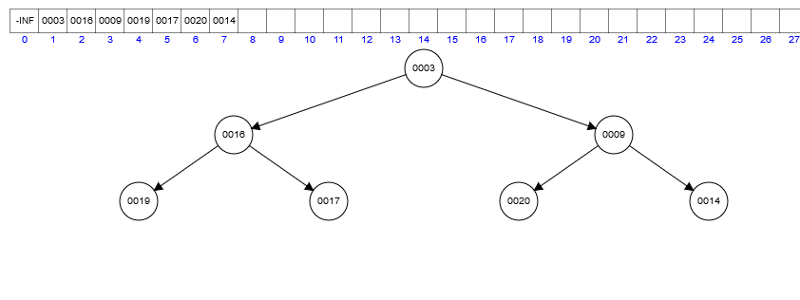
Exercise: Solution (remove 1)
To recreate: https://www.cs.usfca.edu/~galles/visualization/Heap.html

Slide 26
PQ Heap Indexing: How can we achieve random access based on the key (and not just the array index)?
IndexMinPQ.java implements an “Indexable MinPQ”: a min-oriented PQ that allows access by key.

Slide 27
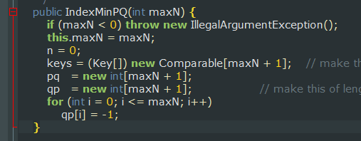
IndexMinPQ.java: Some good things to know
There are three important data structures: “pq”, “qp”, “Keys”. The work of implementing the indexable PQ is distributed across all three of these arrays.
The pq data structure is not identical to ‘A’ from previous slide (see below). It does not store keys; it stores IDs.
A
3
5
12
7
8
37
15
42
9
0
1
2
3
4
5
6
7
8
9

Slide 28
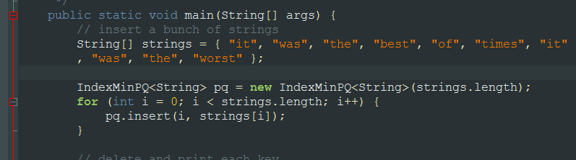
IndexMinPQ.java: What does pq[] contain?
Each key (in the test in main, these are Strings) is assigned an arbitrary index, based on its position in the strings array.
This is stored in PQ. So, these are the keys’ “IDs”.

Slide 29
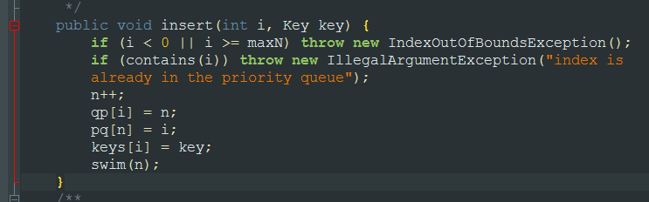
IndexMinPQ.java: What does qp[] contain?
qp is the “inverse” of pq. qp[key ID] = location of that key in pq
For example, “best” was assigned ID #3. We would go to qp[3] to find out where “best” is located in pq.

Slide 30
IndexMinPQ.java: What does keys[] contain?
The contents of keys[] should match those of the original string array.

Slide 31
IndexMinPQ.java: Summary
Keys[]: A key’s position in this array is determined by an ID that was assigned by the user when the Key was added.
PQ: pq[j] says what is at position j in the heap, but does not store the key itself: It stores its ID. Must go to Keys[ID] to get actual key
QP: qp[ID] tells you the current heap position of the key with that ID
So how do we edit a key in the heap?

Slide 32
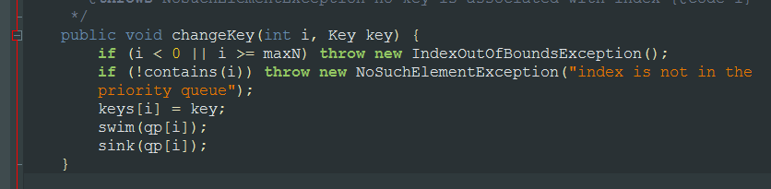
IndexMinPQ.java: changeKey
If we know the key’s ID, we can change it quickly and easily in keys[].
We use the ID and qp[] to find out where the key of the ID is in the heap.
The sink and swim methods adjust for any new violations in the heap principles.

Slide 33
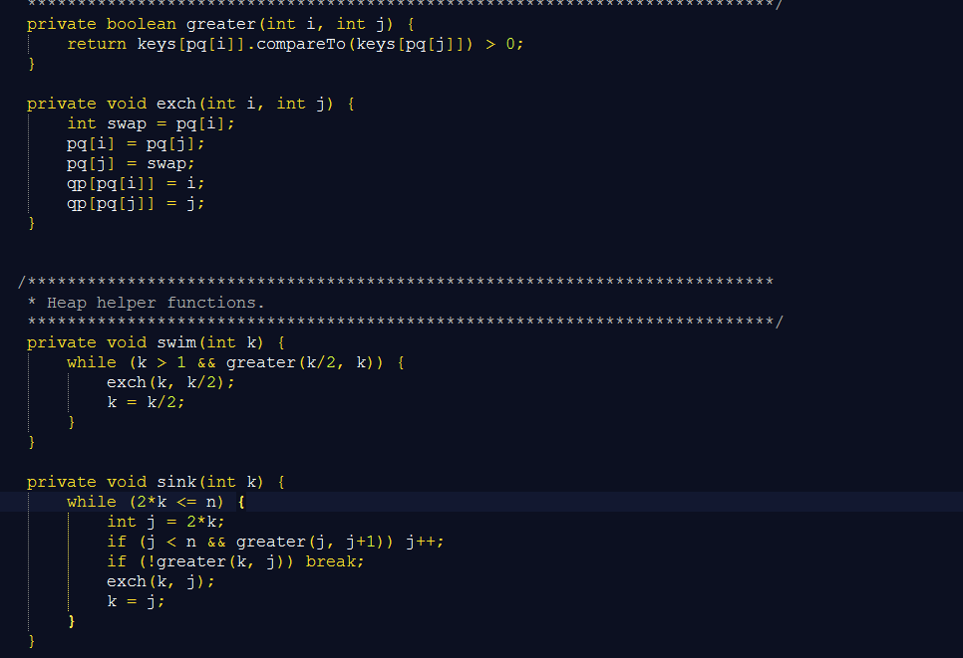
IndexMinPQ.java: swim/sink
First swap positions of IDs in heap
Then update table mapping IDs to heap positions
k = heap position of ID to sink/swim

