Slide 1
CS1501 Recitation #4: 10/2/19
These slides are available online:
https://github.com/kc13/CS1501
Agenda for today:
There are a few quizzes left to be picked up
Discussion of BinaryStdIn.java, BinaryStdOut.java
References: https://algs4.cs.princeton.edu/code/edu/princeton/cs/algs4/BinaryStdIn.java
https://algs4.cs.princeton.edu/code/edu/princeton/cs/algs4/BinaryStdOut.java

Slide 2
What are BinaryStdIn.java and BinaryStdOut.java, and why are they useful?
These are files that are used by the textbook’s code for compression algorithms: Huffman.java, LZW.java
They’re relevant for the course projects:
They are called by LZW.java, which serves as starter code for Project #2.
They might be useful for later projects also.
Overview of both files: These classes provide methods that:
Read data from stdin
Write data to stdout
Do so either 1 bit at a time, or in larger chunks

Slide 3
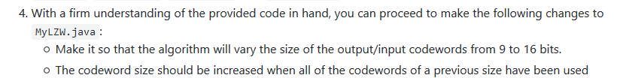
Why would we want to read in data as individual (or chunks of) bits?
For various reasons, but in the context of compression:
Huffman compression relies upon variable length encoding (individual characters represented by variable length bitstrings, greater char frequency → shorter bitstring length
LZW compression uses fixed length bitstrings; however, the length may not be a multiple of 8 (in other words, they contain fractional bytes)
Default in LZW.java: codeword size of 12 bits
In Project #2:

Slide 4
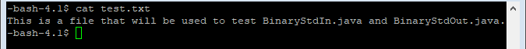
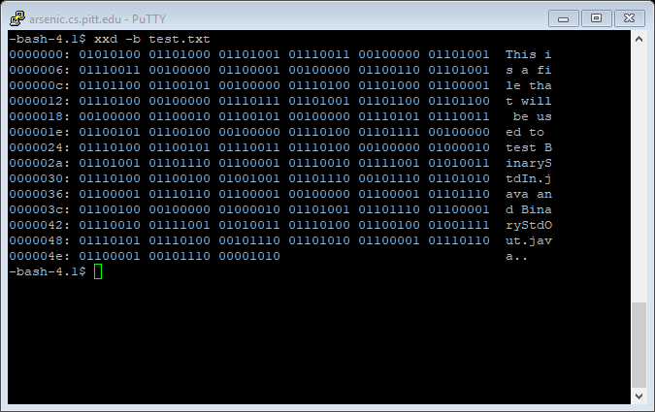
Demonstration of example uses (files will be available on Github)
Test input file: test.txt
As ASCII characters:
Binary representation (using xxd in Linux, but several other free viewing programs are available):

Slide 5
Demonstration of example uses (files will be available on Github)
Test driver program: BinaryDriver.java
BinaryStdIn.java and BinaryStdOut.java are the only dependencies
Execution: java BinaryDriver < test.txt
Input redirection (“<“) required since the code reads from/writes to stdin/stdout (instead of directly from/to files)
LZW code operates the same way
Execution will be illustrated on the subsequent slides

Slide 6
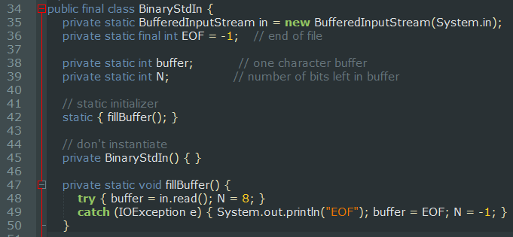
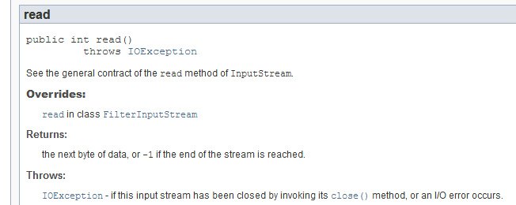
BinaryStdIn initialization (before client calls any methods):

Slide 7
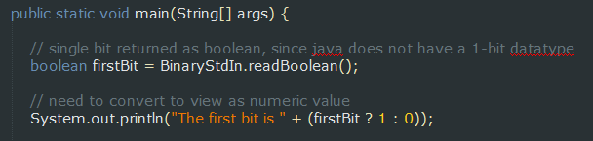
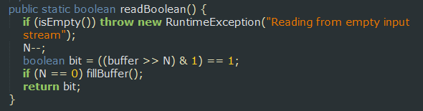
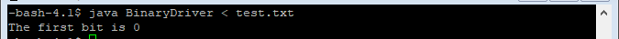
Driver program first tries to read the first bit of the first byte
The >> N operation will shift the buffer contents by 7 bits to the right, which will result in a binary value of 0000000, where the final 0 is the digit highlighted in the green square above. Note also that this operation effectively “consumes” that top 0 bit; the next operation will start at the next digit (1).

Slide 8
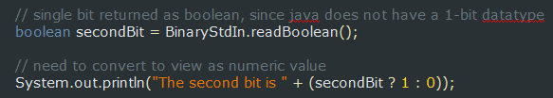
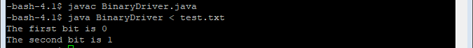
Driver program next tries to read the second bit of the first byte
The >> N operation will shift the buffer contents by 6 bits to the right, which will result in a binary value of 0000001, where the 1 is the digit highlighted by the green square above. The next operation will start with the 0 that immediately follows that 1.

Slide 9
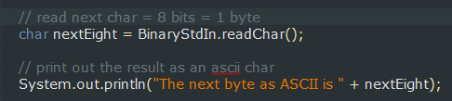
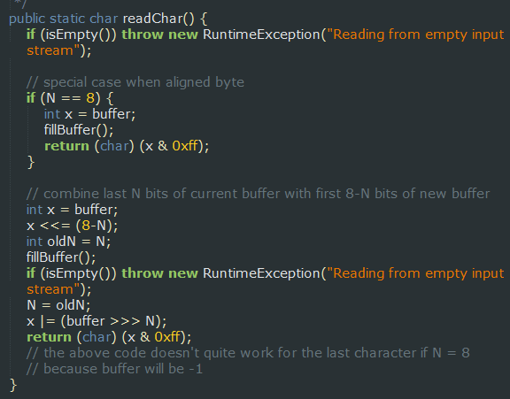
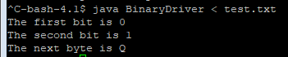
What happens if we next try to read a char (= 1 byte = 8 bits)?
Will it read in the next 8 bits, following the current position? Or will it read the next byte-aligned byte?
Q = decimal value 81 = 01010001

Slide 10
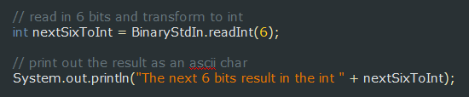
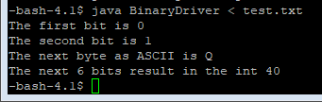
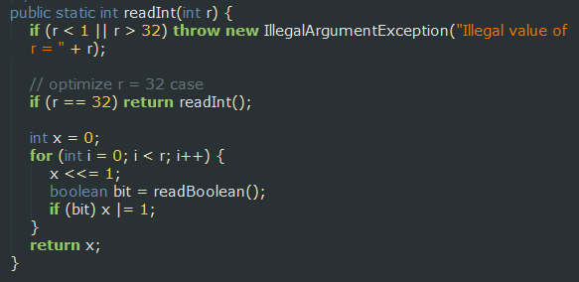
Next: Let’s try reading in 6 bits so the pointer is back on a byte boundary
One way to do this is with the readInt(int r) method:
40 = 00101000 (as expected)

Slide 11
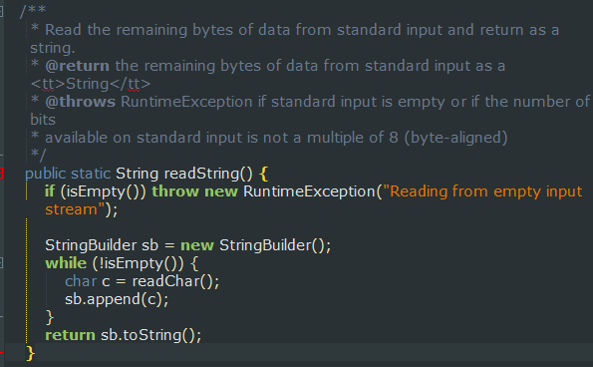
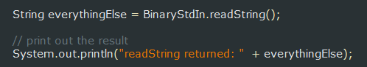
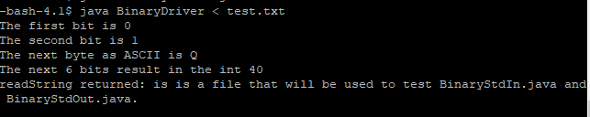
Next: readString() method

Slide 12
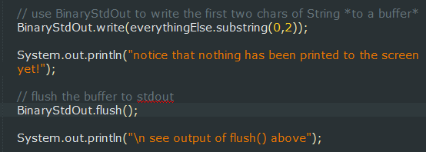
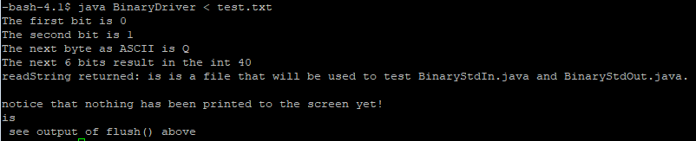
BinaryStdOut: We can use this to write variable length amounts of data to a buffer (additional commands are required in order to write to stdout):
Example: writing the first two characters of the everythingElse string to the buffer and then stdout:
See lines 226-229, and 88-92 of BinaryStdOut for the called functions

Slide 13
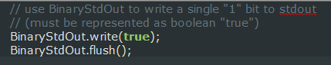
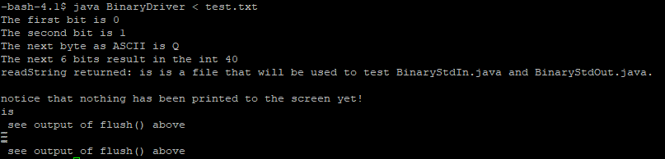
BinaryStdOut: We can also write individual bits using the writeBit method (similar to what was accomplished in earlier slides using the ternary operator)
Example: writing a single “1” bit to stdout
Output will look somewhat odd, since we didn’t write a full character:

Slide 14
Some brief comments on the LZW project:
This is an assignment for which it may be especially important to plan out strategies in advance.
It may help to create some very small simple test files to try out, before moving on to the set of files that were given to you.

