Slide 1
CS1501 Recitation #5: 10/11/19
These slides are available online:
https://github.com/kc13/CS1501
Agenda for today:
Review of Knuth-Morris-Pratt (KMP) substring search
Discussion of KMP.java, and a KMP exercise

Slide 2
Brute Force Substring Search
Target pattern: vivid
Text to search: viiivivivid
i marks the point in the text where we are seeking a match with character 0 in the pattern
j is the “pattern pointer”: which character in the target pattern are we attempting to match? i+j is the “text pointer”: where are we in the text to be searched?
Unnecessary work when i = 1 (We saw this character on the previous iteration.)
If we never back up the text pointer, we may need some way to remember previous characters that matched the target.

Slide 3
Knuth-Morris-Pratt: Some terminology
Text pointer: Keeps track of our current character position in the text to search.
Target pattern: vivid
Text to search: viiivivivid
Pattern pointer: Keeps track of the current character in the pattern, which we are matching against the text to search.
KMP will never decrement the text pointer, but it can decrement the pattern pointer.

Slide 4
Knuth-Morris-Pratt: Deterministic finite state automaton
The DFA helps keep track of the recent history of matches, which determines how to update the pattern pointer.
Target pattern: vivid
# of states = pattern.length() + 1
!= v
v
v
v
i
v
i
d
0
1
2
3
4
5
!(v || i)
v
!= v
!(v || i)
!(v || d)
Notes:
Can think of j in two ways: which character in the pattern are we looking to match, and how long a string of consecutive matches exists in our recent history

Slide 5
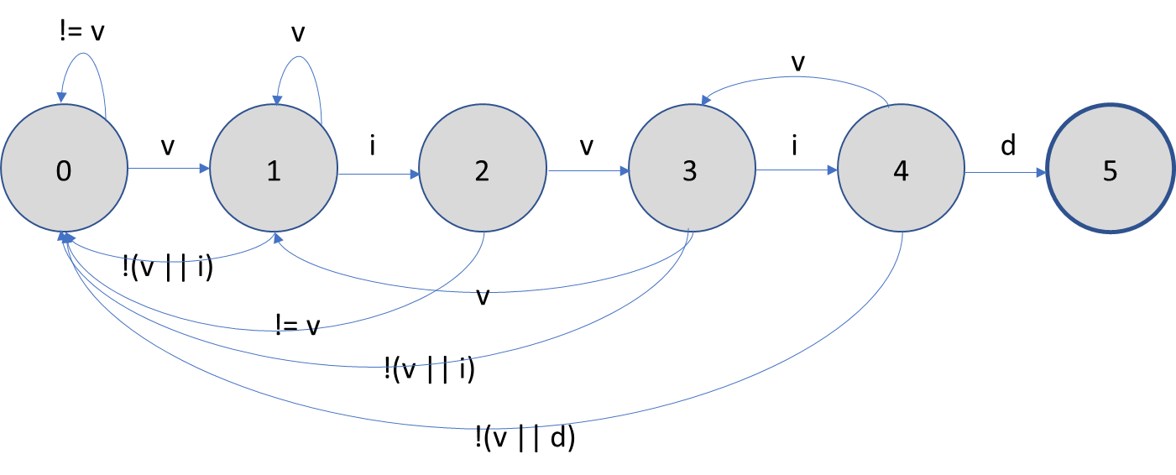
Knuth-Morris-Pratt: DFA data structure
How do we implement this in code?
What data structure do we use?
Textbook implementation (KMP.java) stores the transition matrix as a 2D array.
j = pattern pointer = DFA state we are departing
For the ‘vivid’ example, the full array dimensions would be 256 x 5
c = ASCII character

Slide 6
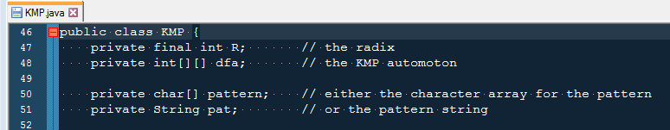
KMP.java: lines 46-51
Declaration of instance variables
This code works with patterns represented as either char arrays or Strings; here we’ll focus on Strings.

Slide 7
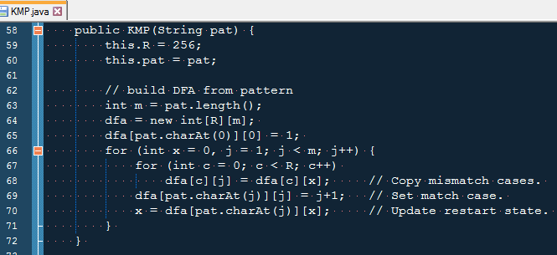
KMP.java: lines 58-72
Lines 59-60: Initialize instance variables; Radix = character set size

Slide 8
KMP.java: lines 58-72
Lines 63-64: Initialize transition matrix (here compressing all unused ASCII characters to one row)
v i v i d
 | 0 | 1 | 2 | 3 | 4
d | 0 | 0 | 0 | 0 | 0
i | 0 | 0 | 0 | 0 | 0
v | 0 | 0 | 0 | 0 | 0
!(d||i||v) | 0 | 0 | 0 | 0 | 0

Slide 9
KMP.java: lines 58-72
v i v i d
Line 65: Add a ‘1’ to dfa[v][0]
 | 0 | 1 | 2 | 3 | 4
d | 0 | 0 | 0 | 0 | 0
i | 0 | 0 | 0 | 0 | 0
v | 1 | 0 | 0 | 0 | 0
!(d||i||v) | 0 | 0 | 0 | 0 | 0

Slide 10
KMP.java: lines 58-72
v i v i d
Line 66:
Header of outer for loop:
Init x at 0
Init j at 1
Loop through departure states, excluding final state
 | 0 | 1 | 2 | 3 | 4
d | 0 | 0 | 0 | 0 | 0
i | 0 | 0 | 0 | 0 | 0
v | 1 | 0 | 0 | 0 | 0
!(d||i||v) | 0 | 0 | 0 | 0 | 0

Slide 11
KMP.java: lines 58-72
v i v i d
Line 67:
Header of inner for loop:
Loop over characters in ASCII set
 | 0 | 1 | 2 | 3 | 4
d | 0 | 0 | 0 | 0 | 0
i | 0 | 0 | 0 | 0 | 0
v | 1 | 0 | 0 | 0 | 0
!(d||i||v) | 0 | 0 | 0 | 0 | 0

Slide 12
KMP.java: lines 58-72
v i v i d
Line 68:
Body of inner for loop over ASCII set:
When j = 1:
dfa[c][1] = dfa[c][0]
 | 0 | 1 | 2 | 3 | 4
d | 0 | 0 | 0 | 0 | 0
i | 0 | 0 | 0 | 0 | 0
v | 1 | 1 | 0 | 0 | 0
!(d||i||v) | 0 | 0 | 0 | 0 | 0

Slide 13
KMP.java: lines 58-72
v i v i d
Line 69:
Below inner loop:
When j = 1:
pat.charAt(1) = “i"
dfa[i][1] = 2
 | 0 | 1 | 2 | 3 | 4
d | 0 | 0 | 0 | 0 | 0
i | 0 | 2 | 0 | 0 | 0
v | 1 | 1 | 0 | 0 | 0
!(d||i||v) | 0 | 0 | 0 | 0 | 0
Notes:
Line 69 sets the matches – these are like the straight lines in the DFA diagram

Slide 14
KMP.java: lines 58-72
v i v i d
Line 70:
Below inner loop:
When j = 1:
pat.charAt(1) = “i"
x = dfa[i][0] = 0
 | 0 | 1 | 2 | 3 | 4
d | 0 | 0 | 0 | 0 | 0
i | 0 | 2 | 0 | 0 | 0
v | 1 | 1 | 0 | 0 | 0
!(d||i||v) | 0 | 0 | 0 | 0 | 0
Notes:
Line 70 prepares x for the next iteration, to determine which column to copy over

Slide 15
KMP.java: lines 58-72
v i v i d
Line 66:
Back to outer loop header
j = 2
 | 0 | 1 | 2 | 3 | 4
d | 0 | 0 | 0 | 0 | 0
i | 0 | 2 | 0 | 0 | 0
v | 1 | 1 | 0 | 0 | 0
!(d||i||v) | 0 | 0 | 0 | 0 | 0

Slide 16
KMP.java: lines 58-72
v i v i d
Line 67-68:
Back to inner loop with j = 2 and x = 0
For all rows, copy over contents of column 0 to column 2
 | 0 | 1 | 2 | 3 | 4
d | 0 | 0 | 0 | 0 | 0
i | 0 | 2 | 0 | 0 | 0
v | 1 | 1 | 1 | 0 | 0
!(d||i||v) | 0 | 0 | 0 | 0 | 0

Slide 17
KMP.java: lines 58-72
v i v i d
Line 69:
Below inner loop with j = 2 and x = 0
dfa[v][2] = 3
 | 0 | 1 | 2 | 3 | 4
d | 0 | 0 | 0 | 0 | 0
i | 0 | 2 | 0 | 0 | 0
v | 1 | 1 | 3 | 0 | 0
!(d||i||v) | 0 | 0 | 0 | 0 | 0

Slide 18
KMP.java: lines 58-72
v i v i d
Line 70:
Below inner loop with j = 2 and x = 0
x ← dfa[v][0] = 1
 | 0 | 1 | 2 | 3 | 4
d | 0 | 0 | 0 | 0 | 0
i | 0 | 2 | 0 | 0 | 0
v | 1 | 1 | 3 | 0 | 0
!(d||i||v) | 0 | 0 | 0 | 0 | 0

Slide 19
KMP.java: lines 58-72
v i v i d
Line 66:
Outer loop: j = 3 and x = 1
 | 0 | 1 | 2 | 3 | 4
d | 0 | 0 | 0 | 0 | 0
i | 0 | 2 | 0 | 0 | 0
v | 1 | 1 | 3 | 0 | 0
!(d||i||v) | 0 | 0 | 0 | 0 | 0

Slide 20
KMP.java: lines 58-72
v i v i d
Lines 67-68:
Inner loop: j = 3 and x = 1
Copy column 1 to column 3
 | 0 | 1 | 2 | 3 | 4
d | 0 | 0 | 0 | 0 | 0
i | 0 | 2 | 0 | 2 | 0
v | 1 | 1 | 3 | 1 | 0
!(d||i||v) | 0 | 0 | 0 | 0 | 0

Slide 21
KMP.java: lines 58-72
v i v i d
Line 69:
Below inner loop: j = 3 and x = 1
dfa[i][3] = 4
 | 0 | 1 | 2 | 3 | 4
d | 0 | 0 | 0 | 0 | 0
i | 0 | 2 | 0 | 4 | 0
v | 1 | 1 | 3 | 1 | 0
!(d||i||v) | 0 | 0 | 0 | 0 | 0

Slide 22
KMP.java: lines 58-72
v i v i d
Line 70:
Below inner loop: j = 3 and x = 1
x ← dfa[i][1]
x = 2
 | 0 | 1 | 2 | 3 | 4
d | 0 | 0 | 0 | 0 | 0
i | 0 | 2 | 0 | 4 | 0
v | 1 | 1 | 3 | 1 | 0
!(d||i||v) | 0 | 0 | 0 | 0 | 0

Slide 23
KMP.java: lines 58-72
v i v i d
Line 66:
Outer loop: j = 4 and x = 2
 | 0 | 1 | 2 | 3 | 4
d | 0 | 0 | 0 | 0 | 0
i | 0 | 2 | 0 | 4 | 0
v | 1 | 1 | 3 | 1 | 0
!(d||i||v) | 0 | 0 | 0 | 0 | 0

Slide 24
KMP.java: lines 58-72
v i v i d
Lines 67-68:
At inner loop: j = 4 and x = 2
Copy column 2 to column 4
 | 0 | 1 | 2 | 3 | 4
d | 0 | 0 | 0 | 0 | 0
i | 0 | 2 | 0 | 4 | 0
v | 1 | 1 | 3 | 1 | 3
!(d||i||v) | 0 | 0 | 0 | 0 | 0

Slide 25
KMP.java: lines 58-72
v i v i d
Line 69:
Below inner loop: j = 4 and x = 2
dfa[d][4] = 5
 | 0 | 1 | 2 | 3 | 4
d | 0 | 0 | 0 | 0 | 5
i | 0 | 2 | 0 | 4 | 0
v | 1 | 1 | 3 | 1 | 3
!(d||i||v) | 0 | 0 | 0 | 0 | 0

Slide 26
Both representations
 | 0 | 1 | 2 | 3 | 4
d | 0 | 0 | 0 | 0 | 5
i | 0 | 2 | 0 | 4 | 0
v | 1 | 1 | 3 | 1 | 3
!(d||i||v) | 0 | 0 | 0 | 0 | 0

Slide 27
Exercise:
Assume an alphabet consisting of {a,b}.
The search pattern is “aabaaa.” (2a + 1b + 3a)
Draw the DFA as a set of states and arrows.
Optional: Try converting this to a 2D array.
Exercise credit: http://www.cs.princeton.edu/~rs/AlgsDS07/21PatternMatching.pdf

Slide 28
aabaaa

