Slide 1
CS1501 Recitation #4: 10/2/19
These slides are available online:
https://github.com/kc13/CS1501
Agenda for today:
There are a few quizzes left to be picked up
Discussion of BinaryStdIn.java, BinaryStdOut.java
References: https://algs4.cs.princeton.edu/code/edu/princeton/cs/algs4/BinaryStdIn.java
https://algs4.cs.princeton.edu/code/edu/princeton/cs/algs4/BinaryStdOut.java

Slide 2
What are BinaryStdIn.java and BinaryStdOut.java, and why are they useful?
These are files that are used by the textbook’s code for compression algorithms: Huffman.java, LZW.java
They’re relevant for the course projects:
They are called by LZW.java, which serves as starter code for Project #2.
They might be useful for later projects also.
Overview of both files: These classes provide methods that:
Read data from stdin
Write data to stdout
Do so either 1 bit at a time, or in larger chunks

Slide 3
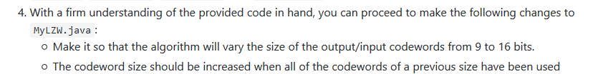
Why would we want to read in data as individual (or chunks of) bits?
For various reasons, but in the context of compression:
Huffman compression relies upon variable length encoding (individual characters represented by variable length bitstrings, greater char frequency → shorter bitstring length
LZW compression uses fixed length bitstrings; however, the length may not be a multiple of 8 (in other words, they contain fractional bytes)
Default in LZW.java: codeword size of 12 bits
In Project #2:

Slide 4
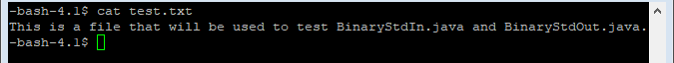
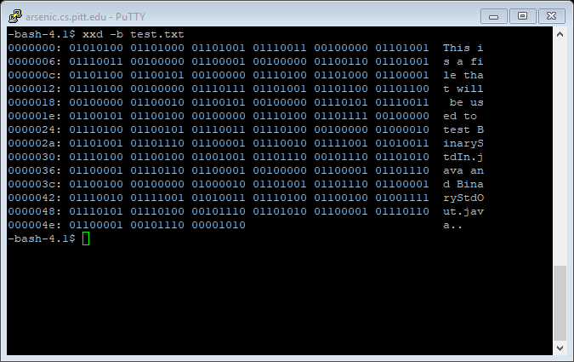
Demonstration of example uses (files will be available on Github)
Test input file: test.txt
As ASCII characters:
Binary representation (using xxd in Linux, but several other free viewing programs are available):

Slide 5
Demonstration of example uses (files will be available on Github)
Test driver program: BinaryDriver.java
BinaryStdIn.java and BinaryStdOut.java are the only dependencies
Execution: java BinaryDriver < test.txt
Input redirection (“<“) required since the code reads from/writes to stdin/stdout (instead of directly from/to files)
LZW code operates the same way
Execution will be illustrated on the subsequent slides

Slide 6
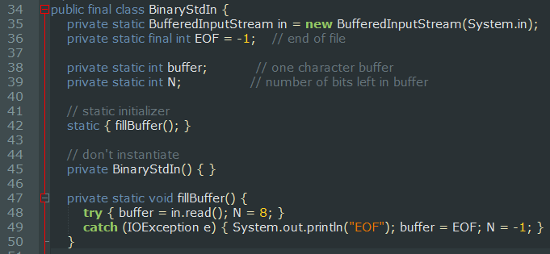
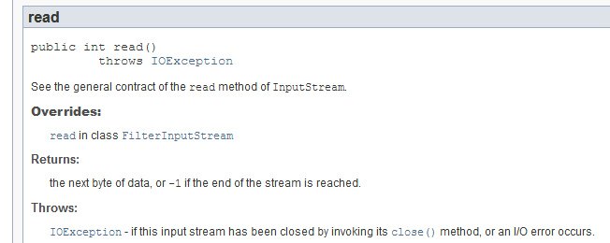
BinaryStdIn initialization (before client calls any methods):

Slide 7
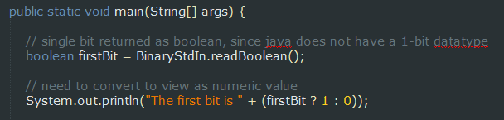
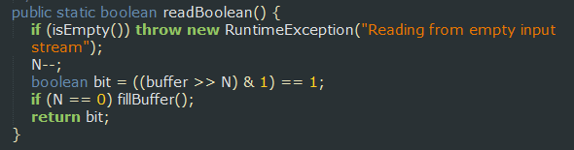
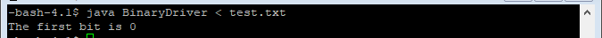
Driver program first tries to read the first bit of the first byte
The >> N operation will shift the buffer contents by 7 bits to the right, which will result in a binary value of 0000000, where the final 0 is the digit highlighted in the green square above. Note also that this operation effectively “consumes” that top 0 bit; the next operation will start at the next digit (1).

Slide 8
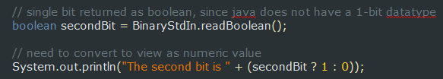
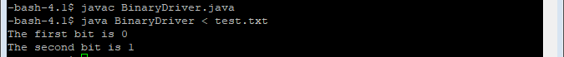
Driver program next tries to read the second bit of the first byte
The >> N operation will shift the buffer contents by 6 bits to the right, which will result in a binary value of 0000001, where the 1 is the digit highlighted by the green square above. The next operation will start with the 0 that immediately follows that 1.

Slide 9
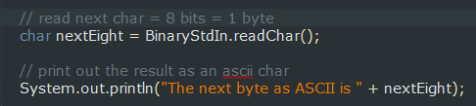
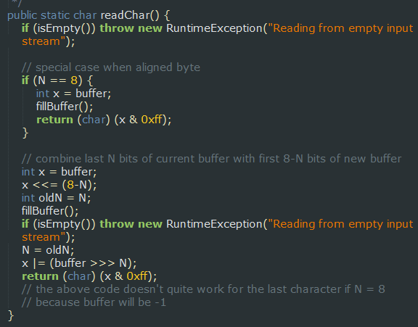
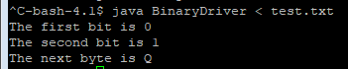
What happens if we next try to read a char (= 1 byte = 8 bits)?
Will it read in the next 8 bits, following the current position? Or will it read the next byte-aligned byte?
Q = decimal value 81 = 01010001

Slide 10
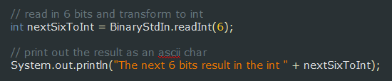
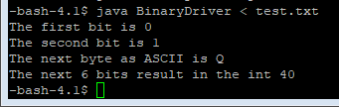
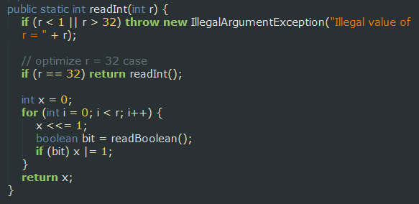
Next: Let’s try reading in 6 bits so the pointer is back on a byte boundary
One way to do this is with the readInt(int r) method:
40 = 00101000 (as expected)

Slide 11
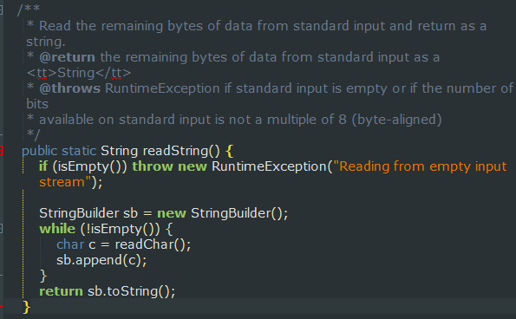
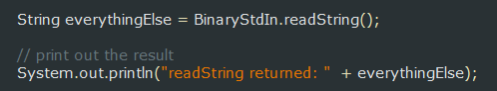
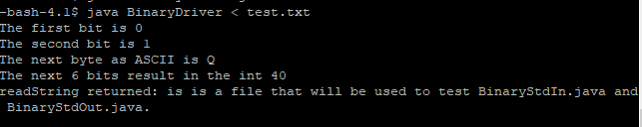
Next: readString() method

Slide 12
Next: A few comments on BinaryStdOut (more slides later) and on LZW project

