Slide 1
CS1501 Recitation #3: 9/27/19
These slides are available online:
https://github.com/kc13/CS1501
Agenda for today:
Quizzes are available (grader’s contact info is on 1501 website)
Review of double hashing (concepts, exercise)
Discussion of linear probing / double hashing code
References: http://people.cs.pitt.edu/~kirk/cs1501/notes/hash.html, http://people.cs.pitt.edu/~nlf4/cs1501/slides/hashing.pdf, https://algs4.cs.princeton.edu/34hash/LinearProbingHashST.java,
https://algs4.cs.princeton.edu/lectures/34HashTables.pdf

Slide 2
Hashing recap:
Why use hash tables?
To store key-value pairs (i.e., unique identifiers like SSNs or PeopleSoft numbers, and associated info (name, phone #, etc…)
Data structure?
Array of length m for keys (if only one value per cell = “open addressing” – see later slides)
Array of length m for values (if only one value per cell = “open addressing” – see later slides)
Operations?
Basic operation: Apply a hash function h(k) to each key k, such that h(k)∈ [0, m-1]. This can be used to place new key value pairs, and search for existing ones. Additional operations may be performed in some hashing variants.

Slide 3
Hashing recap: Allowing multiple values per cell (chaining/closed addressing)
Why?
This is one way to deal with the risk that the hashing operation(s) will map multiple keys to the same index (especially as table occupancy increases). Such a conflict is known as a collision.
Data structure?
Each element in the keys array can point to a separate linked list (illustration is from the Sedgewick slides):
Operations?
Basic operation: To add a new value, apply the initial hash function(s) to identify the keys array index, and then add a new node to the corresponding linked list. Retrieval will require searching the appropriate list.

Slide 4
Hashing function
Typical approach (see slide 10 from lecture):
h(k) = c(k) mod m
Where:
c(k) converts key input to an integer (if necessary this can be especially helpful for strings)
mod = modulo = %
m: length of the hash table array; a prime number is a good choice (not as good: common bases, such as 10 and 2)

Slide 5
Open addressing revisited: How do we resolve collisions, if chaining is not used?
Option #1: Linear probing
From lecture slides (where i = h(k)):
Example: How do we insert 23 into this table?
 | 12 | 23 |  |  |  |  | 18
0 | 1 | 2 | 3 | 4 | 5 | 6 | 7 | 8 | 9 | 10
i = 23 % 11 = 1 (collision). (i + 1) % 11 = 2 % 11 = 2 (insert here)
Qualitative interpretation: Keep searching 1 to the right (with wraparound at the end) until an open spot is found.

Slide 6
Linear probing shortcoming
(illustration from Sedgewick slides)
As load factor (= fraction of array occupied) increases, clusters start to develop, and these can slow down the operation run times.
The code in the textbook helps prevent this by resizing the array if it the load factor exceeds 50%.
Another strategy for addressing this issue is to switch to double hashing.

Slide 7
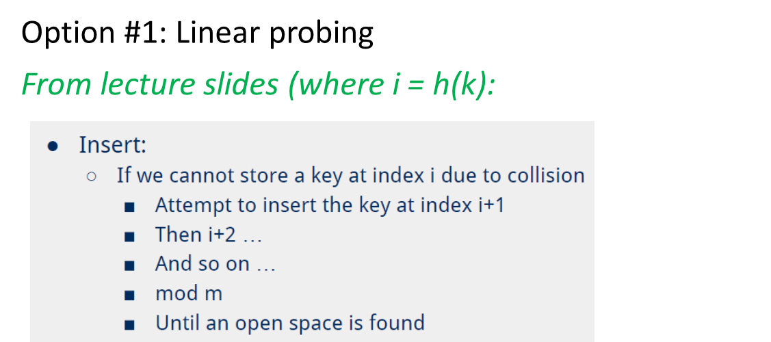
Open addressing continued: Alternatives?
Option #2: Double Hashing
Replace increments of 1 with increments of h2(k), where h2() is some different hash function
In other words:
Compute i = x % m
While i results in a collision:
i = (i + h2(x))%m
In other words:
Compute i = k % m
While i results in a collision:
i = (i + h2(k))%m
Qualitative interpretation: Keep searching h2(k) steps to the right until an open spot is found.
What should we use for h2()?
As stated in lecture: h(x) == h(y) and h2(x) == h2(y) should be unlikely (otherwise you end up with another collision)
It will be problematic if h2(x) == 0 (because then we’re stuck in the original collision spot).
Common solution: Get mod result and then add a constant to this (example from lecture: h2(x) = x mod 7 + 1).

Slide 8
Double hashing exercise:
0 | 1 | 2 | 3 | 4 | 5 | 6 | 7 | 8 | 9 | 10 | 11 | 12
Insert: 60, 94, 47,16,39,77
Hash functions:
h1(k) = k % 13
h2(k) = (k % 11) + 1
Procedure:
Compute i = k % m
While i results in a collision:
i = (i + h2(k))%m

Slide 9
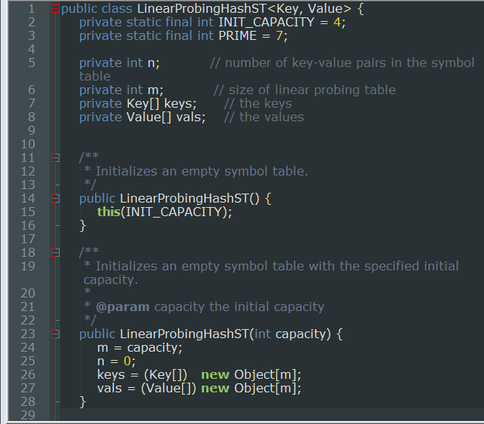
Hashing code: Textbook’s LinearProbingHashST.java
Lines 1-28:
Hash Table constructor: Init key and value arrays with a small initial m value

Slide 10
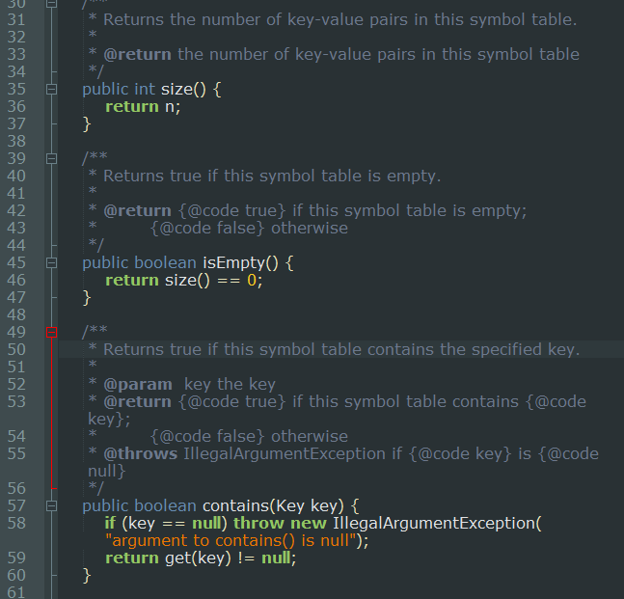
Hashing code: Textbook’s LinearProbingHashST.java
Lines 30-61:
size() returns count of items stored
isEmpty() returns true if there are not items in table
contains(Key key) is a wrapper to a private get method (will be discussed on a later slide)

Slide 11
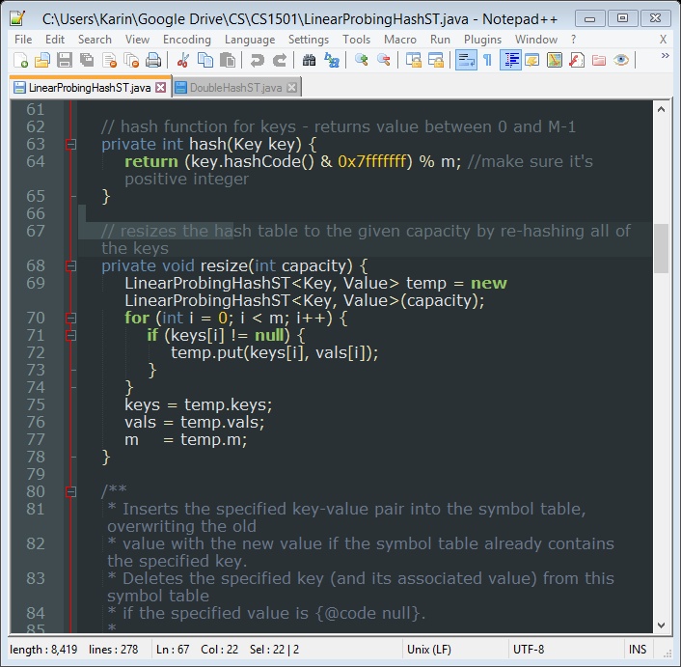
Hashing code: Textbook’s LinearProbingHashST.java
Lines 62-79:
“hash” gets c(k) (numerical representation with & operation to take off sign bit), then performs h1 = c(k) % m
Resize: Called elsewhere in code to grow hash table array when needed (so load factor doesn’t get too high)

Slide 12
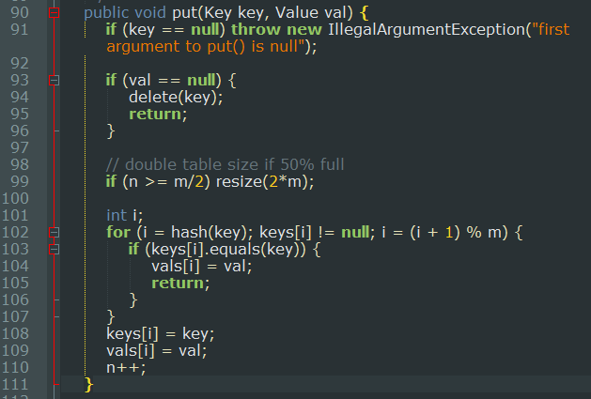
Hashing code: Textbook’s LinearProbingHashST.java
Lines 90-111:
Put method:
Check for null key (error) or null value (indicates key should be removed)
Run resize if load factor >= 50%
Insert with linear probing:
For loop will start with h1(c(k)) output; if need be, search +1 to right until open slot found or encounter the key to be inserted (in which case, just update value)

Slide 13
Hashing code: Textbook’s LinearProbingHashST.java
Lines 90-111:
Put method:
Check for null key (error) or null value (indicates key should be removed)
Run resize if load factor >= 50%
Insert with linear probing:
For loop will start with h1(c(k)) output; if need be, search +1 to right until open slot found or encounter the key to be inserted (in which case, just update value)

Slide 14
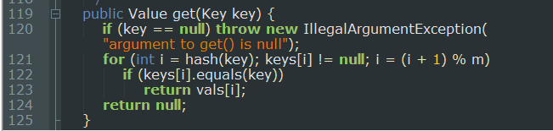
Hashing code: Textbook’s LinearProbingHashST.java
Lines 119-125:
Get method:
Run through similar loop as in “put”
If key is encountered, return the corresponding value.

Slide 15
Hashing code: Textbook’s LinearProbingHashST.java
Lines 119-125:
Get method:
Run through similar loop as in “put”
If key is encountered, return the corresponding value.

Slide 16
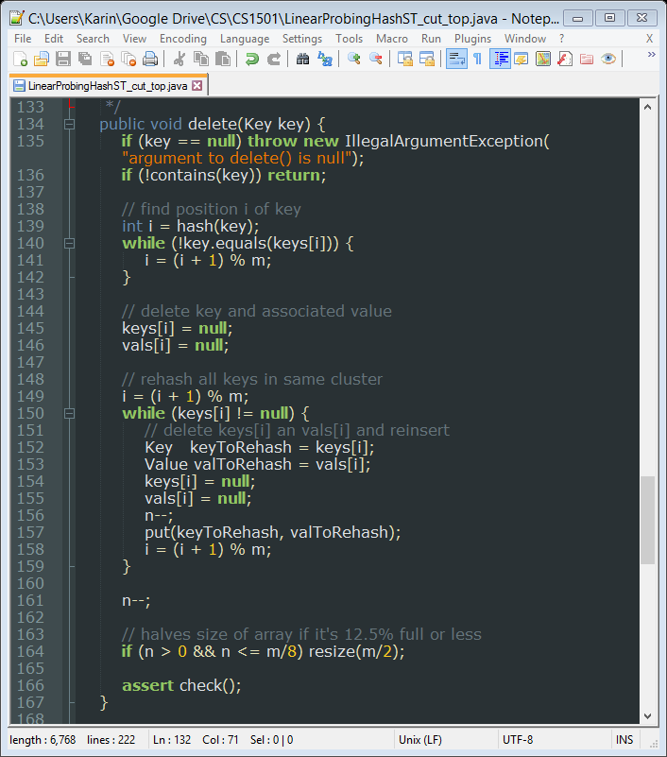
Hashing code: Textbook’s LinearProbingHashST.java
Lines 134-146:
delete method, first part:
Confirm key in table
Find the key, null out corresponding position in both key and value arrays

Slide 17
Hashing code: Textbook’s LinearProbingHashST.java
Lines 148-167:
delete method, second part:
We have to rehash everything that follows within the same cluster.
This issue was discussed on slide 14 in lecture.
These are items that may have ended up in their current location because they collided with the deleted item’s location.
If this is the case, then subsequent attempts to search for one of those keys will fail, because the hole left by the deleted item will be used to terminate the search process – it will never get to the location of the key that originally collided with it.
This method will also shrink the array if the load factor has become sufficiently low.

Slide 18
Hashing code: Textbook’s LinearProbingHashST.java
Lines 148-167:
delete method, second part:
We have to rehash everything that follows within the same cluster.
This issue was discussed on slide 14 in lecture.
These are items that may have ended up in their current location because they collided with the deleted item’s location.
If this is the case, then subsequent attempts to search for one of those keys will fail, because the hole left by the deleted item will be used to terminate the search process – it will never get to the location of the key that originally collided with it.
This method will also shrink the array if the load factor has become sufficiently low.

Slide 19
How would we modify this code to implement double hashing
The following shows one possible approach to this, for a subset of the hashing methods.
Double hashing code is not available from the textbook; the examples on the next few slides were formed with reference to various code samples on the web.

Slide 20
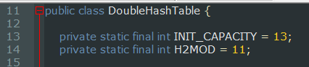
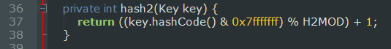
Modification #1: We need an h2() function to go along with our h1() function.
Let’s say we use the hash functions from the exercise (and disregard for the moment the possibility of table resizing):
Hash functions:
h1(k) = k % 13
h2(k) = (k % 11) + 1
We first set up constants at the top of the file:
Then we set up the h2(key) method:

Slide 21
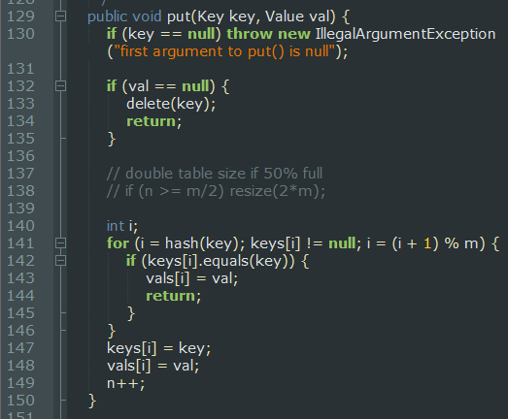
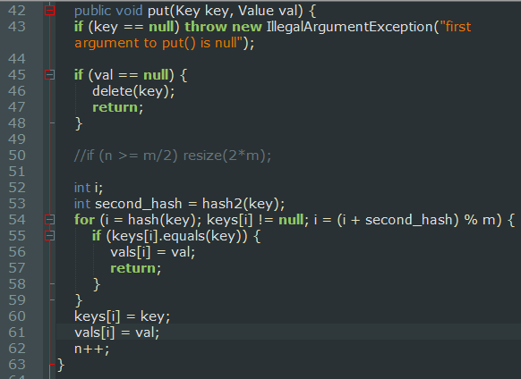
Modification #2: How does the put method change?
Linear probing (ignoring resize):
Double hashing (ignoring resize):
Modification #3: Apply analogous changes to get() and delete(). (Rehashing still has to be done for deletes, though clusters no longer appear contiguous)

Slide 22
Summary:
Double hashing can help avoid some of the run-time slow down that arises when contiguous clusters are formed in linear probing.
Some care has to be taken in choosing the h2() function.
Some of the pitfalls of open addressing remain
Deletion issues (must rehash, or tag spots as deletion locations)
Poor performance / collisions if load factor gets very high

