Slide 1
CS1501 Recitation 11/15/19
These slides will be available online:
https://github.com/kc13/CS1501
Agenda for today:
Review of the Edmonds Karp algorithm
(Ford Fulkerson using BFS)
Exercise
Review of some textbook code
Slide credits: Some content for these slides were adapted from the following (in addition to the lecture slides):
https://youtu.be/oO2X_-UGdF4
https://youtu.be/G240x-KCPd0
https://algs4.cs.princeton.edu/lectures/64MaxFlow-2x2.pdf
https://www.coursera.org/lecture/algorithms-part2/maxflow-applications-HR7SA
https://algs4.cs.princeton.edu/64maxflow/FordFulkerson.java and dependencies
Algorithm execution verified with Matlab

Slide 2
Network flow graphs: Data structure
s
Directed graph
Edge weights = capacity
“s” node = source (in these slides, s = Node 1)
“t” node = sink (here, t = Node with max ID #)
Concept: These enable algorithms that determine the maximum “flow” we can push along paths from the source to the sink (or alternatively, how we can most efficiently stop flow from s → t; i.e., the “min cut”).
t

Slide 3
Network flow graphs: Common analogies
s
Fluid flowing through pipes of varying size (what is the max amount of fluid we can push from s → t, or the minimum total diameter of pipes we need to sever to prevent flow from s → t?)
Traffic (vehicles, data) flowing through paths (roads, links) of varying capacity (e.g., what is max # cars per unit time that we can send from s → t, or minimum total capacity of the roads we need to cut to prevent travel from s → t?)
Real world applications can be much more abstract (see Coursera video listed on title slide for examples)
t

Slide 4
Network flow graphs: Finding max flow / min cut
s
In general, algorithms for finding max flow / min cut involve iteratively adding flow to the graphs according to some procedure.
The algorithms need to follow some basic rules for adding flow.
t

Slide 5
Rules for flow quantities assigned to the network:
s
Must not exceed edge capacity.
Inflow = Outflow at all vertices except s and t.
This all fits with the intuition behind the analogies given on the earlier slide (e.g., a pipe’s diameter limits how much fluid it can hold; however much fluid goes into a node should flow out of it)
t

Slide 6
Rules for flow quantities assigned to the network:
s
We typically start with all flows set to 0.
Look for full paths from s→ t which consist of edges with “residual capacity”:
If we’re moving forward, in the direction of the arrow, then residual capacity = [edge capacity - flow assigned to that edge so far].
Along a path of edges with residual capacity, we can only send as much flow as is allowed by the edge with the least amount of residual capacity available (the bottleneck).
t

Slide 7
Example of adding flow along a path:
s
Bottleneck on edge from 2 → 3
Once nonzero flow is present on the edge, it is possible to introduce paths that go backwards (against the arrow) along these edges.
8/
8/
8/
t
Backwards flow → subtracting from current flow total on edge
This can be conceptualized as undoing a past assignment of too much flow. (See lecture slides 5-10 for useful examples, and next slide.)

Slide 8
Examples of backwards edges with residual capacity:
https://algs4.cs.princeton.edu/lectures/64MaxFlow-2x2.pdf

Slide 9
Max Flow problem:
s
What is the maximum amount of “flow” that we can get from s to t?
8/
Once we know the max flow, we also know the capacity of the “min cut”.
8/
S-t Cut: Split of graph into two disjoint sets A and B, such that all paths from s-t are severed.
8/
t
Min cut: Cut that minimizes the sum of the capacities for the edges included in the cut (only edges from A→B summed).

Slide 10
Max Flow problem:
s
How do we identify the paths that will lead to maximum flow?
Ford Fulkerson:
Iteratively add paths from s to t, so long as it is possible to add positive flow along forward edges, or subtract flow along backward edges.
t

Slide 11
Max Flow problem:
s
What Ford Fulkerson doesn’t tell us: How do we identify which paths to draw, and when to draw them?
The answer to this question can greatly affect the efficiency with which the algorithm is completed.
t

Slide 12
Max Flow problem:
s
Edmonds Karp: Use BFS to sequence the path search.
BFS finds paths with the fewest number of edges.
General procedure:
Run iterations of BFS:
Each iteration: Return the first augmenting path that BFS discovers from s → t
Terminate when no augmenting paths remain
t

Slide 13
Max Flow problem:
s
Iteration #1 (Assuming BFS convention of visiting lower-numbered vertices first when vertices are an equal # of edges away
1-2-3-6 is the first s-t path returned; bottleneck flow is 8
8/
8/
8/
t

Slide 14
Max Flow problem:
s
Iteration #2: Note initial bottleneck from 1 → 2; constrains flow along path to 5.
13/
8/
5/
13/
t
5/
5/

Slide 15
Max Flow problem:
s
All paths out of s are blocked. Max flow = 13.
13/
If multiple edges had led into t, we would have summed the incoming edge flows to get max flow.
8/
5/
13/
Capacity of min cut also = 13. (e.g., you can sever the edge between 1 and 2).
t
5/
5/

Slide 16
Exercise: Use Edmonds Karp to find max flow / mincut
s
t
Notes:
BFS: 1 on queue, then pop it, add 2,3,4 to queue, pop 2, add 5 to queue, pop 3, add nothing to queue, pop 4, add 6 = t to queue, this identifies an s→t path, we see that we can push residual flow along it, we get the 17.

Slide 17
Solution: Iteration #1 (assuming priority for nodes of lower ID#)
s
17/
17/
t
Notes:
BFS: 1 on queue, pop, add 2,3,4, pop 2, add 5, pop 3, add nothing, pop 4, add 6, s→t but no residual flow, pop 5, touches 6 = t so residual flow there, can add 7

Slide 18
Solution: Iteration #2 (assuming L → R BFS)
s
Max flow = 24
7/
Example min cut of capacity 24
17/
7/
7/
17/
t
Notes:
3 can’t get us anywhere through backwards edges, bottleneck elsewhere

Slide 19
Textbook code for an edge (FlowEdge.java)
https://algs4.cs.princeton.edu/lectures/64MaxFlow-2x2.pdf

Slide 20
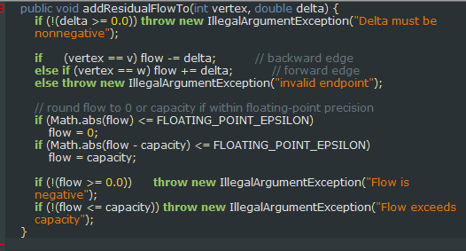
addResidualFlowTo: v and w are instance variables that represent the vertices at the start (v) and end (w) of the arrow

Slide 21
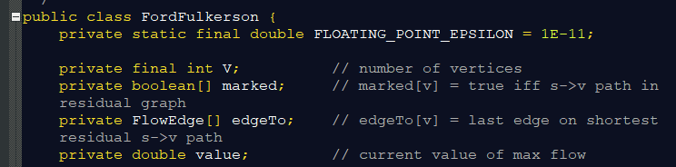
Highlights from textbook code for FordFulkerson.java (which implements Edmonds-Karp)
Notes:
V for count of vertices in network, marked used to keep track of visits in each BFS iteration, edgeTo to keep track of augmenting path returned by each BFS iteration, value for keeping track of s→t flow achieved

Slide 22
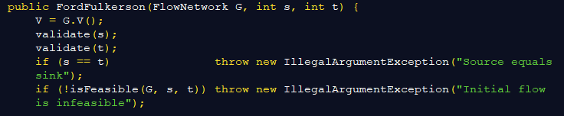
Top of constructor
Notes:
Sanity checks

Slide 23
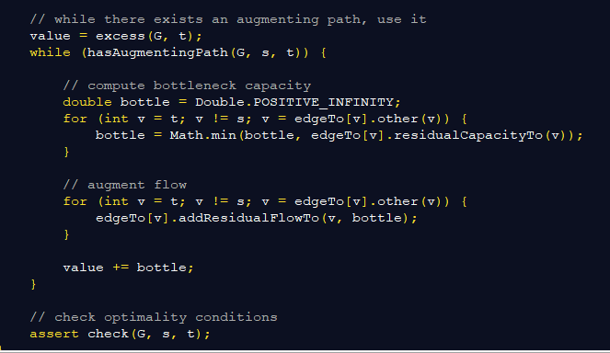
More of constructor
Iteratively running BFS
Notes:
Sanity checks

Slide 24
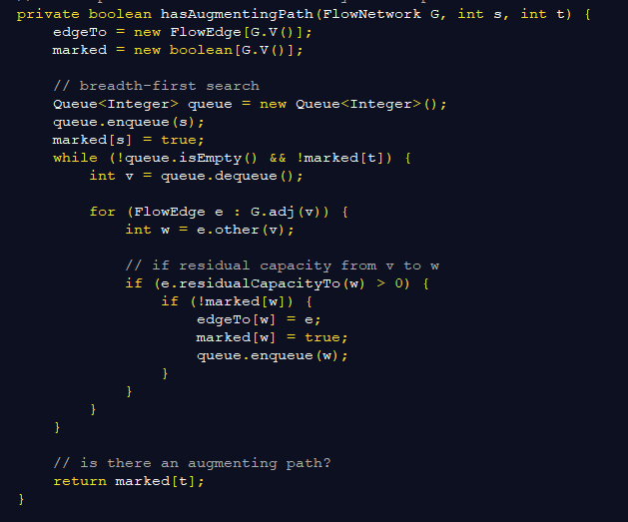
hasAugmentingPath
Notes:
Sanity checks

Slide 25
Back to the constructor
Notes:
Sanity checks

