Slide 1
CS1501 Recitation 11/10/17
These slides are available online:
https://github.com/kc13/CS1501
Agenda for today:
Review of the Edmonds Karp algorithm
(Ford Fulkerson using BFS)
Slide credits: Some content for these slides were adapted from the following:
https://youtu.be/oO2X_-UGdF4
https://youtu.be/G240x-KCPd0
https://algs4.cs.princeton.edu/lectures/64MaxFlow-2x2.pdf
Algorithm execution verified with Matlab

Slide 2
Network flow graphs: Data structure
s
Directed graph
Edge weights = capacity
“s” node = source (in these slides, s = Node 1)
“t” node = sink (here, t = Node with max ID #)
Concept: These enable algorithms that determine how much “flow” we can push along paths from the source to the sink (or alternatively, how we can most efficiently stop flow from s → t).
t

Slide 3
Rules for adding flow:
s
Must not exceed edge capacity.
Inflow = Outflow at all vertices except s and t.
t

Slide 4
Example of adding flow along a path:
s
Bottleneck on edge from 2 → 3
Once nonzero flow is present on the edge, it is possible to introduce paths that go backwards (against the arrow) along these edges.
8/
8/
8/
t
Backwards flow → subtracting from current flow total on edge
This can be conceptualized as undoing a past assignment of too much flow.

Slide 5
Max Flow problem:
s
What is the maximum amount of “flow” that we can get from s to t?
8/
Once we know the max flow, we also know the capacity of the “min cut”.
8/
S-t Cut: Split of graph into two disjoint sets A and B, such that all paths from s-t are severed.
8/
t
Min cut: Cut that minimizes the sum of the capacities for the edges included in the cut (only edges from A→B summed).

Slide 6
Max Flow problem:
s
How do we identify the paths that will lead to maximum flow?
Ford Fulkerson:
Iteratively add paths from s to t, so long as it is possible to add positive flow along forward edges, or subtract flow along backward edges.
t
How do we identify which paths to draw, and when to draw them?

Slide 7
Max Flow problem:
s
Edmonds Karp: Use BFS to sequence the path search.
BFS finds shortest paths.
General procedure:
Run iterations of BFS:
Each iteration will identify a path
Terminate when no open paths remain
t

Slide 8
Max Flow problem:
s
Iteration #1 (Assuming BFS convention of visiting leftmost edges first, when nodes are an equal # of edges away)
8/
8/
8/
t

Slide 9
Max Flow problem:
s
Iteration #2: Note initial bottleneck from 1 → 2; constrains flow along path to 5.
13/
8/
5/
13/
t
5/
5/

Slide 10
Max Flow problem:
s
All paths out of s are blocked. Max flow = 13.
13/
If multiple edges had led into t, we would have summed the incoming edge flows to get max flow.
8/
5/
13/
Capacity of min cut also = 13. (Sever edge between 1 and 2).
t
5/
5/

Slide 11
Exercise: Use Edmonds Karp to find max flow / mincut
s
t

Slide 12
Solution: Iteration #1 (assuming priority for nodes of lower ID#)
s
17/
17/
t

Slide 13
Solution: Iteration #2 (assuming L → R BFS)
s
Max flow = 24
7/
Example min cut of capacity 24
17/
7/
7/
17/
t

Slide 14
Textbook code for an edge (FlowEdge.java)
https://algs4.cs.princeton.edu/lectures/64MaxFlow-2x2.pdf

Slide 15
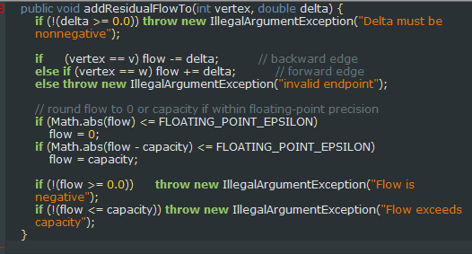
addResidualFlowTo: v and w are instance variables that represent the vertices at the start (v) and end (w) of the arrow

