Slide 1
CS1501 Recitation #1: 9/8/17
These slides are available online:
https://github.com/kc13/CS1501
Agenda for today:
Overview of the recitation
Demonstration of how to submit assignments on Github

Slide 2
Contact info
Email: kmc51@pitt.edu
Office: 6150 Sennott Square
Office hours: M 3-4:15 PM; W 2-3 PM; F 2-5:45 PM

Slide 3
Where to access recitation materials (optional):
Github repository:
https://github.com/kc13/CS1501
This repository will include recitation slides, and possibly other helpful material.
It will not be used for homework submission!
Homework will be submitted through unique repositories that will be created for you prior to each assignment.

Slide 4
Questionnaire (also optional):
Google form:
https://goo.gl/forms/xo3R5806e4UQTGLW2
Single, open ended question, where you can share your thoughts on what you might like to see in this recitation.
The form will be available for the next three weeks.

Slide 5
Attendance:
Not monitored, however –
There will be unannounced quizzes.
Lowest quiz grade will be dropped.

Slide 6
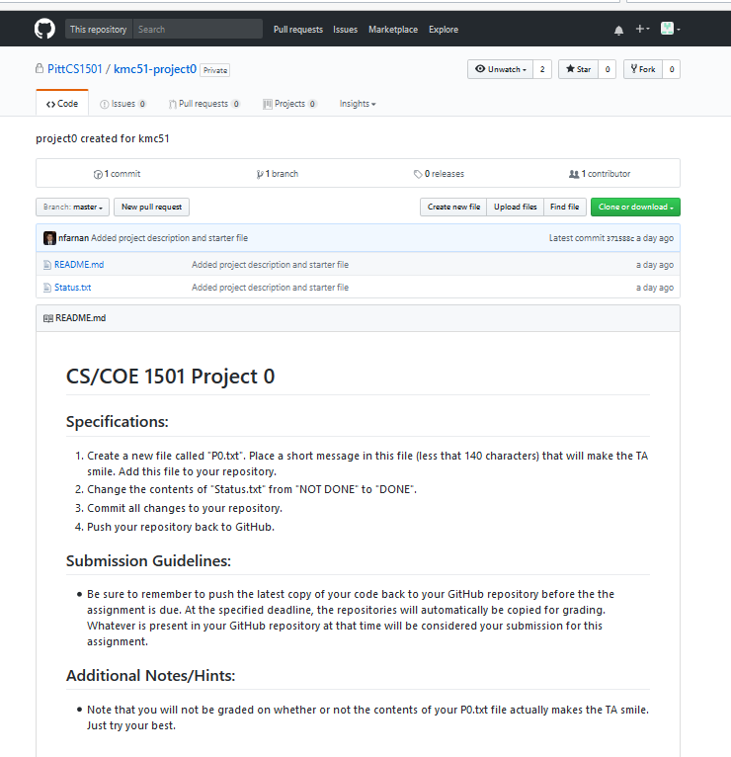
Homework submission through Github:
For practice, you will submit a “Project 0.”
This project will be made available to you in the near future.
Github will send you an email to invite you to the CS1501 organization.

Slide 7
Homework submission through Github:
The project will require you to both modify an existing text file and add a new one.
Today we will discuss how to accomplish this using git on the command line.
There are ways to accomplish the same process through the web and/or a GUI-based application (Github Desktop). Use of these alternatives is done at your own risk (you might experience problems).

Slide 8
What is git?
Version control system (for detailed info, see Prof. Farnan’s “git_crash_course” slides in the kc13/CS1501 repository).
Users can record changes to the files of a developing program in a local or remote repository.
You can use git to push the final version of your homework to the designated assignment repository.

Slide 9
How can git be accessed?
These slides will explain how to set up git for a Windows machine.
Options for installing git on MacOS are described here:
https://git-scm.com/book/en/v2/Getting-Started-Installing-Git

Slide 10
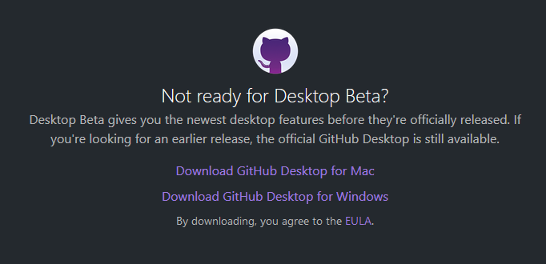
Git on Windows
If you install Github Desktop from Github (https://desktop.github.com/) it will also set up the Git shell.
There’s a beta version available now, but these slides use the official version (see link at bottom of page).

Slide 11
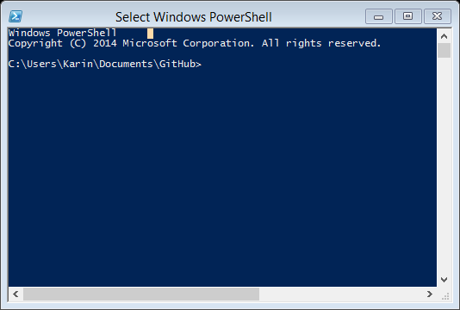
After installation
Search for the application “Git Shell”. Upon opening, you should see a Windows PowerShell screen that may look something like this:

Slide 12
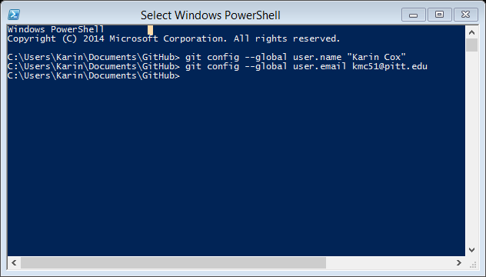
Do some basic configuration
“git config --list” can be used to view configuration settings

Slide 13
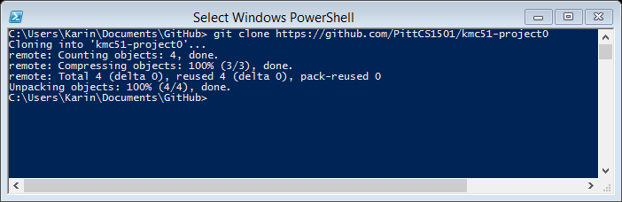
How do we do Project 0?
First, clone the remote repository to your local workspace.
Command: git clone <full Github URL for repository>

Slide 14
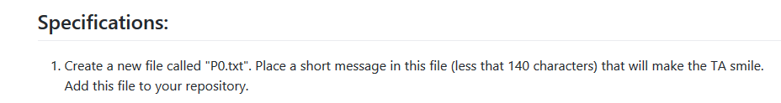
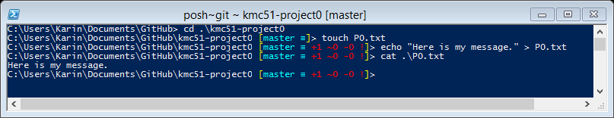
Complete step 1 of Project 0:
(Command line only shown for illustration; using File Explorer and a text editor is fine).

Slide 15
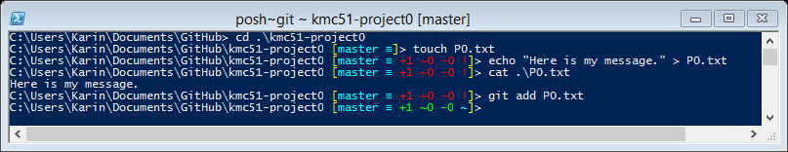
Complete step 1 of Project 0 (continued):
Add the completed P0.txt file to the “staging area.”
command: git add <filename>

Slide 16
Complete step 1 of Project 0 (continued):
Add the completed P0.txt file to the “staging area.”
command: git add <filename>

Slide 17
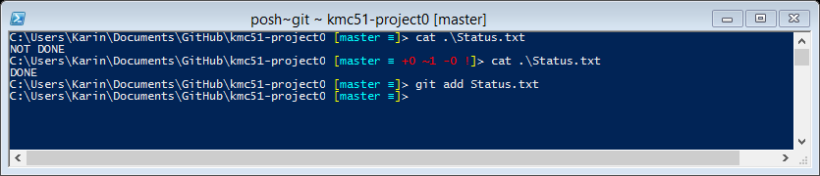
Complete step 2 of Project 0:
2. Change the contents of "Status.txt" from "NOT DONE" to "DONE".
(here, behind the scenes with a GUI-based text editor):

Slide 18
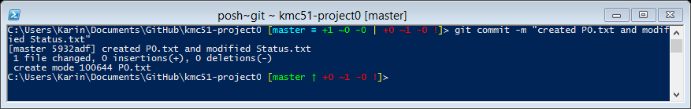
Complete step 3 of Project 0:
3. Commit all changes to your repository.
Command: git commit -m <descriptive message”>
This “commits” changes to your local repository.
The message is obligatory!
Commands “git status” and “git log” are helpful for keeping track of past additions/commits.

Slide 19
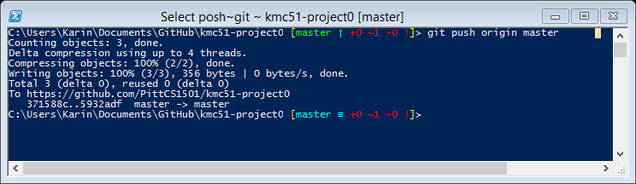
Complete step 4 of Project 0:
4. Push your repository back to GitHub.
Command: git push origin master
“Pushes” modified contents up to the Github repository.
master = label for current branch

Slide 20
Complete step 4 of Project 0:
4. Push your repository back to GitHub.
Command: git push origin master
“Pushes” modified contents up to the Github repository.
master = label for current branch

Slide 21
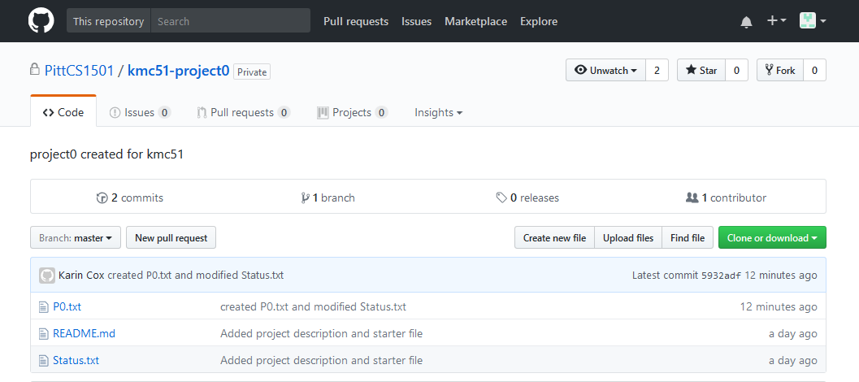
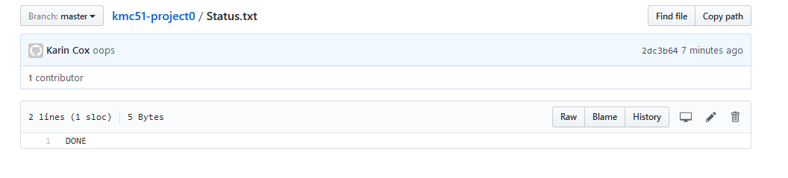
Confirm that the updates appear in the Github repository:

Slide 22
Final remarks:
Your final project submission = contents of Github repository at the time of the deadline.
Leave plenty of advance time to push contents to the repository and confirm correct updating of the Github repository.
Expect to be invited to the PittCS1501 group and provided with your own project0 repository in the near future.

