Slide 1
CS1501 Recitation 10/27/17
These slides are available online:
https://github.com/kc13/CS1501
Agenda for today:
Review of Graph Articulation Points:
What they are
How to find them
Slide credits: Some images and content for these slides were adapted from the following:
http://people.cs.pitt.edu/~ramirez/cs1501/
All results confirmed against:
https://algs4.cs.princeton.edu/41graph/Biconnected.java

Slide 2
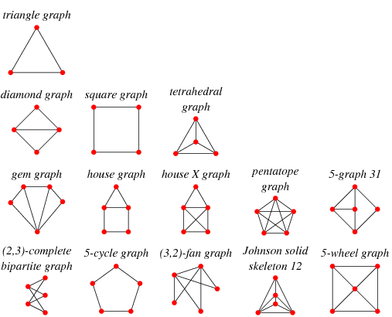
Biconnected graphs: What are they?
Examples:
Requirement: At least two distinct paths (no overlap) must exist between any arbitrary pair of vertices.
Implication: If you remove one path, another still remains.
Image credit: http://mathworld.wolfram.com/BiconnectedGraph.html

Slide 3
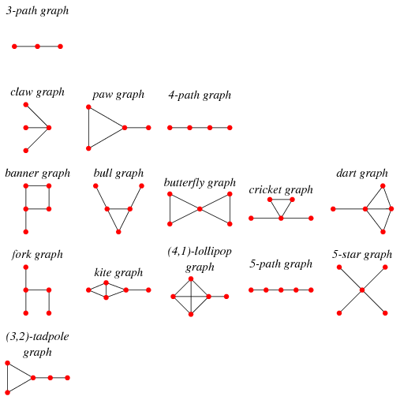
Graphs that are not biconnected:
Examples:
Articulation points: single vertices that, if removed, will separate the graph
Articulation points exist if and only if the graph is not biconnected
Image credit: http://mathworld.wolfram.com/BiconnectedGraph.html

Slide 4
How do we detect articulation points?
Step #1: Run depth first search (DFS), enumerate nodes according to order of visitation.

Slide 5
How do we detect articulation points?
Step #1: Run depth first search (DFS), enumerate nodes according to order of visitation.
Arbitrary root
0

Slide 6
How do we detect articulation points?
Step #1: Run depth first search (DFS), enumerate nodes according to order of visitation.
Arbitrary root
0
3
1
4
2

Slide 7
Some terminology before moving on to step #2:
DFS# = Order in visitation sequence.
Back edge = Connects to vertices that were already in the tree at the time the edge was considered.
0
Back edge
3
Back edge
1
4
2
Back edges help signal the existence of alternative routes.

Slide 8
Non-articulation points: A vertex V is not an articulation point if every child of V may connect to an “earlier vertex” (lower DFS#) without going through V (here = red, orange, green, purple).
For yellow (the articulation point), there exist children (2-3) that cannot connect to an earlier vertex (0) without going through yellow.
0
3
1
4
2

Slide 9
Step #2: Assign the “low” values: These provide information about the “earliest” vertex that a given vertex can access, by using either a back edge from itself, or going through a descendent (child or later “generations”) that can connect to earlier vertices using a single back edge.
low = 0
low = 1
0
3
low = 0
1
low = 1
low = 0
4
2

Slide 10
Where are the articulation points?
Look for the children of any parent with low values that are ≥ the parent’s DFS#:
low = 0
low = 1
The parent is an articulation point.
0
3
low = 0
1
low = 1
low = 0
4
2

Slide 11
The rules for root nodes are different.
When there are >= 2 children for the root, the root node must be an articulation point.

Slide 12
Exercise: Find the articulation point(s) for the following:

Slide 13
Exercise: Find the articulation point(s) for the following:
Low = 1
Low = 0
Low = 1
Low = 3
Low = 1
Low = 1

