Slide 1
CS1501 Recitation #4: 9/29/17
These slides are available online:
https://github.com/kc13/CS1501
Agenda for today:
Building the trie/codeword table for Huffman compression

Slide 2
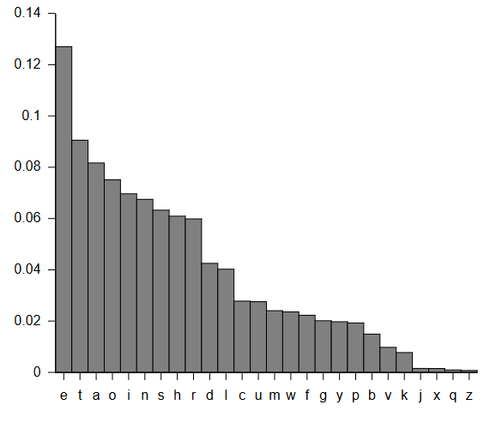
Brief overview of Huffman compression
ASCII representation of a character typically consumes 8 bits
e.g., A = 65 = 01000001
Storage could use less space if we used variable length bit strings, with some characters represented with fewer than 8 bits.
The shortest bit strings are assigned to the most frequent characters.
Codeword = bit string assigned to character
Source: Wikipedia

Slide 3
Prefix free codewords
If we want to read characters from the compressed text as we encounter them, we’ll have problems if the entire codes for some characters match the initial bitstring for other characters’ codes:
E | 0
T | 1
A | 00
O | 01
Compressed text = 01
ET or O?
E | 0
T | 10
A | 111
O | 110
Huffman code = 110
O

Slide 4
How was this table created?
E | 0
T | 10
A | 111
O | 110
First, we need character frequencies (hypothetical values given below):
E | 12
T | 7
A | 6
O | 5
Second, we create a set of incomplete, single node binary tries:
E:12
T:7
A:6
O:5

Slide 5
How was this table created?
Third: Find the two nodes with minimum value and “merge” underneath a single parent.
E:12
T:7
A:6
O:5

Slide 6
How was this table created?
Third: Find the two nodes with minimum value and “merge” underneath a single parent. Textbook convention is to place the lower value on the left.
11
O:5
A:6
E:12
T:7

Slide 7
How was this table created?
Fourth+: Repeat the process. Always refer to the parent node for the frequency count.
11
O:5
A:6
E:12
T:7

Slide 8
How was this table created?
Fourth+: Repeat the process. Always refer to the parent node for the frequency count.
T:7
11
E:12
O:5
A:6

Slide 9
How was this table created?
Fourth+: Repeat the process. Always refer to the parent node for the frequency count.
18
T:7
11
E:12
O:5
A:6

Slide 10
How was this table created?
Fourth+: Repeat the process. Always refer to the parent node for the frequency count.
E:12
18
T:7
11
O:5
A:6

Slide 11
How was this table created?
Fourth+: Repeat the process. Always refer to the parent node for the frequency count.
30
E:12
18
T:7
11
O:5
A:6

Slide 12
How was this table created?
Final step: Create the table. Codeword corresponds to traversal path down to the character at the leaf. Left = 0, Right =1
Note: In practice this is only done when decompressing the file.
E | 0
T | 10
A | 111
O | 110
30
E:12
18
T:7
11
O:5
A:6

Slide 13
Exercise: Create the trie and codewords given the following frequencies.
Steps:
Create a set of incomplete, single node binary tries.
Find the two nodes with minimum value and “merge” underneath a single parent (lower value on left, parent adopts sum of two child values).
Repeat the process, referring to the root of each trie for identifying the value.
Use the traversal paths to each character to populate the codeword table.
A | 24
B | 13
C | 8
D | 4
E | 2
F | 1

Slide 14
Solution (verified against Huffman.java):
A | 24
B | 13
C | 8
D | 4
E | 2
F | 1
A | 0
B | 10
C | 111
D | 1101
E | 11001
F | 11000

Slide 15
Huffman vs. LZW:
Huffman: Variable length codewords for fixed length strings (= 1 character).
LZW: Fixed length codewords for variable length strings.
Huffman: Codeword info (trie) stored along with compressed text.
LZW: Codewords can be reconstructed from compressed text.

