Slide 1
CS1675 Recitation #11: 11/16/18
These slides are available online:
https://github.com/kc13/CS1675
Agenda for today:
Review of topics relevant for HW#8:
Decision stumps
Boosting / AdaBoost algorithm
Other HW8 details

Slide 2
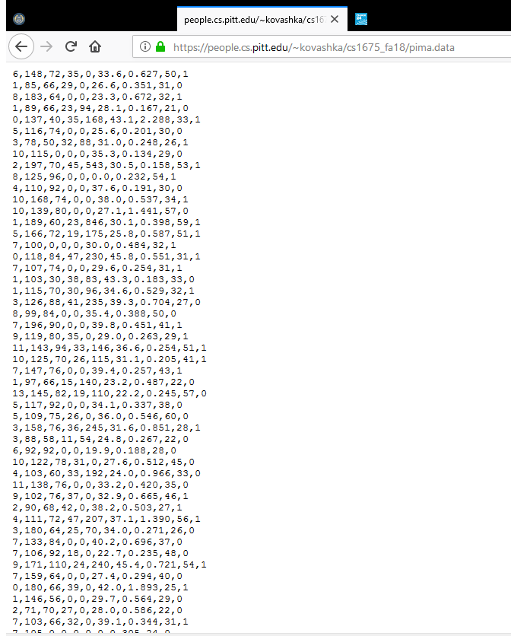
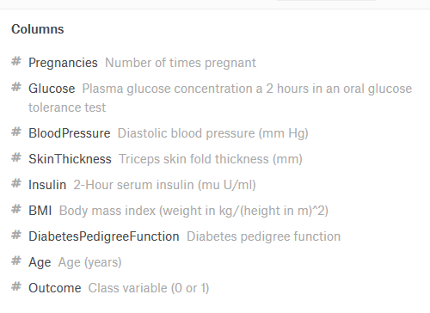
For all examples in these slides (and Part III of HW8)
Pima Indians dataset
Can reuse code from previous HW for standardization/cross-validation/etc
Convert Y data (Outcome) from 1/0 to 1/-1
Column names from https://www.kaggle.com/uciml/pima-indians-diabetes-database

Slide 3
Decision stumps (for decision_stump_set function)
Very simple classifier
Chooses 1 feature (i.e., 1 dimension)
Sets a threshold
Assigns opposite predictions if the feature is >= or < the threshold.
Age >= 50?
yPred = -1
yPred = 1
no
yes
Designing the classifier:
Which feature should we use?
What threshold should be used?
Which label should be assigned to “yes”?

Slide 4
decision_stump_set
This function will find the most effective decision stump to use, given:
An N x D training dataset
An N x 1 Y label vector
An N x 1 weight vector (for computing weighted accuracy, so some data rows can be deemed more important than others)
The most effective decision stump will be used to classify an M x D test dataset (X_test).
Age >= 50?
yPred = -1
yPred = 1
no
yes

Slide 5
decision_stump_set
For an N x D dataset, D x 20 candidate classifiers will compete to be the one used for the final output. Breakdown:
D (for each feature) x
10 (use 10 roughly uniformly spaced thresholds that cover the feature’s value range) x
2 (assign 1 or -1 if feature >= threshold)
Age >= 50?
yPred = -1
yPred = 1
no
yes

Slide 6
decision_stump_set: evaluating classifiers
For each decision stump, use the training labels to determine the accuracy on each sample of the training data.
Weight that accuracy vector by the N x 1 vector of weights, and sum.
Use the best-performing classifier to generate predictions for the test dataset.
Age >= 50?
yPred = -1
yPred = 1
no
yes

Slide 7
Boosting/AdaBoost (HW8 Part II)
General idea:
A decision stump (or other weak classifier) may not be very useful on its own.
A combination of weak classifiers might do a better job.
AdaBoost finds a set of weights (alphas) to apply to the different classifiers’ predictions. Weighting of the individual rows of the training data (w vector) is used in the algorithm to find these weights.

Slide 8
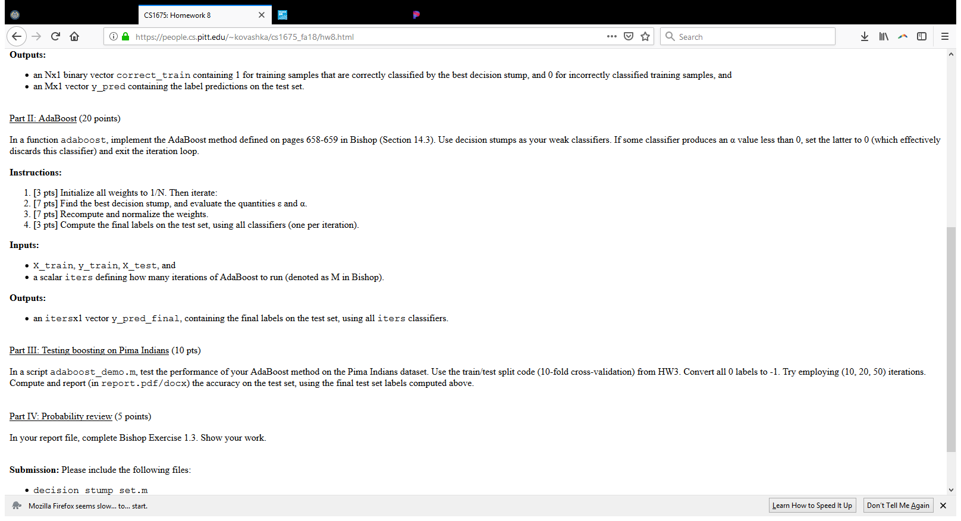
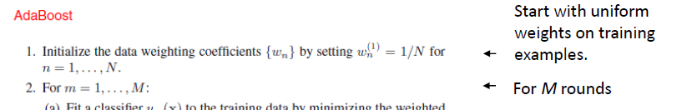
For HW8 implementation of AdaBoost
This will:
Follow the method in Bishop 14.3 / lecture slide 16
Make use of your decision_stump_set function
First step: Set up a vector of uniform weights for the rows of the training data:
Then set up a loop to iterate iters times (iters will be an input to your adaboost function).

Slide 9
For HW8 implementation of AdaBoost
Next:
You have a function that can do this! Also keep track of the predictions that it makes on X_test – you’ll need that later.
Note that you will maintain a vector of alphas (1 for each iteration).
From instructions: “If some classifier produces an α value less than 0, set the latter to 0 (which effectively discards this classifier) and exit the iteration loop.”

Slide 10
For HW8 implementation of AdaBoost
Next:

Slide 11
For HW8 implementation of AdaBoost
Next:
Do this after the M iterations. You’ll make use of the predicted Y vectors that you stored during each loop.

Slide 12
Exercise: Practice with decision stumps:
Data: Upper right corner of Pima dataset, not standardized (don’t worry about standardization for the exercise, and conversion from 0 to -1 has already been done for you):
DPF age y
0.6270 50.0000 1.0000
0.3510 31.0000 -1.0000
0.6720 32.0000 1.0000
0.1670 21.0000 -1.0000
2.2880 33.0000 1.0000
0.2010 30.0000 -1.0000
0.2480 26.0000 1.0000
0.1340 29.0000 -1.0000
0.1580 53.0000 1.0000
0.2320 54.0000 1.0000

Slide 13
Exercise: Practice with decision stumps:
Tasks (to do by hand or another method):
Create a set of eight decision stumps (2 features x 2 thresholds x 2 label assignments). What thresholds do they use (approximately)? (Use >= and <).
Which decision stump performs best, when evaluated according to uniformly-weighted accuracy?

Slide 14
Solution starts on next slide:

Slide 15
Decision stumps + weights for these data:
DPF age y
0.6270 50.0000 1.0000
0.3510 31.0000 -1.0000
0.6720 32.0000 1.0000
0.1670 21.0000 -1.0000
2.2880 33.0000 1.0000
0.2010 30.0000 -1.0000
0.2480 26.0000 1.0000
0.1340 29.0000 -1.0000
0.1580 53.0000 1.0000
0.2320 54.0000 1.0000
weights
0.1
0.1
0.1
0.1
0.1
0.1
0.1
0.1
0.1
0.1

Slide 16
Decision stumps + weighted accuracy:
DPF age y
0.6270 50.0000 1.0000
0.3510 31.0000 -1.0000
0.6720 32.0000 1.0000
0.1670 21.0000 -1.0000
2.2880 33.0000 1.0000
0.2010 30.0000 -1.0000
0.2480 26.0000 1.0000
0.1340 29.0000 -1.0000
0.1580 53.0000 1.0000
0.2320 54.0000 1.0000
In the AdaBoost algorithm, the highlighted stump is the one that we would (1) apply to X_test, (2) would be used to calculate alpha and epsilon for this iteration.

