Slide 1
CS1675 Recitation #13: 12/7/18
These slides are available online:
https://github.com/kc13/CS1675
Agenda for today:
Info regarding finals week
Review of Hidden Markov Models (HMMs)
Naïve/efficient solutions for computing the observation likelihood
Exercise: Computing the efficient solution for a sample problem (based on tables given in HW9)
Note: some material/images from lecture slides

Slide 2
Finals week
I will hold TA office hours on Monday from 2:30-4:00 pm and Wednesday from 4:00-5:30 pm.
Adriana will hold office hours after the exam on Tuesday, from 4:30 pm to 5:30 pm (watch for an announcement over the weekend).
Reminder: I will start grading HW9 on Wednesday. If you expect to use late minutes to override a previous attempt that you submitted before the Tuesday night deadline, please contact me.

Slide 3
Review of Hidden Markov Models (HMMs)
From lecture slides

Slide 4
Example from HW9: Part of Speech (POS) tags, and their generation of observable words (w/ very limited sets of both):
z_{i} ϵ {start, PropNoun, Noun, Verb, Det, end}
x_{i} ϵ {'john ', 'mary ', 'cat ', 'saw ', 'ate ', 'a ', 'the '}

Slide 5
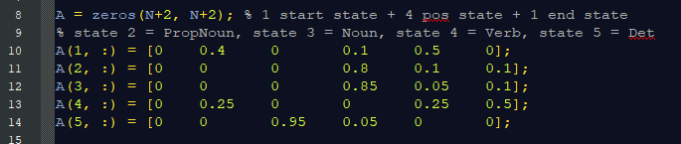
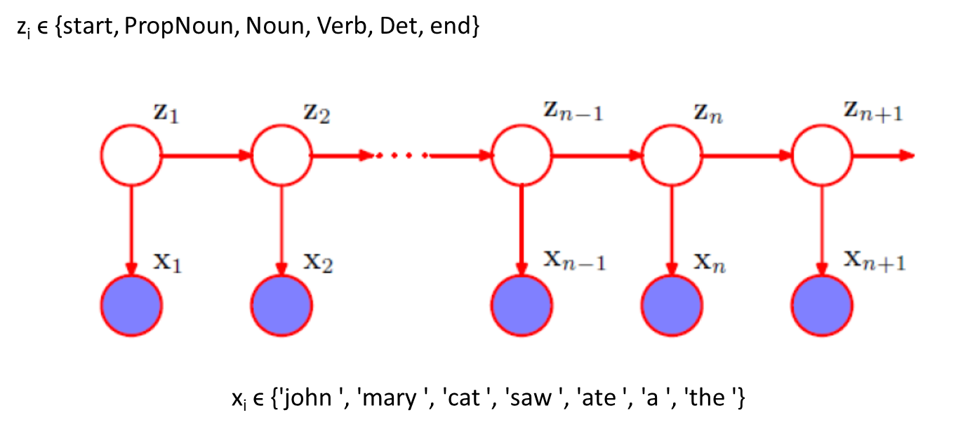
In addition to the different values that the latent POS tags (z) and observable words (x) might take, we need two sets of probabilities:
The transition matrix tells us the probability of transferring to a specific state at time t+1, given the state at time t:
See hmm_starter.m file from HW9 instructions and slide 53 from lecture
Example: p(state_{t+1} = PropNoun | state_{t} = start) = 0.4
Row 6 = all zeros
(We’ll never ask the probability of
transitioning from the end state
to another state)

Slide 6
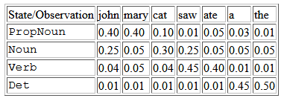
In addition to the different values that the latent POS tags (z) and observable words (x) might take, we need two sets of probabilities:
The observation matrix tells us the probability of observing a specific word at time t, given a specific POS tag at time t (note: there are no words observed during the start/end states)
See HW9 instructions and hmm_starter.m file from HW9
Example: p(word_{t} = saw|state_{t} = verb) = 0.45

Slide 7
Computing observation likelihood: Naïve and efficient solutions
For HW9, you are asked to write a Matlab program that will compute the observation likelihood of several sentences, such as “John ate.”
Observation likelihood = What is the probability of observing “John ate”, given our transition and observation matrices?
Transition matrix (A)
Observation matrix (B)

Slide 8
Observation likelihood: Naïve solution
Naïve solution for observation likelihood of “John ate”
Refer to these formulas from the lecture slides:
Steps:
“John ate” arises from 4 HMM timepoints, which proceed through the start state, two POS tag states, and the end state. We need to enumerate all of the possible 4-timepoint sequences (here, denoted as Q) that may arise from this HMM.
Note that these slides will assume that the end state should be included in the probability calculation. You may also encounter approaches that do not include the end state. Either approach is considered valid, although the probabilities that are returned will differ. For start/end, P(O|Q) = 1 (or can be ignored).
For each state sequence (e.g., start-PropNoun-Verb-end), we use the top formula to compute the joint probability of the observed words O (John ate) and that state sequence (Q).
The observation likelihood, P(O), is the sum of the joint probabilities P(O,Q) over all possible 4-timepoint sequences Q.

Slide 9
Why is this solution inefficient?
There is a lot of redundancy across the individual joint probability calculations – many individual terms in the overall product will be calculated again and again.
The efficient solution takes advantage of this redundancy by storing intermediate results in a matrix.
This is an example of dynamic programming / memoization.

Slide 10
Observation likelihood: Efficient solution
The exercise today will involve computing the observation likelihood of “John ate” using the efficient solution and the probabilities given on the previous slides.
You can do this by hand, or with Matlab/another tool.
The next few slides will provide some guidelines on how to compute the observation likelihood using the efficient solution.
These will closely follow/borrow material from slides 75+ in the lecture slide deck.

Slide 11
Observation likelihood: Efficient solution
As with the naïve approach, we first need to make sure that we have the two probability matrices available, and we need to know how many timepoints we have.
Remember “John ate” = 4 timepoints (after adding start and end states). In these slides, nT will denote the # of timepoints.
Transition matrix (A)
Observation matrix (B)

Slide 12
Observation likelihood: Efficient solution
Next, we can initialize a matrix with nT - 2 columns and a # of rows equal to the # of possible non-start/non-end states.
# non-start/non-end states = the total # of POS tags
= 4 in this example
hereafter denoted in these slides as nS
T = 2 T = 3
The sum of each column of this matrix will reflect the observation likelihood for our sample sentence, up through the timepoint represented by the column. We will not use this matrix to represent timepoints 1 and 4 (since t = 1 must be at start and t = 4 must be at end).
PropNoun
Noun
Verb
Det

Slide 13
Observation likelihood: Efficient solution
Next, we initialize the T = 2 column (i.e., the first non-start timepoint) by calculating, for each POS tag (row) i:
p(state_{t=2} = POS_{i} | state_{t=1} = start) * p(word_{t=2} = John|state_{t=2} = POS_{i}) =
p(word_{t=2} = John, state_{t=2} = POS_{i}| state_{t=1} = start)
T = 2 T = 3
PropNoun
Noun
Verb
Det
We can get the needed probabilities from the A and B matrices.

Slide 14
Observation likelihood: Efficient solution
Next, we complete the T = 3 column by calculating, for each POS tag (row) i:
Σ_{j} [p(state_{t=3} = POS_{i} | state_{t=2} = POS_{j}) * p(word_{t=2} = John, state_{t=2} = POS_{j} |state_{t=1} = start) * p(word_{t=3} = ate|state_{t=3} = POS_{i})]
T = 2 T = 3
##
##
##
##
We need to compute the sum over j to account for all of the different subsequences that might have led to POS_{i} at T = 3 (here, just start followed by one POS tag). The new term in the formula comes from the column that was computed on the last round. If this were a longer sentence, with more columns, we would repeat the formula, each time multiplying information from the A and B matrices by the values from the t-1 column.
PropNoun
Noun
Verb
Det

Slide 15
Observation likelihood: Efficient solution
Next, we compute a total observation likelihood as follows:
Σ_{j} [(value in column T = 3, row j) * p(state_{t=4} = end | state_{t=3} POS_{j}) ]
T = 2 T = 3
In other words: Each entry in column T = 3 communicates the probability of observing the sequence “John ate”, assuming one of the 4 possible POS tags at t = 3. So to get the full likelihood of observing “John ate” followed by an end state, we need to take the sum of column 3, weighted by the probabilities of transitioning from each POS tag to the end of the sentence.
## | ##
## | ##
## | ##
## | ##
PropNoun
Noun
Verb
Det

Slide 16
Efficient solution exercise:
What is the observation likelihood of “John ate”?
What does the completed matrix look like, for the efficient solution?
Reminders:
We are including the end state in our calculations.
Transition matrix (A)
Observation matrix (B)

Slide 17
Solution on next slide

Slide 18

Observation likelihood, efficient solution
p(John ate | model parameters)?
Answer: 0.0256787500 (see post on Piazza)
Matrix (the slides call this α, or a “forward trellis”):

Slide 19
Slightly more detail in case it is helpful….
Without end state
With end state: p(O|λ) = dot(α₂, A(2:end-1,end)) = : 0.0256787500

Slide 20
Some final comments about HW9:
For Parts II-III, you are asked to implement the naïve solution.
Incorporating the transition to the end state is optional. See Piazza for some comments on this (and some sample observation likelihoods for each approach).

