Slide 1
CS1675 Recitation #7: 10/5/18
These slides are available online:
https://github.com/kc13/CS1675
Agenda for today:
Logistic regression continued
Calculating likelihood estimates
Deriving likelihood gradient with respect to weights
Demo of perceptron output

Slide 2
Logistic regression exercise
General goal: Given data and two possible solutions for the LR weights, determine which set of weights is preferable, given the likelihood formula.

Slide 3
Logistic regression exercise
Data:
https://github.com/kc13/CS1675/recitation7/candy-data.xlsx
Original source:
https://www.kaggle.com/fivethirtyeight/the-ultimate-halloween-candy-power-ranking
Data are identical (except Kaggle file is csv)
See the Kaggle page for acknowledgements / full description
To read in the Excel data:
[num,txt,raw] = xlsread(‘candy-data.xlsx’)
num = all the numeric data (everything but the name)
num(:,1) will be our Y variable: Is the candy chocolate or not?
You will need to create X and Y variables such that:
X is a set of training features consisting of a bias column and columns 2:end of num.
Y is num(:,1).
For this exercise, we won’t split into train/test sets or standardize the data.

Slide 4
Logistic regression exercise
Two candidate LR weights:
https://github.com/kc13/CS1675/recitation7/candy-data-w1.txt
https://github.com/kc13/CS1675/recitation7/candy-data-w2.txt
These can be read into Matlab with dlmread.
One of these sets of weights is the logistic regression solution provided by external statistical software (SPSS) after 20 iterations.
The other is the same weight vector after being corrupted with a small amount of normally distributed noise. It is associated with a smaller maximum likelihood score, relative to the solution vector.

Slide 5
Task:
Write a Matlab function to compute the likelihood of observing the data (X and Y) given a logistic regression model with weight solution w. Use this function to determine whether w1 or w2 was the original solution provided by the external software (i.e., which has a higher L(w)).
Computing likelihood:
Reminders:
We’re taking the product over the N rows of the dataset (prod can do this on matrices, or you can use a loop)
σ = sigmoid function (you can implement this yourself, or use logsig if you have it)
Note the sigmoid is applied before exponentiation.
Y is already coded in 1/0s, as this formula expects.
The likelihood values will be very small. The value for the corrupted w should be smallest.

Slide 6
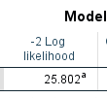
Solution:
Likelihood for w1: 2.4951e-06
Likelihood for w2: 1.3288e-57
w1 was the original solution.
Validation of L(w1) against SPSS:
Note that -2 * log(2.4951e-06) = 25.8024
Matlab files demonstrating sample solutions to this exercise will be posted to Github later today (and shown in recitation).

Slide 7
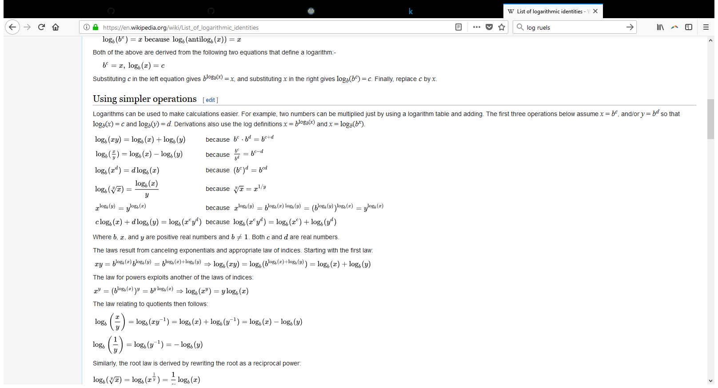
Logistic Regression: Quick review of gradient ascent update rule derivation
We start with the likelihood function, which we want to maximize:
Next, we will take the log of L(w):
Note use of log rules (source: Wikipedia):

Slide 8
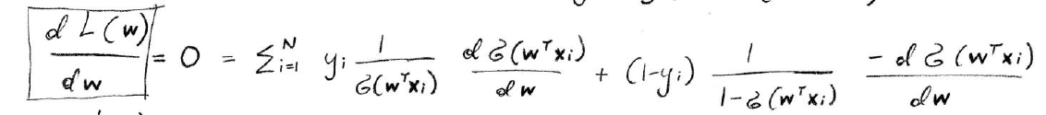
Logistic Regression: Quick review of gradient ascent update rule derivation
We want to find a maximum, so we want to find the weights for which the gradient = 0
This derivative makes use of the following rules:
Chain rule (because you have functions nested w/n the log functions)
d/dx log(x) = 1/x

Slide 9
Logistic Regression: Quick review of gradient ascent update rule derivation
We want to find a maximum, so we want to find the weights for which the gradient = 0
This derivative makes use of the following rules:
Chain rule (because you have functions nested w/n the log functions)
d/dx log(x) = 1/x

Slide 10
Logistic Regression: Quick review of gradient ascent update rule derivation
The next line applies some basic algebra/arithmetic (distributive property to pull out remaining derivative term; combination of fractions):
The next line takes the derivative of the d/dw term, with a combination of the chain rule and the known derivative of the sigmoid function:

Slide 11
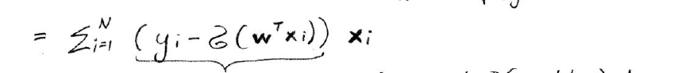
Logistic Regression: Quick review of gradient ascent update rule derivation
Eliminate terms:
Final gradient ascent rule:

Slide 12
Demo of expected perceptron output

