Slide 1
CS1675 Recitation #8: 10/26/18
These slides are available online:
https://github.com/kc13/CS1675
Agenda for today:
Review of ml_svm_notes.pdf (relevant for HW6)
Brief review of kernels + exercise

Slide 2
ml_svm_notes.pdf: Lagrange multipliers
Lagrange multipliers:
“…used to find the stationary points of a function of several variables subject to one or more constraints.” (Bishop Appendix E).
The above notes depict a general case in which we are attempting to find the minimum of a function of the vector w, constrained by the requirement that application of each a series of functions (denoted as h_{i = 1:n}) to w yields an output of 0. In other words, these h_{i} functions comprise a set of equality constraints.

Slide 3
Lagrangian function: equality constraints only
Lagrange multipliers allow us to transform this constrained optimization problem into an unconstrained optimization problem (which is likely easier to solve).
This unconstrained problem is expressed as the Lagrangian function:
..where the β_{i} are the Lagrange multipliers (refer to Appendix E of Bishop for more information). This is the function that we want to minimize.

Slide 4

Lagrangian function: adding inequality constraints
What if we also need to include inequality constraints (i.e., functions denoted as g_{i} that yield an output <= 0 when applied to w)?
Given that the Karush-Kuhn-Tucker (KKT)* conditions hold, we can incorporate these additional functions (and a set of weights, denoted as α_{i}) into the unconstrained optimization problem:
* For more information, see ml_svm_notes.pdf and/or Bishop Appendix E

Slide 5
Lagrangian with inequality constraints: Primal and Dual
There are two representations of how we might solve this problem. First, the primal:
Stated in words: We want to find the w that minimizes l_{p}(w), where l_{p}(w) is equal to the maximum Lagrangian function output with respect to the α_{i} (constrained to be nonnegative) and the β_{i} for that w.

Slide 6
Lagrangian with inequality constraints: Primal and Dual
This is the primal representation of the problem. From the notes:
There is also a dual representation of the problem:
Stated in words: We want to find the α and β that maximize l_{d}(α, β), where l_{d}(α, β) is equal to the minimum Lagrangian function output with respect to w for that α and β.

Slide 7
Lagrangian with inequality constraints: Primal and Dual
This is the primal representation of the problem. From the notes:
There is also a dual representation of the problem:
When the KKT conditions hold, these representations are equivalent.

Slide 8


How is this relevant to SVMs?
1. We want to minimize this function:
2. Subject to this constraint:
y_{i} = class label = -1 or + 1
The distance of all training points from the decision boundary will be >= 1.
We can also express this constraint as an inequality relative to zero:
So we can set up the following Lagrangian function:

Slide 9
How is this relevant to SVMs?
Lagrangian function:
For SVMs, it is traditional to solve the dual problem rather than the primal. That is, we first minimize the Lagrangian with respect to w and b, and then plug this result into the expression that maximizes α. The subsequent lines in the notes perform the minimization step:

Slide 10
Plugging the min w result into the maximization problem:

Slide 11
This is then converted to a quadratic programming problem (optimize a quadratic function subject to constraints):
Constraints:
Optimization problem:
Which is a matrix formulation of the maximization problem form the previous slide:

Slide 12
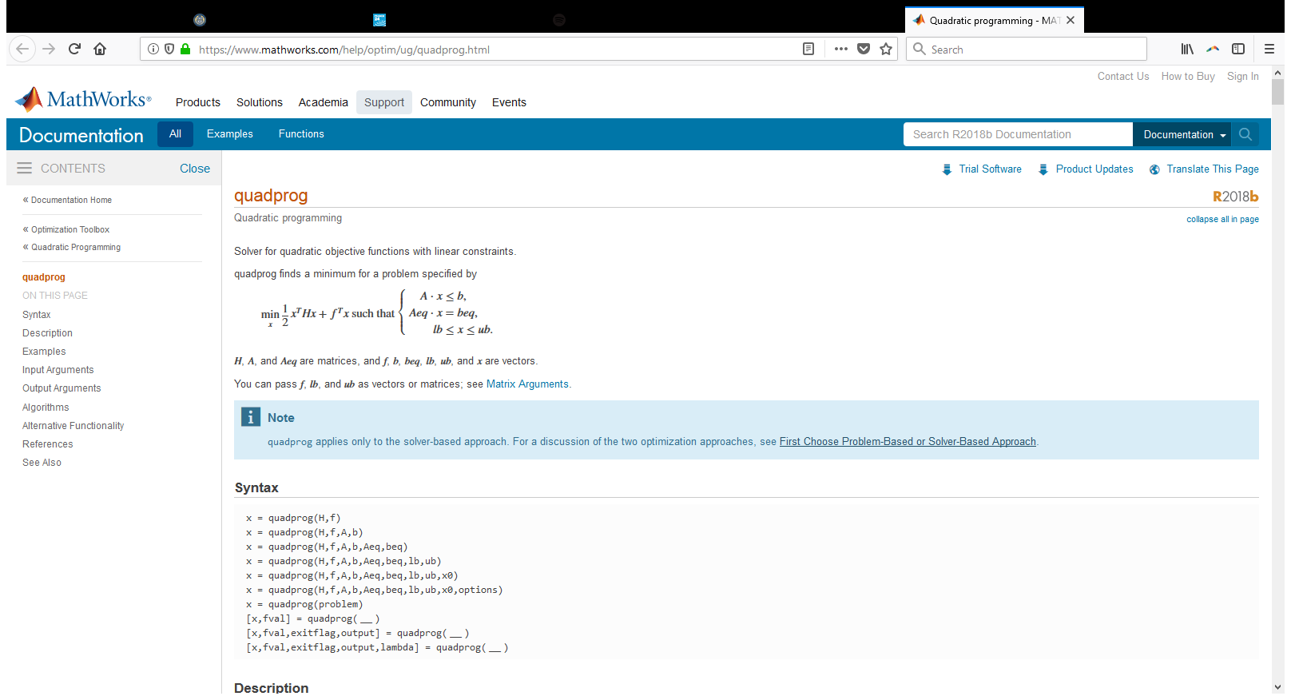

How is this relevant for HW6?
For the HW, you will need to figure out how to assign the variables required by quadprog.

Slide 13
Hint #1:
Matlab expects a minimization problem, but the notes present a maximization problem:
How can you recast the problem from the notes to be a minimization problem, as Matlab expects?

Slide 14
Hint #2: The input H
Each entry in H will reflect the multiplication (as specified in the formula) of the feature vectors and class labels for a pair of training samples.

Slide 15
Hint #3: The inputs A and b
Remember that you can specify empty arguments to Matlab functions as [].

Slide 16
Hint #4: The input f.
You can deduce what it is using this term (after you’ve adjusted the formula to be a min problem). Which vector do we already know?

Slide 17
Hint #5: The inputs Aeq and beq.
Remember our constraints:

Slide 18
Hint #6: The inputs lb and ub
lb: again, refer to our set of constraints:
Two options will be considered acceptable for ub:
[ ] (leave it empty)
C * ones(num_train, 1) (vector consisting of the C value submitted to the outer svm_quadprog function)

Slide 19
Moving on to kernels

Slide 20
Recap of lecture material on kernels
Kernels are often brought up in the context of nonlinear SVMs. Recall that SVMs attempt to place a decision boundary that separates two classes of decision points. In the example below, the two classes are linearly separable only after each x_{i} is transformed to a 2D vector such φ(x_{i}) = [x_{i} , x_{i}²].

Slide 21
Recap of lecture material on kernels
Concern: Transforming all the datapoints might be computationally expensive.
Kernel functions help address this issue by providing a formula for the dot product of φ(x_{i}), φ(x_{j}) that may eliminate the need to actually implement the transformation defined by φ. This is helpful for nonlinear SVMs, which require the computation of dot products between data points during both training and test.

Slide 22
Use of kernel functions
If we have identified a kernel function k(x_{i},x_{j}) = dot(φ(xi), φ(xj)) for the transform φ that we wish to perform on the data that we are classifying, we can replace the dot products in the classification algorithm with k(x_{i},x_{j}), instead of having to actually perform the transformation on the data points.
Example: Using a trained SVM to classify a test point:
Replace with k(x_{i},x)

Slide 23
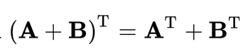
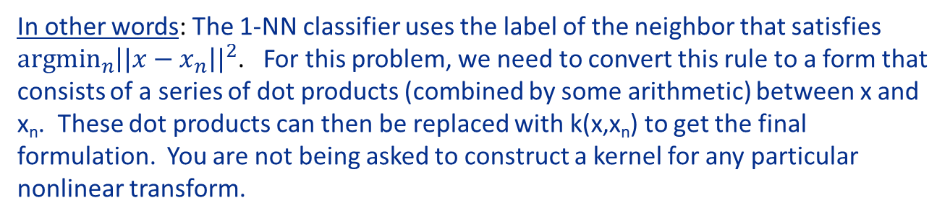
Bishop Exercise 6.3
The nearest-neighbor classifier (Section 2.5.2) assigns a new input vector x to the same class as that of the nearest input vector x_{n} from the training set, where in the simplest case, the distance is defined by the Euclidean metric ||x – x_{n}||². By expressing this rule in terms of scalar products (= dot products) and then making use of kernel substitution, formulate the nearest-neighbor classifier for a general nonlinear kernel.
In other words: The 1-NN classifier uses the label of the neighbor that satisfies $\underset{n}{argmin}{{\left||x−x_{n}\right||}^{2}}$. For this problem, we need to convert this rule to a form that consists of a series of dot products (combined by some arithmetic) between x and x_{n}. These dot products can then be replaced with k(x,x_{n}) to get the final formulation. You are not being asked to construct a kernel for any particular nonlinear transform.
Hints: Expand the norm notation, remembering that the L2 norm of a vector x is x^{T}x, that x^{T}x is the same as an inner product of x with itself, and transpose distribution properties. Then express the expanded form with kernel notation (what type of kernel do you see?)
Transpose distributive property

Slide 24
Solution - next slide

Slide 25
Solution

