Slide 1
CS401 Lab: 7/18/16
Lab handout: http://people.cs.pitt.edu/~ramirez/cs401/labs/lab8.htm
These slides: https://github.com/kc13/cs401
Agenda for today:
Quick overview of Lab #8
Time available for lab / demos: 65 minutes
1st section: 11:30-12:35, 2nd section: 2:30-3:35
Demos of Lab #7 should be presented first
If you need more time for Lab #8, it can be demonstrated at the beginning of next week’s lab, or during office hours.
Quiz: Last 45 minutes of lab:
→ 1st section: 12:35-1:20, 2nd section: 3:35-4:20

Slide 2
Lab #8 Overview
For this lab you will need to download three files:
SimpleDeque.java: interface file
MyDeque.java: class that uses the interface file (incomplete)
Lab8.java: program that will test MyDeque

Slide 3
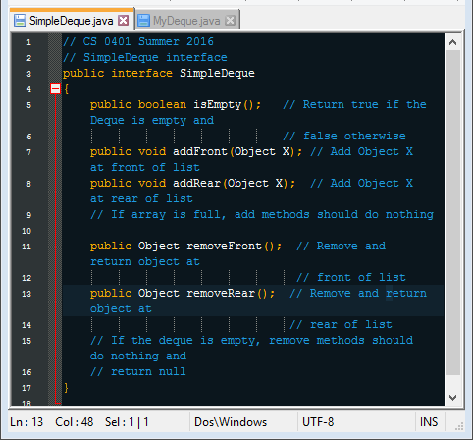
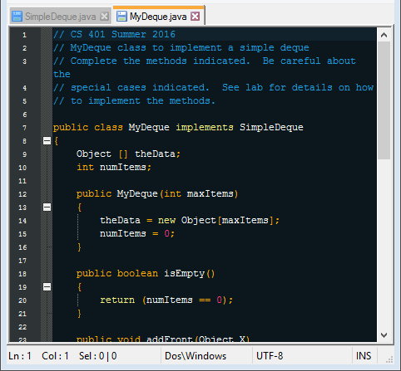
Interfaces
It can be helpful to think of an interface as a contract with a client of your class (i.e., another Java program).
The interface specifies the methods that your class must commit to implementing, if you claim that it implements the interface
Today’s lab: Note that all public methods declared in SimpleDeque are also present in MyDeque

Slide 4
Completing MyDeque
myData (array of Objects), initialized to hold “maxItems”
numItems
Initialized at 0
Should be continually updated to track the number of elements in the array.
Can also be helpful for pointing to the index of the first empty slot in the array.

Slide 5
Methods in MyDeque (reordered for these slides)
public boolean isEmpty()
{
return (numItems == 0);
}
Already complete
If any empty slots exist at the end of the array, place X in the first available slot.
Remember to adjust numItems!
public void addRear(Object X)
{
// Add new item at rear of list. If the list is full,
// do not add the item (just do nothing).
}
8
1 | 2 | 5 | 7 | 3

Slide 6
Methods in MyDeque
public Object removeRear()
{
// Remove and return rear item from list. If list is empty,
// return null.
}
8
1 | 2 | 5 | 7 | 3 | null
Remember :
check if the array is empty
store the removed object in a temporary variable
set the newly vacated slot to null
adjust numItems
return the removed object to the user

Slide 7
Methods in MyDeque
public void addFront()
{
// Add new item at front of list (shifting old items
// to right first). If the list is full, do not add
// the item (just do nothing).
}
8
 | 1 | 2 | 5 | 7 | 3
Remember to check if the list is full,
shift existing items to the right (a for loop may help)
add the new item in position 0
adjust numItems

Slide 8
Methods in MyDeque
public Object removeFront()
{
// Remove and return front item from list, shifting remaining
// items to the left to fill the spot. If list is empty,
// return null.
}
8
1 | 2 | 5 | 7 | 3 | null
Remember to check if the list is empty,
store the removed object in a temporary variable
shift existing items to the left
Is probably a good idea to set the one newly-vacated position to null
adjust numItems,
return the removed object

Slide 9
For the demo:
addFront() method – 1 point
removeFront() method – 1 point
addRear() method – 1 point
removeRear() method – 1 point
Scoring will be primarily based on match with target output (see instructions), although the source code should also be available.

