Slide 1
CS401 Lab: 5/16/16
Please locate a functioning computer and log in with your Pitt user name and password.
Setup may take 5-10 minutes. (This may be prevented in the future if you use the same computer again.)
Hardcopy of today’s lab is available at the front of the room if you want one.
Agenda for today:
Basic info regarding the lab + policies
Brief discussion of today’s lab
Remaining time is available to work on lab, ask questions, and demonstrate lab completion.

Slide 2
Basic lab info + policies
Labs:
Room: 5505 Sennott Square
Session #1: 11:30 am-1:20 pm Session #2: 2:30-4:20 pm
Attendance: required
Holidays: no class or lab on Memorial Day or July 4th
For lab handouts:
http://people.cs.pitt.edu/~ramirez/cs401/
→ see “CS0401 Lab Schedule” section
TA: Karin Cox
Email: kmc51@pitt.edu
Office hours: Thursday 12:30-2:45 pm, Friday 3:00-5:15 pm
Office: 6150 Sennott Square
To access slides: https://github.com/kc13/CS401
→ In some cases these may not be available until 1-2 days after lab

Slide 3
More on attendance + demonstration of lab completion:
Attendance is required (see Course policies on website for details).
This is true even if you completed the assignment in advance of the lab.
Typically you will need to do a short in-lab demonstration of the assignment.
Lab assignments may be demonstrated during office hours, but this should only be requested under unusual circumstances.
Quiz #1 and Quiz #2 will both be given during lab (check the website for announcements).

Slide 4
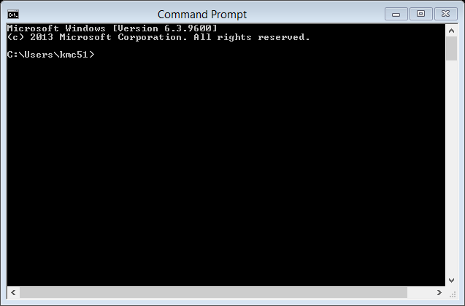
Lab 1: Getting Started with Java and the PC Lab
Section 1: Use the Command Prompt to access your files on AFS (Andrew File System).
Even though this step is not strictly necessary for completing the rest of the lab (for example, if you used your own computer), it may be a good idea to at least try it out for this first lab session.
Open command prompt (via start menu or search)
Most basic commands:
cd (print working directory)
cd MyDirectoryName (enter subdirectory within working directory)
cd .. (move up to parent directory)
dir (list directory contents, like ls in linux)
mkdir MyNewDirectoryName (create new directory)
type MyFileName (print entire contents of a file, like cat in linux)
more MyFileName (like type, but can proceed incrementally)
copy MyFilePath . (copy file specified by a full filepath to the current working directory (“.”), note copy is like cp in linux)
Useful command reference:
https://technet.microsoft.com/en-
us/library/bb490890.aspx

Slide 5
Lab 1: Getting Started with Java and the PC Lab
Section 1: Use the Command Prompt to access your files on AFS (Andrew File System).
AFS: Globally accessible file system that may be accessed through these lab machines and elsewhere
useful for sharing files for classes, and for making sure files are backed up
All Pitt faculty/staff/students are assigned accounts accessed with their Pitt username/password
See http://technology.pitt.edu/service/andrew-file-system-afs or http://people.cs.pitt.edu/~tech/news/faqs.html#sp20 if you would like more information on AFS, and how to access it through other machines
When you log on to a lab machine, you will need to go through an authentication process if you want to access AFS.

Slide 6
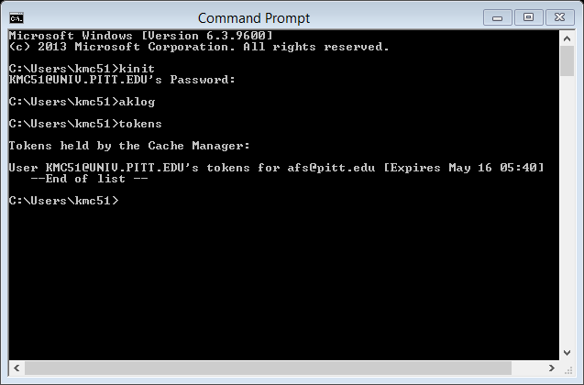
Authentication Process:

Slide 7
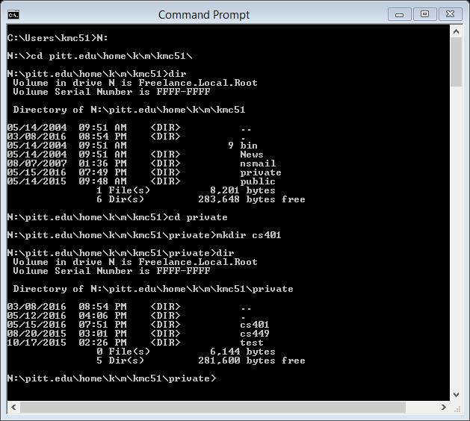
Accessing AFS:
- tab button will attempt to autocomplete filepaths, up arrow will bring up previous commands
typing “cls” will clear any contents currently printed to the command window

Slide 8
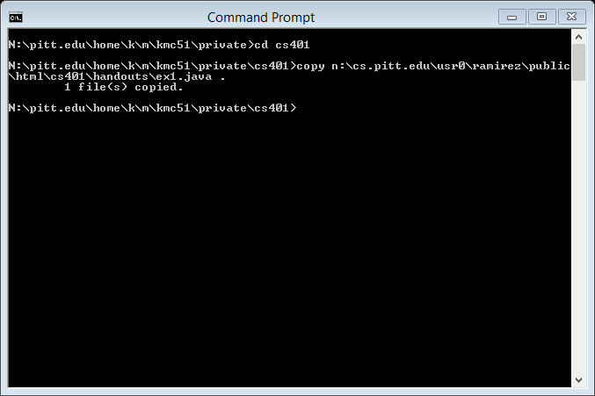
Copy a file:

Slide 9
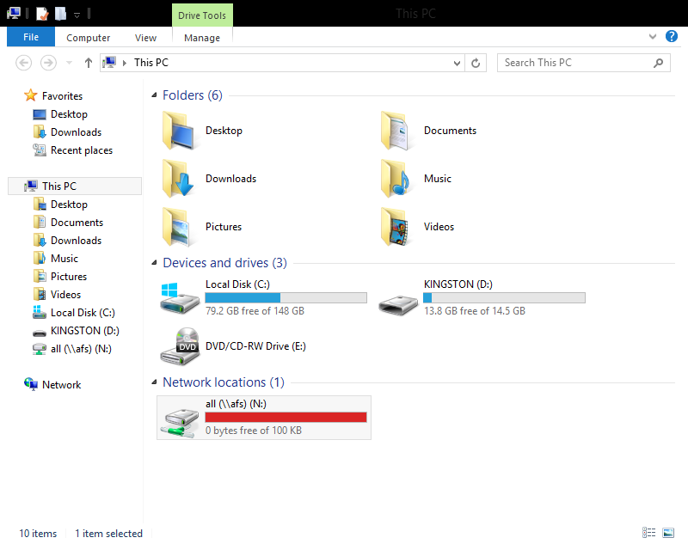
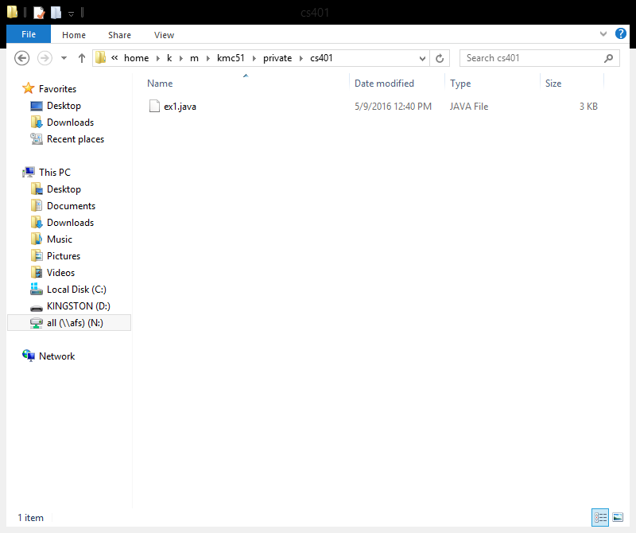
Section 2: Editing Files with a graphical editor:
Right click on ex1.java, edit with Notepad++, leave Notepad++ open for a later step

Slide 10
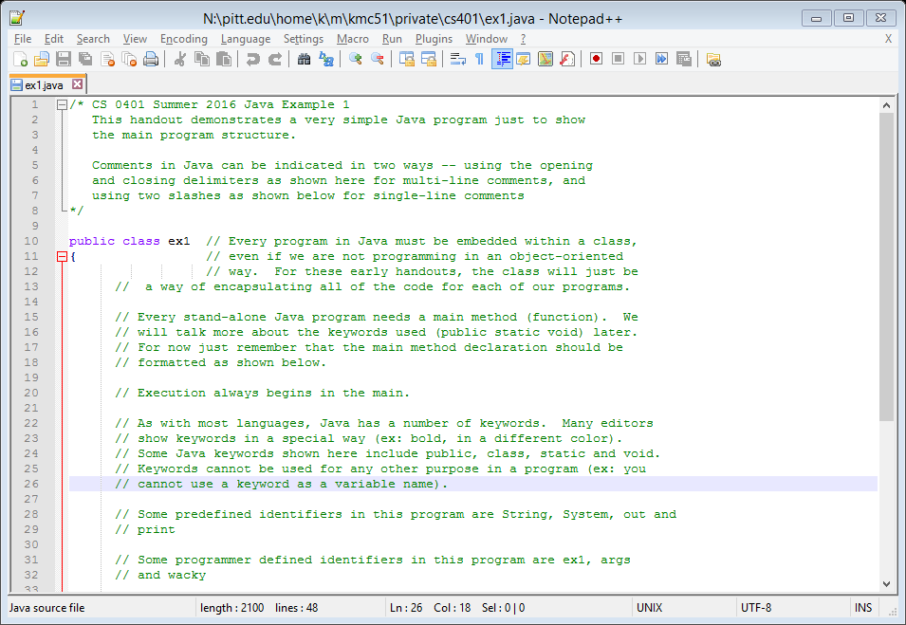
Section 2: Editing Files with a graphical editor:

Slide 11
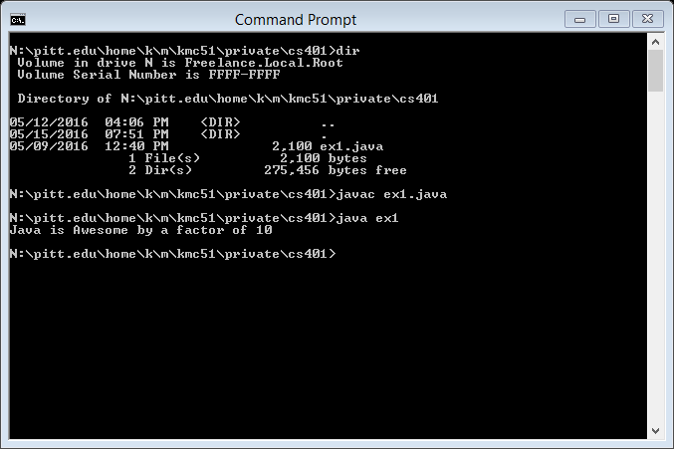
Section 3: Compiling and Running a Java Program

Slide 12
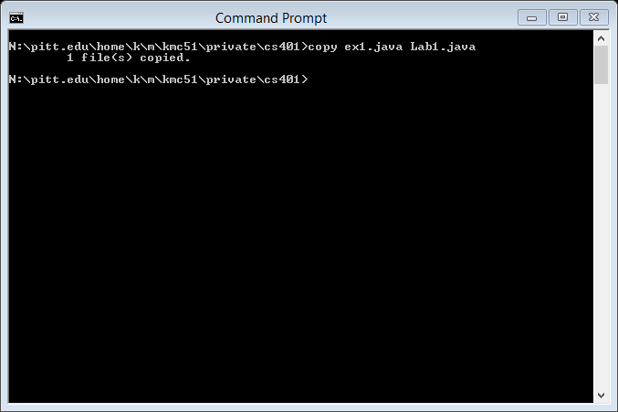
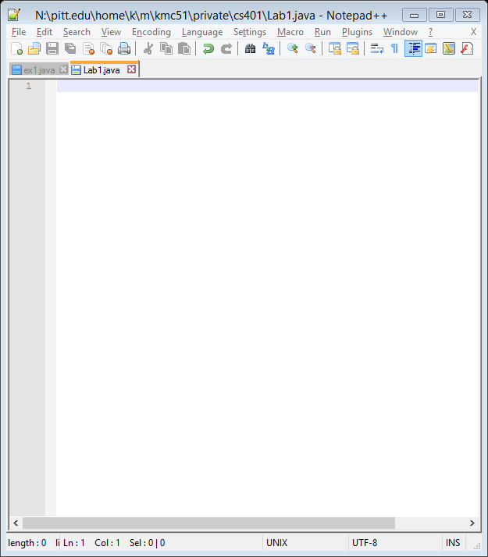
Section 4: Exercise (the part you need to demo)

Slide 13
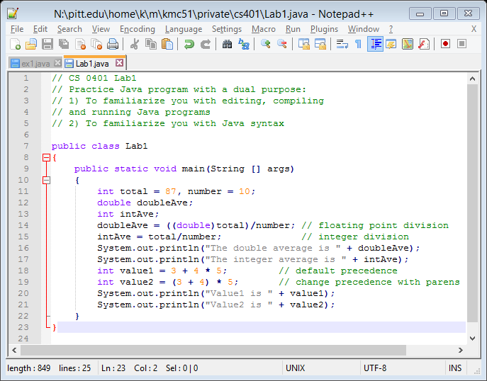
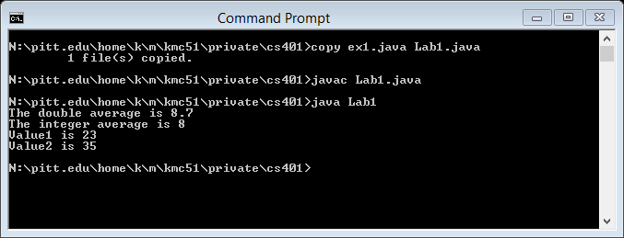
Section 4: Exercise (the part you need to demo)

