Slide 1
CS401 Lab: 6/13/16
Today’s lab may be done on either a lab machine or your own computer.
You can access the lab handout online: http://people.cs.pitt.edu/~ramirez/cs401/labs/lab4.htm
And also these slides: https://github.com/kc13/cs401
Agenda for today:
Quick overview of Lab #4
Time available for lab / demos: 70 minutes
1st section: 11:30-12:40, 2nd section: 2:30-3:40
Demos of Lab #3 should be presented at the beginning
If you need more time for Lab #4, it can be demonstrated at the beginning of next week’s lab, or during office hours.
Quiz: Last 40 minutes of lab:
→ 1st section: 12:40-1:20, 2nd section: 3:40-4:20

Slide 2
Lab #4 Overview
Note that for this lab you are advised to download three files (links are in the assignment instructions):
MyRectangle.java
Lab4.java
Lab4out.txt

Slide 3
Lab #4 Overview
Note that for this lab you are advised to download three files (links are in the assignment instructions):
MyRectangle.java
Lab4.java
Lab4out.txt

Slide 4
Objective: Create and test a class for representing a rectangle, using the provided files as a starting point.
Top left corner of screen = (0,0)
Context: Imagine that we will want to use this class for rectangles that will be displayed on a screen. Points will be represented with integer-valued coordinates.
Top left rectangle corner = (100,50)
width
height
Instance variables: What data do we need to store to specify a rectangle?
startX: value of x coordinate at top left corner rectangle
startY: value of y coordinate at top left corner of rectangle
Bottom right point = (max x, max y)
width: how far rectangle extends to right of top left corner
height: how far rectangle extends down from the top left corner

Slide 5
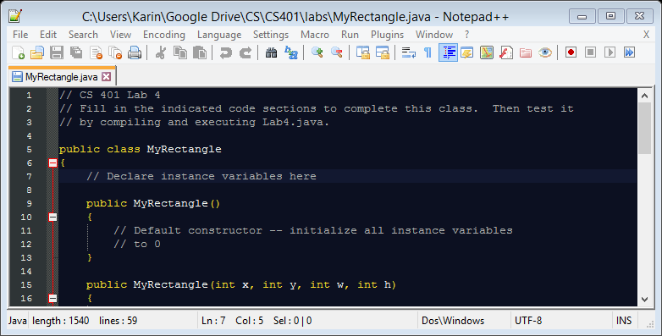
In MyRectangle.java:
Instance variables should be specified after the header line and before the first constructor. Be sure to include the keyword “private” and the datatype (int).

Slide 6
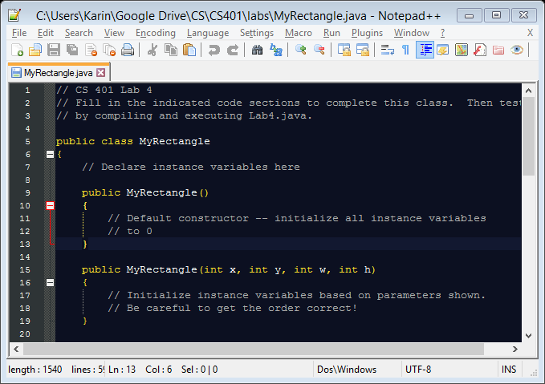
Constructors: Methods to create new rectangles
Constructor #1: default constructor
specifies behavior when user enters no arguments
in this case, initialize all instance variables to 0
Constructor #2: handles user-provided values
in this case, assign x, y, w, and h to the appropriate instance variables

Slide 7
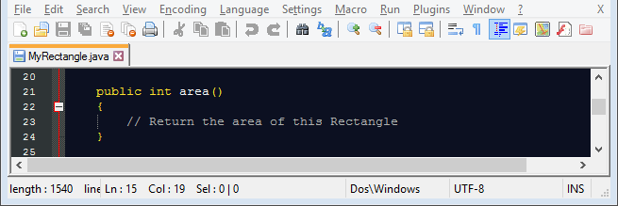
Accessors: Methods to let the user get information about the object
area method: compute area using appropriate instance variables, and return to user

Slide 8
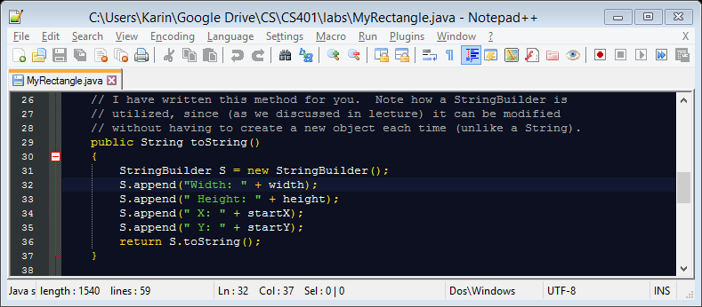
Accessors: Methods to let the user get information about the object
toString() method: already done for you
This is required for System.out.println statements to work in Lab4.
This particular toString method happens to make use of StringBuilder’s built-to String method

Slide 9
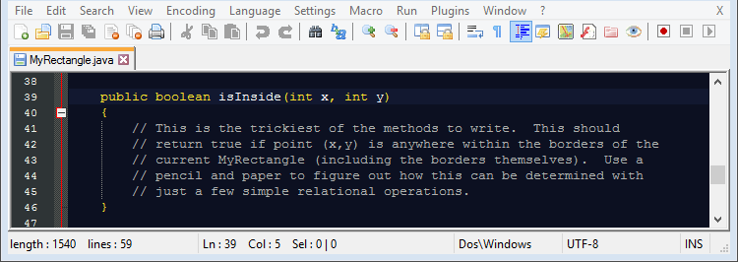
Accessors: Methods to let the user get information about the object
(120,70)
R1 = new MyRectangle(100, 50, 80, 20);
int x1 = 120, y1 = 70;
testInside(R1, x1, y1);
(testInside calls isInside)
isInside should return true
(the indicated point is just on the border of the rectangle surface)
Test point = (120,70)

Slide 10
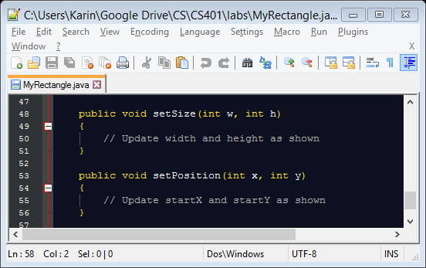
Mutators: Methods to let the user modify data for the object
The body of these methods will be similar to that of Constructor #2, except you will only need to handle a subset of the variables for each.
Note that no return statement is needed (return type is void).

Slide 11
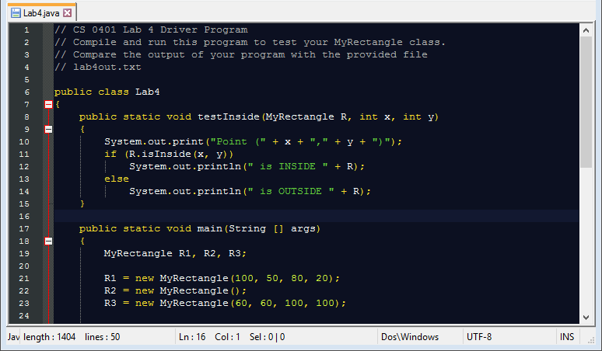
Lab4.java: the “main” program
→ also may be referred to as the “client” or “driver” program
used to test the class that has been created
already completed, but it may be helpful to review
make sure it is in the same folder as MyRectangle.java

Slide 12
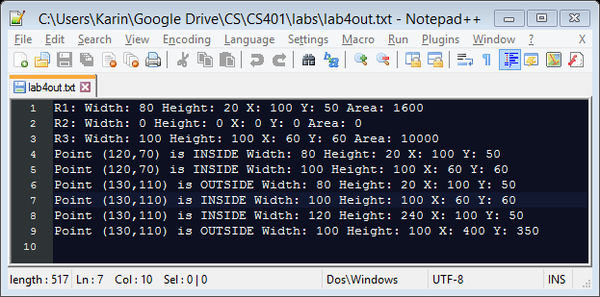
Lab4.java: compilation and execution
javac Lab4.java
java Lab4
Point breakdown:
constructors (1 point)
area method (1 point)
isInside method (1 point)
set methods (1 point)
Output should match that in lab4out.txt:
For the demo:
Show the source code, your Lab4 output, and lab4out.txt

