Slide 1
CS401 Lab: 6/6/16
Today’s lab may be done on either a lab machine or your own computer.
You can access the lab handout online: http://people.cs.pitt.edu/~ramirez/cs401/labs/lab3.htm
And also these slides: https://github.com/kc13/cs401
Agenda for today:
Overview of Lab #3
Remaining time is available to work on lab, ask questions, and demonstrate lab completion.
Remember Assignment #1 is due tonight at 11:59 pm, and Quiz #1 will be given during next week’s lab.

Slide 2
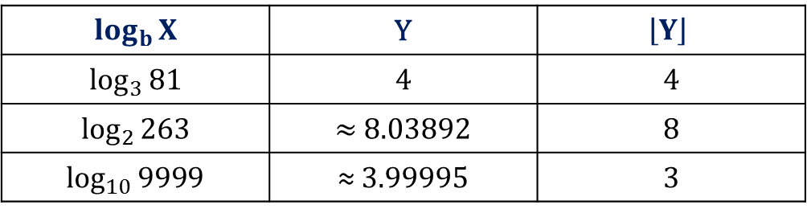
Goal: Write a Java program to compute the floor of a logarithm
Y = log_{b}X ⬄ b^{Y} = X
Examples:
$$\log_{b}{X}$$ | Y | $$\left\lfloor Y\right\rfloor$$
$$\log_{3}{81}$$ | 4 | 4
$$\log_{2}{263}$$ | ≈ 8.03892 | 8
$\log_{10}{999}$9 | ≈ 3.99995 | 3

Slide 3
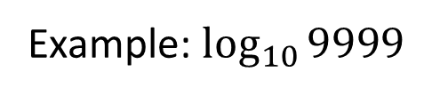
Method: Count iterations of integer division until quotient < base
Example: $\log_{10}{999}$9
9999/10 = 999 r 9
Answer: 3
999/10 = 99 r 9
99/10 = 9 r 9

Slide 4
Program Requirements:
Prompt user to enter an integer base b > 1 (e.g., ‘2’ for log₂)
Quit program if entered b ≤ 1
Prompt user to enter a positive integer X
User must be prompted again if X ≤ 0
Use the integer division method to calculate floor(log_{b}(X))
Print the result to the screen
(4) Continue indefinitely.
Other considerations:
The user may enter an X that is less than the base
e.g., log₁₀(5).
Answer = 0 (no iterations of division routine)
You can assume the user will input integers for b and X
not required to gracefully handle non-integer input

Slide 5
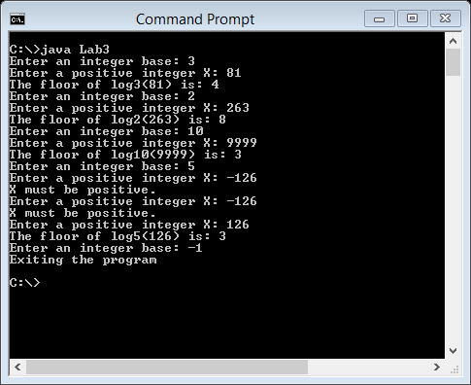
Sample Output:

Slide 6
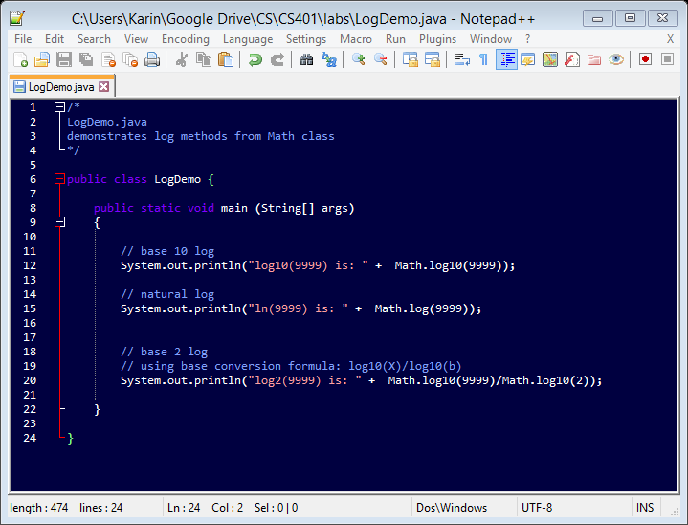
What is not allowed (but may be helpful in other situations, when an exact logarithm is needed):

Slide 7
For the demo:
Show some sample log calculations.
Show example of user entering a negative X.
(3) Exit with a negative base.
Options if more time is needed:
Demonstrate at beginning of next lab.
Demonstrate during office hours.

