Slide 1
CS401 Lab #9: 7/25/16
You can access the lab handout online: http://people.cs.pitt.edu/~ramirez/cs401/labs/lab9.htm
And also these slides: https://github.com/kc13/cs401
Agenda for today:
Graded quizzes are available at the front of the room.
→ note on question #3: the first point was awarded by default
→ solutions will be posted on the CS401 website
→ check that the point total is correct
2. Overview of Lab #9
3. Time available for lab / demos (Lab #8 demos should be presented right away).

Slide 2
Lab #9 Overview
To complete this lab you will need four files:
Movie.java: Class to represent a movie, from Lab #6
MovieDB.java: Class to represent a movie database, from Lab #6
movieFile.txt: Text file with movie info, from Lab #6
Lab9.java: Client program that utilizes classes; incomplete

Slide 3
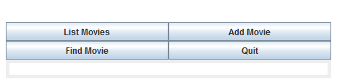
Objective: Complete an implementation of a graphical interface.
The user will be able to access much of the same functionality as was available in Lab #6 (list movies, add movie, find movie)
→ Input/output will be done through the GUI
In Lab #9, all that you need to complete is the body of ControlListener (which implements ActionListener)
→ The program can be compiled and run without changes (buttons won’t work; use Ctrl-C to exit)

Slide 4
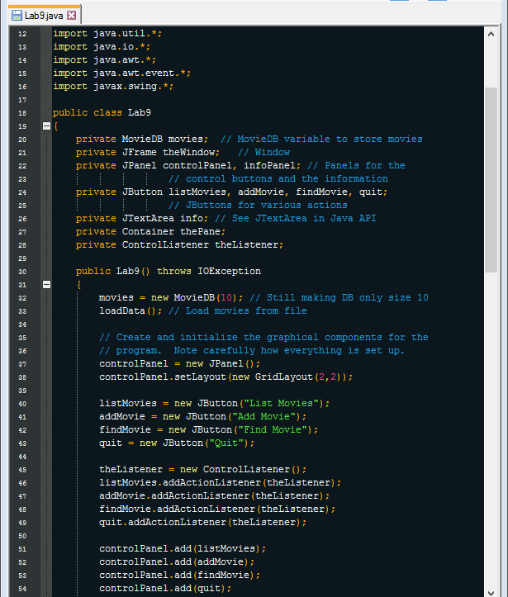
Lab9.java: highlights, lines 12-54
movies: movieDB instance
theWindow: JFrame instance
JButton objects: ControlListener will need to respond to clicks on any of these options.
JTextArea object: where the output text will be displayed

Slide 5
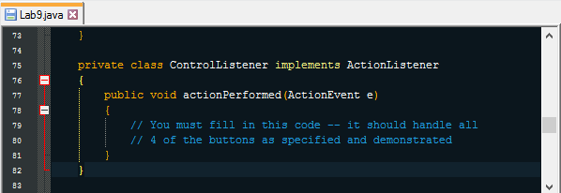
Lab9.java: highlights, lines 75-82
e: This will refer to any action (button click).
Will need to know which button was clicked to generate e.
This can be done using e.getSource()
Will need to cast the returned value as JButton type
→ see ex24b.java for an example
This returned value will then need to be compared with the four JButton instances that are present in the program
→ see Counters.java for a somewhat related example

Slide 6
Lab9.java: highlights, lines 75-82
e: This will refer to any action (button click).
Once you have determined which button generated the event, you will need to execute code that is relevant to what the user requested.
→ see detailed instructions in lab handout
Make note of the requirement that the JTextArea shows only the needed data (previous data are cleared out) and is resized to match the current data shown (for example, with pack()).
JTextArea

Slide 7
Tips and helpful resources:
JTextArea has a “setText()” method that may be helpful for clearing out the text field.
A JOptionPane object will return an int value indicating which option the user chose. The value assigned to the option depends on its position within the display.
Example: If the order of the buttons, from left to right, is “Yes”, ”No”, and “Cancel”, then these responses will map onto the integers 0, 1, and 2.
If you forget this mapping, you can also access the options’ values through fields that are made available in the JOptionPane class (e.g., you could test the returned int against either “0” or “JOptionPane.YES_OPTION”).
Resources: Class slides, handouts, Lab #6, API, and other Oracle webpages.

Slide 8
For the demo:
List Movies – 1 point
Add Movie – 1 point
Find Movie – 1 point
Quit – 1 point
Scoring is largely based on execution, although the source code should be available.
You can assume that the user will enter appropriate inputs, not click Cancel, and not exceed the database capacity.
This can be demonstrated next week. Note that Lab #10 will need to be completed during that lab session also (no extra week).

