Slide 1
CS401 Lab: 7/11/16
Today’s lab may be done on either a lab machine or your own computer.
You can access the lab handout online: http://people.cs.pitt.edu/~ramirez/cs401/labs/lab7.htm
And also these slides: https://github.com/kc13/cs401
Agenda for today:
Overview of Lab #7
Time available to work on lab, show demos (Lab #6 demos should be presented right away).

Slide 2
Lab #7 Overview
For this lab you will need to access your MyRectangle.java file from Lab #4.
If you do not have this available, you will need to recreate it.
Start with the partially-completed MyRectangle.java linked to the Lab #4 instructions.
You will also need to download two files (links are in the assignment instructions):
Lab7.java: Client program for a new class (“MySquare”) that you will create using MyRectangle
lab7out.txt: Sample output of Lab7.java

Slide 3
Objective: Create a “MySquare” class that both inherits elements from MyRectangle and adds its own methods.
superclass
subclass
MyRectangle.java
MySquare.java
Various variables and methods defined here.
Inherits all of these variables and methods.
Can only directly access instance variables declared as protected or public.
New variables and methods can also be defined here.

Slide 4
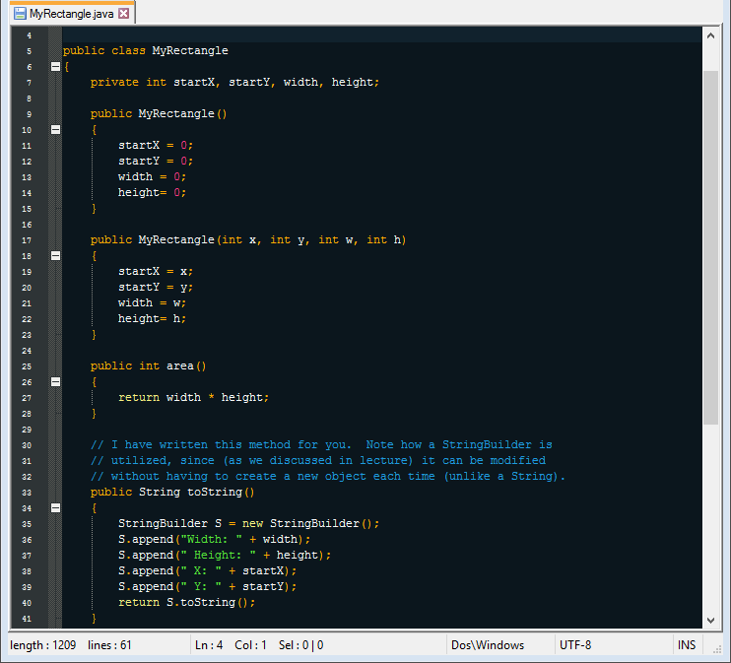
Review: MyRectangle.java (completed)
Change to protected
Keep in mind that the MySquare class will inherit all of these variables/ methods.

Slide 5
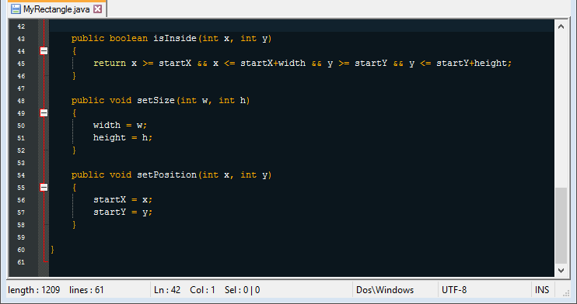
Review: MyRectangle.java

Slide 6
Creating MySquare.java: Note --> no new instance variables!
(1) Create the header line:
(2) Create two constructors (the first one is done for you here):
public MySquare() {
super(); // use the MyRectangle constructor
// that takes no arguments
}
public MySquare(int x, int y, int side) {
// hint: you can also use “super” here
// to invoke the 4-parameter
MyRectangle constructor
}
See the sections “Simple example of inheritance” and “Inheritance vs. Composition” in the Handouts section of the course website.

Slide 7
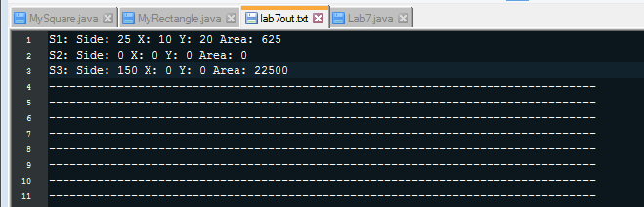
Creating MySquare.java:
(3) Create a toString() method:
You need to write your own (rather than rely on the inherited version)
Header line:
public String toString() {
// add code
}
Output to show on screen:

Slide 8
Creating MySquare.java:
(3) Create a toString() method:
You need to write a method specific to MySquare (rather than rely on the inherited version)
Header line:
public String toString() {
// add code
}
Output to show on screen:

Slide 9
Creating MySquare.java:
(3) Create a setSize(int w, int h) method:
You need to write your own (rather than rely on the inherited version)
If h == w, this can behave like the MyRectangle method
Otherwise, print out a message reporting the problem to the user.
(4) Create a setSide(int side) method:
This is a new method (no inherited version).
You can set the side lengths by adjusting the appropriate inherited instance variables.

Slide 10
For the demo: Once you’ve confirmed that you’ve reproduced lab7out.txt:
Run Lab7, and show the output. Then, pull up the source code. When appropriate, the code should make use of the inherited variables and methods.
Each of the following is worth 1 point out of the total 4:
Constructors
toString() method
setSide() method
setSize() method
This lab may also be demonstrated at the beginning of next week’s lab.

