Slide 1
CS401 Lab: 6/27/16
Today’s lab may be done on either a lab machine or your own computer.
You can access the lab handout online: http://people.cs.pitt.edu/~ramirez/cs401/labs/lab6.htm
And also these slides: https://github.com/kc13/cs401
Agenda for today:
A few quizzes were not picked up last week. These are available at the front of the room.
→ Also remember Assignment #2 is due tomorrow at 11:59 pm.
Overview of Lab #6
Time available for lab / demos (Lab #5 demos should be presented right away).

Slide 2
Lab #6 Overview
Note that for this lab you are advised to download five files (links are in the assignment instructions):
Movie.java: Class to represent a movie, already completed
MovieDB.java: Class to represent a movie database, completed
Lab6.java: Client program that utilizes classes; incomplete
movieFile.txt: File from/to which the program will read/write.
output.txt: Sample output

Slide 3
Objective: Use a class (MovieDB) that shares similar functionality as is present in Java’s built-in ArrayList class.
MovieDB: Like ArrayList, stores a collection of objects.
Unlike ArrayList, only stores objects of one type (Movie)
Like ArrayList, provides some abstract methods to the user (add movie to DB, search for a movie, etc).
For this assignment:
First, read through the Movie and MovieDB code.
Then, complete the 3 unfinished code sections in Lab6.java.

Slide 4
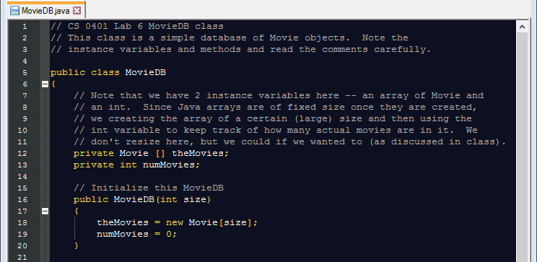
MovieDB class:
- Movie objects (see Movie.java) will be stored in an array
- An integer will keep track of how many movies have been stored so far
The constructor creates a new array of a user-specified size, and initializes the # of movies stored to 0.

Slide 5
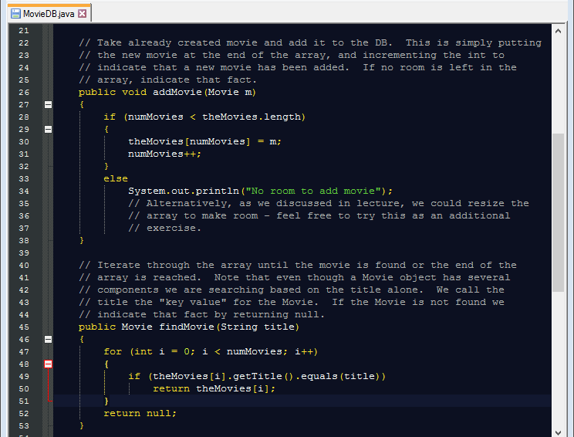
addMovie method will add a new movie to the array (if there is space)
findMovie method will seek and return a Movie object (or null) given a title

Slide 6
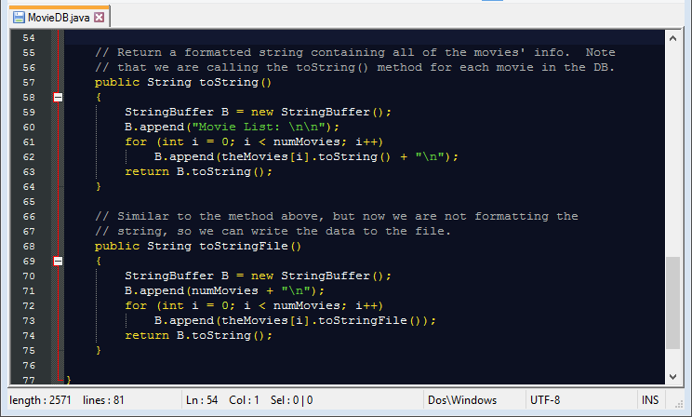
toString method will a String representation of all movies in the database
toStringFile method does the same, but the String representation is appropriate for saving to the file, rather than printing to the screen.

Slide 7
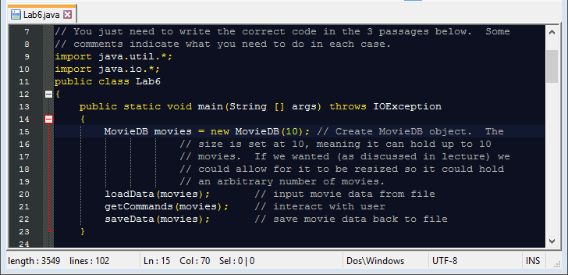
Lab6.java: Lines 9-23
No new code required for these lines
Creates a new MovieDB object with room for 10 movies.
Runs three methods, the first two of which require more code

Slide 8
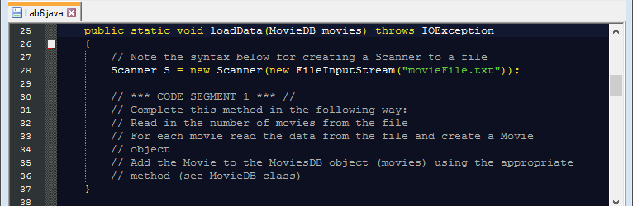
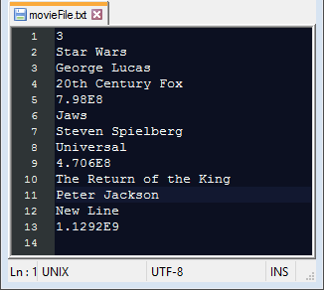
Lab6.java: Lines 25-37 (loadData method)
Note input parameter “movies”, which specifies a MovieDB object
A Scanner object “S” is created to read from movieFile.txt
format of movieFile.txt:
-First line specifies number of movies.
-Subsequent groups of 4 lines specify info that needs to be provided to the Movie constructor (see line 12 in Movie.java)
- Use each group of 4 lines to create a new Movie object, and add it to the MovieDB object with the addMovie method.

Slide 9
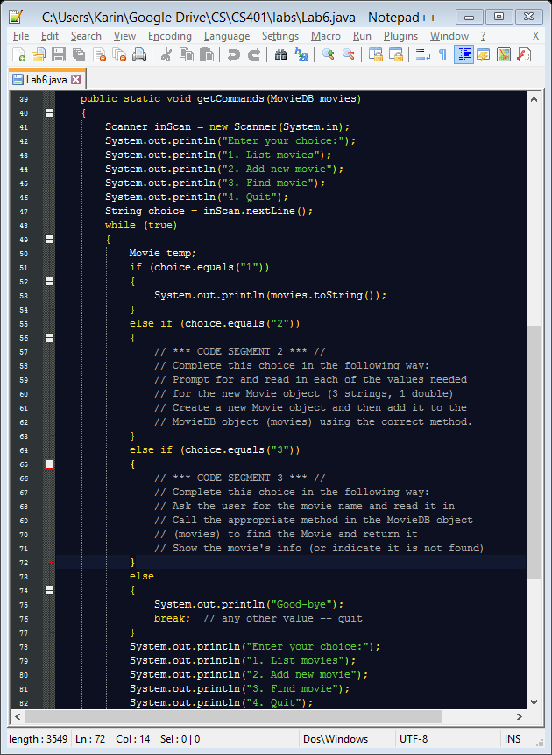
Lab6.java: Lines 39-85
getCommands method
Code segment 2:
This requires prompting the user for all the information you need to create a new Movie object.
Note that the Scanner object (inScan) has already been created for you.
As in the previous code segment: Use these values to create a new Movie object and store it to the current MovieDB object.

Slide 10
Lab6.java: Lines 39-85
getCommands method
Code segment 3:
Prompt the user for the name of the movie s/he wants to find in the database.
Use the input and the findMovie method to search for the movie.
If it is present, show the movie’s info on the screen (note that the Movie class does have a toString() method); otherwise, report that the movie is not found.

Slide 11
For the demo:
This assignment is broken down into 4 points. Make sure that the source code is available.
2 points: Code segment #1
--> This can be tested by choosing option #1 (List movies).
1 point: Code segment #2
--> This can be tested by choosing option #2 (Add new movie) and then again choosing option #1.
1 point: Code segment #3
--> This can be tested by choosing option #3 (Find movie) and searching for movies that do and do not exist in the database.

