Slide 1
CS401 Lab: 5/23/16
You can access the lab handout online: http://people.cs.pitt.edu/~ramirez/cs401/labs/lab2.htm
And also these slides: https://github.com/kc13/cs401
Agenda for today:
Overview of Lab #2
Remaining time is available to work on lab, ask questions, and demonstrate lab completion.

Slide 2
Some technical notes on completing Lab #2:
Last week, some people experienced issues with AFS:
Saving from within Notepad++: Some issues may come up when attempting to save a new file from within Notepad++. You should be able to save changes to an existing file (so, for example, a copy of ex1.java).
Other issues: If you are experiencing other problems, then during this lab you can instead save your work in some file local to the lab computer (for example, \Users\<YourUserName>), or to your computer or a flash drive.

Slide 3
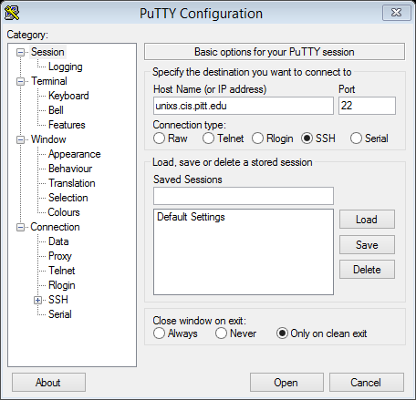
Lab 2: Some Tools and Submission Information
Section 1: Logging in Remotely to access your Pitt files
→ This section shows you how to make an SSH (secure shell) connection to Pitt’s Unix cluster, which allows you direct access to AFS.
Open PuTTY
Type unixs.cis.pitt.edu in the “Host Name” box
Optional (if using own computer):
You can save connection settings by typing a name for the session under Saved Sessions (e.g., unixs), and clicking Save).

Slide 4
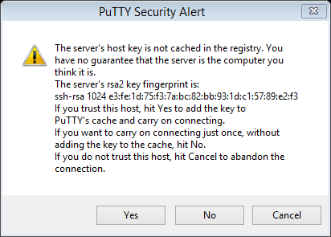
Lab 2: Some Tools and Submission Information
Section 1: Logging in Remotely to access your Pitt files
→ This section shows you how to make an SSH (secure shell) connection to Pitt’s Unix cluster, which allows you direct access to AFS.
Click “Yes” if you see the Security Alert Message.

Slide 5
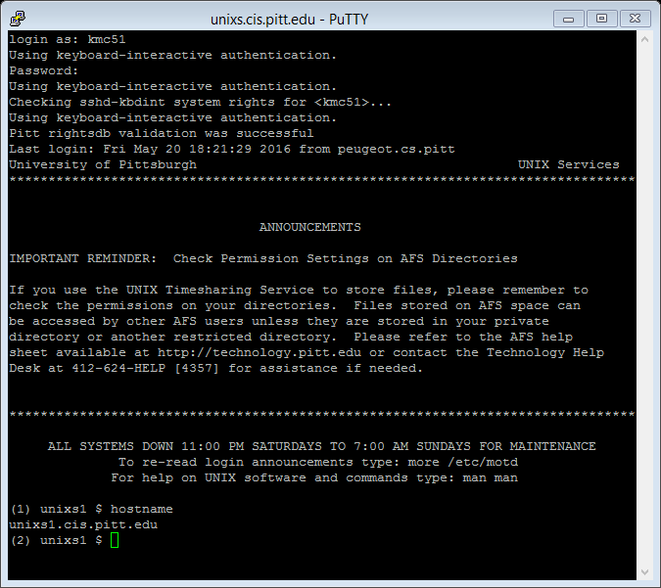
Lab 2: Some Tools and Submission Information
Section 1: Logging in Remotely to access your Pitt files

Slide 6
Lab 2: Some Tools and Submission Information
Section 1: Logging in Remotely to access your Pitt files
Command syntax often differs between Windows Command Prompt and the Unix shell. Examples:
Different between systems
Unix/Linux | Windows | function
cp <file1> <file2> | copy <file1> <file1> | Copy file from one filepath to another (“.” still stands for working directory in both systems)
ls | dir | List directory contents
cat | type | Read text file (completely, note both systems use “more”)
pwd | cd (no arguments) | Print working directory
cd (no arguments) | cd %HOMEPATH% | Change directory to home directory
Shared between systems
more |  | Scroll through text file
cd <directory path>, cd .. |  | Change directory
mkdir <directory> |  | Create new directory

Slide 7
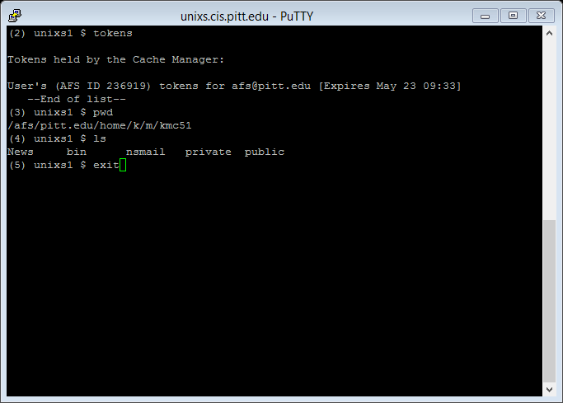
Lab 2: Some Tools and Submission Information
Section 1: Logging in Remotely to access your Pitt files

Slide 8
Lab 2: Some Tools and Submission Information
Section 2: Submitting using the Course Submission Site (Lab Exercise)
The main point of this exercise is to make sure you have no trouble submitting your assignments, once they’re due.
First, read over the assignment submission guidelines:
http://www.cs.pitt.edu/~ramirez/cs401/assigs/submit.html

Slide 9
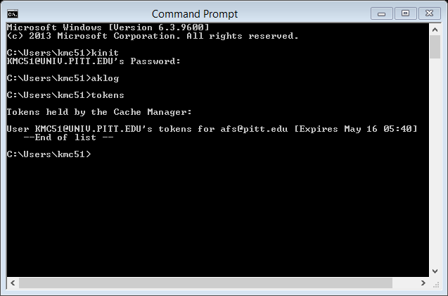
Lab 2: Some Tools and Submission Information
Section 2: Submitting using the Course Submission Site (Lab Exercise)
Practice submission (if using AFS on Windows):
Repeat the procedure with Command Prompt/AFS authentication:

Slide 10
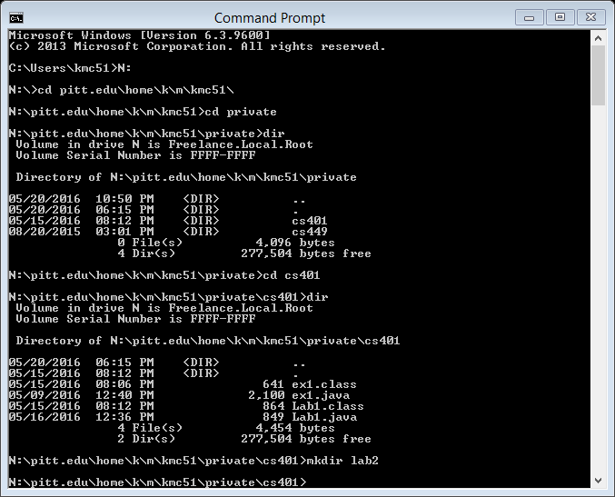
Lab 2: Some Tools and Submission Information
Section 2: Submitting using the Course Submission Site (Lab Exercise)
Return to the cs401 subdirectory you created under your private home subdirectory, and create a lab2 subdirectory.

Slide 11
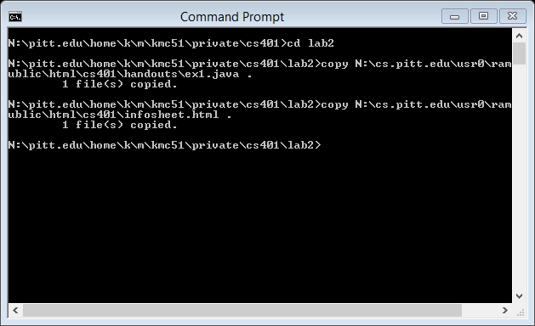
Lab 2: Some Tools and Submission Information
Enter the lab2 folder, and copy some files into it:
If you’ve having trouble copying from AFS, you should be able to download these files through a web browser (try http://people.cs.pitt.edu/~ramirez/cs401/handouts/ex1.java and http://people.cs.pitt.edu/~ramirez/cs401/infosheet.html)

Slide 12
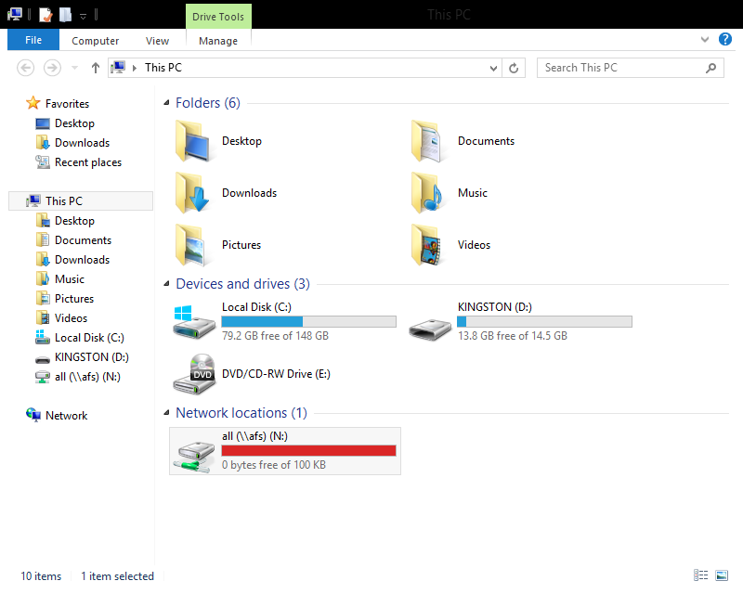
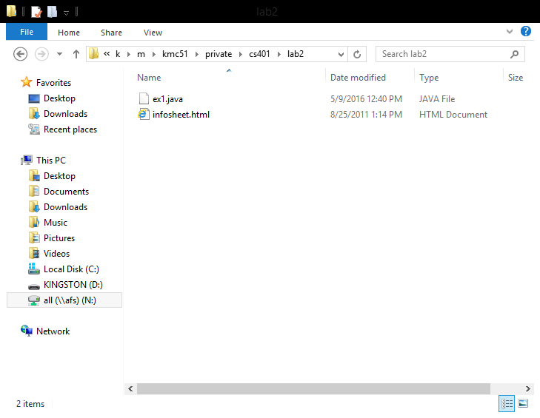
Lab 2: Some Tools and Submission Information
Section 2: Submitting using the Course Submission Site (Lab Exercise)
Once again, use File Explorer (folder icon on Toolbar) to get to N:\pitt.edu\home\<FL>\<SL>\<yourPittID>\private\cs401\lab2

Slide 13
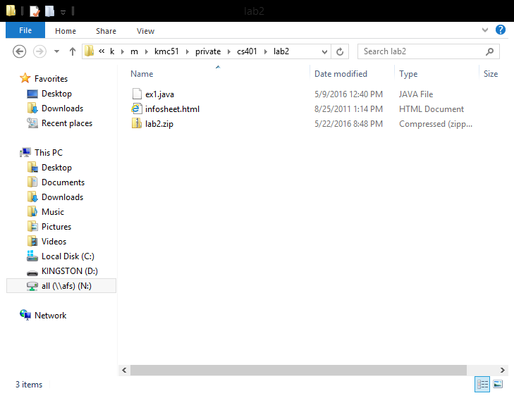
Lab 2: Some Tools and Submission Information
Section 2: Submitting using the Course Submission Site (Lab Exercise)
Select both files in the folder (click on the both while holding down the control key.
Click the right mouse button to pull up an option menu
Move your mouse arrow to SecureZip → Add to new “lab2.zip”

Slide 14
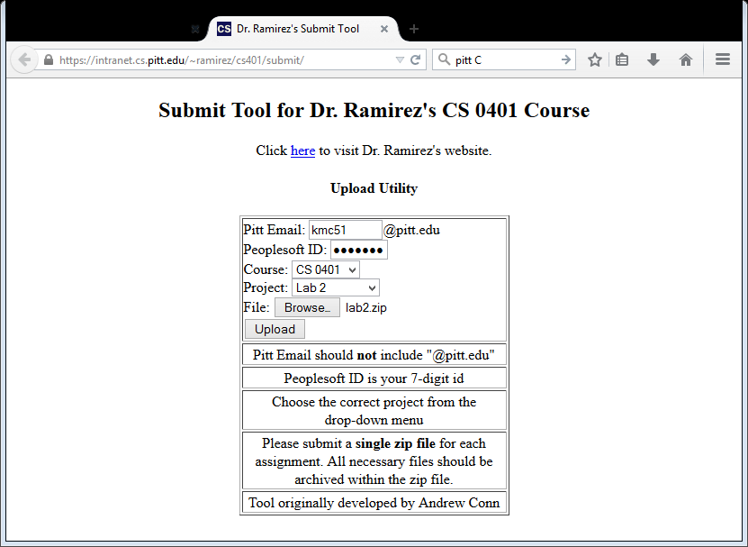
Lab 2: Some Tools and Submission Information
Section 2: Submitting using the Course Submission Site (Lab Exercise)
Go to the submission website https://intranet.cs.pitt.edu/~ramirez/cs401/submit/
Enter your username and peoplesoft number.
Choose “Lab 2”
Browse to an select the lab2.zip file.
Click Upload

Slide 15
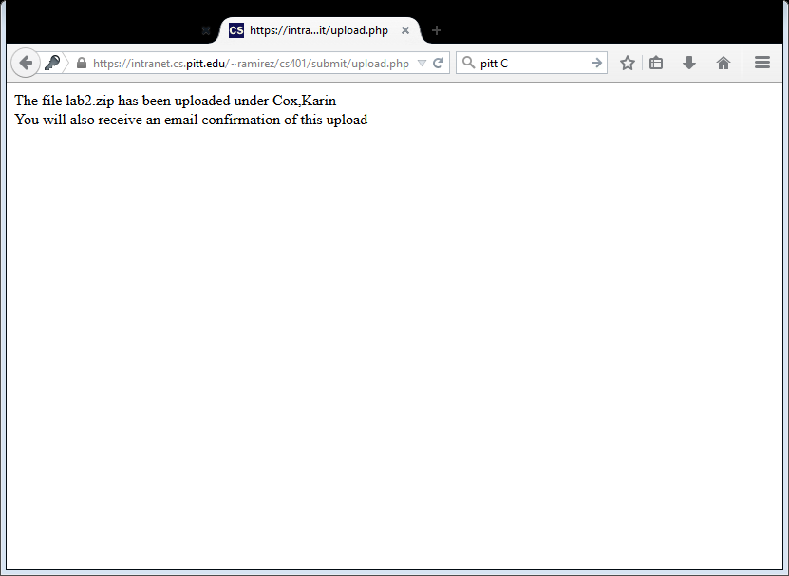
Lab 2: Some Tools and Submission Information
Section 2: Submitting using the Course Submission Site (Lab Exercise)
You should see a screen like this (this is the demo part)
Note you might see an error if you try to submit a file with the same name multiple times.

Slide 16
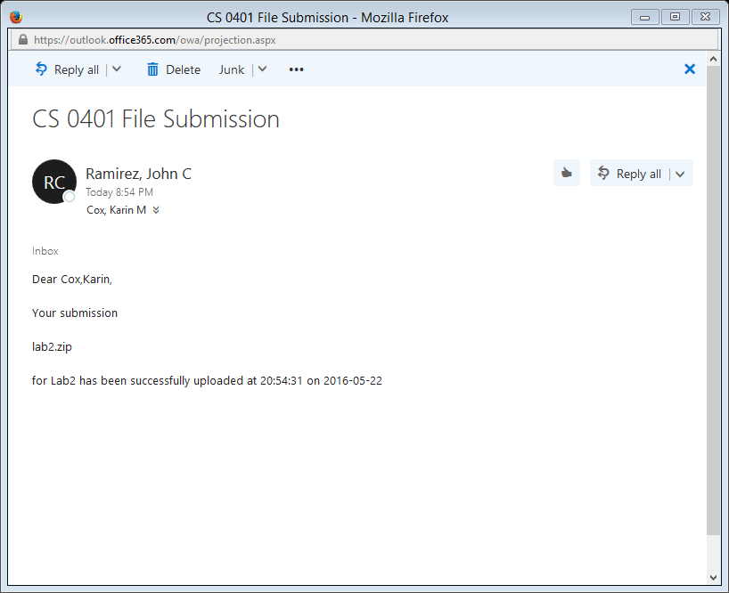
Lab 2: Some Tools and Submission Information
Section 2: Submitting using the Course Submission Site (Lab Exercise)
You should also get an email confirmation within about 5 minutes.

Slide 17
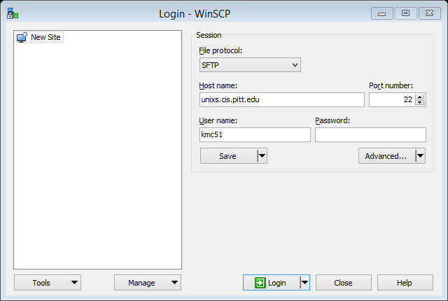
Lab 2: Some Tools and Submission Information
Section 3: Securely copying a file from one computer to another using a secure protocol (example here: WinSCP, available from the start menu).

Slide 18
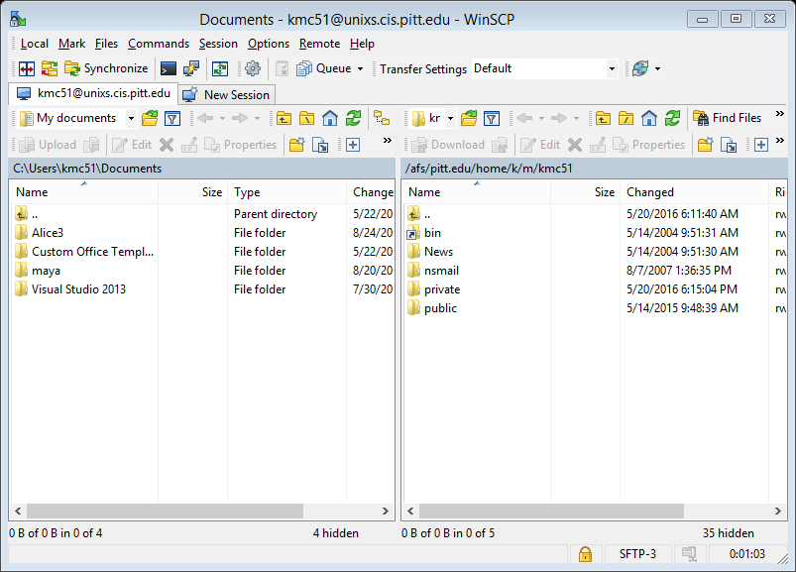
Lab 2: Some Tools and Submission Information
Once again, the default location on the unix server (see right side of screen) is your AFS home directory. If you ever wanted to transfer files from the local machine to an AFS folder, you would just navigate to the appropriate directories on each side, and then drag the files from left to right.

