Slide 1
CS401 Lab 2/28/20
These slides will be available online:
https://github.com/kc13/CS401MD
Agenda for today:
Discussion of Lab #6 / 2D Arrays

Slide 2
Lab #6: Two files (Exercise1.java, Exercise2.java) that will require running operations over 2D arrays.
→ To quote the Java documentation: Multi-dimensional arrays are simply nested arrays. A two-dimensional array is an array of arrays. A three-dimensional array is an array of two-dimensional arrays, and so on.
Elements are accessed using [row][col]
For example, for array a to the left, the star is in a[2][1]

Slide 3
Lab #6: How the .length property works for 2D arrays
a.length would return 4. If you know you are working with a square matrix, then this tells you the length of both the rows and columns.
In this case, a.length would still return 4 – the number of rows, not the number of columns.

Slide 4
Lab #6: How the .length property works for 2D arrays
How do you get the number of columns?
Note that, technically, the number of columns could vary across rows (this is a consequence of the 2D array being implemented as an array of arrays).
To get the column count for a specific row, choose the row index and then append the .length, e.g.:
a[1].length → number of columns in row 1

Slide 5
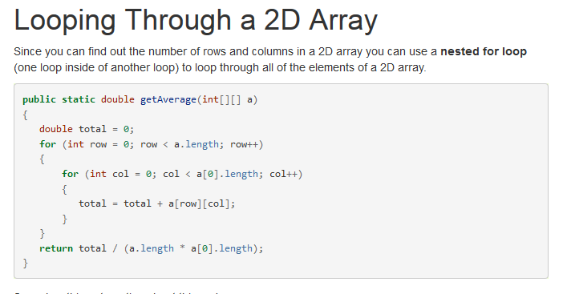
Lab #6: Exhaustively looping through the elements of a 2D array
Example from
http://ice-web.cc.gatech.edu/ce21/1/static/JavaReview-RU/Array2dBasics/a2dLoop.html
See also the printMatrix method in Exercise1.java

Slide 6
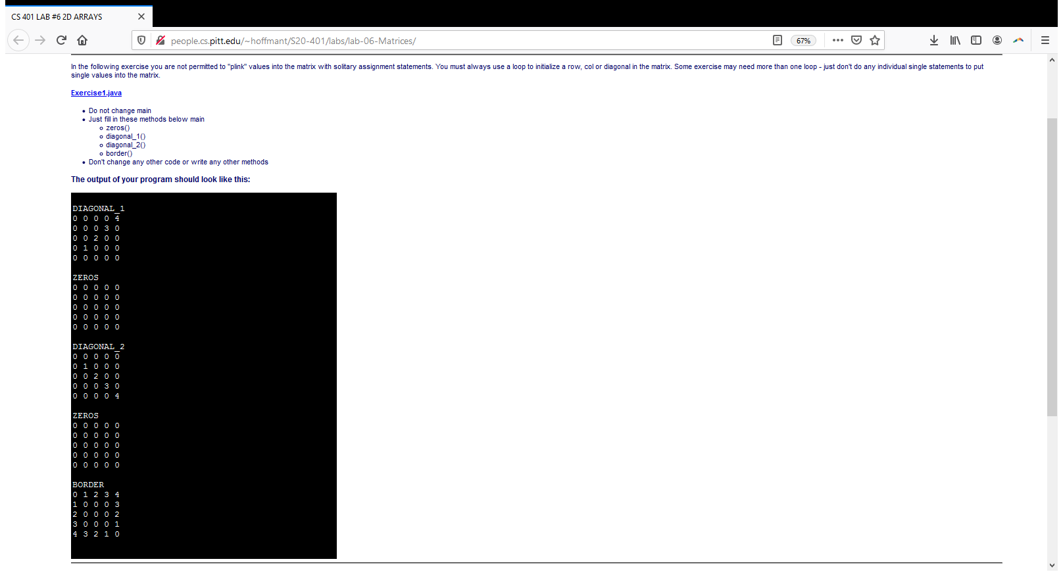
Lab #6: Exercise #1
As in the past, you are given starter code, which implements a main method, which calls some functions.
You complete the four functions required here.
Each will take in a matrix (i.e., 2D int array) as an argument, and write the array with values that match the patterns shown / described in the comments.
You should use loops to write the values.

Slide 7
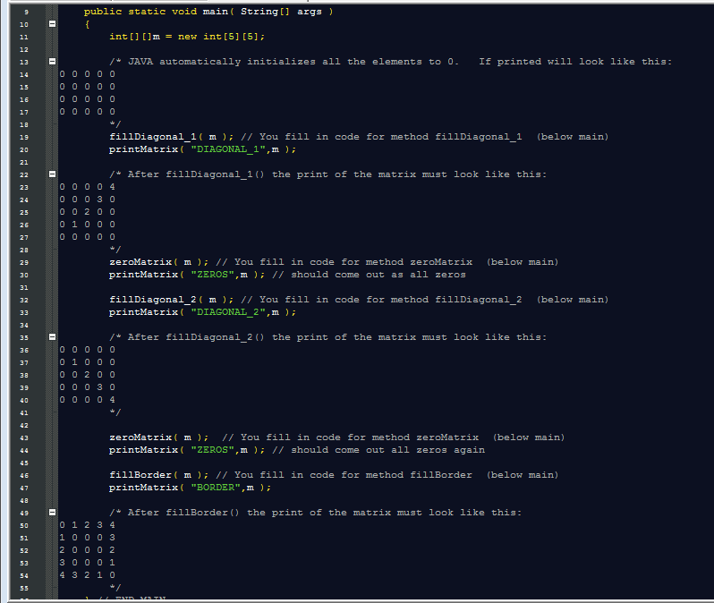
Lab #6: Exercise #1: Main
You will write the methods that are called here. Even though you know that the text matrix is 5x5, don’t write your methods with an assumption of a 5x5 matrix.

Slide 8
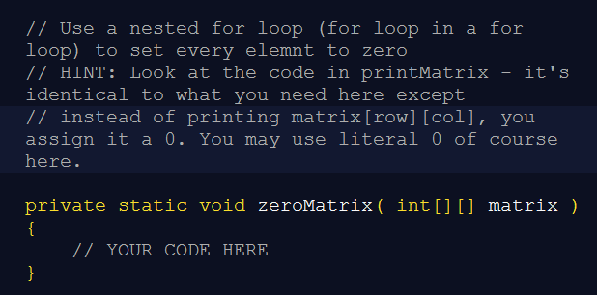
Lab #6: Exercise #1
Fourth method to complete: (presenting here first, because it is the easiest)
Target output:
All 0’s.

Slide 9
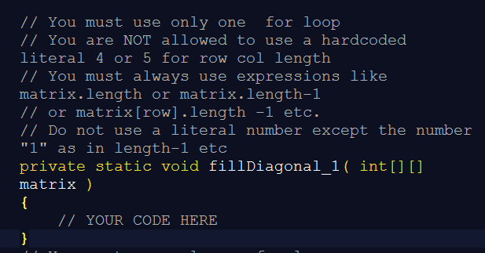
Lab #6: Exercise #1
First method to complete:
Target output:
Digits 0:# of rows-1 going from lower left to upper right corner.
Note you should also use only 1 for loop.

Slide 10
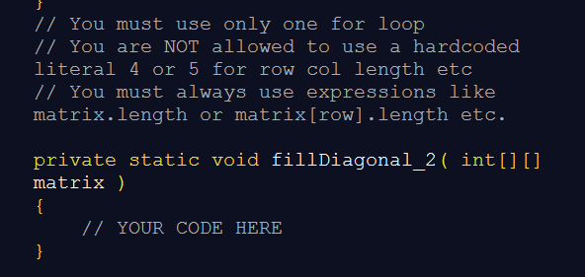
Lab #6: Exercise #1
Second method to complete:
Target output:
Digits 0:# of rows-1 going from upper left to lower right corner.
You should also use only 1 for loop.

Slide 11
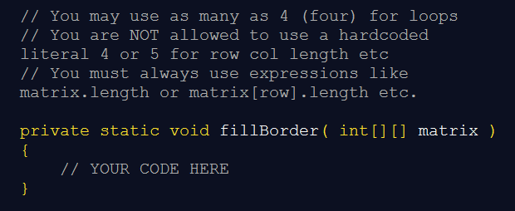
Lab #6: Exercise #1
Third method to complete:
Target output:
See above.
Note you are allowed to use up to 4 for loops. (You might also want to make use of if statements).

Slide 12
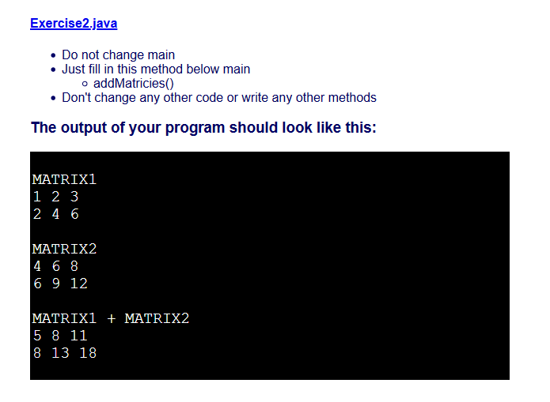
Lab #6: Exercise #2

Slide 13
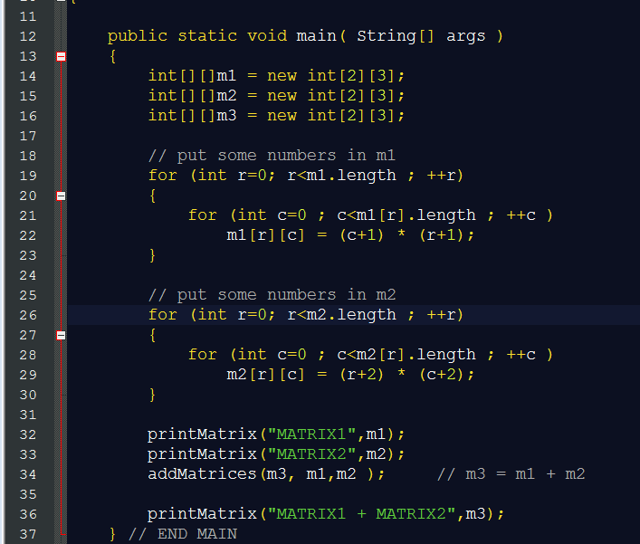
Lab #6: Exercise #2: Main

Slide 14
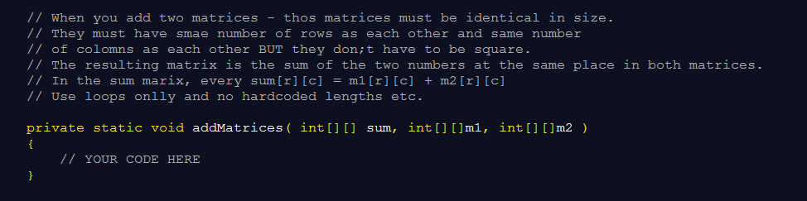
Lab #6: Exercise #2
→ Just one method to complete for this exercise

