Slide 1
CS401 Lab 1/31/20
These slides will be available online:
https://github.com/kc13/CS401MD
Agenda for today:
Brief comments about command line tools
Comments regarding Lab #2

Slide 2
CS401 Lab 1/31/20
These slides will be available online:
https://github.com/kc13/CS401MD
Agenda for today:
Brief comments about command line tools
Comments regarding Lab #2

Slide 3
Command line interface
If you’re new to using command line interfaces, note that it can be extremely useful (even beyond CS401) to learn even just a few commands. Some links to documentation are provided on the subsequent slides.
Important reminder: If you delete a file or directory on the command line, you should assume that it is removed entirely (and does not go to the Recycle Bin/Trash).
Also note you can also often use the Tab key to autocomplete the names of files or filepaths (though Linux/Mac sometimes does a better job of this than Windows does).

Slide 4
Windows Command Prompt
Documentation: https://docs.microsoft.com/en-us/windows-server/administration/windows-commands/windows-commands
Most useful commands to know:
cd (and cd ..)
dir
Other useful commands:
type
cp
mkdir
rename
move
cls
del (see earlier warning)
rd (see earlier warning)
Note that if you simply enter the name of a file in the working directory, Windows should open that file for you using the appropriate application.

Slide 5
Windows Command Prompt alternatives
PowerShell
Typically installed by default
Reference: https://devblogs.microsoft.com/scripting/table-of-basic-powershell-commands/
Supports a larger set of commands than Command Prompt does, including some traditional Linux commands
Other alternatives that you would need to download and install:
Cygwin – good if you want to mimic a Linux environment, see https://www.cygwin.com/
Windows Terminal - in development, see https://www.microsoft.com/en-us/p/windows-terminal-preview/9n0dx20hk701?activetab=pivot:overviewtab

Slide 6
MacOS - Terminal
Documentation: https://support.apple.com/guide/terminal/welcome/mac
Note: Terminal behaves like the Bash or zsh shells in Linux.
Most useful commands to know:
cd (and cd ..)
ls
pwd
Other useful commands:
cat
cp
mkdir
mv (can be used to both move and rename files)
clear
rm (see earlier warning)
rmdir (see earlier warning)
To open a file or a directory, just type open <file or directory name>

Slide 7
MacOS - Terminal
Other commands/tools that are likely already installed, which you might find helpful (documentation should be readily available through a Google search)
For viewing/searching/processing text:
more, less, grep, sed, cut
Text editors:
nano/emacs/vi
For downloading basic content from the web:
curl
wget is also useful, but you may need to install it

Slide 8
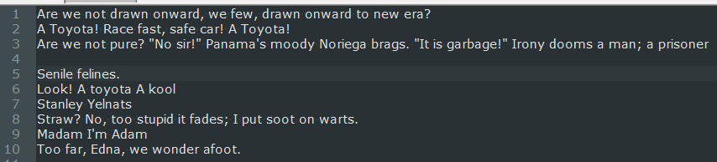
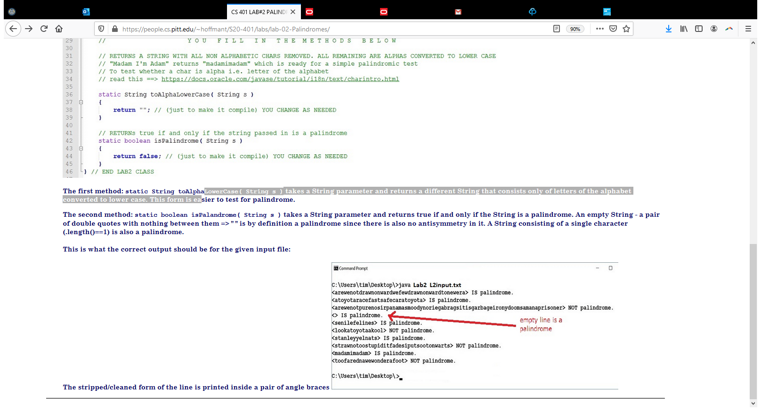
Lab #2: Overview
General idea:
You are given some starter code (Lab2.java) that you will need to complete.
The program expects a filename to be provided on the command line. You are given a test file, L2input.txt (shown above).
Target output (above): Each line, following some cleaning, is printed inside <>. This is followed by a statement of whether the line is a palindrome or not.

Slide 9
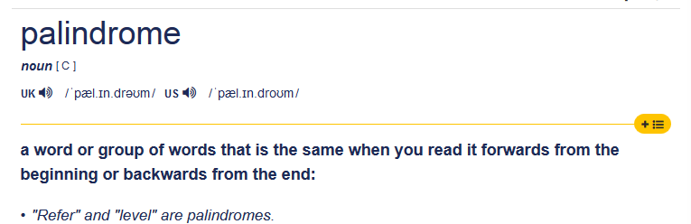
Lab #2: Palindromes
General idea:
General definition from https://dictionary.cambridge.org/us/dictionary/english/palindrome

Slide 10
Lab #2: Palindromes
More specific requirements for palindromes, for this assignment:
A string is tested for being a palindrome or not only after being cleaned of any characters that are not true letters (as judged by the isLetter method from the Character class; see https://docs.oracle.com/javase/tutorial/i18n/text/charintro.html
Letters are also all converted to lower case
Empty stings are judged to be palindromes; a single character is a palindrome.

Slide 11
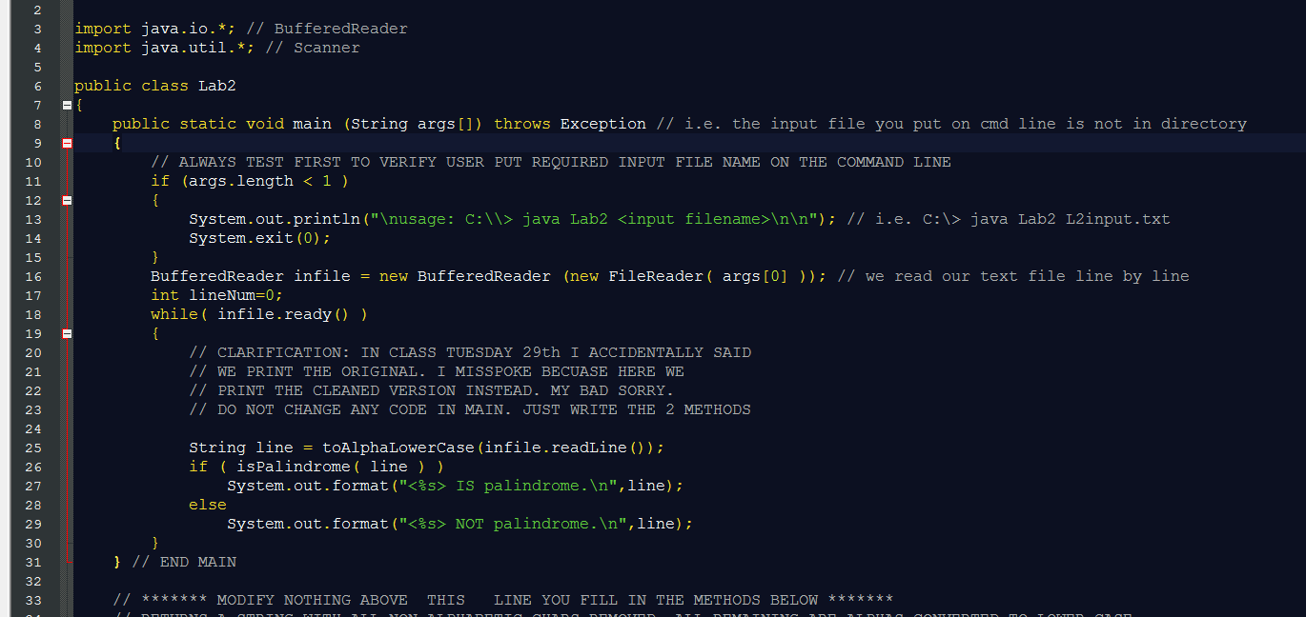
Lab #2: Starter Code – section that should not be modified
What this section does:
Reads in the file, line by line
For each line:
It will call toAlphaLowerCase() to clean the line (remove non-letters)
It will call isPalindrome() on the cleaned line
The returned Boolean will determine the subsequent print statement

Slide 12
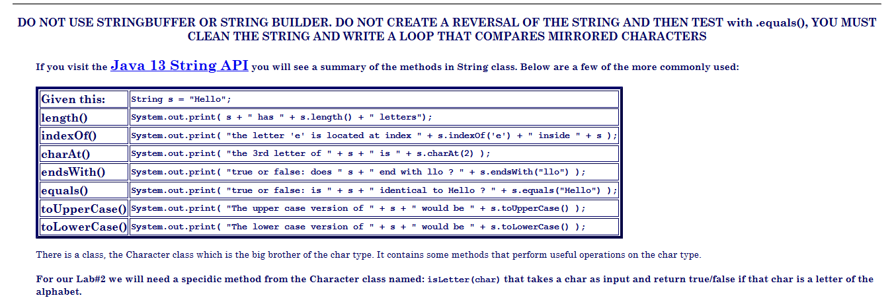
Lab #2: Rules to follow for modifying methods (discussed on following slides):
Remember that + is the concatenation operator for Strings.

Slide 13
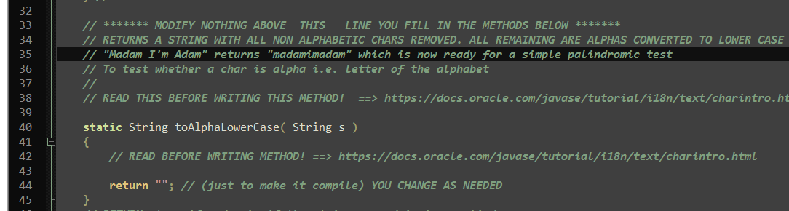
Lab #2: toAlphaLowerCase()
You will replace the current return statement with one that returns a cleaned String.
The new String should only include characters which are determined to be letters using Character.isLetter(), and which have been converted to lower case.
Keep in mind that the input may be an empty String (in which case you can just return “”).

Slide 14
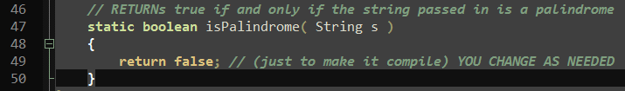
Lab #2: isPalindrome()
Use a loop to confirm that the character sequence is identical, whether read forward or backwards.
Change the return line to report the outcome of this test.
Remember to handle the special case of empty strings (which are considered palindromes for this assignment).

Slide 15
Lab #2: Submission
Hand-in site: http://intranet.cs.pitt.edu/~hoffmant/HS401/login.php
→ Remember that you must be on Pitt’s network, or using the VPN.

