Slide 1
CS401 Lab 2/14/20
These slides will be available online:
https://github.com/kc13/CS401MD
Agenda for today:
General description of the Lab #4 assignment

Slide 2
Lab #4: Overview
Link:
http://people.cs.pitt.edu/~hoffmant/S20-401/labs/lab-04-InsertInOrder/

Slide 3
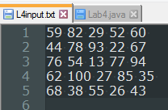
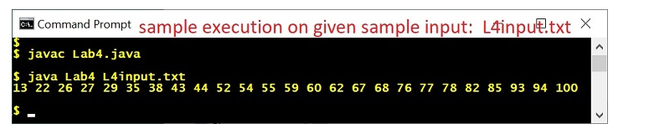
Lab #4: Overview
Big picture: You’re going to finish some starter code:
http://people.cs.pitt.edu/~hoffmant/S20-401/labs/lab-04-InsertInOrder/Lab4.java
It will read in this input file: http://people.cs.pitt.edu/~hoffmant/S20-401/labs/lab-04-InsertInOrder/L4input.txt
It will print out the numbers in sorted order – note that what is most important is how you get to this point (described on subsequent slides)

Slide 4
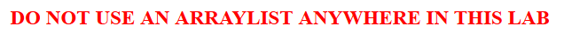
Lab #4: What not to do
Also: Do not use Arrays.sort() to accomplish insertInOrder (to be described on later slide). You’ll need to use the specific procedure that they illustrate on the website.

Slide 5
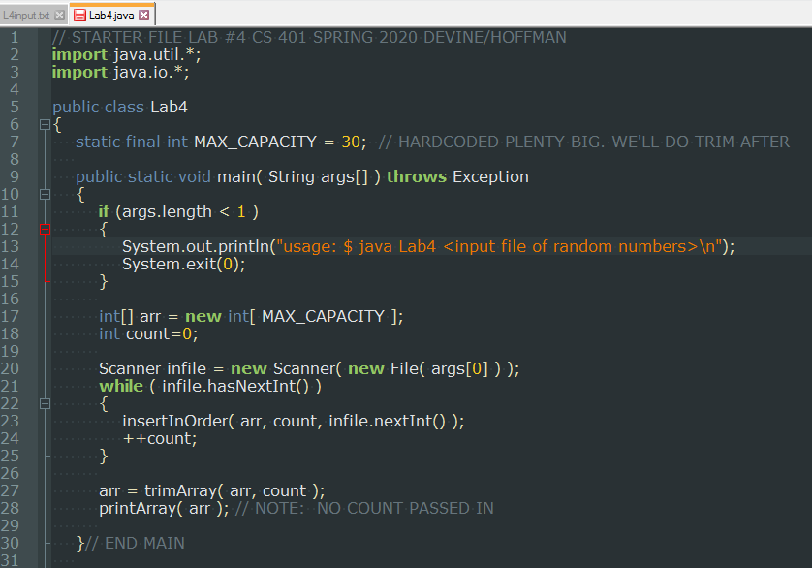
Lab #4: Starter code (some typos corrected, although these do not affect program functionality):
Methods you will complete: insertInOrder, trimArray, printArray

Slide 6
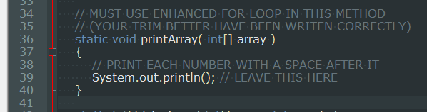
Lab #4: Starter code for printArray – worth 10% of grade
Must use enhanced for loop (e.g., for int i : array)
This means you’ll run into issues if your array contains uninitialized elements
You’ll take care of this issue in trimArray
Just print out each element followed by whitespace:
Note this kind of method could be very helpful in debugging other programs you write that use arrays!

Slide 7
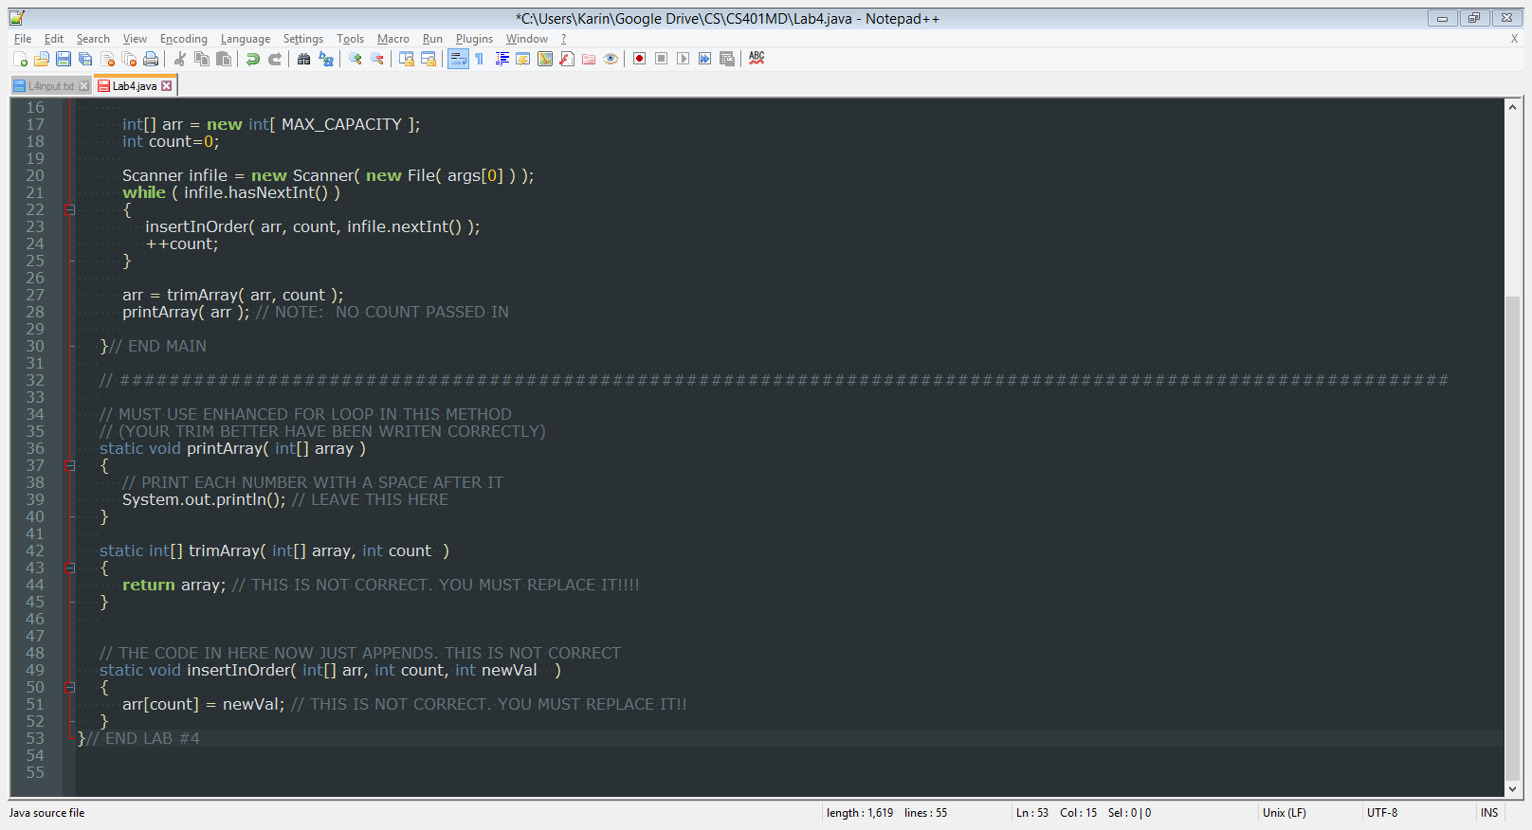
Lab #4: Starter code for trimArray – 20% of grade
Given the input array (“array”), return an array that contains only the first n elements, where n = count.
The output is an array that can be safely processed using the enhanced for loop, as required for the printArray method.

Slide 8
Lab #4: Starter code for insertInOrder – 70% of grade
Inputs: a new int value (newVal) to insert into an integer array (array), and info about how many elements are already in the array (count).
Outputs: This is a void method, so you do not need to return an array. The modifications to int[] arr will be seen outside of the scope of this method.
Details: This is because Java passes the memory address of an array to be changed, not a copy of the values in the array.

Slide 9
Lab #4: Starter code for insertInOrder – 70% of grade
You’ll need to insert newVal into the array, such that
all elements that have been assigned to the array are in sorted order
all elements that have been assigned to the array are “packed tight to the front” (in other words, in elements i = 0 through i = count-1)
Note that the array that the calling code will be passing to this function has space for up to 30 elements; the file will only insert 25.
Arrays that are either empty or only contain 1 element are understood to be sorted.
Note from the instructors: You should use a procedure like that illustrated at the end of the instructions (and on the subsequent slides). Importantly, this means that you cannot simply make use of Arrays.sort().

Slide 10
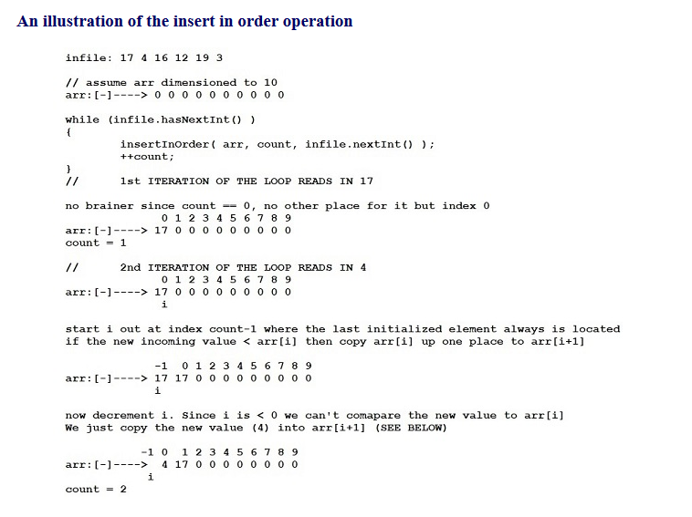
Lab #4: the walk through of how insertInOrder should function
(Note this is not a depiction of what your terminal output should look like – it’s an explanation of how your method should work, on a different example input file and an array of different initial size.)

Slide 11
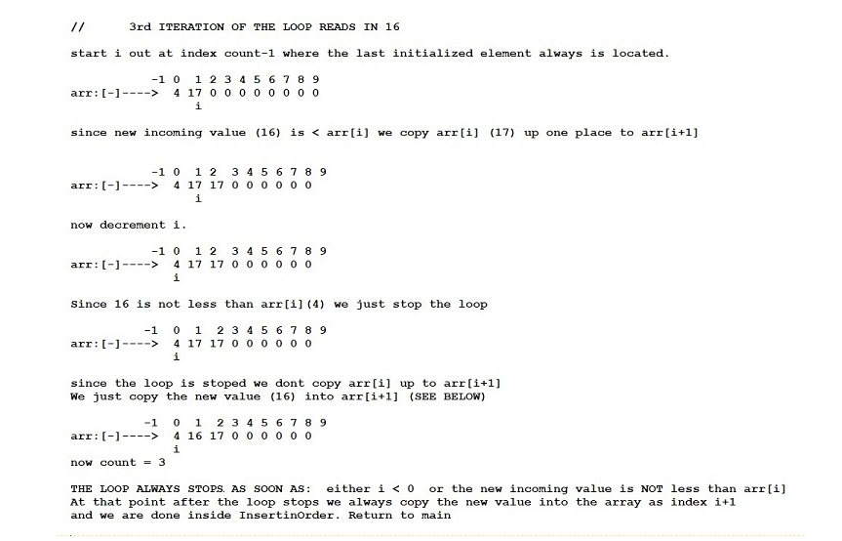
Lab #4: the walk through of how insertInOrder should function
(Note this is not a depiction of what your terminal output should look like – it’s an explanation of how your method should work, on a different example input file and an array of different initial size.)

Slide 12
Lab #4: Recap
Using the starter code and the test file --
Write the printArray and trimArray methods.
Write the insertInOrder method so that:
All values are updated to appear in the appropriate sorted position,
And the values are packed into the leftmost elements of the array
Without using Arrays.sort, and without using ArrayLists.
Questions?

