Slide 1
CS401 Lab 1/10/20
These slides will be available online:
https://github.com/kc13/CS401MD

Slide 2
Basic info
TA: Karin Cox
Email: kmc51@pitt.edu
Office: 6150 Sennott Square
Office hours: T 5:30-6:30 pm; F 2:00-4:00 pm
Slides:
https://github.com/kc13/CS401MD
Optional to access; URL for Github site will always be on the first slide (MD = the instructor’s initials)

Slide 3
For lab #0:
All of the relevant instructions and links are here:
https://people.cs.pitt.edu/~hoffmant/S20-401/labs/lab-00/
Note some of the links may only work if you are working on campus or are using the Pitt VPN.
General goals:
Make sure you can compile and execute Java programs on the command line.
Review and agree to some policy documents.

Slide 4
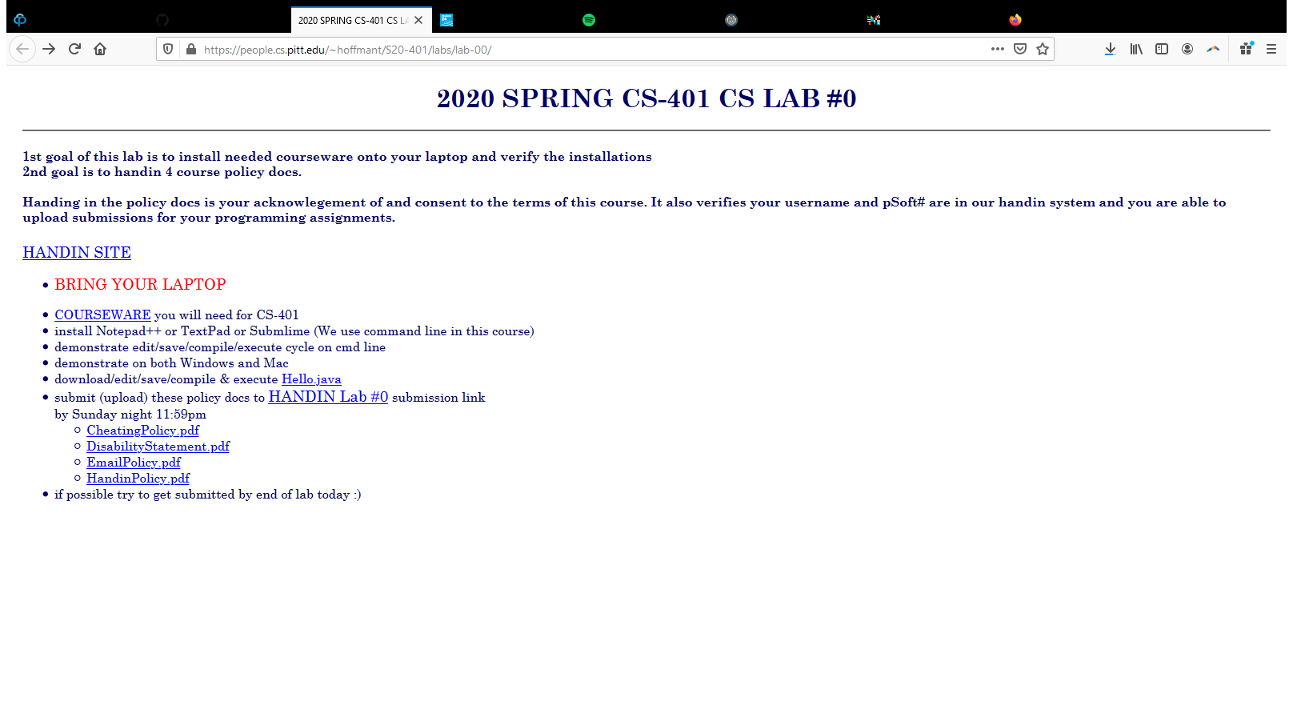
For lab #0:
All of the relevant instructions and links are here:
https://people.cs.pitt.edu/~hoffmant/S20-401/labs/lab-00/

Slide 5
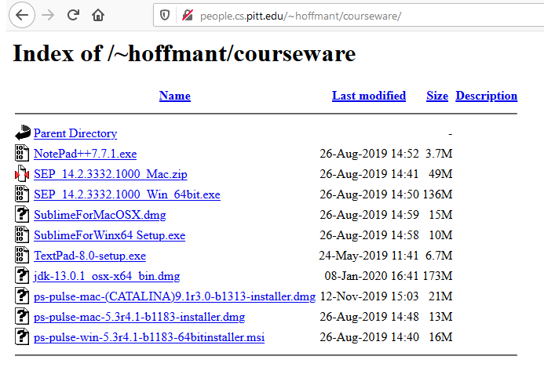
Courseware link:
Includes installation files for:
Various text editors
The Java Development Kit (JDK); see also https://www.oracle.com/technetwork/java/javase/downloads/jdk13-downloads-5672538.html
Pulse VPN client (for accessing resources off campus) and Symantec Endpoint Protection (prerequisite for installing Pulse)

Slide 6
Java: Setting up the Path system variable
To run Java commands on the command line, the system needs to know where to search for them.
Some systems (especially Windows) may not set this up by default; you may need to do it yourself (as a test: try typing ‘java’ or ‘javac’ on the command line, and see if the command is recognized).
If you need to set up the path, here’s one reference:
https://www.java.com/en/download/help/path.xml

Slide 7
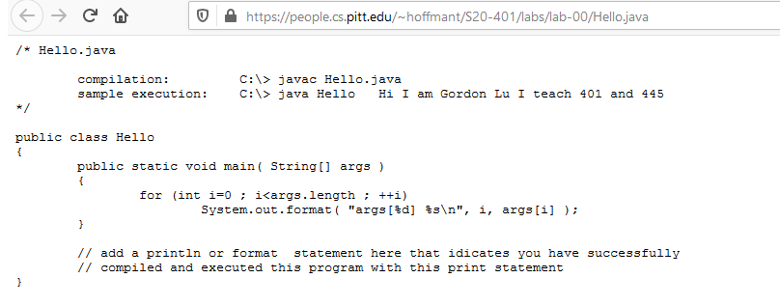
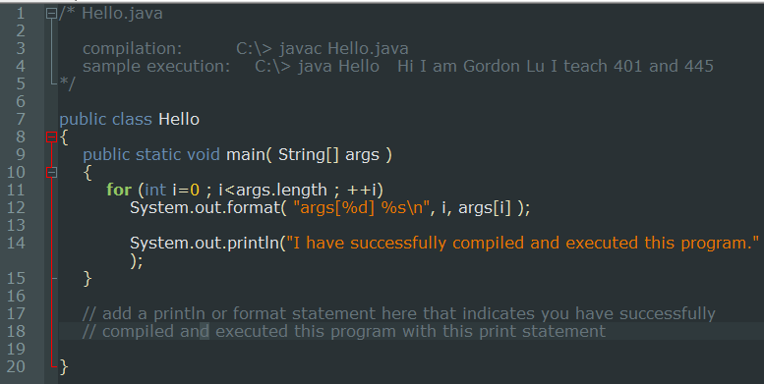
Compile and execute the provided Hello.java program

Slide 8
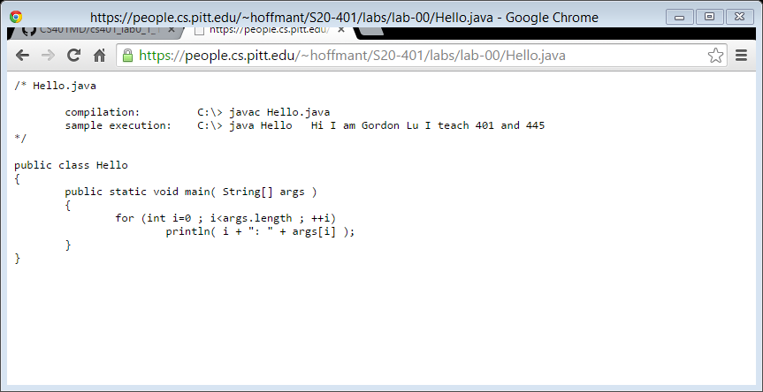
Update:
If your file looks like this, you may need to add System.out before println to get it to work.
System.out.println( i + “: “ + args[i]);

Slide 9
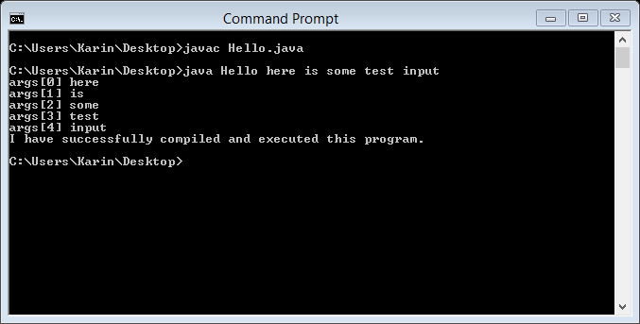
Compile and execute the provided Hello.java program
Note that you are not being asked to submit this file, but it would be a very good idea to confirm that you can edit/compile/execute the file on the command line.

Slide 10
Download and review the four policy documents

Slide 11
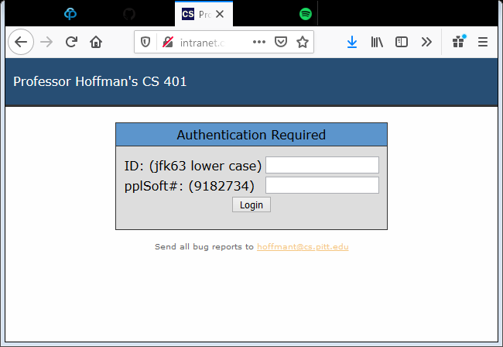
Submit the four policy PDFs (no modification needed for the policy files)
If you can’t login, then send an email to both HoffmanT@pitt.edu and mjd73@pitt.edu with a subject line with this format:
SUBJ: 401 <pitt-username> HANDIN WON’T LET ME LOGIN
Send this from your Pitt address. In the body of the email, include your full name, Pitt username, and PeopleSoft number.

Slide 12
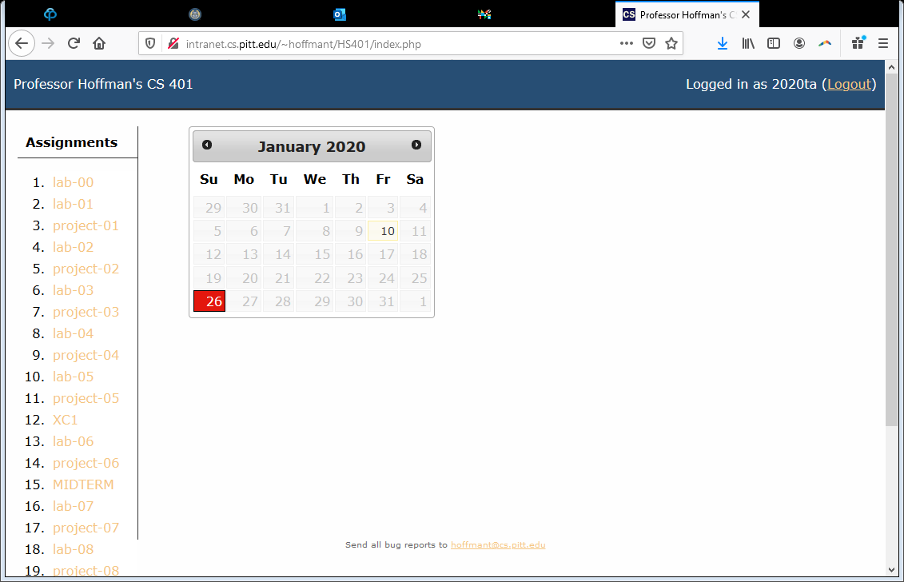
Submit the four policy PDFs (no modification needed for the policy files)
Click lab-00
Click “click me” in the blue box that will show up in the top right
Browse for and upload the four pdf files.

