Slide 1
CS401 Lab 1/24/20
These slides will be available online:
https://github.com/kc13/CS401MD

Slide 2
Lab #1
Link: See Lab #1, Week #3 on Courseweb
https://people.cs.pitt.edu/~hoffmant/S20-401/labs/lab-01-MarathonTimes/

Slide 3
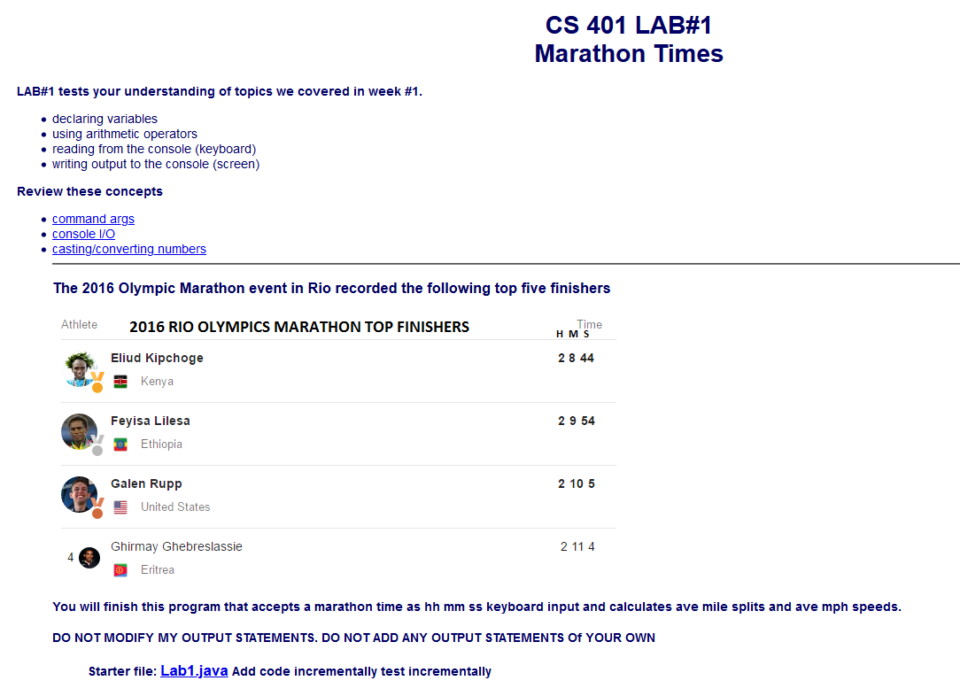
Lab #1:
General idea:
You are given some starter code (Lab1.java) that you will need to complete.
This program will accept some inputs on the command line. They will be of the format shown in the example marathon times provided here.

Slide 4
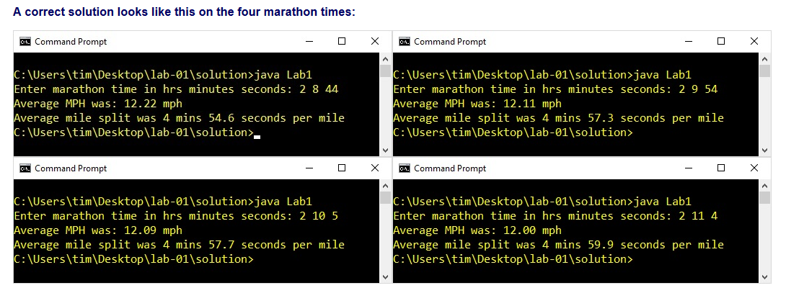
Lab #1:
Expected program behavior:
Enter time in the format <hours> <minutes> <seconds>
Output:
First message reports the average miles per hour (given that a marathon is 26.21875 miles long)
Second message reports the average number of minutes to complete each mile (also known as the average “mile split”, see https://www.verywellfit.com/what-are-splits-in-running-2911656)

Slide 5
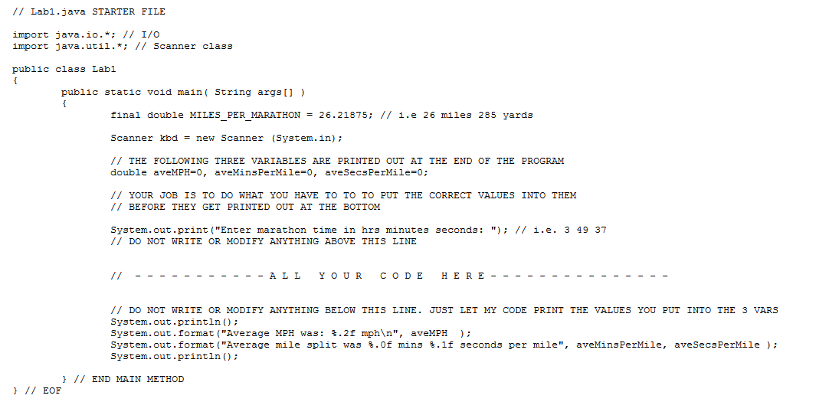
Lab #1: Starter code
Top section: Initializes constant for marathon length and Scanner to read input; declares doubles to represent average MPH, minutes/mile, seconds/mile, presents user prompt
Bottom section: Prints values that you will place into the three doubles.

Slide 6
Lab #1: Remaining tasks
Use Scanner methods to read in the three input numbers.
Do some arithmetic.
Make sure to edit the file in the designated location only.

Slide 7
Lab #1: Remaining tasks
Relevant Java documentation:
https://docs.oracle.com/javase/tutorial/java/nutsandbolts/operators.html
https://docs.oracle.com/javase/10/docs/api/java/util/Scanner.html
You might also want to review class material on casting.

Slide 8
Lab #1 Submission
http://intranet.cs.pitt.edu/~hoffmant/HS401/index.php
Click on ‘lab-01’.

