Slide 1
CS401 Lab 2/7/20
These slides will be available online:
https://github.com/kc13/CS401MD
Agenda for today:
General description of Lab #3 assignment
Some relevant comments on ArrayList/arrays

Slide 2
Lab #3: Overview
Link:
http://people.cs.pitt.edu/~hoffmant/S20-401/labs/lab-03-ArrayListCanonical/

Slide 3
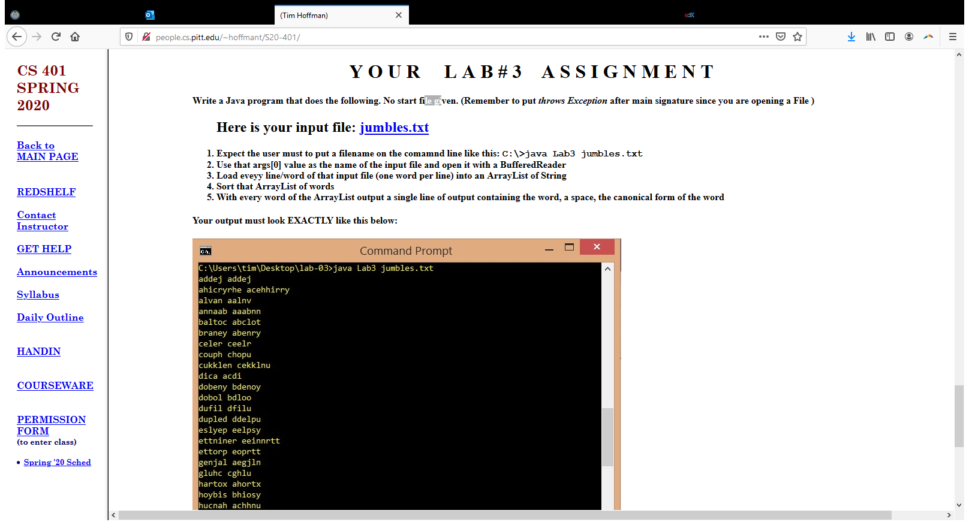
Lab #3: Overview
The assignment (concepts to be discussed on later slides):
You need to write the code (Lab3.java) from scratch (no starter file).
It will take in one input file (provided) on the command line:
See the starter code for Lab2 as a reference for
Including code for throwing an Exception (needed in the event of file opening issues)
Reading in the file using BufferedReader.

Slide 4
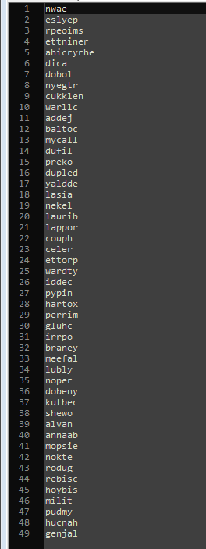
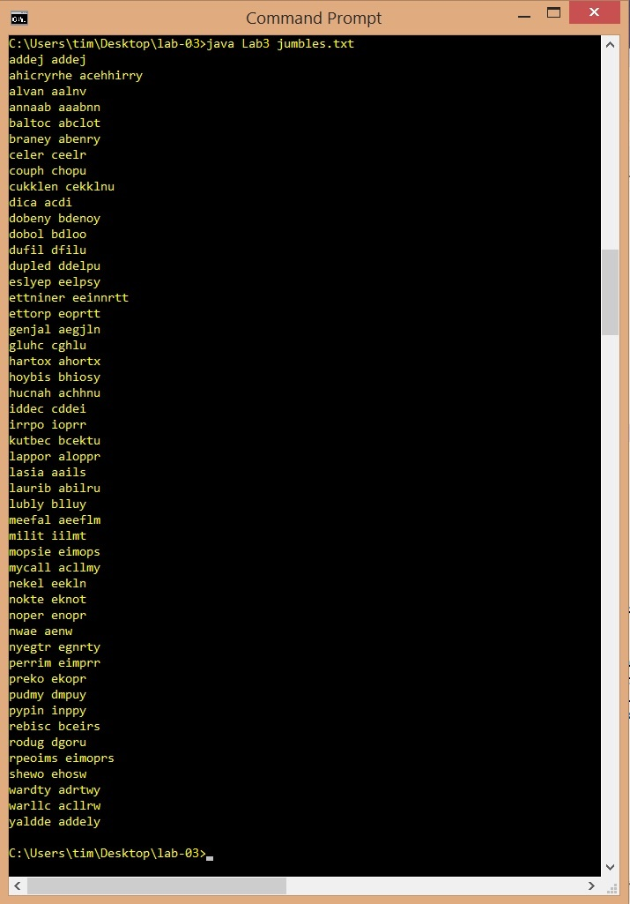
Lab #3: Input file and target output
The strings are sorted, and then printed in both original form and with the characters sorted into alphabetical order.

Slide 5
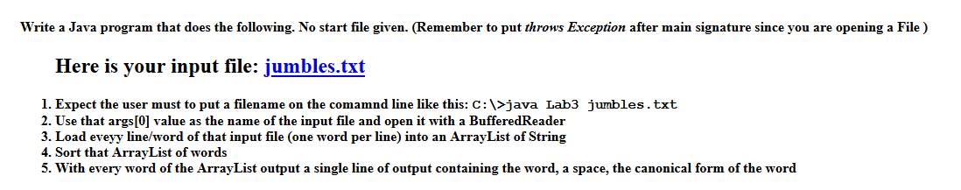
Lab #3: Procedure
In other words: As you read in the file line by line (with BufferedReader), you’ll insert each string (here called a word, even if they’re nonwords) into an ArrayList (described on subsequent slides). Later slides will also describe methods you can use to sort your ArrayList of strings, and also to sort the characters within each string.

Slide 6
Lab #3: Other concepts/methods introduced in lab
Arrays class (here also termed a library)
API: https://docs.oracle.com/javase/10/docs/api/java/util/Arrays.html
Description from API: “This class contains various methods for manipulating arrays (such as sorting and searching).”

Slide 7
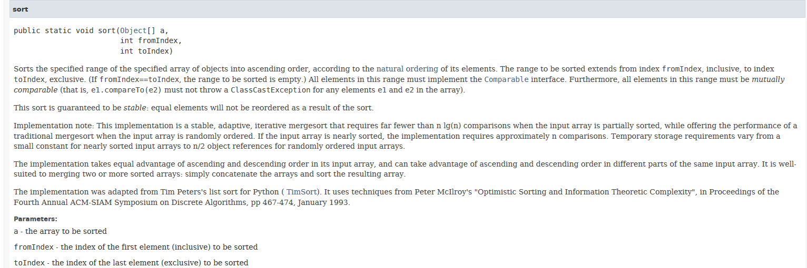
Lab #3: Arrays class methods for sorting and searching
API info for sorting a String array (or an array of any object type)
https://docs.oracle.com/javase/10/docs/api/java/util/Arrays.html#sort(java.lang.Object%5B%5D,int,int)

Slide 8
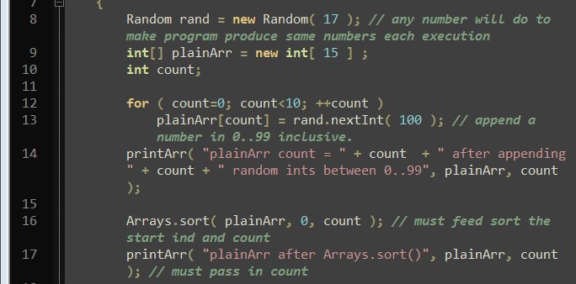
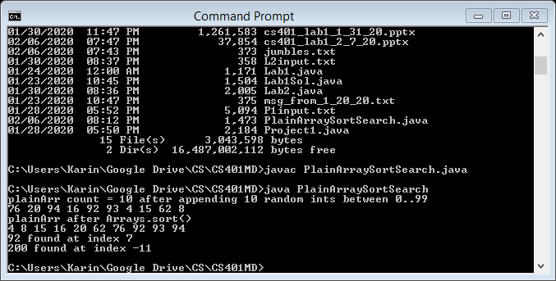
Lab #3: Arrays class methods for sorting and searching
Example given in sample file PlainArraySortSearch.java
Conveying some info from the CS401 instructors: It is important to provide the start and end index arguments for the sort (even though there is a version of the method for which these are not required). This is because, when we are dealing with a standard array, we don’t want to bother dealing with elements of the array that may have not yet been initialized.

Slide 9
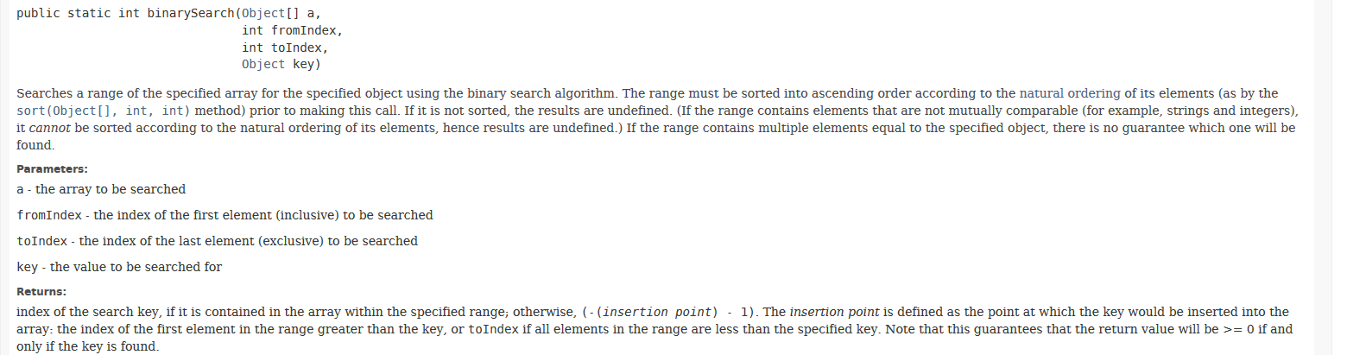
Lab #3: Arrays class methods for sorting and searching
API info for searching a String array (or an array of any object type)
https://docs.oracle.com/javase/10/docs/api/java/util/Arrays.html#binarySearch(java.lang.Object%5B%5D,int,int,java.lang.Object)

Slide 10
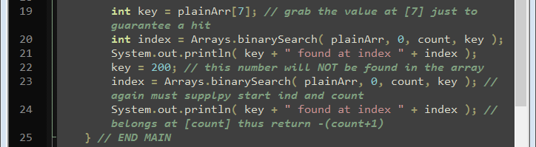
Lab #3: Arrays class methods for sorting and searching
Example given in sample file PlainArraySortSearch.java
Again, note that we are providing start and end indices.

Slide 11
Lab #3: ArrayList concept/methods
API info here:
https://docs.oracle.com/en/java/javase/11/docs/api/java.base/java/util/ArrayList.html
Big advantage over typical arrays:
You can grow/shrink them dynamically.

Slide 12
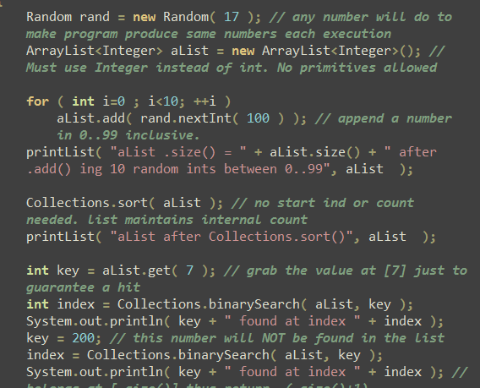
Lab #3: Illustration in ArrayListSortSearch.java
Constructor: Note the class of objects you want to hold must be included in brackets.
add method: by default, will append the provided argument to the end of the list
size method: analogous to length property for arrays (but note this is a method, not a property, hence the () at the end)
Collections.sort() and .binarySearch(): Analogous to the operations of the same name for Arrays; see https://docs.oracle.com/javase/8/docs/api/java/util/Collections.html
Note we are not providing start and end indices here. The ArrayList and Collections methods are smart enough to give us the behavior we want.

Slide 13
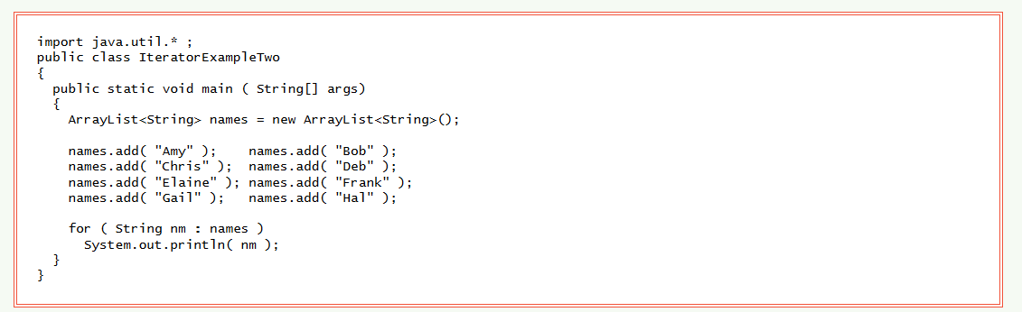
Lab #3: “Enhanced” for loop format for ArrayList
Example from https://chortle.ccsu.edu/Java5/Notes/chap54/ch54_18.html
Additional info from the instructors:
You should use this enhanced for loop with your ArrayList in your assignment.
Note it would not be so safe to use with a standard array, because it might loop through unitialized elements.

Slide 14
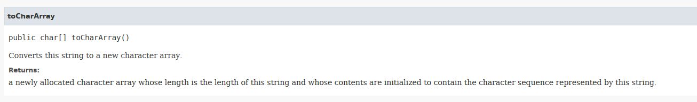
Lab #3: .toCharArray() (method from String API)
You will use this to get an array of characters that you can sort (necessary to print out 2nd column in assignment output)

Slide 15
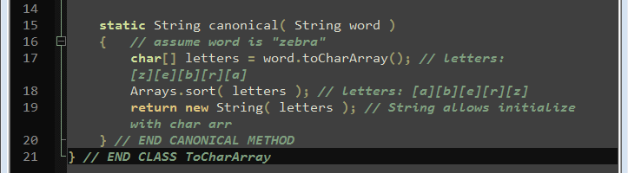
Lab #3: ToCharArray.java
This method shows you how you can get the string with sorted characters. Note that toCharArray() will return a full array, so we’re not so concerned about using the sort method that accepts index arguments.

Slide 16
Lab #3: Assignment recap
Read in the file provided on the command line, using BufferedReader. Reference to earlier labs will help with this.
For each row in the file, add the string to an ArrayList.
Use Collections.sort() to sort the ArrayList.
Use the enhanced for loop and toCharArray() and Arrays.sort() to print out the two strings that are needed on each line of the output.
Hand-in site: http://intranet.cs.pitt.edu/~hoffmant/HS401/login.php

