Slide 1
CS401 Lab 2/28/20
These slides will be available online:
https://github.com/kc13/CS401MD
Agenda for today:
Trace of mystery2() method from Project #5
Open time to ask questions

Slide 2
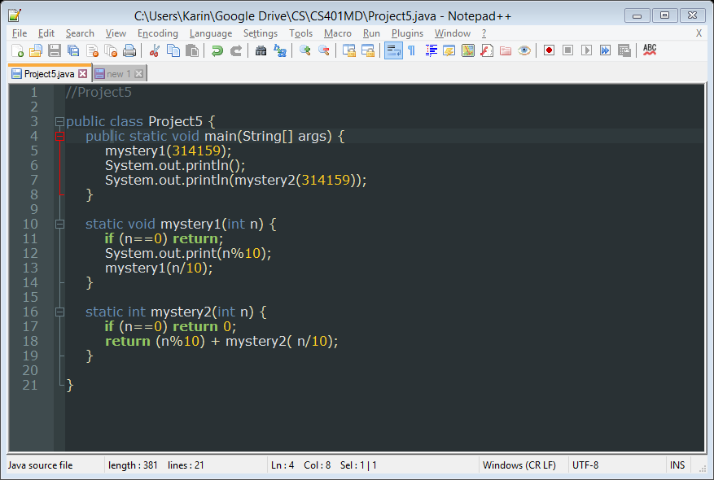
From the posted code sample:
Anticipating the outcome:
-This will print out 23.
-It is taking the sum of the digits in the number.
-More importantly: How does this happen? How can we trace through this code, or any recursive code, to anticipate this outcome?

Slide 3
From the posted code sample:
General pointers:
--It helps to draw out the individual method calls as a stack (illustrated later), and keep track of the parameter values (here, just n) for each layer of the stack
--Convention is to draw the stack growing upwards. When individual method calls return, the call is popped off the top of the stack (for more background, see https://en.wikipedia.org/wiki/Stack_(abstract_data_type))
--Remember that for statements involving the return keyword, any method calls on the right hand side must be processed first.

Slide 4
From the posted code sample:
Tracing:
--On the board: illustration of calling mystery2 with a smaller number (789, expected to return 24)

Slide 5
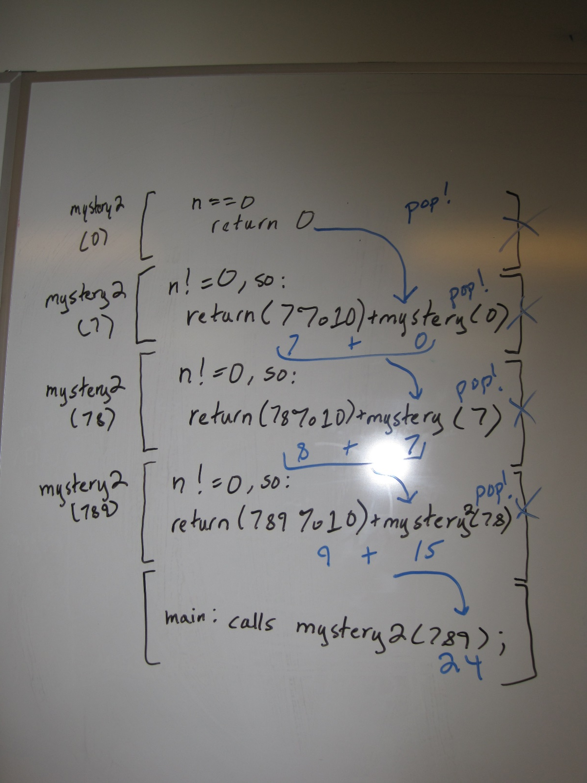
Image of trace on whiteboard:

Slide 6
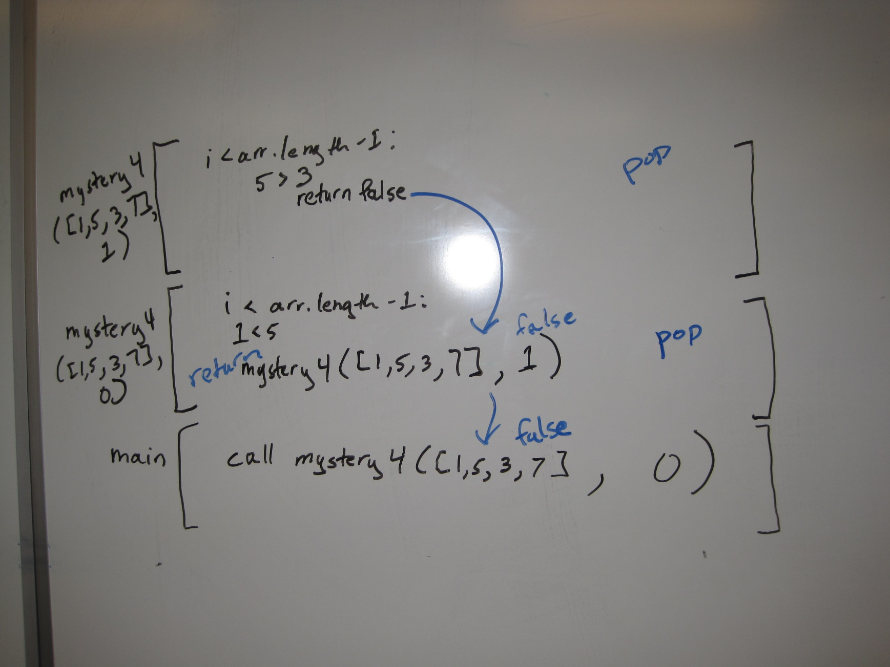
Same, for mystery4():

