Slide 1
CS401 Lab 2/21/20
These slides will be available online:
https://github.com/kc13/CS401MD
Agenda for today:
Description of the Lab #5 assignment

Slide 2
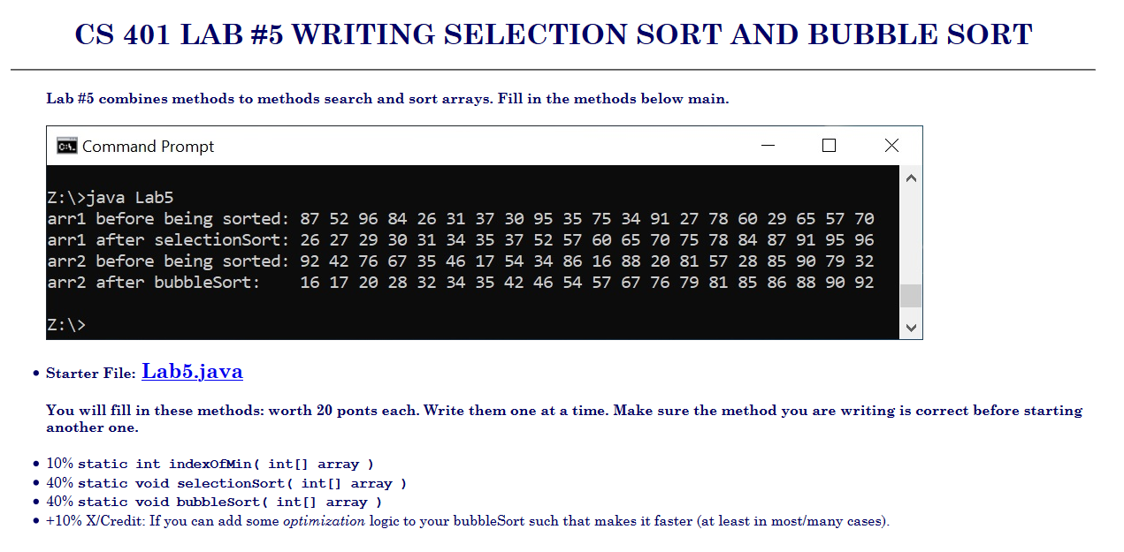
Lab #5: Overview
Link: http://people.cs.pitt.edu/~hoffmant/S20-401/labs/lab-05-SelectionBubble
Big picture: You’ll complete the starter code (Lab5.java), including two sorting methods and an “indexOfMin” method that will be useful for Selection Sort

Slide 3
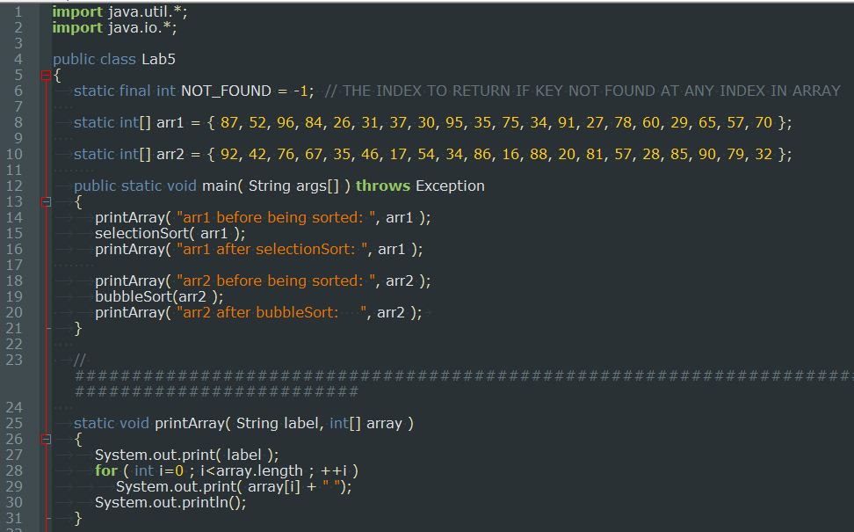
Lab #5: Starter code, completed sections

Slide 4
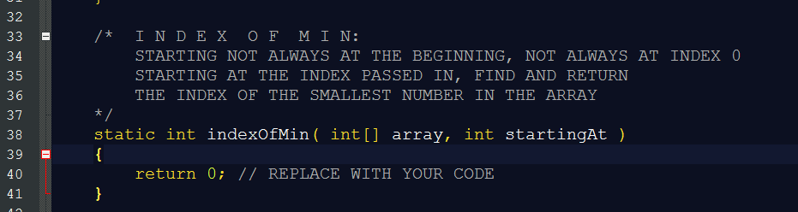
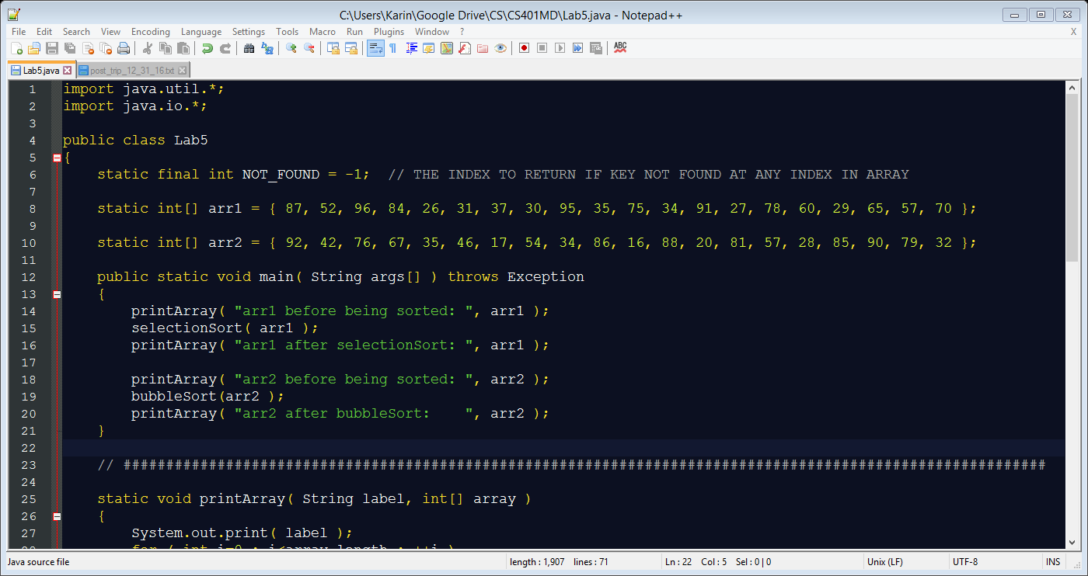
Lab #5: indexOfMin
Examples using arr1:
indexOfMin(arr1, 6) → returns 13 (index of 27)
indexOfMin(arr1, 16) → returns 16 (index of 29)
Possibly helpful side note: You can assign an integer the maximum possible value available in Java as follows: int val = Integer.MAX_VALUE;
(But you can also complete the code without using this.)

Slide 5
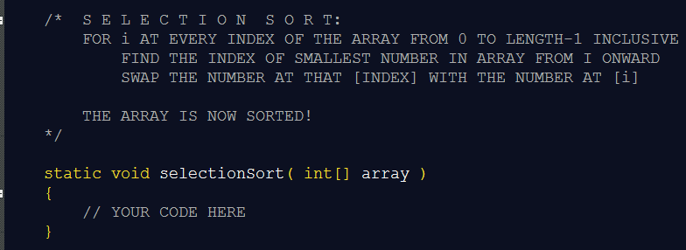
Lab #5: Selection Sort
Note opportunity to make use of the indexOfMin function…

Slide 6
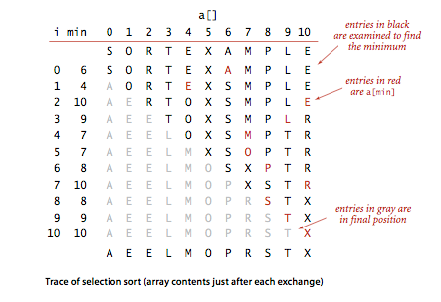
Lab #5: Selection Sort
Example from https://algs4.cs.princeton.edu/21elementary/, sorting chars instead of ints

Slide 7
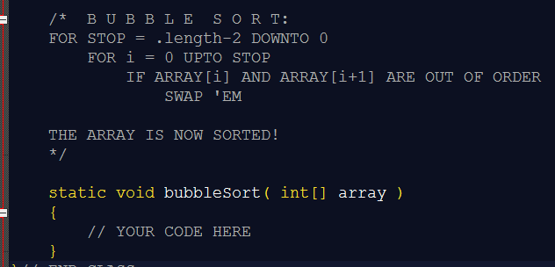
Lab #5: Bubble Sort
This will be demonstrated on the whiteboard (see next slide)
General idea, in words: let L be the length of the array
You go through the array for multiple iterations (specifically, L-1), each time terminating one row earlier than you did on the last iteration.
For each iteration through the array, you progress down through the rows (down to the termination point), and compare the items in the current and next row. If the value of the item in the current row is > the value of the item in the next row, you need to swap their positions in the array.

Slide 8
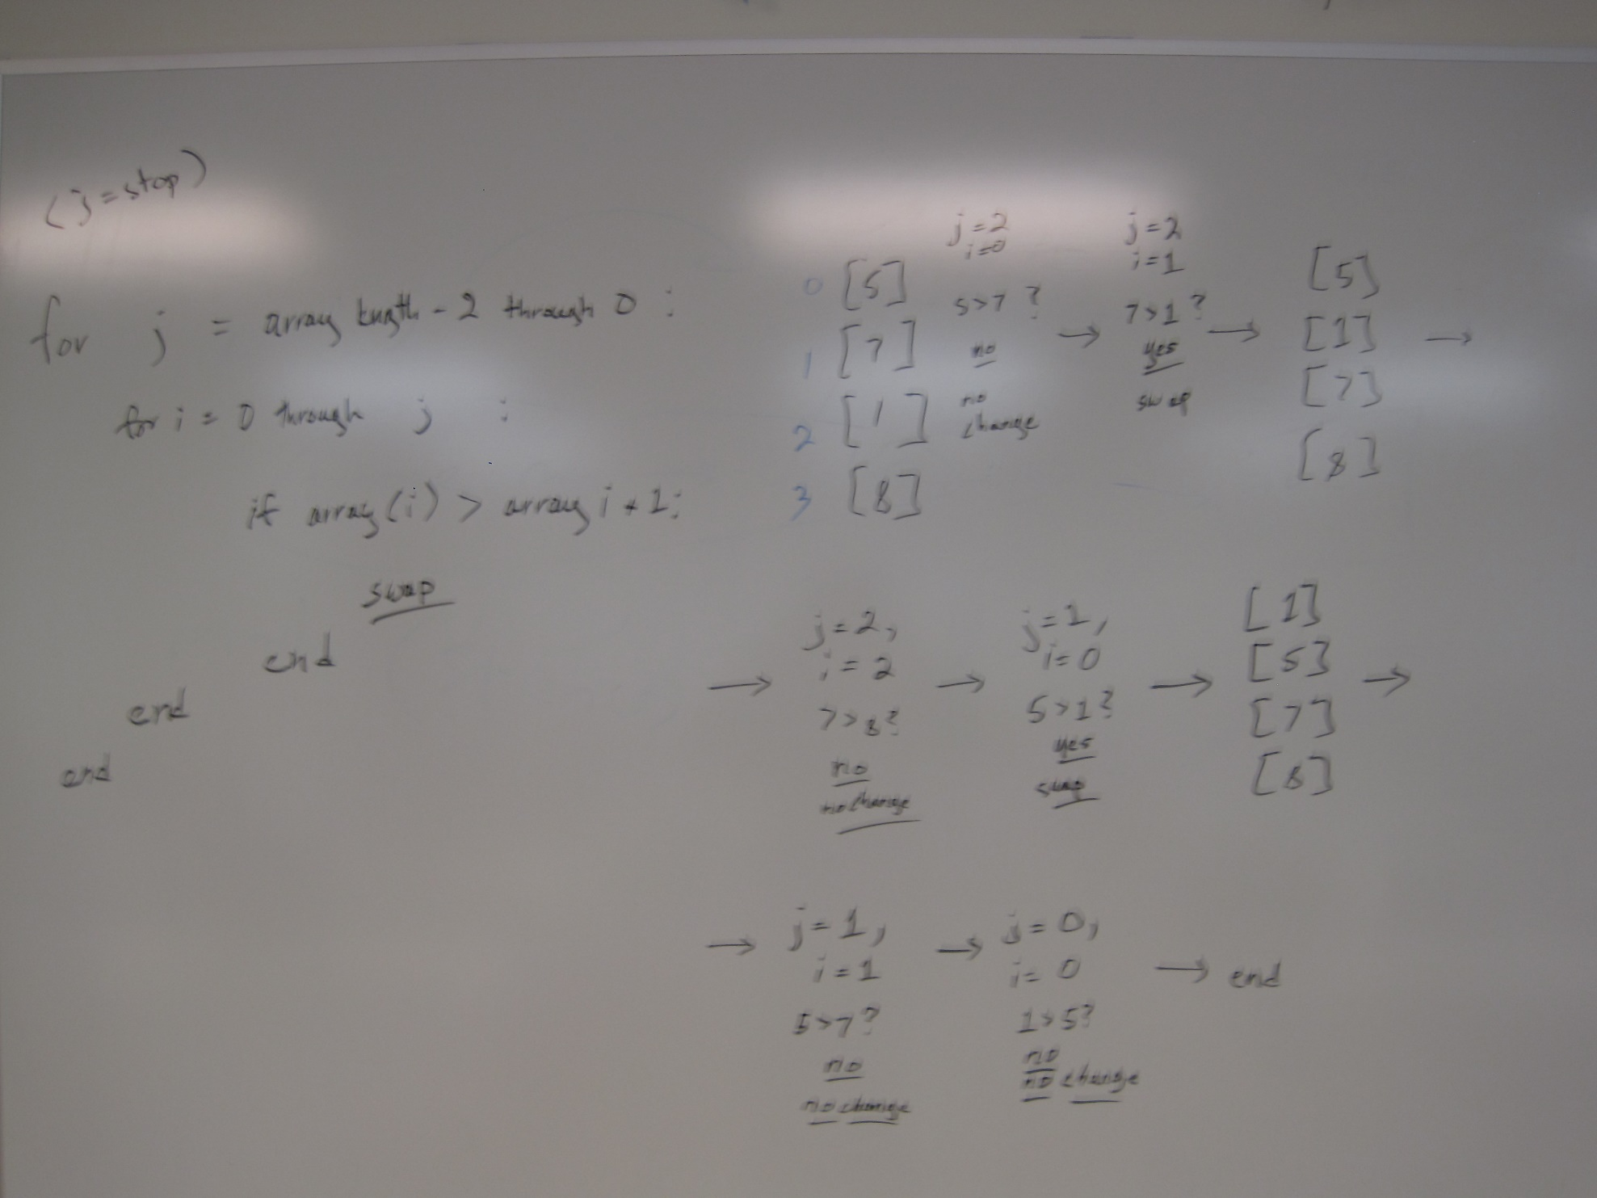
Lab #5: Bubble Sort

Slide 9
Lab #5: Bubble Sort
Java operations that are likely to be useful here:
for loop nested inside another for loop
if statement conditioned on array[i] > array[i+1]
Code that will handle the swapping of two values (if this is unfamiliar, see https://en.wikipedia.org/wiki/Swap_(computer_programming)#Using_a_temporary_variable)
This will also be useful for selection sort
Note that bubble sort (as well as selection sort) are “in place” sorting algorithms – you should not need to create a separate, 2nd array – you can just swap items within the single array.
It’s a void method – no need to return anything.

Slide 10
Questions?

