Slide 1
CS401 Lab 1/13/20
These slides will be available online:
https://github.com/kc13/CS401PF
Please sign in sometime before you leave lab today!

Slide 2
Basic info
TA: Karin Cox
Email: kmc51@pitt.edu
Office: 6150 Sennott Square
Office hours: T 5:30-6:30 pm; F 2:00-4:00 pm
Slides:
https://github.com/kc13/CS401PF
Optional to access; URL for Github site will always be on the first slide (PF = the instructor’s initials)

Slide 3
Some policies (based on information provided by the course instructor):
Recitation Material
The recitation material will be posted on the website (more precisely on the Syllabus page) as shown in the last column of the page below:
http://paulobrasko.com/cs-0401/course-material/syllabus/

Slide 4
Some policies (based on information provided by the course instructor):
Recitation Due date/time
Lab assignments should be demonstrated to the TA during lab time.
You can demonstrate your lab either (a) during the lab period when it is assigned, or (b) at the beginning of the next lab period.
This typically implies that you have one week to finish the lab.
However, for the lab assigned on 1/13, you have two weeks, since we do not have a lab meeting on 1/20 ( Dr. Martin Luther King’s birthday).
Lab work will not be accepted after the deadline described above. A score of 0 will be given for a lab that is not demonstrated by the deadline.
Each lab will be given a score from 0-100 that will be posted in Courseweb.
More detailed information about scoring will be given for the individual labs.
Note that many assignments will be such that there are multiple ways to successfully complete it.

Slide 5
Some policies (based on information provided by the course instructor):
Recitation Attendance
Students should be present in all recitations.
Please sign in to record your attendance!
After each lab, an email will be sent out to any students who missed the lab, with the professor cc’d.

Slide 6
Some policies (based on information provided by the course instructor):
Questions about the policies?

Slide 7
Lab assignments for today
http://paulobrasko.com/cs-0007/laboratory-schedule/lab_chapter_2_part_1_a/
http://paulobrasko.com/cs-0007/laboratory-schedule/lab_chapter_2_part_2_a/

Slide 8
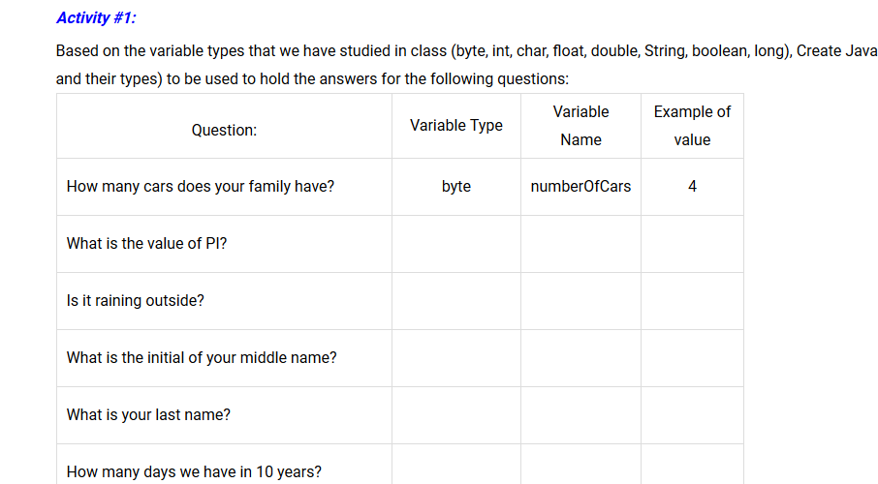
Chapter 2 Part 1 Recitation – Naming Convention, Data Types, and Literals and Arithmetic Operators
This is broken up into two subparts, and individual activities.
Subpart 1, Activity #1: Pen and paper exercise: Think of some descriptive variable names, using camel case convention, and write the appropriate data type and an example value. Note for some items, there are multiple possibilities that might make sense.
Note: Some possibly helpful info on Java’s primitive data types (all in the list excluding String) may be found here: https://docs.oracle.com/javase/tutorial/java/nutsandbolts/datatypes.html
Notes:
Don’t need to show this unless want the feedback

Slide 9
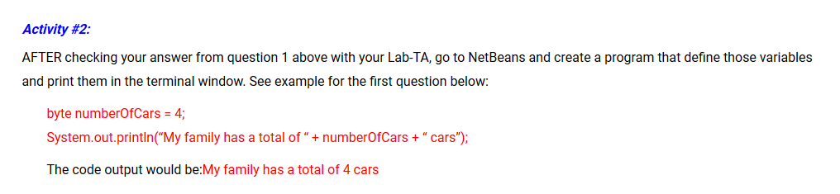
Chapter 2 Part 1 Recitation – Naming Convention, Data Types, and Literals and Arithmetic Operators
Subpart 1, Activity #2:
If you feel confident about your answer to Activity #1, feel free to move on to this part without checking in with me first.
For this part, you just need to write a small program where you declare the variables from your table + initialize them to some value, given the syntax shown. Then, you can print those values out to the screen, embedded in some statement, again as shown in the example.
If you are unsure how to create and execute a program in NetBeans, see the video tutorials linked to the first entry in the online course syllabus.
Notes:
Don’t need to show activity #1 unless want the feedback

Slide 10
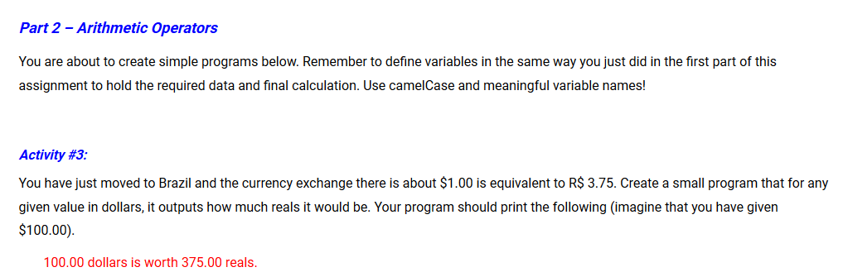
Chapter 2 Part 1 Recitation – Naming Convention, Data Types, and Literals and Arithmetic Operators
Subpart 2, Activity #3:
This program will require nothing more than declaring and initializing some variables, performing a calculation, and printing the result.

Slide 11
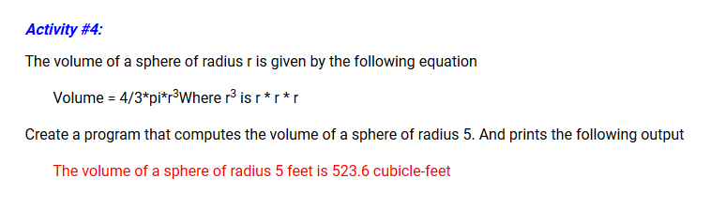
Chapter 2 Part 1 Recitation – Naming Convention, Data Types, and Literals and Arithmetic Operators
Subpart 2, Activity #4:
As in activity 3, this program will require nothing more than declaring and initializing some variables, performing a calculation, and printing the result.
Note:
Math.PI is a Java constant that represents the value of pi.
See https://docs.oracle.com/javase/8/docs/api/java/lang/Math.html#PI
Math.pow(a,b) can be used to raise a to the bth power, see https://docs.oracle.com/javase/8/docs/api/java/lang/Math.html#pow

Slide 12
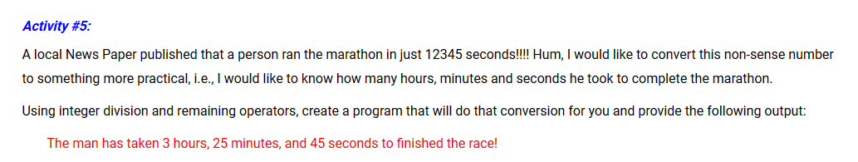
Chapter 2 Part 1 Recitation – Naming Convention, Data Types, and Literals and Arithmetic Operators
Subpart 2, Activity #5:
Comments:
Integer division: a/b = truncated result of the division of a by b (for example, 7/2 = 3)
Remainder operator is % (7 % 2 = 1)

Slide 13
Chapter 2 Part 1 Recitation – Naming Convention, Data Types, and Literals and Arithmetic Operators
What to demonstrate for Part 1:
→ Show that your four short programs run and print out the request information. Make sure the source code is available for review.

Slide 14
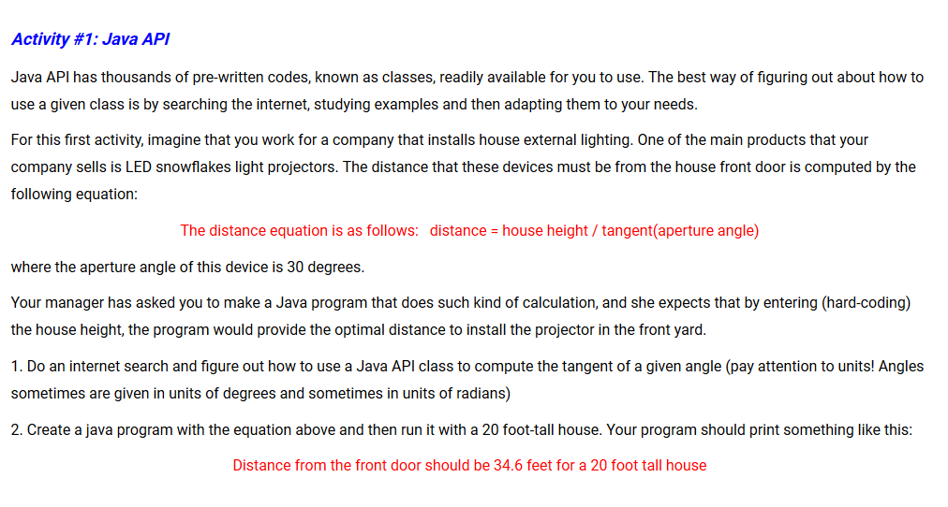
Chapter 2 Part 2 Recitation – Java API, String Class, Variable Scope, Comments, Code Style
This is broken up into three activities. Activity #1:
This is much like the programs completed for Part 1, except you will have to look up a new operation to perform, which will be part of a pre-existing Java class. Note: There are also built in Java methods to convert degrees to radians (or vice versa), or you can choose to calculate the conversion yourself (180 degrees = pi radians).

Slide 15
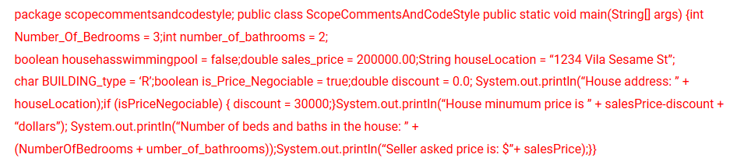
Chapter 2 Part 2 Recitation – Java API, String Class, Variable Scope, Comments, Code Style
Activity #2: Scope, Comments, and Code Style
To start, you will need to create a new project, delete any source code that shows up by default, and replace it with the block of code given by the professor:
Please make note of his comments regarding the need to adjust punctuation symbols (for example, you will need to retype any double quote “ and single quote ‘ characters so that NetBeans will recognize them).

Slide 16
Chapter 2 Part 2 Recitation – Java API, String Class, Variable Scope, Comments, Code Style
Activity #2: Scope, Comments, and Code Style
Once you’ve copied the code and adjusted any unrecognized characters, you will need to:
Reformat the code (including variable names, adding spaces/tabs/etc)
Correct any remaining errors in the code, or anything that might look strange in the output
Add comments to explain the purposes of any variables

Slide 17
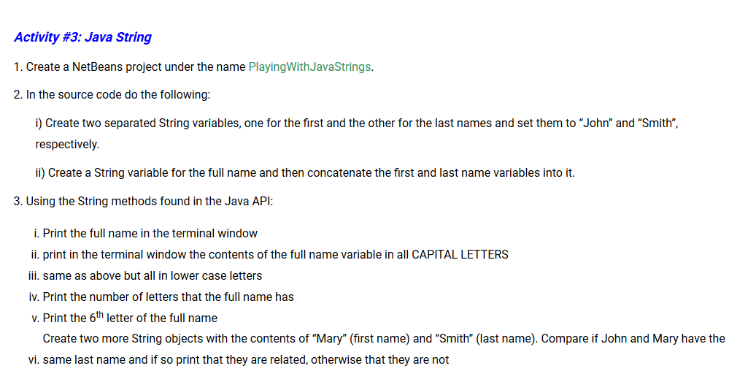
Chapter 2 Part 2 Recitation – Java API, String Class, Variable Scope, Comments, Code Style
Activity #3

Slide 18
Chapter 2 Part 2 Recitation – Java API, String Class, Variable Scope, Comments, Code Style
What to demonstrate for Part 2:
→ Show that your four programs run correctly; make sure source code is available.
Reminder: Please remember to sign in if you haven’t already!

