Slide 1
CS401 Lab 2/24/20
These slides will be available online:
https://github.com/kc13/CS401PF
Agenda for today:
Please sign in sometime before you leave lab!
What is expected for demos of Lab #6 / Partial credit breakdown
Demos of Lab #6
Status of next lab assignment – waiting on info from the instructor

Slide 2
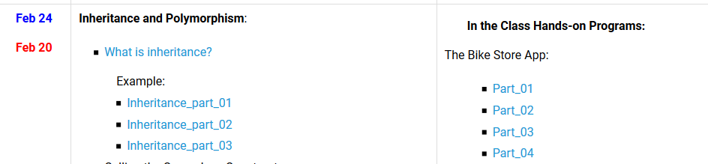
Lab #6: Recap
There are four videos, linked to the syllabus, that describe how to create the “Bike Store App”
All you need to do is reproduce this program
There are a few things that are added just for the sake of illustration (“Engine” class, and “whatever” method). Don’t worry about recreating those.v
Video links

Slide 3
Lab #6: Bike Store App
For the demo, just demonstrate that you’ve recreated the program, and that it runs:
In the Bike class, you should have some constructors and get/set methods
In the main method, you should create some object instances and print out info about them.

Slide 4
Lab #6: For the demos – for determining partial credit

