Slide 1
CS401 Lab 1/27/20
These slides will be available online:
https://github.com/kc13/CS401PF
Agenda for today:
Please sign in sometime before you leave lab!
Quick review of some of the lab policies
Review of what is expected for demos of Labs 1-2
Demos of Lab #1
Demos of Lab #2
Comments regarding Lab #3 (time permitting – otherwise you can access this material online later)
(if applicable): any Lab #3 demos that are ready

Slide 2
Reminder: Basic info
TA: Karin Cox
Email: kmc51@pitt.edu
Office: 6150 Sennott Square
Office hours: T 5:30-6:30 pm; F 2:00-4:00 pm
Slides:
https://github.com/kc13/CS401PF
Optional to access; URL for Github site will always be on the first slide (PF = the instructor’s initials)

Slide 3
Some policy reminders (see also 1/13 slides):
Recitation Due date/time
Lab assignments should be demonstrated to the TA during lab time.
You can demonstrate your lab either (a) during the lab period when it is assigned, or (b) at the beginning of the next lab period.
This typically implies that you have one week to finish the lab (exceptions: two weeks allowed lab assigned on 1/13, since there was no lab on 1/20; and lab #2 demos will be viewed after lab #1 demos on 1/27).
Lab work will not be accepted after the deadline described above. A score of 0 will be given for a lab that is not demonstrated by the deadline.
Each lab will be given a score from 0-100 that will be posted in Courseweb.
More detailed information about scoring will be given for the individual labs, if/when partial credit is given.
Note that many assignments will be such that there are multiple ways to successfully complete it.

Slide 4
More reminders:
Recitation Attendance
Students should be present in all recitations.
Please sign in to record your attendance!
After each lab, an email will be sent out to any students who missed the lab, with the professor cc’d.

Slide 5
Lab #1: Recap of what to demonstrate
There were two Parts, and multiple Activities within each part.
You were asked to write or edit several short programs.
Show that your short programs run and print out the requested information. Make sure the source code is available for review.
Note: When comparing Strings, do not use ==.
This is always wrong, even if sometimes it might happen to give you the correct answer.
== compares memory addresses: for more explanation see:
https://www.baeldung.com/java-compare-strings
in some cases two String variables with the same content will point to the same memory location, but not always – you should not assume this
String methods that you can use instead: .equals(), .equalsIgnoreCase(), etc.

Slide 6
Lab #2: What to demonstrate
If the program runs:
You’ll be asked to do a quick run through the 10 questions, with some fraction of them answered incorrectly.
For full credit (100 points), the questions should be presented + and responses should be accepted in the manner described in the program instructions, and the final score should also be correctly presented as the instructions specify.
Partial credit may still be awarded if only part of this is accomplished.
If the program does not run:
It may be possible to earn some partial credit if you can show that at least one of the functional requirements was met (e.g., you can read in the file).
Remember it is always a good idea to write and test your code incrementally.

Slide 7
Lab #2: Functional requirements (summarized)
Read the exam questions / choices / answers from the text file.
Place the Strings you read from the file into the appropriate arrays.
Present the questions and choice options (using JOptionPane – this also applies to #4 and #5).
Provide feedback for correct / incorrect answers.
Inform the student of whether they have passed the test or not.

Slide 8
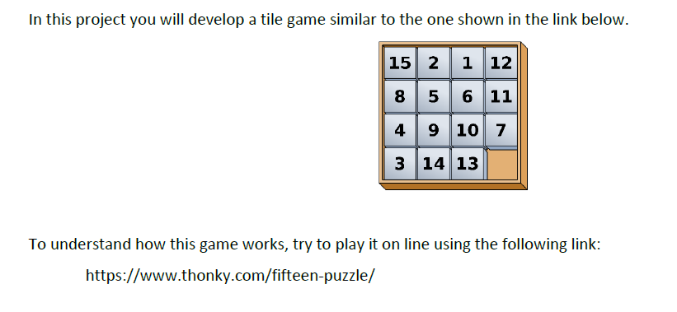
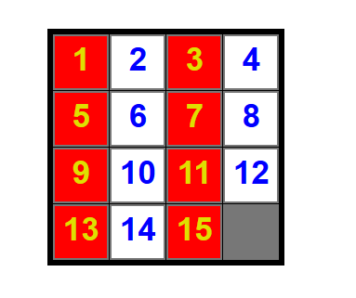
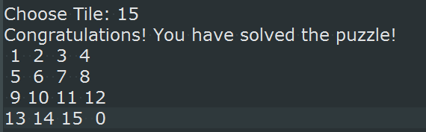
Lab #3: The Tile Game
In your program, this will be rendered as text (instead of GUI):
Goal:

Slide 9
Lab #3: The Tile Game: General idea
You are given some starter code, which calls several methods.
You are responsible for writing the methods.

Slide 10
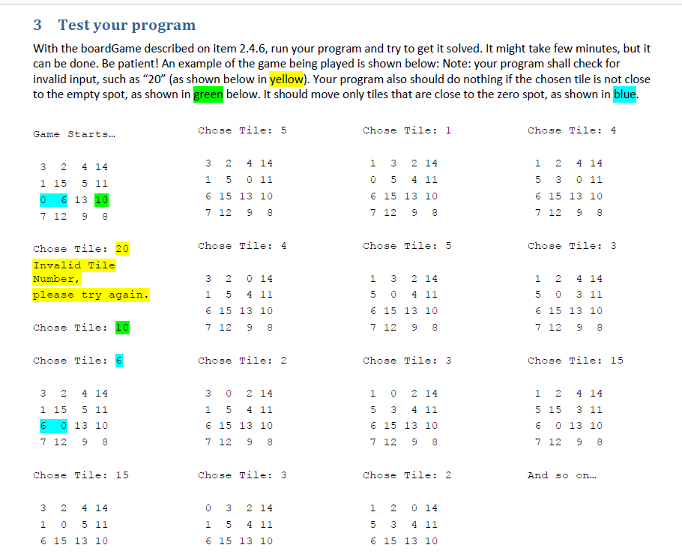
Lab #3: The Tile Game – skipping ahead to final page of instructions

Slide 11
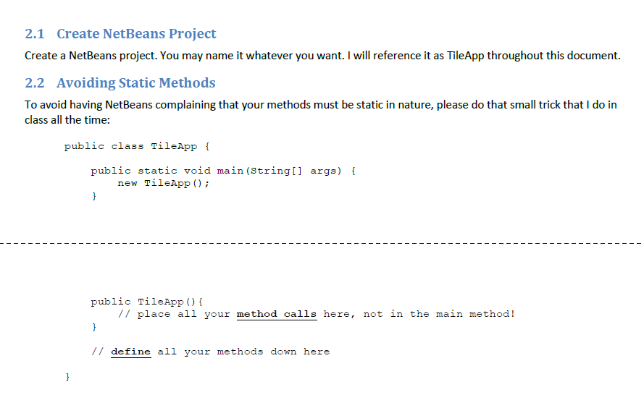
Lab #3: Getting started
If you want to take the alternative approach (declare methods as static, and call from within main), that is OK, so long as you know how to do this + can get the program working.

Slide 12
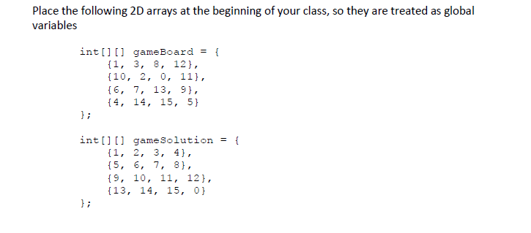
Lab #3: Getting started – skipping ahead to page 4
You’ll want to declare these 2D arrays after the line “public class TileGameApp {…” and before the main method.
You’ll fill in the actual values (shown above) in the initializeGame method (to be described on a later slide).

Slide 13
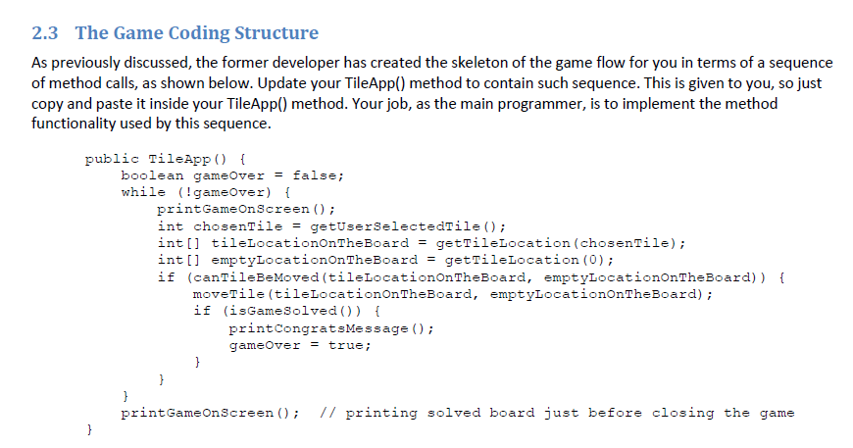
Lab #3: Getting started – main game loop (provided)
You just need to copy this into your code.
You will need to complete the methods called here.
Note the two int[] arrays are two-element arrays that will hold information in the format of [row number][column number]

Slide 14
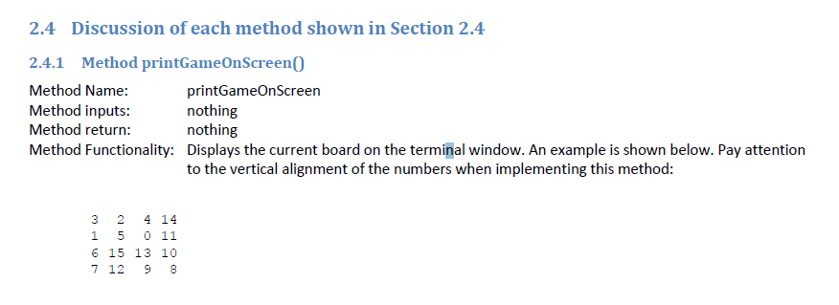
Lab #3: printGameOnScreen()
Returns void, takes no arguments
You will have to figure out some way to align the numbers as shown (note only single whitespace between one number and the next if the number on the right has two digits).
There are multiple ways to get this to work; whatever works for you is fine.

Slide 15
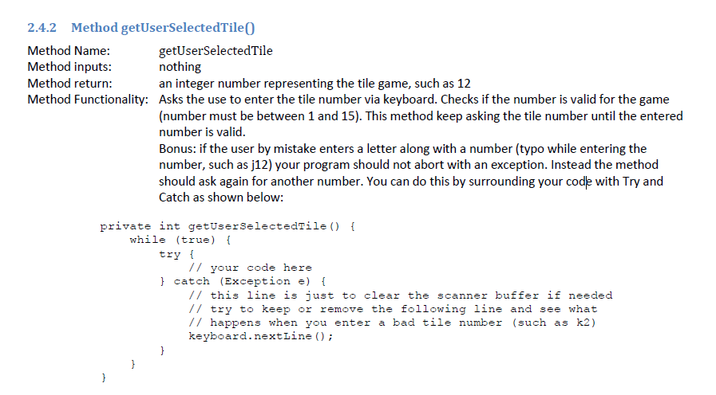
Lab #3: getUserSelectedTile()
The sample code illustrates how to approach the bonus part.
It does also show the appropriate header line, and you’ll likely want to use a loop of some form.

Slide 16
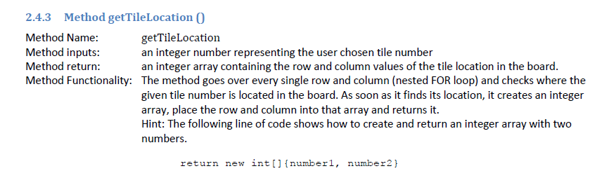
Lab #3: getTileLocation()
This method will search for the number provided as an input argument, and return its location in [row, column] format.
If you want to use a different approach than that described here, that’s fine, so long as you accept the inputs and return the outputs that are expected.

Slide 17
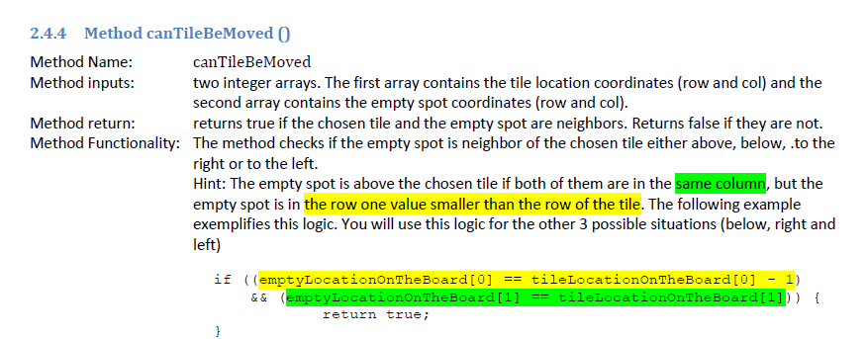
Lab #3: canTileBeMoved()
Main idea: Given the row, column information for the tile to move, and the empty spot, make sure that these are neighbors (above/below/left/right – diagonals don’t count).

Slide 18
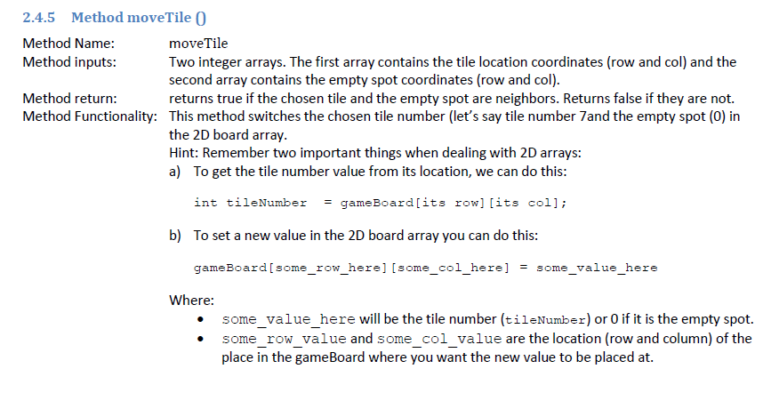
Lab #3: moveTile()
Some of this repeats the functionality of canTileBeMoved()
It also goes beyond this other method, when the two coordinates are neighbors: You need to update the gameBoard array so that the empty spot and the other tile swap positions.

Slide 19

Lab #3: isGameSolved()
Main idea: Check whether the contents of gameboard appear in ascending order (as illustrated in the earlier slide).

Slide 20
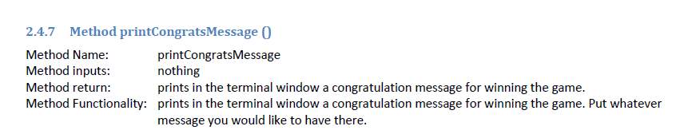
Lab #3: printCongratsMessage()

Slide 21
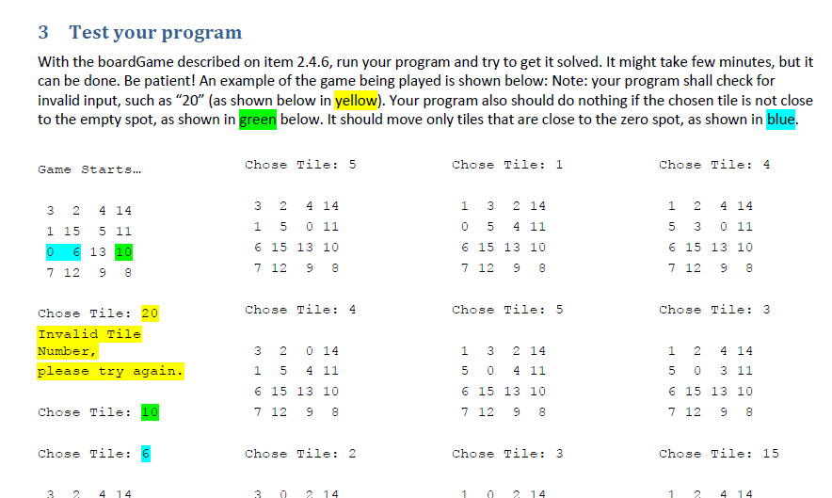
Lab #3: For the demos
As on page 5 of the instructions, show a few rounds of normal game play, and how the program responds to the invalid input cases.
For successful completion, you don’t need to demonstrate a full game, start to finish. you may either:
Show a screenshot of a previous game that you finished to completion.
Or, change the gameBoard so that you may solve the puzzle very quickly.
In any case, please be sure to have your source code available to show.

