Slide 1
CS401 Lab 3/2/20
These slides will be available online:
https://github.com/kc13/CS401PF
Agenda for today:
Please sign in sometime before you leave lab!
Description of the lab “assignment” #7
This consists of the first part of Assignment #2
(“assignment” is in quotes because it will not be graded separately as a lab – no demo required)

Slide 2
Lab #7 (first part of Assignment #2 – Netfliz App)
Overview of the full assignment:
You will create a program that presents users with information about different shows that they may watch, through a series of GUIs:

Slide 3
Lab #7 (first part of Assignment #2 – Netfliz App)
Overview of the full assignment:
The program will make use of several classes.
These will be the focus for the lab assignment.
In total, you will need to create five classes:
StreamingVideo (a superclass)
Movie (extends StreamingVideo)
TVShow (extends StreamingVideo)
Season (used by, but not a subclass of TVShow)
Episode (?) (used by, but not a subclass of TVShow)

Slide 4
Lab #7 (first part of Assignment #2 – Netfliz App)
Overview of the full assignment:
The program will make use of several classes.
These will be the focus for the lab assignment.
In total, you will need to create five classes:
StreamingVideo (a superclass)
Movie (extends StreamingVideo)
TVShow (extends StreamingVideo)
Season (used by, but not a subclass of TVShow)
Episode (?) (used by, but not a subclass of TVShow)

Slide 5
Lab #7 (first part of Assignment #2 – Netfliz App)
Overview of the full assignment:
The program will make use of several classes.
These will be the focus for the lab assignment.
In total, you will need to create five classes:
StreamingVideo (a superclass)
Movie (extends StreamingVideo)
TVShow (extends StreamingVideo)
Season (used by, but not a subclass of TVShow)
Episode (?) (used by, but not a subclass of TVShow)

Slide 6
The StreamingVideo superclass (pg 4):
Just need some class fields and getters/setters for:
These fields are shared by the Movie/TVShow subclasses.
No constructor required here.

Slide 7
The Movie class (pg 4):
Extends StreamingVideo, and so inherits its methods and class fields (although the latter are declared as private, and so must be accessed through the getters/setters, rather than accessed directly).
Example: to access the title, use getTitle() rather than just title
It will also have its own specific class fields – you should both declare these + create setters/getters for them:
One constructor:
Argument: filepath of text file containing info about a movie (see appendices B and C – note you may have to try retyping characters if the copy-and-pasted text causes errors).
The constructor will read in the file, which will contain info needed to fill in the class fields (those specific to Movie, and those inherited from the StreamingVideo superclass).

Slide 8
The Movie class (pg 4):
You’ll add a toString() that displays info about the following:
You’ll put together the String using StringBuilder.
Note you can insert line breaks by appending “\n”.

Slide 9
The TVShow class (pg 5):
Like Movie: Extends StreamingVideo, and so inherits its methods and class fields (although the latter are declared as private, and so must be accessed through the getters/setters, rather than accessed directly).
It will also have its own specific class fields – you should both declare these + create setters/getters for them:
(Note the List holds instances of the Season class, which you will create in another file).

Slide 10
The TVShow class (pg 5):
One constructor:
Argument: filepath of text file containing info about a TV Show (see appendices D and E).
The constructor will read in the file, which will contain info needed to fill in the class fields (those specific to TVShow, and those inherited from the StreamingVideo superclass).
This is a little more complex of a process then is involved for the Movie class (see later slides).
A toString() method: Will use StringBuilder to create a string that will be later used by JOptionPane:

Slide 11
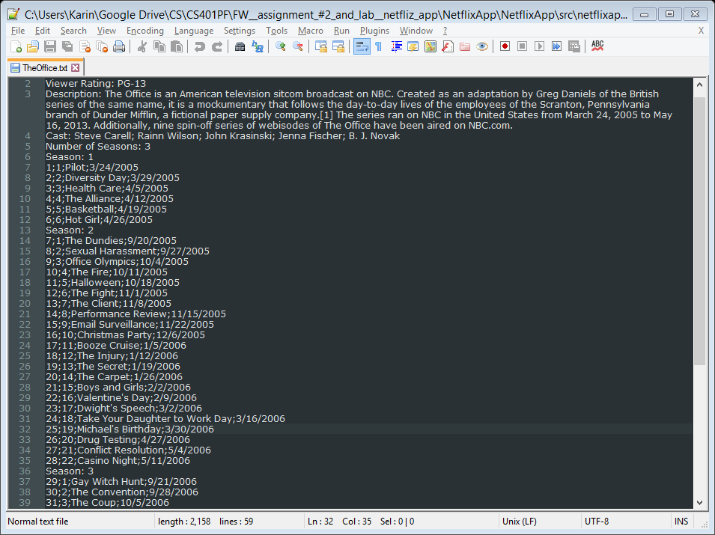
The TVShow class: top part of example file for a tv show (The Office)

Slide 12
The Season Class (example Season for The Office shown below)
Episode described on later slides

Slide 13
The Episode Class (see individual rows below)
Will need class fields (and getter methods) for:
String episodeTitle;
int seasonEpisodeNumber;
int overallEpisodeNumber;
String releasedDate;
A constructor should be created to take in all the Episode info present on a line, and assign the appropriate values in the line to the appropriate class fields.
A toString() method should be created, which will supply the info for this JOptionPane:

