Slide 1
CS401 Lab 2/3/20
These slides will be available online:
https://github.com/kc13/CS401PF
Agenda for today:
Please sign in sometime before you leave lab!
What is expected for demos of Lab 3 / Partial credit breakdown
Demos of Lab #3
Comments regarding Lab #4
(if applicable): any Lab #4 demos that are ready

Slide 2
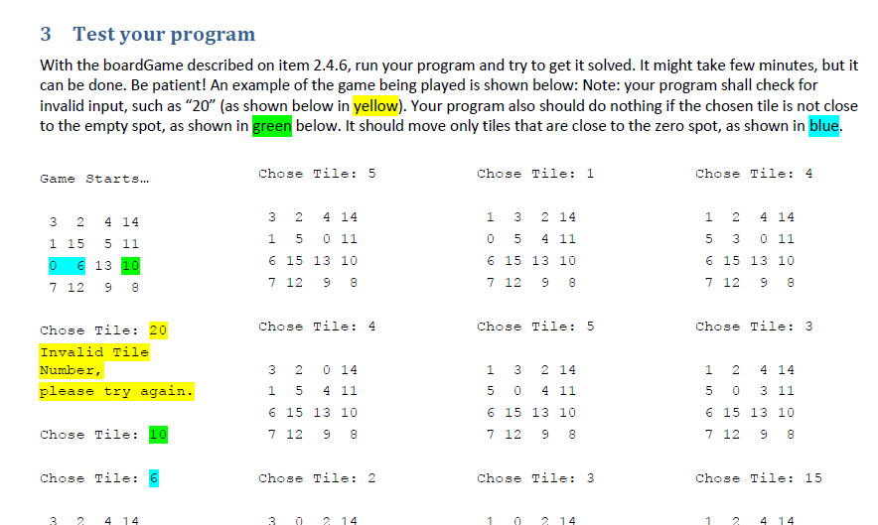
Lab #3: For the demos
As on page 5 of the instructions, show a few rounds of normal game play, and how the program responds to the invalid input cases.
For successful completion, you don’t need to demonstrate a full game, start to finish. You may either:
Show a screenshot of a previous game that you finished to completion.
Or, change the gameBoard so that you may solve the puzzle very quickly.
In any case, please be sure to have your source code available to show.

Slide 3
Lab #3: For the demos – for determining partial credit

Slide 4
Lab #4: The Car Dealer Application
The big picture:
You will create three classes, corresponding to three different car models: Corolla, Camry, and Sienna.
Each class will need to hold information about a set of features (described in instructions/later slides).
Terminology in Java: “class fields”; you may also see the term “instance variables”
You will write a short main program (i.e., the one with the main method, like you’ve been writing for all the labs) that will make use of these classes.

Slide 5
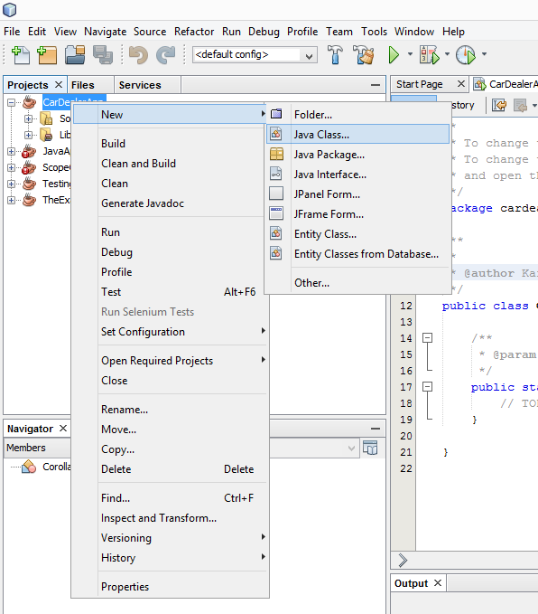
Lab #4: Top of section 4.1
First, create a new application project, as always.
Next, you can create your first class (Corolla – similar methods will apply for the other models). The method for doing this is described on pg. 3, and illustrated on the right:

Slide 6
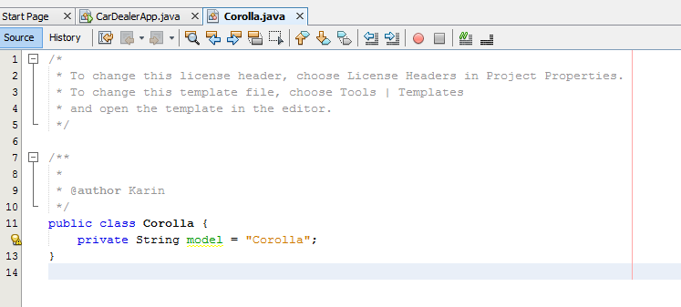
Lab #4: 4.2.1.1: Create the class fields for the new class
Steps to follow:
Identify the variable type that you will need to use for each feature (the examples on page 2 may help with this step).
At the top of the class (see below), declare each of the variables, preceded by the ‘private’ keyword. The first is shown as an example.

Slide 7
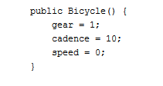
Lab #4: 4.2.1.2.1: Create the default constructor
This is the constructor that will be executed if the user wants to create a new Corolla instance, but provides no features. In this case, you should assign to the class fields the features that are considered “standard” for the Corolla (see the Table on page 2).
Steps to follow:
Create the default constructor header and brackets.
In the constructor body, assign the standard values to the appropriate class fields.
The general format of your code will be similar to the example default constructor shown on the right (taken from https://docs.oracle.com/javase/tutorial/java/javaOO/constructors.html)

Slide 8
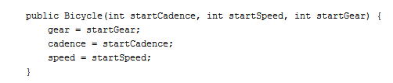
Lab #4: 4.2.1.2.2: Create the two non-default constructors
This is the constructor that will be executed if the user wants to create a new Corolla instance, but does provide some features as arguments, which may or may not match the standard features.
Note the example format of a non-default constructor, shown below (again taken from the same Java documentation):

Slide 9
Lab #4: 4.2.1.2.2: Create the two non-default constructors
The first constructor should accept three arguments:
Year
Price
Color
On the header line of the constructor, you will need to specify these three features as input parameters.
In the body of the constructor, you will need to:
Assign the values provided by the user to the appropriate class fields.
For the remaining, unspecified fields, you should assign the default, “standard” values.

Slide 10
Lab #4: 4.2.1.2.2: Create the two non-default constructors
The second constructor should accept one argument:
Year
On the header line of the constructor, you will need to specify this single feature as the one input parameter.
In the body of the constructor, you will need to:
Assign the value provided by the user to the class field for year.
For the remaining, unspecified fields, you should assign the default, “standard” values.

Slide 11
Lab #4: 4.2.1.3: Create the setting and getting methods
The first method will be used to allow the user to set the car’s price, which may be different from what was originally assigned by the constructor.
The method will take this form:
Before updating the price field to the user’s value, you should first confirm that it falls within the range provided in the table (18000-20000, see page 2).
If the price is outside of the range, do not update the price field. Otherwise, go ahead and update the field.
You may find it helpful to include print statements to report whether or not the price was updated.

Slide 12
Lab #4: 4.2.1.3: Create the setting and getting methods
The next method will be used to get the car’s price. The header will take on this form:
The method should simply return the current price.

Slide 13
Lab #4: 4.2.1.3: Create the setting and getting methods
From page 5:
This is asking you to create get and set methods for all of the other fields, excluding the model name: year, color, accessories.
These methods should function in a manner analogous to the getPrice and setPrice methods.
The set methods should always confirm that the user provided a value that is considered permissible, given the information in the table.
The get methods should simply return the requested value.

Slide 14
Lab #4: 4.2.1.3: Creating more methods
For the first method, just find some way to print to the terminal all of the specified information.
Use the second method to update the list of available accessories (not the specific accessories that this particular car has – this is already covered by the appropriate method made in the previous step).
For the third method, you can return the minimum of the price range.

Slide 15
Lab #4: Create the Camry and Sienna classes
These classes will be very similar to the Corolla class. You just need to adjust the default values, and the value ranges that you check in the setting methods.

Slide 16
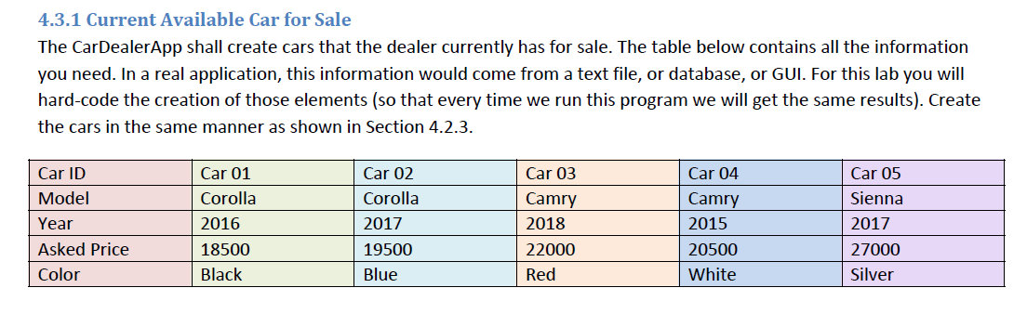
Lab #4: CarDealerApp Implementation
This will all be written in the file that was originally created for your project, with the main method.
This code will allow you to demonstrate that you can create new instances of your classes, and set the feature values as appropriate. Note this will require use of the constructors and your set methods.
You should create car instances according to the following table. Make note of the statement about hard-coding being permissible.

Slide 17
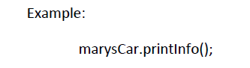
Lab #4: CarDealerApp Implementation
Following the creation of the car instances, you are asked to print the information about all of the cars to the terminal. You can make use of the individual classes’ printInfo methods for this.
Subsequently, you should include some lines that attempt to set some of the cars’ features to values that either are or are not acceptable. This is to test that your setting methods are working properly.

Slide 18
Lab #4: Demo
Source code for the main file, and all of the classes, should be available.
You should be able to show, in your code and in the terminal window, that you are able to:
Create the cars shown in the table, as verified with printInfo() statements.
Use the set methods to update different features to legitimate values, and to reject invalid values.
→ This can be confirmed using either printInfo statements, or print statements embedded in your setting methods.

