Slide 1
CS401 Lab 3/23/20
These slides will be available online:
https://github.com/kc13/CS401PF
Agenda for today:
Logistics for online labs/office hours
Comments on the lab assignment

Slide 2
Details for working remotely
Labs
Through Zoom, if all goes well today
Connection details will be provided in advance
Assignment submission
Please observe the same deadline as before the transition to remote (by the lab session one week following the lab’s release)
Tentative plan: Submit lab via email to kmc51@pitt.edu
Office hours
Also through Zoom
Connection details will be provided in advance

Slide 3
Lab Assignment
Prerequisite:
Install SceneBuilder and integrate with Netbeans using instructions here:
https://www.youtube.com/watch?v=9MC-c0WAx2A&feature=youtu.be
Be sure to make note of the filepath where SceneBuilder is installed, so you can provide this input to Netbeans.
This video will also show you how to create a new JavaFX project in NetBeans (JavaFX → JavaFXML Application)

Slide 4
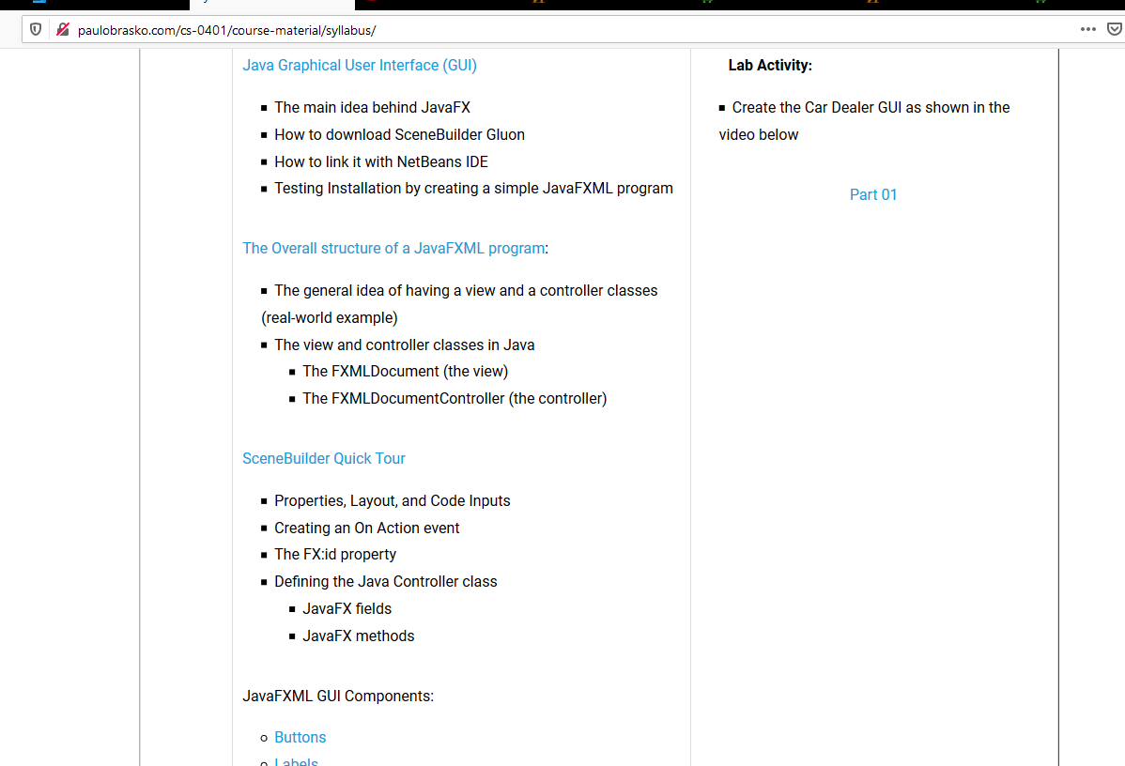
Assignment: Car Dealer GUI – see video link here: https://youtu.be/RpW-nMZnioQ

Slide 5
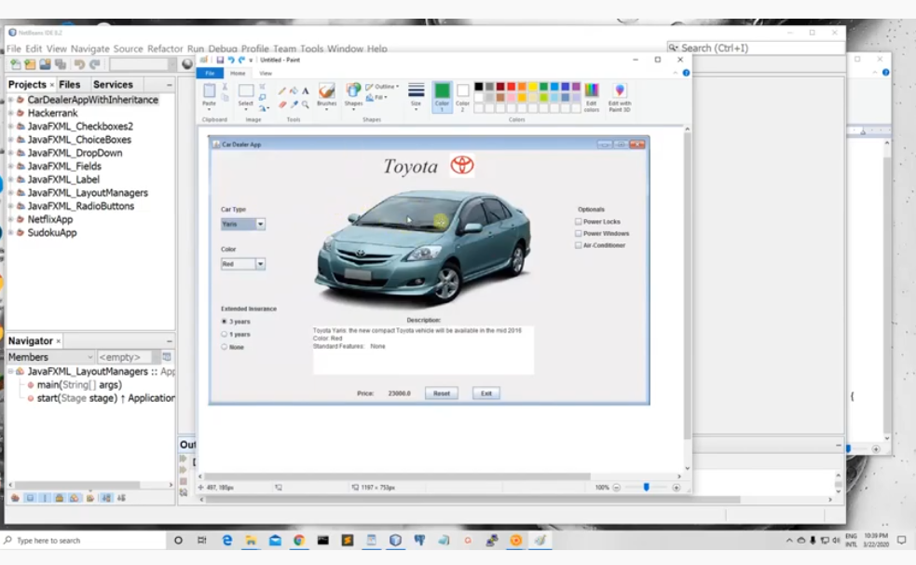
Car Dealer GUI
The video will walk you through creating the first part of a program. Not all of the functionality will be available at first (including the picture of the car).

Slide 6
Car Dealer GUI
The video should explain every step you need to do. (So this is much like the Bike Store App).
Every once in a while (for example, about 5:00 minutes in), there will be an illustration of some comments using an image in Microsoft Paint (using this is not part of the assignment).

Slide 7
Car Dealer GUI: submission for this lab
You should complete the steps demonstrated in the video.
Compress your NetBeans project (.zip or something else) and send it to kmc51@pitt.edu
Deadline: End of 3/30 lab (10:50 or 12:50 pm, depending on your section)

