Slide 1
CS401 Lab 4/13/20
These slides will be available online:
https://github.com/kc13/CS401PF
Agenda for today:
Remember to submit lab to kmc51@pitt.edu
Bike Display
Partial credit will be given for partially complete assignments
Top priority is correct program functioning
No remaining lab assignments for the term
There are just a few comments on the next few slides about the lab due today / submission logistics /etc.

Slide 2
Bike Display: submission for this lab
Compress your NetBeans project (.zip or something else) and send it to kmc51@pitt.edu
Some suggestions (if you haven’t submitted yet):
Could you send all the contents of your NetBeans project? (Beyond the .java/.fxml files)?
In other words: Something packaged in a similar form as the skeleton code that the professor distributed.
If emailing the code as an attachment is problematic (for example, because the file is too big:
Try uploading the file to a cloud storage service (through Pitt: OneDrive or Box; services outside of Pitt like Google Drive / Dropbox are also OK)
You should be able to share the file, and create a link to it, which can be sent in an email.

Slide 3
Bike Display: submission for this lab
Additional suggestions (if you haven’t submitted yet):
If the program is not fully functional, it would help to send a brief description of what is expected to work, either in the body of an email or in a readme.txt file packaged along with the code.

Slide 4
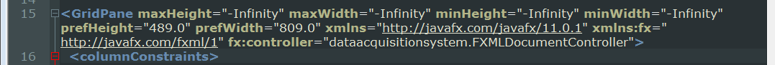
Bike Display: fx controller reference in the fxml file
For some reason this has been an issue for some people, so if the GUI isn’t showing up properly at all, check this:

