Slide 1
CS401 Lab 2/10/20
These slides will be available online:
https://github.com/kc13/CS401PF
Agenda for today:
Please sign in sometime before you leave lab!
What is expected for demos of Lab 4 / Partial credit breakdown
Demos of Lab #4
Comments regarding Lab #5
(if applicable): any Lab #5 demos that are ready

Slide 2
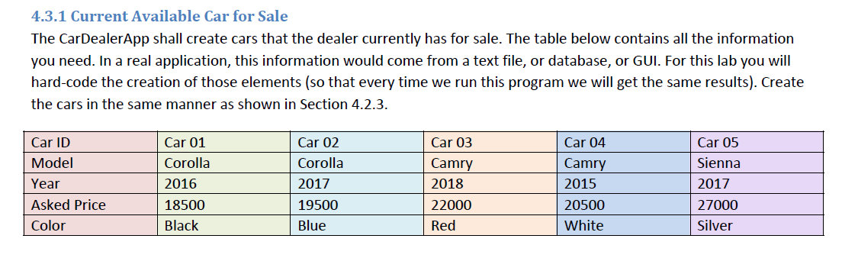
Lab #4: Demo reminder
Source code for the main file, and all of the classes, should be available.
You should be able to show, in your code and in the terminal window, that you are able to:
Create the cars shown in the table, as verified with printInfo() statements.
Use the set methods to update different features to legitimate values, and to reject invalid values.
→ This can be confirmed using either printInfo statements, or print statements embedded in your setting methods.

Slide 3
Lab #4: For the demos – for determining partial credit

Slide 4
Lab #5: The Car Dealer Application with Inheritance
The big picture:
For the previous lab, you created three separate classes for the three different car models.
Many lines of code were identical across those classes – you could just copy and paste.
In general, this kind of redundancy is undesirable in Java, and avoidable if you make a superclass that contains the shared operations – individual classes can then inherit the superclass variables and methods, and also extend upon them.
In this lab, you will create such a superclass (“Car.java”) and then create new versions of the Corolla/Camry/Sienna classes that will extend upon the Car superclass, rather than just repeating code that is already in it.

Slide 5
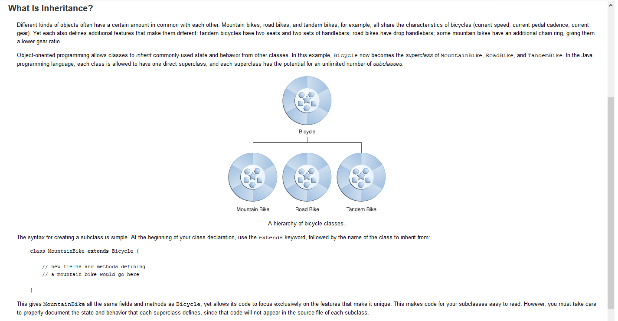
Lab #5: The Car Dealer Application with Inheritance
From https://docs.oracle.com/javase/tutorial/java/concepts/inheritance.html

Slide 6
Lab #5: The Car Dealer Application with Inheritance
For the lab:
First, you want to create your new Car superclass. You’ll create this like you would create any other new class.
At the top of the Car class, you can include all the instance variables (= class fields) that you repeatedly declared across the different classes for the previous lab.
Declare them as “protected” instead of private
This allows subclasses to directly access these class fields, but other code (like the main application) cannot

Slide 7
Lab #5: The Car Dealer Application with Inheritance
Next:
You should have several methods that appear strictly identical across your individual classes from last lab. You should place these repeated methods in your new Car superclass. These methods include:
The set methods
The get methods
The print info methods
Adding these methods to the superclass will be the top priority for this lab. If you find other methods you can move to the superclass, though, please feel free!

Slide 8
Lab #5: The Car Dealer Application with Inheritance
Next (2.3 in instructions):
You can now start changing your individual classes from last lab.
First, you’ll want to add the extends statement to the class header; this says that everything from the Car superclass should be inherited.
Example: public class Corolla extends Car
You can get rid of any class field declarations or methods that are now in your Car superclass.

Slide 9
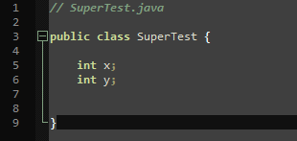
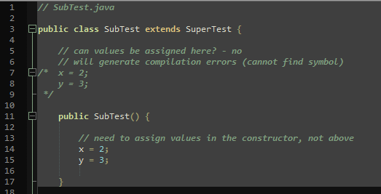
Lab #5: The Car Dealer Application with Inheritance
The instructions recommend the following steps for your constructors:
In the default constructor:
Assign all class field values (this may involve moving some assignments into the constructor that were previously outside of it).
Remember that the superclass only declared the variables, and did not assign values to them.
You cannot assign these values outside of the constructor. Example:

Slide 10
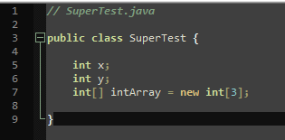
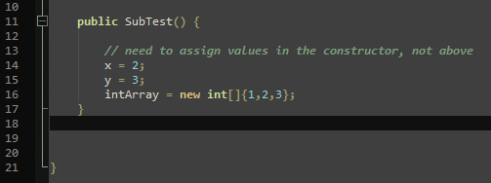
Lab #5: The Car Dealer Application with Inheritance
The instructions recommend the following steps for your constructors:
In the default constructor:
For assigning values to any inherited arrays, the list of values will need to be preceded by new <datatype>[], as in the example below:

Slide 11
Lab #5: The Car Dealer Application with Inheritance
The instructions recommend the following steps for your constructors:
In the non-default constructor:
First call this() (to invoke the default constructor) and then assign any arguments accepted by the constructor to the appropriate class field (in other words, overwrite the default value).
Note: the “this.” is needed before manufacture in order to distinguish between the manufactureYear input argument and the manufactureYear class field; this would not be necessary if these had different names

Slide 12
Lab #5: The Car Dealer Application with Inheritance
Create a main application to run tests:

Slide 13
Lab #5: Demo
Show that you can successfully run the tests listed on the previous slide.
Show the source code for your Car.java superclass and at least one of the individual subclasses (e.g., Corolla).

Slide 14
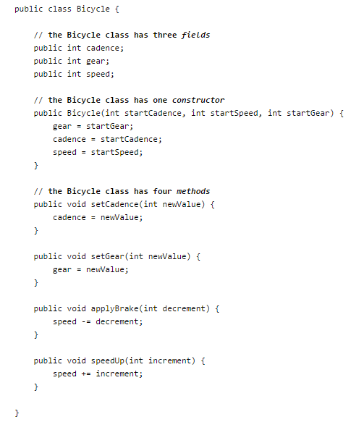
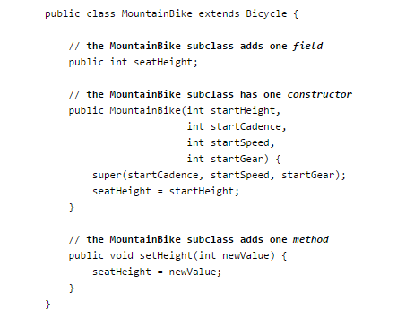
Extra info about inheritance (not needed for lab)
A subclass can run a constructor from a superclass by using the “super” keyword:
From https://docs.oracle.com/javase/tutorial/java/IandI/subclasses.html

