Slide 1
Assignment #3: Due 11:59PM on Friday, March 4th, 2016
Full details: people.cs.pitt.edu/~ramirez/cs445/assigs/assig3/assig3.htm
Principal objective: Create and test a version of the StringBuilder class, relying on linked lists and recursion in the implementation
Make note of all the files provided to you:
Assignment 3 instructions | on website, as html
MyStringBuilder.java | Skeletal implementation (reminder of methods you need to create)
MyStringBuilder2.java | Same functionality as MyStringBuilder, but must use recursion instead of loops
Assig3.java | driver program (do not alter)
A3Out.txt | output of Assig3, you should replicate
Assig3B.java | Similar to Assig2B for Assignment #2, except you add MyStringBuilder2 as a 4th test case

Slide 2
As before, two sample components of MyStringBuilder2 have been prepared for you:
a constructor that takes a String and converts it into a new MyStringBuilder2
a toString() method that returns a String representation of the MyStringBuilder2 data
The next few slides will go through these samples in detail:

Slide 3
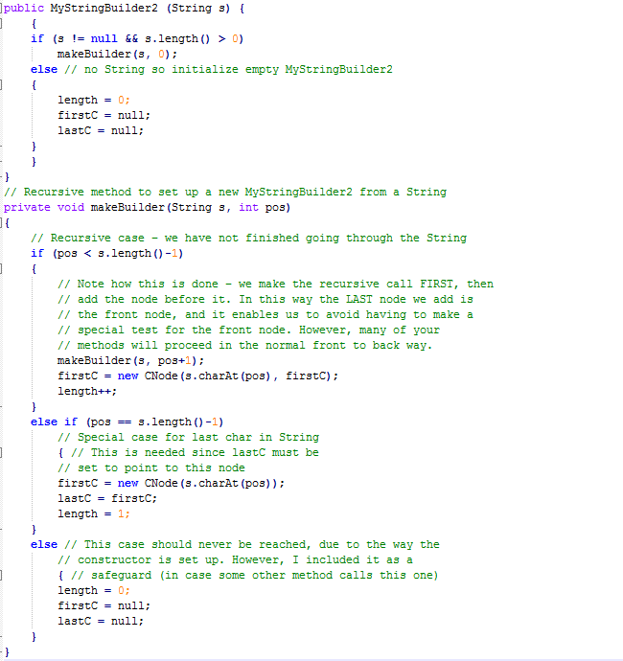
Constructor example
Check for special cases
Call private method makeBuilder, passing the String s and character position 0
makeBuilder will use a series of recursive calls to create the linked list that stores the characters

Slide 4
Constructor example:
s = “cat”
s.length()-1 = 2
Linked list:
c
a
t | null
firstC
firstC
lastC
firstC
Call stack:
makeBuilder
s → “cat”
pos = 2
makeBuilder
s → “cat”
pos = 1
makeBuilder
s → “cat”
pos = 0

Slide 5
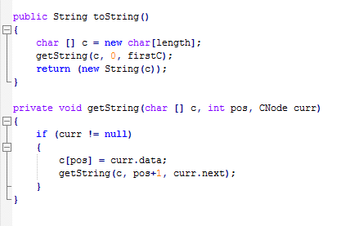
Example:
Assume “cat” already stored in the stringbuilder linked list
Linked list:
c
a
t
c
c
a
t | null
firstC
lastC

