Slide 1
Recitation 3/15-3/16:
You should have received your Assignment #2 grade by this point.
(2) Today: Review of Assignment #4 (posted on Saturday) and FindWord.java handout from website.

Slide 2
Assignment #4: Due 11:59PM on Tuesday, March 29, 2016
Full details: people.cs.pitt.edu/~ramirez/cs445/assigs/assig4/assig4.htm
Principal objective: Find paths through mazes using recursion and backtracking.
Make note of all the files provided to you:
Assignment 4 instructions | on website, as html
Assig4.java | You create: Reads an input maze file, outputs the possible solutions
data4-1.txt, data4-2.txt, data4-3.txt | Input files, accepted on command line, represent 1 or more maze problems
a4out-1.txt, a4out-2.txt, a4out-3.txt | Target output for the three mazes above

Slide 3
Maze representation (this example is data4-1.txt)
# of rows
# of columns
4 5
0 0
0 0 0 0 1
0 1 1 0 1
0 1 2 0 1
0 1 0 0 1
Starting coordinates are (0,0): top left corner
Start here
Maze structure:
0 = path, 1 = wall, 2 = goal
End here (2,2)
Legal directions: Up, down, left, right.

Slide 4
Output (this example is data4-1.txt)
4 5
0 0
0 0 0 0 1
0 1 1 0 1
0 1 2 0 1
0 1 0 0 1
First, echo the provided input:
The new board is:
0 0 0 0 1
0 1 1 0 1
0 1 2 0 1
0 1 0 0 1
Searching for solutions starting at (0,0)
For each solution you find, report the total number of segments (include origin, exclude goal):
Solution Found with 9 segments
Then report the path in two formats. First, display the maze with x’s indicating the path taken (excluding goal):
x x x x 1
0 1 1 x 1
0 1 2 x 1
0 1 x x 1
Second, report the maze coordinates as a list of ordered pairs:
Path: (0,0) (0,1) (0,2) (0,3) (1,3) (2,3) (3,3) (3,2) (2,2)

Slide 5
Full output (this example is data4-1.txt)
4 5
0 0
0 0 0 0 1
0 1 1 0 1
0 1 2 0 1
0 1 0 0 1
The new board is:
0 0 0 0 1
0 1 1 0 1
0 1 2 0 1
0 1 0 0 1
Searching for solutions starting at (0,0)
Solution Found with 9 segments
x x x x 1
0 1 1 x 1
0 1 2 x 1
0 1 x x 1
Path: (0,0) (0,1) (0,2) (0,3) (1,3) (2,3) (3,3) (3,2) (2,2)
Solution Found with 7 segments
x x x x 1
0 1 1 x 1
0 1 2 x 1
0 1 0 0 1
Path: (0,0) (0,1) (0,2) (0,3) (1,3) (2,3) (2,2)
There were a total of 2 solutions found
A total of 34 recursive calls were made
The shortest solution had 7 segments
x x x x 1
0 1 1 x 1
0 1 2 x 1
0 1 0 0 1
Path: (0,0) (0,1) (0,2) (0,3) (1,3) (2,3) (2,2)
Print all solutions, and
the total number of recursive calls made in the process of finding them,
and reprint the solution that contains the shortest path.

Slide 6
Subsequent slides go through the FindWord.java file from the CS445 website.
This is recommended in the assignment instructions as “big picture” help on how to address the maze problem.
It uses recursion and backtracking to find words in a 2D grid, rather than maze paths.
Example file grid.txt (contains “word”):
4 4
AXTM
BWIK
LORF
NIDX

Slide 7
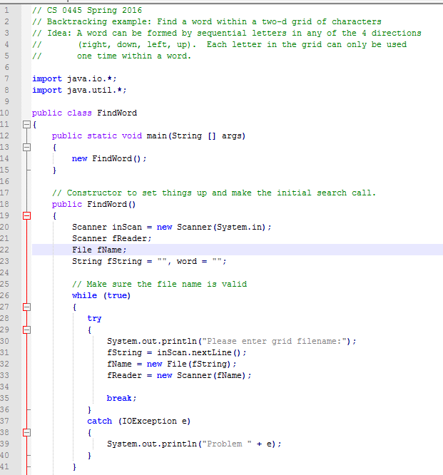
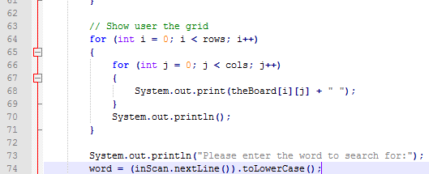
Lines 7-74:
Main method / call to FindWord constructor
User inputs a grid filename
Letter grid is echoed back to user
User enters word to seek (e.g., “word”)

Slide 8
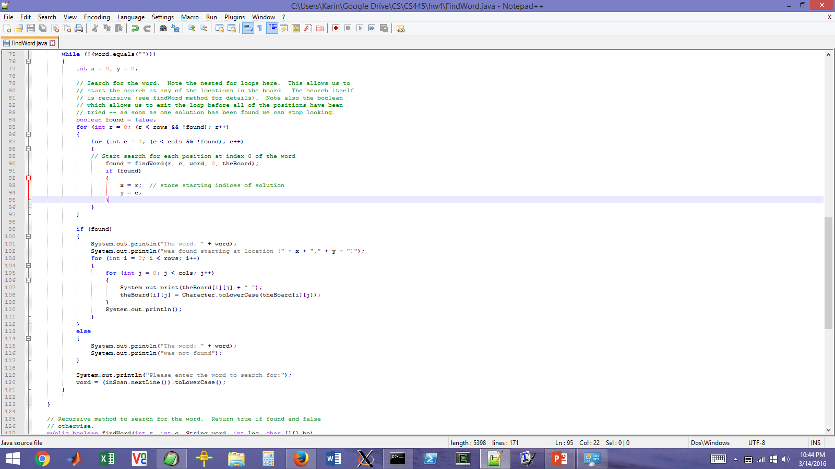
Lines 75-121:
While word not found:
Double nested for loop through rows/cols (start at top left)
Call findWord method, starting at given row/col
Remaining lines display output to user depending on whether or not word was found

Slide 9
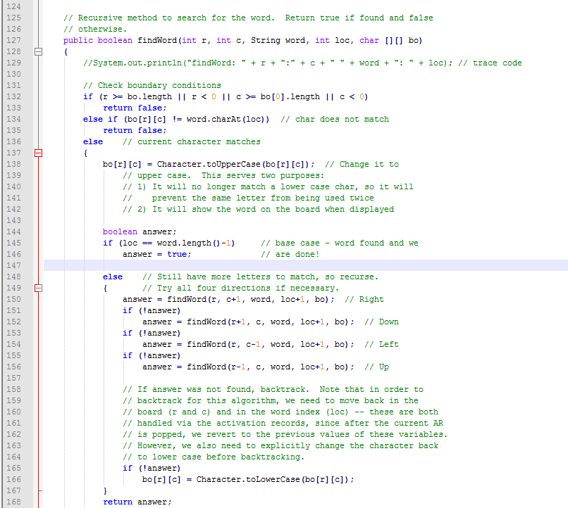
Lines 75-121:
(1) starting at the row/col from our double-nested for loop…
(2) Make sure we’re still within the bounds of the grid
(3) Return false if the first character of search word (“w”) does not match character at our starting position
(4) If first character matches, highlight it and move on
(5) Base case (won’t satisfy until loc = 3 and found “d”)
(6) Recursive calls: Will initially check for “o” (loc = 1) in square to the right
If successful, move on to subsequent recursive calls (loc = 2 for “r”, etc ..)
If unsuccessful, the program will backtrack out of that particular recursive call, and try squares below, to the left, and above
If none of this is successful for a specific loc:
Return the character to lower case – we don’t want it marked anymore, because it does not mark a position in a successful search
(7) Return true or false for this particular recursive call

