Slide 1
Recitation 3/29-3/30:
Today: Review of Iterators, and then time available to work on Assignment #4
(2) Office hours this week: Tuesday 5:00-6:00 pm, Thursday 4:00-6:00 pm, Friday 2:30-5:30 pm
(3) Assignment #3 grades will be emailed out by midnight on 3/30.

Slide 2
Java Iterators:
References:
Iterators video from Coursera Algorithms course: https://www.youtube.com/watch?v=QllczI9r_js
Related code samples; for example: http://algs4.cs.princeton.edu/43mst/Queue.java.html
CS445 slides and handouts, Oracle documentation, other assorted websites

Slide 3
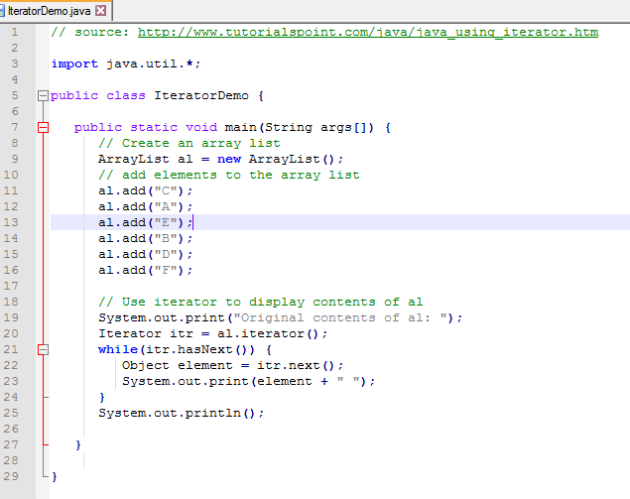
Java Iterators: Why are they useful?
#1: They allow the user to exhaustively cycle through all the elements in a collection, without worrying about how this might be done.
For example: Because ArrayList implements the Iterable interface, you can use an iterator to cycle through its elements, without knowing how Java constructs this data structure or traverses through it.
Prints to screen:
Original contents of al: C A E B D F

Slide 4
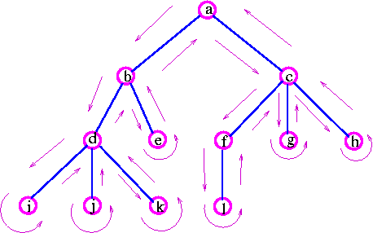
Java Iterators: Why are they useful?
#2: You can create multiple iterators, if you want to offer the user multiple sequences of looping through the elements (example provided in these slides)
#3: The usefulness becomes especially clear when you have a complicated data structure:
Image Source: http://www.personal.kent.edu/~rmuhamma/GraphTheory/MyGraphTheory/trees.htm

Slide 5
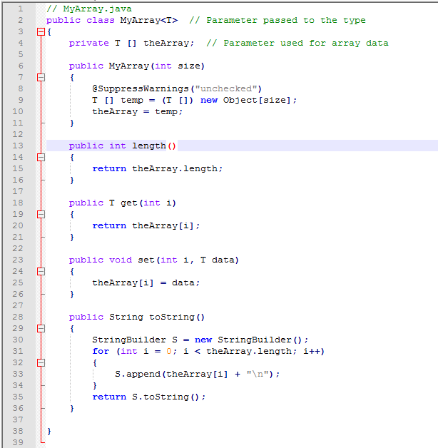
Java Iterators: Implementation example, using MyArray.java handout
--> This was an illustration of how to use generics in Java.
--> Includes constructor to create MyArray of a specific size, methods to insert and retrieve elements from specific indices, and toString() and length() methods.

Slide 6
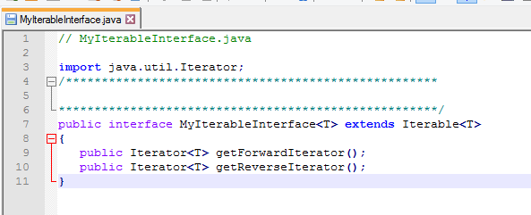
Implementation: Converting MyArray to MyIterableArray
Please note: There are multiple ways to implements Iterators; this will demonstrate one possible way.
As in the course textbook and slides: We will create a new interface, “MyIterableInterface”, that extends the Iterator interface, and requires implementation of multiple kinds of Iterators:
Separate file
Required import
Extends Iterable interface, note the Type parameters <T>
If a class claims to implement this interface, it must include these two methods, to return these two types of iterators.

Slide 7
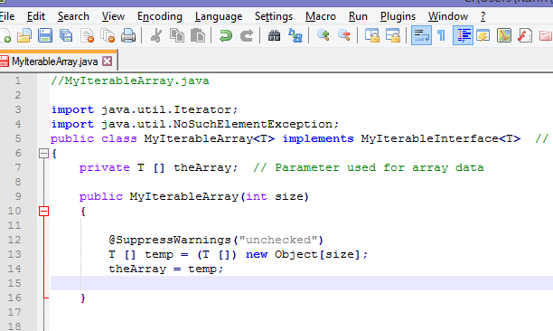
Implementation: Converting MyArray to MyIterableArray
Now we can start modifying the MyArray file:
Two new imports:
Iterator, as before, and an Exception to throw if the user attempts to call next() when no elements remain.
Header Line:
Statement that we are implementing the interface that we just created.

Slide 8
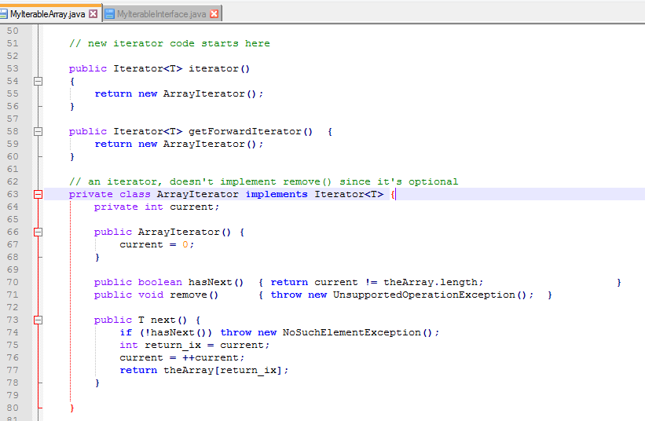
Implementation: Converting MyArray to MyIterableArray
Skipping past the original methods, down to the new Iterator code (just first part shown here):
We are extending Iterator interface; an iterator method is expected. In this implementation, we will just take this as a request for the forward iterator.
This is the method, required by our new interface, to return a new iterator that goes in the forward direction.
Header line for the forward iterator
Constructor. This sets a “current” index at the initial position in array.
hasNext() method: Required by the Iterator interface. If we have incremented past the last element, then there are none left through which we may iterate.
remove() method: Technically considered “optional”. We’re not implementing this, so we throw an exception if someone tries to use it.
next() method: Required. So long as elements remain, we return the element at index current, and increment current, to be ready for any following “next()” calls.

Slide 9
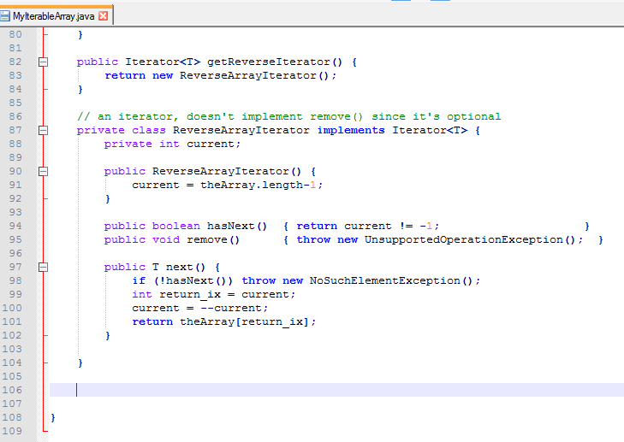
Implementation: Converting MyArray to MyIterableArray
Skipping past the original methods, down to the new Iterator code (final part shown here):
This is the method, required by our new interface, to return a new iterator that goes in the reverse direction.
Constructor. This sets a “current” index at the final position in the array.
hasNext() method: Required by the Iterator interface. If we have incremented past the last element, then there are none left through which we may iterate.
next() method: Required. So long as elements remain, we return the element at index current, and decrement current, to be ready for any following “next()” calls.

Slide 10
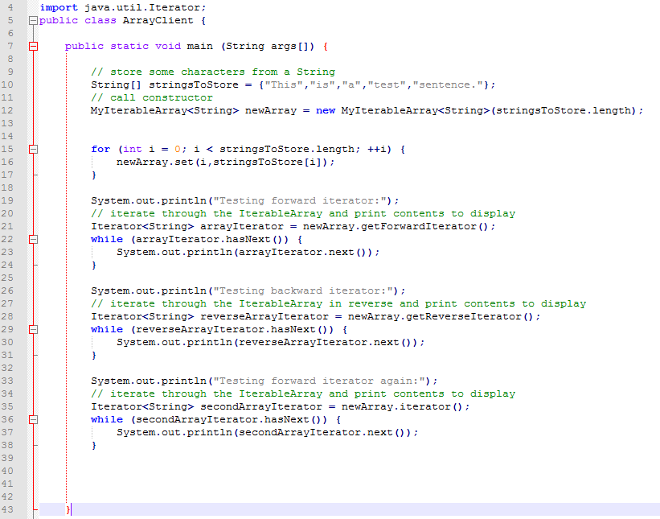
Implementation: Testing with a client program:

Slide 11
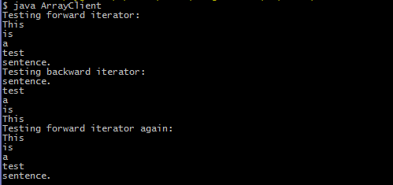
Implementation: Screen output:

