Slide 1
CS447 Recitation #9: 7/15/20
These slides are available online:
https://github.com/kc13/CS447
Agenda for today:
Overview of Lab #9

Slide 2
Lab #9 overview: Building a Register File
Specifications:
Similar to registers in MIPS / MARS, except only 8:
32-bit wide data
Can write one register at a time
Can read from two registers at a time

Slide 3
Lab #9 overview: Inputs to / outputs of the Register File
Crossed lines imply bit width > 1
Allows for the write to actually take place (otherwise, destination register and data are ignored)
Indices to choose which two registers to read (0-7).
Data read from the rs and rt registers
Index to choose destination register
Data to write to destination register
8 of them (see next slide for Register component info)
Required input to all registers, see “Wiring”

Slide 4
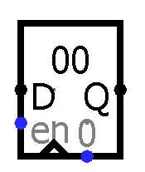
Lab #9: Registers in Logisim
Bit width may be set in attribute panel
(default is 8 bits; note values are displayed in hexadecimal)
Input
Output
Enable:
1-bit input, 1 = allow write, 0 = disable write
Clock input
“Clear”, not needed here
Trigger attribute: should be set to “Falling Edge” for all registers.

Slide 5
Lab #9: Decoders and ANDs for write register (rd) selection
This illustrates how writes are done for the first 4 of 32 registers.
The “enable” and “write data” pins of all registers will receive inputs on every clock tick.
Each AND gate will determine (1) whether writes are permitted on this cycle, and (2) whether the specific register is the destination of the write.
The decoder translates the register number so that a 1 bit is routed to the chosen register, and a 0 bit elsewhere.

Slide 6
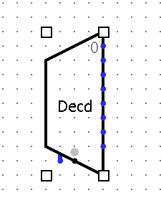
Lab #10: Decoder in Logisim (see “Plexers”)
In Attribute Panel, adjust “Select Bits” to 3 (to allow for 000 to 111).
The grey dot marks the pin where you will input this 3-bit value.
The other pin on the bottom should be irrelevant here.
The eight outputs should be routed to the 8 different registers. Only one of them should carry a ‘1’ value at any given time.

Slide 7
Lab #9: Multiplexers for selecting registers to read
Note that the figure depicts 32 registers instead of 8.
Each register should send its output to both MUXes.
Make sure to adjust the data bit width of the multiplexers, and also the Select Bits attribute.

Slide 8
Lab #9: Testing
The Poke tools can be used on input pins, the register, and the clock.
Simulate/Ticks Enabled will set the clock to run on its own.

Slide 9
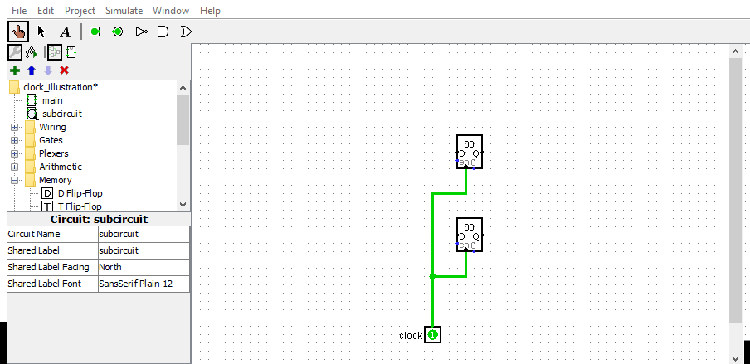
Lab #9: Updated at 3:30 pm: Clock wiring across canvases.
Example of how to set up the clock in the subcircuit (this is analogous to the register file subcircuit that you will create). Note the clock is represented by a 1-bit labeled input pin.

Slide 10
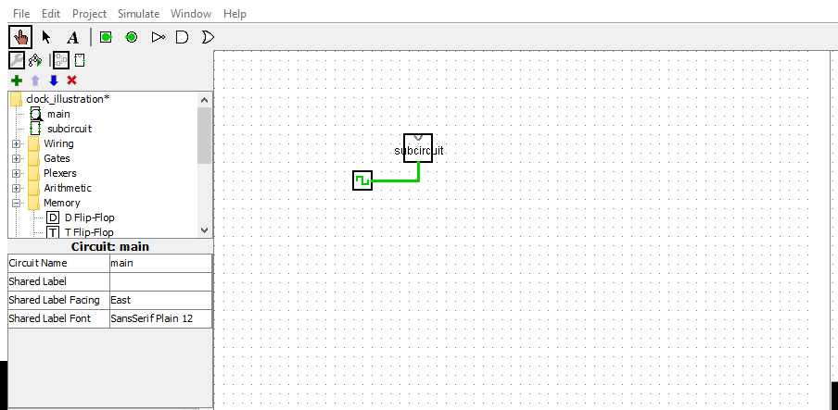
Lab #9: Updated at 3:30 pm: Clock wiring across canvases.
You can feed in the clock to the subcircuit from the main canvas.
If you start the clock (Ticks Enabled), and then double clock on the subcircuit block, you should see the clock ticking within that subcircuit.

Slide 11
Questions?

