Slide 1
CS447 Recitation: 3/16/18 and 3/19/18
These slides are available online:
https://github.com/kc13/CS447JB
Agenda: Lab #6 Overview
Image credits: Several images are from slide deck #12: Minimization and Sequential Logic

Slide 2
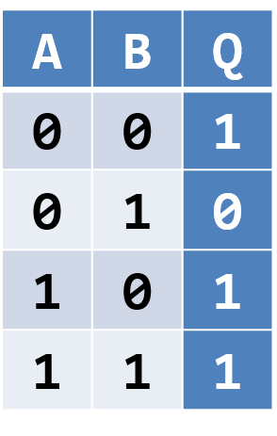

Lab #6: Defining and implementing a Karnaugh Map
Reminders:
The desired mapping of inputs to outputs is specified in a truth table:
The logic that will implement this mapping is described with a Boolean expression:
$$Q=A+\overline{B}$$
(Q = 1 if A = 1 or B = 0)
Karnaugh maps are a strategy to help find simplified Boolean expressions.

Slide 3
Lab #6: Karnaugh Maps and Grey Codes
Karnaugh Maps start by sequencing the truth table according to the Grey codes:
Binary codes of a fixed width, sequenced so that only one bit changes on each line:
00
01
11
10

Slide 4
Lab #6: Karnaugh Maps and Grey Codes
The Grey Code bitstrings map onto the different available inputs, and their status as negated or not:
00
01
11
10
!A,!B
!A,B
A,B
A,!B

Slide 5


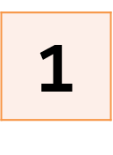
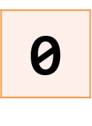

Lab #6: Tables for Karnaugh Maps
To draw the Karnaugh Maps, rearrange the Truth Table into a row-column format.
0
1
0
1
One input variable appears along the rows, the other appears along the columns, and both are ordered according to Grey Codes (here, just 1 bit long).

Slide 6
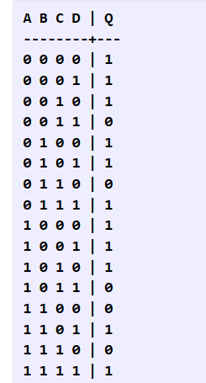
Lab #6: Tables for Karnaugh Maps
In the lab, you will need to transform a truth table with four input variables into a row-column format:
To rearrange:
Use four rows and four columns.
A and B can be represented along the columns.
Order according to Grey Codes (!A!B, !AB, AB, A!B)
C and D can be represented down the rows.
Again, order according to Grey Codes

Slide 7


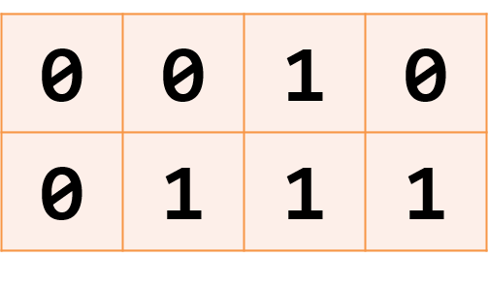
Lab #6: Drawing groups of true (1) outputs
Returning to one of the class lecture examples:
00
01
11
10
Draw rectangles such that:
All enclosed elements = 1
Length of any side must be a power of 2 (1,2,4,8, etc…)
Try to make any individual rectangle as large as possible
Wrapping around edges is permitted, and around corners (see left)
Overlapping is permitted
0
1
1 | 0 | 0 | 1
0 | 0 | 0 | 0
0 | 0 | 0 | 0
1 | 0 | 0 | 1

Slide 8

Lab #6: Use rectangles to define a “sum of products” Boolean expression
00
01
11
10
0
1
output $=AC_{i}+AB+BC_{i}$

Slide 9
Lab #6: The “sum of products” expression maps onto a circuit that may be built with logic gates
output $=AC_{i}+AB+BC_{i}$
Implement products with AND gates
Combine the outputs of the AND gates with an OR gate

Slide 10
In the lab assignment:
Arrange into row-column format
Draw the rectangles
Derive the sum of products expression
Build the circuit in Logisim

Slide 11
Logisim details:
The Karnaugh Map will be implemented as a subcircuit in Logisim.
This “kmap” subcircuit will be used as a component in a “main” circuit.

Slide 12
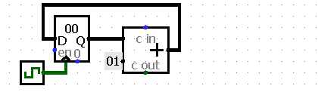
Main circuit in Logisim:
Note that you are given a starter file (see link for “simple_counter.circ” in instructions). You are asked to copy all of its components into the “main” canvas:
This circuit contains a register, the value of which will increment by 1 with tick of the clock (the green icon).

Slide 13
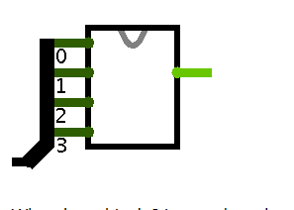
Main circuit in Logisim:
Instructions are given in the lab for changing the bit width of the register to 4, and feeding its contents into the kmap component:
This will let you test the kmap with values ranging from 0000 to 1111.

Slide 14
Main circuit in Logisim:
You will be asked to copy the contents of the simple_counter file two more times.
Detailed instructions are given for converting these components to registers that will track the output of the kmap component.
One register will count the number of times the output is one, and the other will count how often the output is zero.

