Slide 1
CS447 Recitation #1: 1/22/18
These slides are available online:
https://github.com/kc13/CS447JB
Agenda for today:
Overview of the recitation
Review of Lab #1

Slide 2
Contact info
TA: Karin Cox
Email: kmc51@pitt.edu
Office: 6150 Sennott Square
Office hours: M 11:00-12:00 PM; M 1:00-3:00 PM; F 3:00-4:00 PM

Slide 3
Recitation format:
Attendance is optional.
Emphasis will be placed on allowing time for questions / help with labs.
Aspects of the lab will be highlighted at the start of the recitation.
In-depth presentations can be prepared on request.

Slide 4
Where to access recitation slides (optional):
Github repository:
https://github.com/kc13/CS447JB
This repository will include recitation slides, and possibly other helpful material. Use of this information is optional.
This repository is independent of the Github “Gists” used for the lab instructions.

Slide 5
Questionnaire (also optional):
Google form:
https://goo.gl/forms/BNZMgUdqvoV6KSd52
Single, open ended question, where you can share your thoughts on what you might like to see in this recitation.
Responses will be monitored over the next three weeks.

Slide 6
Textbook
Computer Organization and Design (Patterson and Hennessy)
Not required for this class
If you would find it helpful, note that the 4th edition is available as an eBook, through the library.
Look for the book with the green cover, published in 2012.
The 2017 book is the ARM edition (not MIPS)

Slide 7
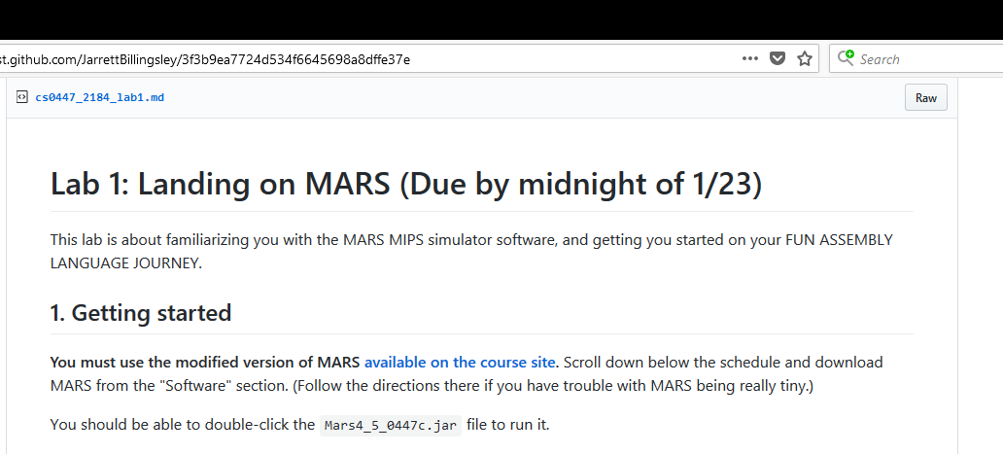
Lab #1 Highlights: Preparing MARS
Using the modified version (with the correct settings) will be important for this class. This MARS version is different from the version on the lab machines.
Be sure to confirm the settings, as instructed
If you’re using the lab machines, you can save the .jar file to the desktop and click on it.

Slide 8
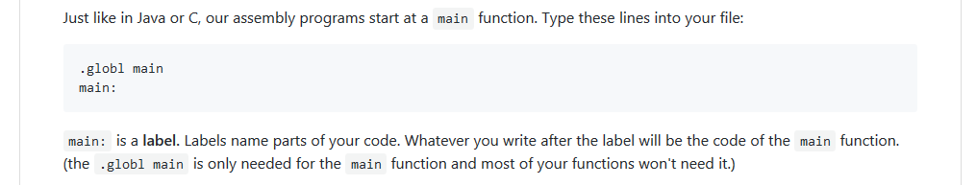
Lab #1 Highlights: Creating the “main” function
Be sure to type “.globl” (not .global)
If you are curious what this means:
“.globl” is a MIPS directive
Using this will make the “main” label visible to other files (see “Directives” tab under “Help”)
We prepared our MARS settings to jump to the global “main” label when the program starts.

Slide 9
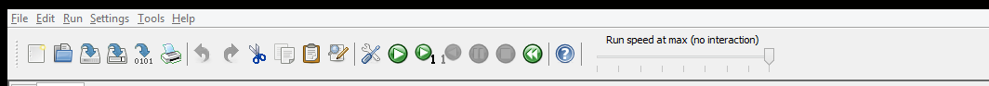
Lab #1 Highlights: Running an assembled program
Wrench: assemble
Green arrow button: Run to completion
Make note of the other green arrow buttons:
Button with the “1” subscript allows you to step through instructions 1 at a time (very helpful for debugging)
Other buttons will allow you to move through the program backwards.

Slide 10
Lab #1 Highlights: Running a syscall
Syscall = System call
We use them in Mars whenever we want to simulate an operation that would require the operating system’s help.
Most typical syscalls: Input and Output

Slide 11
Lab #1 Highlights: Running a syscall
Syscall = System call
We use them in Mars whenever we want to simulate an operation that would require the operating system’s help.
Most typical syscalls: Input and Output
In a sense, you can think of them as functions that you did not write yourself.
They will often require a “code” (to select the syscall you want) and an “argument” (analogous to a function argument)

Slide 12
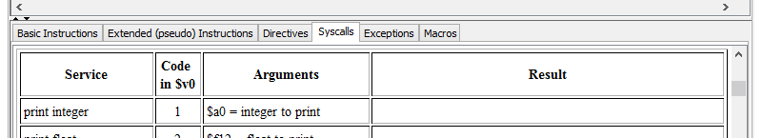
Lab #1 Highlights: Typical procedure for running a syscall
Find the service you wish to use in the “syscalls” table.
Make note of the code and any required argument.

Slide 13
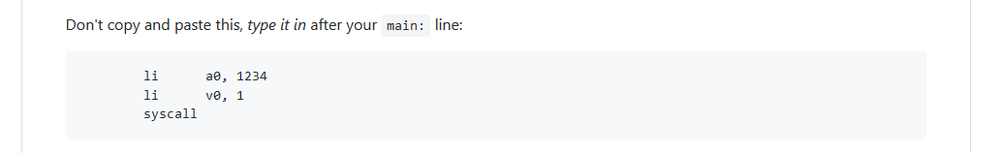
Lab #1 Highlights: Typical procedure for running a syscall
You communicate the required values to the system service by placing them in registers:
The syscall service code is placed in v0
If there is just one argument, it is usually placed in the a0 register (but be sure to confirm with the syscall table).
Once the values are in the registers, you can invoke a “syscall.”
The lab instructions will walk you through a specific example, in which you print the integer “1234.”

Slide 14
Lab #1 Highlights: Writing a function
We’re going to create the MIPS analogue of a function, so that the function can handle our “print integer” syscall for us.
This process will make a lot more sense after functions are discussed in lecture.
In Java, the analogous function would look something like this:
public void printInt (int i) {
System.out.print(i);
}

Slide 15
Lab #1 Highlights: Writing a function
public void printInt (int i) {
System.out.print(i);
}
The lab will explain how to write the equivalent in MIPS.
A few comments:
Your function will expect to find the integer to print in the register a0.
You will end your function with “jr ra”.
jr = jump register (see Help/Basic Instructions)
“ra” is a register that holds the return address
In other words, it tells the program to return to the spot where it left off in the main method, when the function was originally called

Slide 16
Lab #1 Highlights: Calling a function
This is the equivalent of
public static void main (String[] args) {
int i = 1234;
printInt(i);
}
The lab will show you how to call a function with “jal”
jal = jump and link
This will “jump” to the code located at the provided function label. “Link” will place the return address (the line after the jal command) in the ra register.

Slide 17
Lab #1 Highlights: Writing a newline function
This will be a process similar to what you did for printing an integer, except it will not be necessary for the user to supply an argument (since it will always print a newline character)
Newline character = ‘\n’
Be sure to use single quotes and the “print character” syscall

